Slide 1
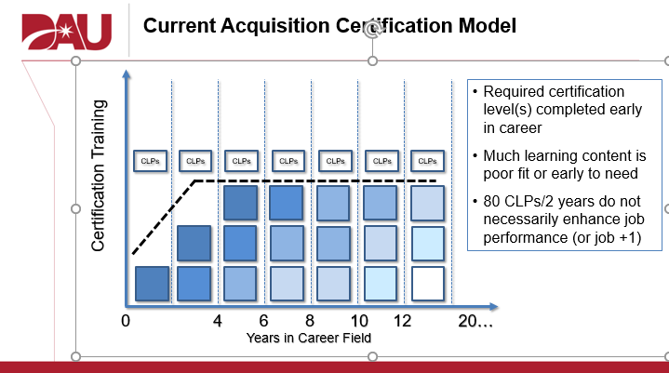
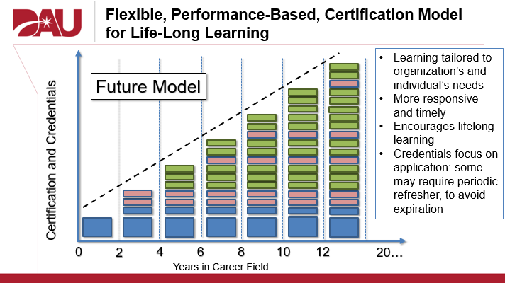
Update to DAU Transformation
Introduced during 36th annual symposium
Multiple task forces examining certification frameworks
T&E projected to remain independent career field
Certification requirements will change
DAU Curriculum
Education / experience

Slide 2
Coronavirus Impacts
All in-person activities affected as of mid-March
Ceased conducting in-person classes
Developing criteria for return
Overwhelming majority of in-person offerings moved online
Most cancellations occurred in Mar/Apr
DAU’s move to the virtual instructor-led environment accelerated and broadened

Slide 3
Operating in the Virtual Environment
Platform considerations
WebEx, MS Teams, etc.
Firewalls, IT Issues
Time zones, duty-day
Course materials
Optimized for in-person vs virtual environment
Exercise adjustments
Instructor skillset
Class conduct, exercises, breakout sessions
“Reading” students
Virtual classroom inefficiencies

Slide 4
Backups

Slide 5
Current Acquisition Certification Model
Required certification level(s) completed early in career
Much learning content is poor fit or early to need
80 CLPs/2 years do not necessarily enhance job performance (or job +1)
CLPs
CLPs
CLPs
CLPs
CLPs
CLPs
CLPs
Certification Training
0
4
6
8
10
12
20…
Years in Career Field
Notes:
In the current certification model, training is front-loaded at the beginning of a person’s career. The training includes all competencies that might be needed across a person’s entire career. The learning fades if the individual doesn’t use, on the job, the skills learned in class (represented by fading of colors on the chart).
NOTES on CLPs:
Continuous learning applies from the beginning of your career. You can use core training toward CLPs.
Some people may come into their position at Levels II or III and some of the pre-requisite Level I or II courses are waived by the DACMs

Slide 6
Flexible, Performance-Based, Certification Model for Life-Long Learning
Learning tailored to organization’s and individual’s needs
More responsive and timely
Encourages lifelong learning
Credentials focus on application; some may require periodic refresher, to avoid expiration
Future Model
Certification and Credentials
0
2
4
6
8
10
12
20…
Years in Career Field
Notes:
In an evolved model, credentials would make up the vast majority of an individual’s training over a lifetime. Credentials can be earned just in time for a particular job or performance need.
Large blue blocks are common acquisition certification courses. Smaller blue blocks are functional core certification courses. Pink blocks represent specialty credentials built in a lifetime of training. Green blocks represent learning credentials selected by the individual for their own currency and breadth.
As the credentials are developed, some may require refresh to remain valid/current, due to the volatility of the content.

Slide 7
Case for an Evolved Certification Model
Flexibility
Professionals design own career path and learning plan (with supervisor)
Learning (credentials) obtained closer to when needed
Responsiveness
Tailored, job-focused, timely learning
Adaptive to leadership priorities and environment
Lifelong Learning
Creates incentives and opportunities for continuous learning
Talent Management
Better data analytics, insight into workforce currency
Notes:
Talent Management: Services (SAEs, PEOs, Commands) and other leaders can leverage the types of data on learning completions that would be available, to evolve job selection, team selection, and career management processes. Will be able to leverage data analytics as part of Talent Management

Slide 8
Deployed DAU Credentials
Initial tranche released in October 2019
Agile for Acquisition Professionals
Fundamentals of Digital Engineering
Services Acquisition Team Member: Acquisition Professional
Services Acquisition Team Member: Non-Acquisition Professional
Additional credentials
Program Protection
Data Analytics for DoD Acquisition Managers
Notes:
Curated content: DAU doesn’t have to originate content at DAU if good sources exist externally. Also, some credentials will reuse existing DAU content, in tailored ways (i.e. we are curating what exists for a best fit to meet learning objectives for a credential).

