Slide 1
Developing a Vehicular Network Emulator to Bridge the Gap in Network Architecture and Application Testing
Muktadir Chowdhury (presenter), Jeremy Clark, Alex Lane, Lan Wang
University of Memphis
Notes:
I am a PhD student at University of Memphis. My supervisor is Dr. Lan Wang. My research area is Vehicular Ad-hoc Networking over Named Data Networking. As a part of my research I worked a bit on the development of a vehicular network emulator to bridge the gap in network architecture and application testing.

Slide 2
Motivation
Testing and evaluation are important for future Internet architecture research, but real testing is costly and non-repeatable.
Global Testbed for Named Data Networking (NDN) [1]
Simulation is scalable, but often requires changes to real code.
Emulation is scalable, and uses real code.
Resource efficient: lightweight containers and link virtualization
One server can emulate a network of hundreds of nodes (or more).
Notes:
Testing and evaluation are important for future Internet architecture research, but real testing is costly and non-repeatable.
For example, we have a global testbed for the NDN project. But it is not possible for everyone to use the testbed to run their code. And it is not scalable as well.
Researchers can use simulation tools to run experiments. But it requires changes to real code.
On the other hand , emulation is scalable and uses real code.
It is more resource efficient than simulator: lightweight containers and link virtualization.
One server can emulate a network of hundreds of nodes (or more).

Slide 3
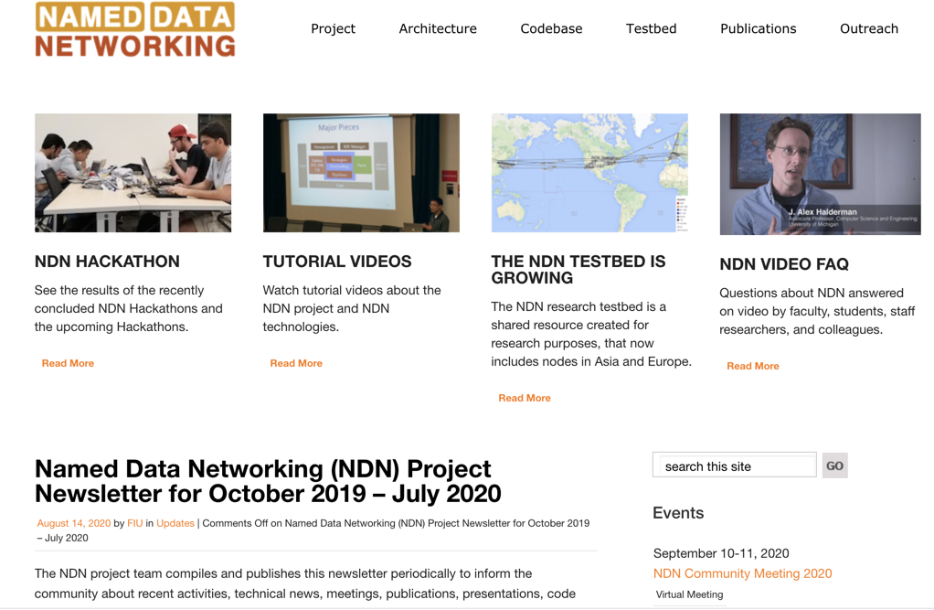
Project Goal
Named Data Networking (NDN) is a promising future Internet architecture [1].
Started in 2010 as one of four projects funded by the NSF FIA program.
NDN has unique advantages over TCP/IP Internet for wireless mobile communication [2,3].
name-based forwarding
pervasive in-network caching
strong security
Goal: improve the NDN emulator (Mini-NDN [4,5]) to support wireless, mobile, and ad-hoc networking, especially in a vehicular environment.

Slide 4
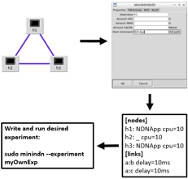
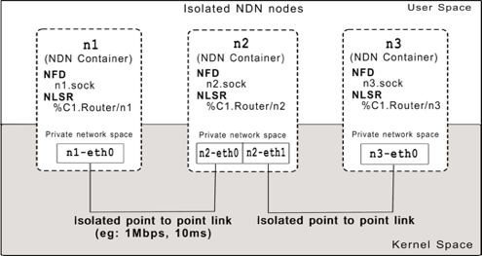
Background: Mini-NDN
Mini-NDN [4,5] is a Mininet [6] based network emulator developed by our group, publicly released in 2015
No need to modify real world applications
Can use any NDN forwarder and library version
Topology can be configured using a simple topology file or GUI.
Experimental framework is provided to write new experiments.
Mini-NDN cluster edition has been developed to scale experiments across a cluster.
Use cases: (a) has been used to test NDN routing protocols [7,8,9], forwarding strategies [8], synchronization protocols [10]; (b) automated unit and integration testing.

Slide 5
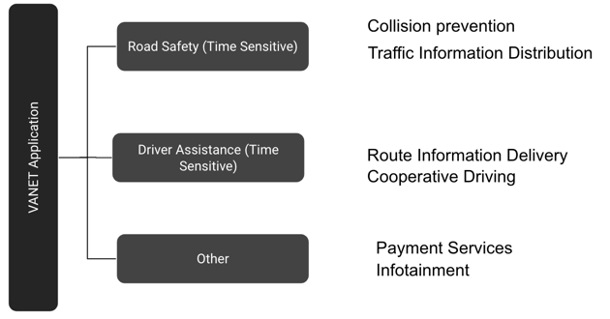
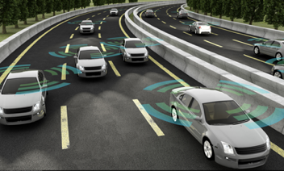
Background: Vehicular Ad-hoc Networks (VANETs)
VANETs are challenging due to their high speed and short/unstable connectivity.
NDN’s data-centric model is better than TCP/IP’s host-centric model for VANETs.
Notes:
VANET is vehicular ad hoc network. It means that they don’t rely on infrastructure for communication. Rather each vehicle acts as a forwarder.
Todays vehicles are equipped with various vehicular applications.
Many of the app require network connectivity.
They can be made more robust if vehicle-to-vehicle communication is used.
However, VANETs are challenging due to their high speed and short/unstable connectivity.
And due to these unique features of VANET NDN’s data-centric model is better than TCP/IP’s host-centric model.

Slide 6
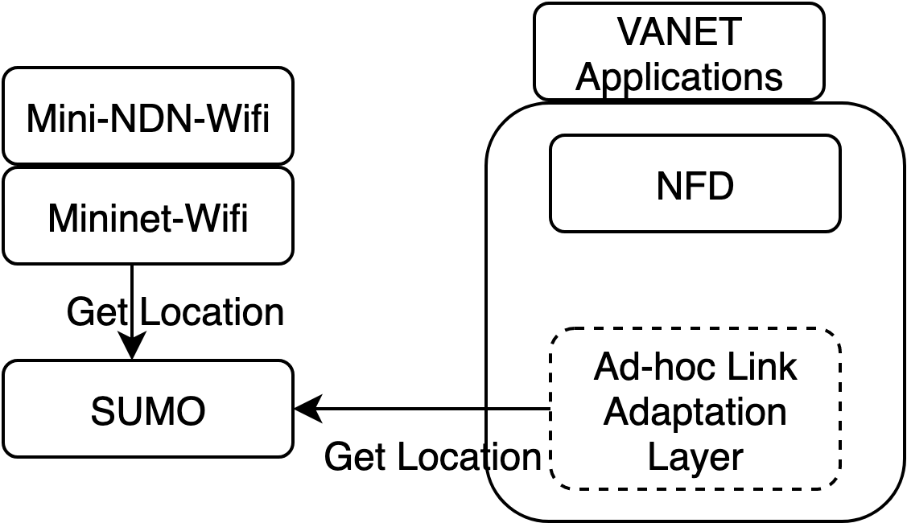
How to make Mini-NDN a VANET emulator?
Leverage Mininet-Wifi [11] to support basic mobility models and wifi links.
Add more mobility models and support of SUMO [12]
Develop Ad-hoc Link Adaptation Layer (A-LAL) for NDN [14]
Add support for 802.11p, the MAC layer protocol for VANETs [13]
Notes:
In order to make progress in this project, first research and engineering question we have to answer is how to make minindn a vanet emulator.
Luckily there is already a wireless extension of mininet called mininet-wifi. So our minindn wifi extension, which will be referred to as minindn-wifi, will be leveraging that.
However we need to add more mobility models and support for SUMO.
Develop Ad-hoc Link Adaptation Layer (A-LAL) for NDN which will faciliate the development of vanet or any other mobile ad applications/ protocols.
Add support for 802.11p, the de facto MAC layer protocol for VANETs [13]

Slide 7
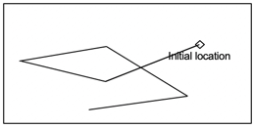
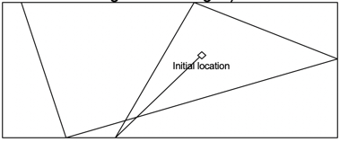
Basic MAC and Mobility Models in Mini-NDN Wifi
Wireless MAC support: 802.11 a/b/g/n
Random Walk: Basic stochastic walk
Random Waypoint: Random walk with nodes traveling to waypoints before changing speed and direction.
Random Direction: Nodes travel in a direction until they hit an edge or max flight distance then change speed and direction.
Truncated Leby Walk: Designed to more realistically model human movement patterns.
Gauss-Markov: Speed and direction are based on previous values.
Reference Point Group: Nodes random walk around a group vector to simulate cohesive movement.
TVC: Uses community reference points to which nodes return periodically.
Random Walk
Random Direction
Notes:
Here are the basic mac and mobility models in minindnwifi , that it inherited from mininetwifi.

Slide 8
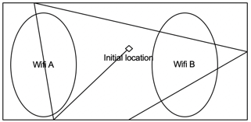
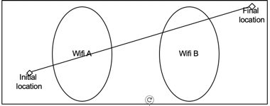
New Group Mobility Model
Existing Reference Point Group Model implementation has two problems.
Initial group position is random.
Group movement follows random direction model.
Developed the new Cohesion Reference Point Group model to more accurately simulate squadron movement patterns.
Initial and final group positions are specified by the user.
Group vector is a series of waypoints specified by the user.
Node movement follows random walk around group central point.
Reference Point Group Model
Cohesion Reference Point Group Model
Notes:
When developing a vanet app the developer might want to test their code for a specific scenario.
We developed a new group mobility model that will let the user test their code for a specific scenario.

Slide 9
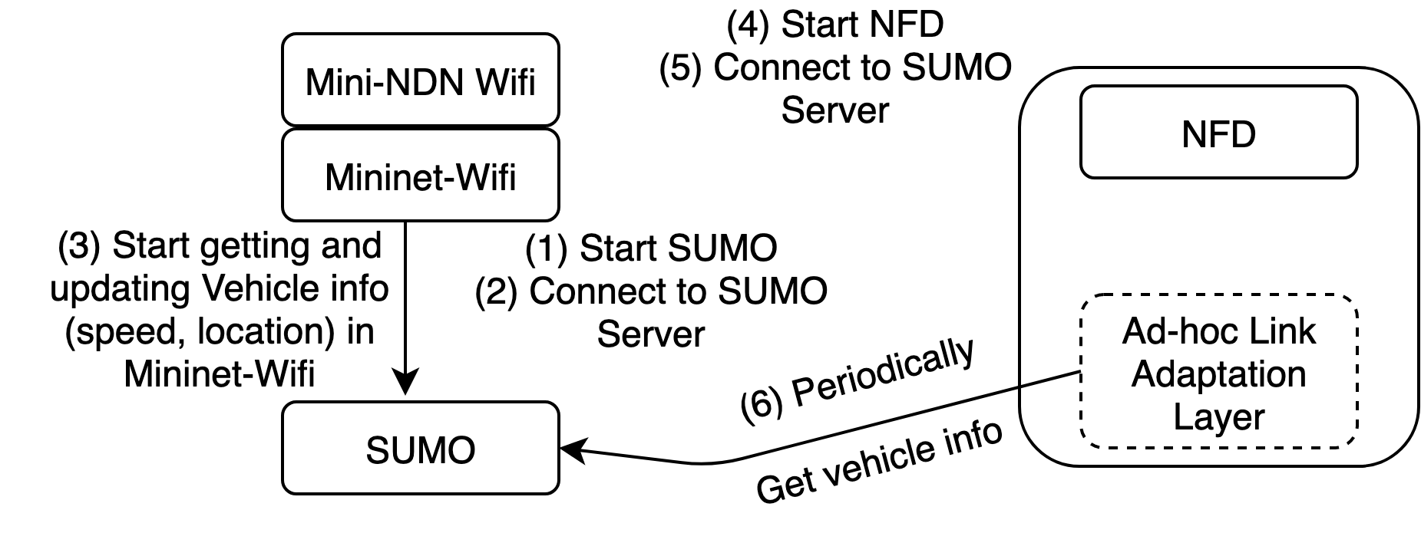
Integration with SUMO - Simulation of Urban Mobility
SUMO [12] is an open-source vehicle traffic simulator.
Widely used in Vehicular Communication Systems research.
Mininet-Wifi already has some integration with SUMO.
Mini-NDN Wifi can leverage that.
Notes:
The new group mobility model we just talked about is to test the application in specific scenarios. But if we want to test our vanet application in a real environment, we need to simulate real vehicular mobility patterns.
And that can be done using a tool called sumo.
SUMO [12] is an open-source vehicle traffic simulator.
Widely used in Vehicular Communication Systems research.
Mininet-Wifi already has some integration with SUMO.
Mini-NDN Wifi can leverage that.
This is the workflow of our preliminary design.

Slide 10
802.11p Support
802.11p: current US and European standard for development of WAVE (Wireless Access in Vehicular Environments)
The 802.11p library Mininet-wifi uses is several years out of date
Difficult to impossible to use on mainline Ubuntu releases without significant manual configuration.
Development work will be put in to update these packages to work with modern libraries and to provide automation tools necessary.
Notes:
802.11p is the current US and European standard for development of WAVE (Wireless Access in Vehicular Environments)
The 802.11p library Mininet-wifi uses is several years out of date
Difficult to impossible to use on mainline Ubuntu releases without significant manual configuration.
Development work will be put in to update these packages to work with modern libraries and to provide automation tools necessary.

Slide 11
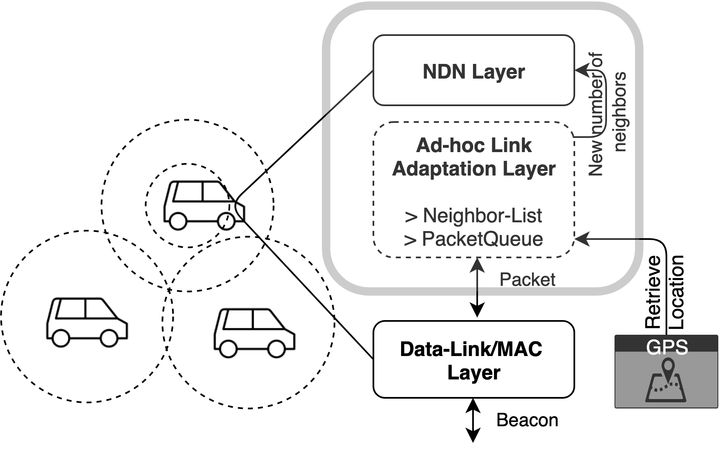
Ad-Hoc Link Adaptation Layer
We have developed Ad-Hoc Link Adaptation Layer.
Augment reliability of packet forwarding in mobile ad-hoc network.
It has three functions:
Adds location information to outgoing packets.
Keeps track of neighbors.
Buffers outgoing packets.
Notes:
We have developed Ad-Hoc Link Adaptation Layer.
Augment reliability of packet forwarding in mobile ad-hoc network.
It has three functions:
Adds location information to outgoing packets.
Keep track of neighbors.
Buffer outgoing packets.

Slide 12
Conclusion and Future Work
We have added basic wireless MAC and mobility support to Mini-NDN.
We have developed Ad-hoc Link Adaptation Layer (A-LAL) for NDN.
We have started working on SUMO and 802.11p support.
Next steps
Finalize SUMO and 802.11p integration.
Improve API and documentation for public release.
Websites for more information
http://minindn.memphis.edu
https://github.com/named-data/mini-ndn

Slide 13
References
[1] L. Zhang, A. Afanasyev, J. Burke, V. Jacobson, k. claffy, P. Crowley, C. Papadopoulos, L. Wang, and B. Zhang. Named Data Networking. ACM SIGCOMM Computer Commu- nication Review (CCR), 44(3):66–73, Jul 2014.
[2] Michael Meisel, Vasileios Pappas, and Lixia Zhang. Ad hoc networking via named data. In Proceedings of the fifth ACM international workshop on Mobility in the evolving internet architecture. 3–8, 2010.
[3] Zhenkai Zhu, Alexander Afanasyev, and Lixia Zhang. A New Perspective on Mobility Support. Technical Report NDN-0013. 2013
[4] Mini-NDN GitHub. https://github.com/named-data/mini-ndn.
[5] Mini-NDN Website. http://minindn.memphis.edu.
[6] Bob Lantz, Brandon Heller, and Nick McKeown. A network in a laptop: Rapid prototyping for software-defined networks. In 9th ACM SIGCOMM Workshop on Hot Topics in Networks, Hotnets-IX, 2010.
[7] V. Lehman, AKM Hoque, Y. Yu, B. Zhang, L. Zhang, L. Wang, "A Secure Link State Routing Protocol for NDN," IEEE Access, vol. 6, issue 1, pp. 10470-10482, Jan. 2018
[8] V. Lehman, A. Gawande, R. Aldecoa, D. Krioukov, B. Zhang, L. Zhang, L. Wang, "An Experimental Investigation of Hyperbolic Routing with a Smart Forwarding Plane in NDN," in Proceedings of the IEEE IWQoS Symposium, June 2016
[9] S. Dulal, L. Wang, "Experimental Comparison between Geohyperbolic and Hyperbolic Routing in NDN," in IEEE INFOCOM 2019, poster, March 2019

Slide 14
References (cont’d)
[10] M. Zhang, V. Lehman, L. Wang, "Scalable Name-based Data Synchronization for Named Data Networking," in Proceedings of the IEEE INFOCOM 2017, May 2017
[11] Mininet-Wifi Github, https://github.com/ intrig-unicamp/mininet-wifi
[12] Daniel Krajzewicz, Georg Hertkorn, Christian R ̈ossel, and Peter Wagner. Sumo (simulation of urban mobility)-an open-source traffic simulation. In Proceedings of the 4th middle East Symposium on Simulation and Modelling (MESM20002), pages 183–187, 2002.
[13] Daniel Jiang and Luca Delgrossi. IEEE 802.11p: Towards an international standard for wireless access in vehicular environments. In VTC Spring 2008-IEEE Vehicular Technology Conference, pages 2036–2040. IEEE, 2008.
[14] M. Chowdhury, J. Khan, L. Wang, “Leveraging Content Connectivity and Location Awareness for Adaptive Forwarding in NDN-based Mobile Ad Hoc Networks”, to appear in ACM Conference on Information-Centric Networking, Sept. 2020.

