Slide 1
Development and Analytic Process Used to Create a 3-Dimensional Graphical User Interface System for Baggage Screening September 2020 Charles McKee, Simone McKnight, & Kevin Zish Presenter: Kevin Zish

Slide 2
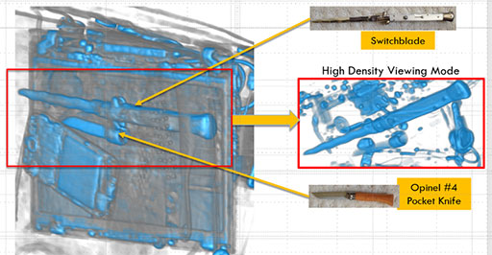
Disclaimer
Overview
We have included content approved for public consumption
The results presented are limited in the depth of detail we can discuss about the data
Several images have been altered according to security guidelines
Some images readily available to the general public (open source) by the CT vendors will be shared
Notes:
Example of the IDSS image shared openly by the company

Slide 3
Creating a Common GUI
Research Process
The TSA has some interesting challenges: continue to process passengers and their property quickly despite year over year increases in passenger volume.
One solution might be CT systems.
CT systems are commonly used in the medical field.
CT systems allow a 3D image to be taken of an object.
CT systems allow for images to be rotated and sliced digitally.
The use of CT systems at the checkpoint allow TSOs to view images clearly and see what is behind or between objects.
In the future, the use of CT systems at the checkpoint may allow passengers to divest nothing from their property, increasing throughput.
Four different vendors have produced a CT machine for security use.
However, each vendor has a different way of showing the images to the user.
The image to the right is an example of the same bag scanned through each machine—notice how the same bag looks different.

Slide 4
Creating a Common GUI
Research Process
The purpose of this project was to create one common interface.
The interface would show a bag image with 1 set of colors and tools, regardless of the machine which produced the image.

Slide 5
Step 1: Review
Research Process

Slide 6
Step 1: Review
Research Process
Review
The review step encompasses all activities that provide the necessary breadth and depth on the topic of interest to develop testable hypotheses and a test plan
Provides guidance to the relevant topic (what works, what doesn’t)
Identifies unknowns and points of concern to address
Identifies possible solutions
Multimethod Approach
Begin with examination of available archival information
Consider active review and feedback methods

Slide 7
Step 2: Prototype & Development
Research Process
Prototype and Development
Key Elements lead to Specific, Testable questions for the current project
Supports development of a test plan and, when relevant, a testable prototype (for product-based testing)
Often can identify additional testable questions for future consideration early
Team-based dynamic supports faster development
All team members develop prototypes/testable questions from content available and team narrows down focus together
CGUI Prototype
Team used Key Elements identified from testing to develop a prototype interface that all individuals commented on and revised over several cycles until group consensus was reached
Specific questions about the prototype were developed by the team and verified by HPB to incorporate into the test plan

Slide 8
Step 2: Prototype & Development—Iteration 0
Research Process

Slide 9
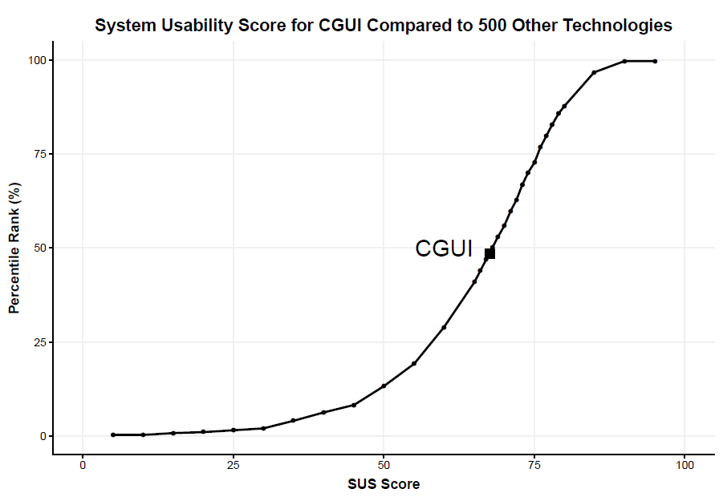
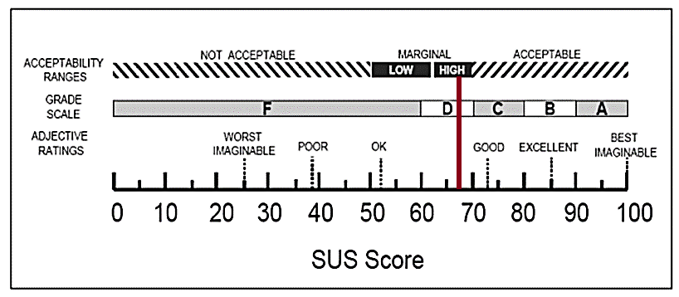
Step 2: Prototype & Development—Iteration 0
Research Process
CGUI Results Overview
Qualitative Data
Provided general system feedback
System Usability Scale
Notes:
The SUS is a reliable and valid measure of the users’ overall perspective of the learnability and usability of a system.
Scores on the SUS can be compared to other systems to determine relative usability.
Scores on the SUS can be correlated to a letter grade and adjective that users would utilize to describe the system.

Slide 10
Step 2: Prototype & Development—Iteration 1-2
Research Process
Notes:
Iteration 1-2 Test focused on two key elements requiring updating from Iteration 0 test
2x2 design examining the Threat Tray and Annotation Methods
Threat Tray: 2x
Annotation: 2x
Drill Down with system-estimated box placement
Box draw where user draws the box over the threat

Slide 11
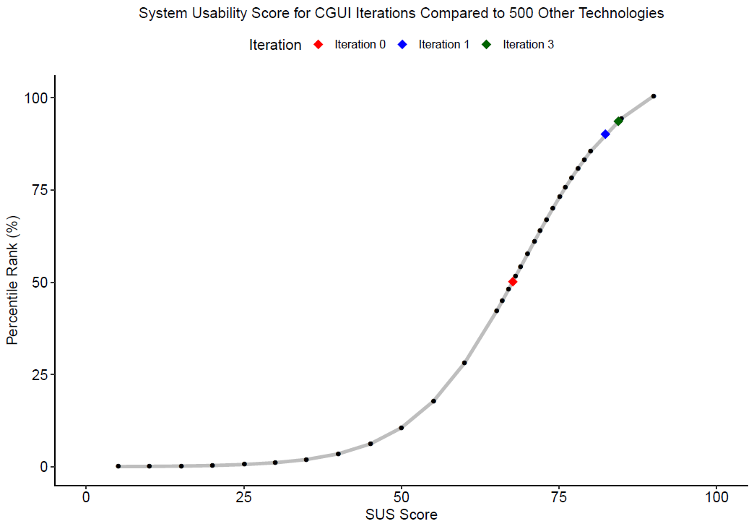
Step 2: Prototype & Development—Iteration 1-2
Research Process
Iteration 1-2 Results Overview
Qualitative Data
Each additional iteration increased the perceived usability of the system.
TSOs felt that the CGUI was a highly usable, easy to learn system by the last iteration.
Several specific desires were noted from other qualitative results
Iteration | SUS Score | Percentile | Grade | Adjective
Iteration 0 | 67.66 | 50.16 | D | OK
Iteration 1-2 | 82.35 | 90.16 | B | Good

Slide 12
Step 2: Prototype & Development—Iteration 3
Research Process

Slide 13
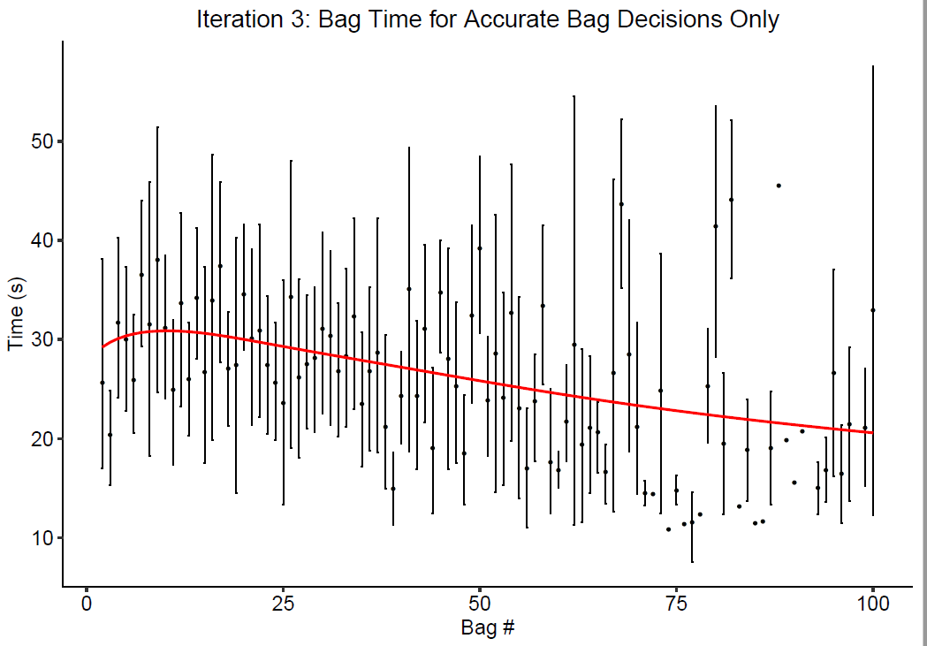
Step 2: Prototype & Development—Iteration 3
Research Process
Iteration 3 Results Overview
Category | Measure | Results
System Learning | Timing | ↑ accuracy w/in 1 hour of training*
 | Accuracy | ↑ speed w/in 1 hour of training*
System Modality | Timing | Touchscreen > Mouse*
 | Accuracy | Touchscreen ≈ Mouse
Iteration | Timing | Iteration 1-2 < Iteration 3
 | Accuracy | Iteration 1-2 ≈ Iteration 3
Notes:
* indicates statistically significant difference
Graph shows accurate adjudications with no automatically detected threats/laptops. These are the bags most likely to be processed quickly.
With a 15 minute walkthrough and 15 minutes of training, CT certified TSOs had no steep learning curve.
TSOs are still learning the system and getting faster after 1 hour of use.

Slide 14
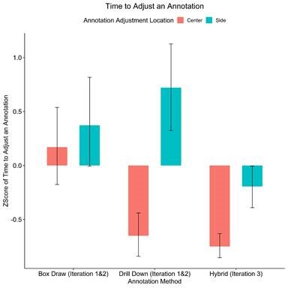
Step 4-5: CGUI Iteration 3
Research Process
Iteration 3 Results Overview
Category | Measure | Results
System Learning | Timing | ↑ accuracy w/in 1 hour of training*
 | Accuracy | ↑ speed w/in 1 hour of training*
System Modality | Timing | Touchscreen > Mouse*
 | Accuracy | Touchscreen ≈ Mouse
Iteration | Timing | Iteration 1-2 < Iteration 3
 | Accuracy | Iteration 1-2 ≈ Iteration 3
Notes:
We can see which action took the longest when making an annotation.

Slide 15
Step 2: Prototype & Development—Iteration 3
Research Process
CGUI Results Summary
Qualitative Data
Each additional iteration increased the perceived usability of the system.
TSOs felt that the CGUI was a highly usable, easy to learn system by the last iteration.
Iteration | SUS Score | Percentile | Grade | Adjective
Iteration 0 | 67.66 | 50.16 | D | OK
Iteration 1-2 | 82.35 | 90.16 | B | Good
Iteration 3 | 84.40 | 93.63 | B | Good
Notes:
Overall, we find a general trend of improvement from the iterative testing process.

Slide 16
Step 3: Develop Recommendations
Research Process
CGUI Recommendations
Specific
Specific prototype for initial implementation was developed
Required tools for all systems regardless of design were identified
Broad
Certain metrics can serve TSA broadly
Measures like the System Usability Scale (SUS) can help establish standards for development and procurement
General training considerations were identified
Development of a structured training
How to support knowledge shift required of TSOs from one system to another
Adaptability of system to future projects
Developed initial prototype versions of how CT interface would react in a scenario where screening protocols shift (e.g., PreCheck vs Standard lanes)
Discussed considerations for system updates given Deep Learning advancements
Notes:
Measures like the System Usability Scale (SUS) can help establish standards for development and procurement
Broadly applicable for any technological system
Can measure current and future-state machines
Broad survey measurement through internal online resources of deployed technology
Specific survey measurement of iterative prototype development
TSA can track the degree of system usability and changes with vendor updates, etc.
TSA can compare usability ratings with performance outcomes and set standards for basic usability needs

