Slide 1
Live Testing of LASER Systems Safe Execution
Cedrick Reid
KBR Missile Exercise Coordinator/Technical Laser Safety Officer
US Fleet Forces Atlantic Exercise Coordination Center, Virginia Beach, VA
Notes:
I am Cedrick Reid the author of the Live Testing of Laser Systems article for the 2020 ITEA Journal this brief is based on.
I am the KBR Missile Exercise Coordinator/Technical Laser Safety Officer for the US Fleet Forces Atlantic Exercise Coordination Center (FFAECC).
I am a retired Operations Specialist Chief with 21 years of Naval Service and I have been with the KBR FFAECC team since 2018. I will provide an overview of what the FFAECC team does and how it relates to advanced laser systems T&E later in the brief.

Slide 2
Introduction
Over the years, LASERs have proven highly useful in battlefield roles such as range finding, target designating, defensive countermeasure against infrared homing missile seeker heads, and other applications. Current development of this technology is focused on designing a LASER that can reach high enough power to partially destroy or defeat a target.
As High Energy LASER (HEL) systems are developed and fielded, there is a requirement for live Test and Evaluation (T&E) and training to confirm their effectiveness and prepare operators to employ them. One of the many challenges powerful LASERs present is protecting personnel from skin and eye injuries.
Notes:
HEL systems and other directed energy weapons are being developed by all the Services. The US Navy has been developing two HEL systems that I will describe later in the brief.
The primary issue with live T&E or training with these systems is safe execution due to their potential to injure personnel.
This technical session will describes a proven solution for the coordination of the complex safety requirements associated with HEL operations and safe execution of T&E and training events.

Slide 3
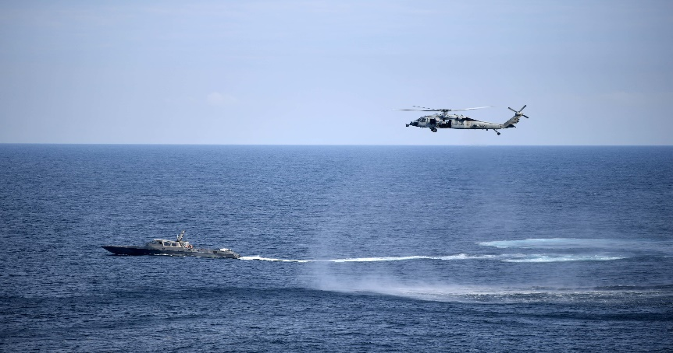
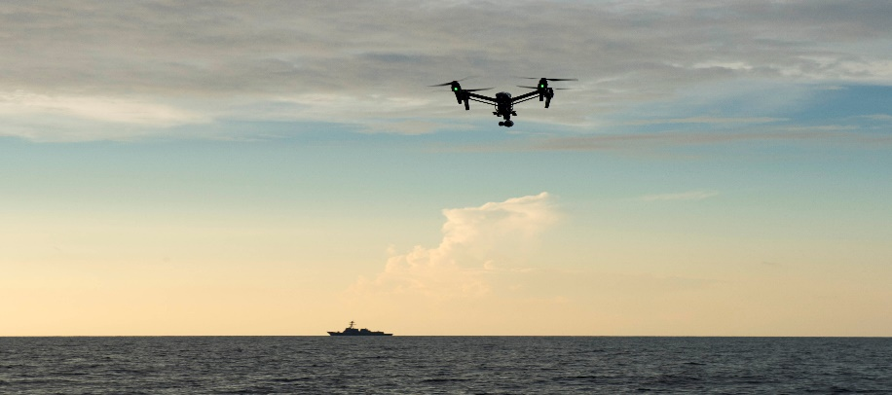
Threat
Fast Inshore Attack Craft/ Fast Attack Craft
Unmanned Aerial System
Notes:
Close-in defense against Unmanned Aerial System, Fast Attack Craft and Fast Inshore Attack Craft threats is an essential capability for US Navy and Marine Corps ships and units operating around the globe.
These highly maneuverable and low signature threats can provide intelligence, surveillance, reconnaissance (ISR) and targeting information to an adversary, as well as conduct attack missions against US and allied forces.
The advancement in adversary tactics, the rapidly increasing availability of small, low-cost commercial-off-the shelf Unmanned Aerial Systems, and the technological sophistication and weaponry onboard Fast Attack Craft and Fast Inshore Attack Crafthas only exacerbated the issue.
UAS: https://media.defense.gov/2020/Jul/06/2002424500/-1/-1/0/160919-N-AT101-289.jpg
FIAC: https://media.defense.gov/2020/Jul/06/2002429365/-1/-1/0/161213-N-ME988-152.JPG

Slide 4
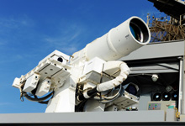
Solution
High Energy Lasers (HEL)
Highly effective deterrent with nearly an unlimited magazine
Notes:
Countering these threats has proven difficult, resulting in multiple Research, Development, Test and Evaluation (RDT&E) efforts to produce accurate and responsive, self-defense weapon systems.
One solution on the development fast-track is High Energy LASERs (HEL). HEL systems (offensive and defensive) are under development by all the Services and, when coupled with a state-of-the-art sensor system, brings a highly effective deterrent with a nearly unlimited magazine.
Countering adversary tactics in employing Unmanned Aerial Systems, Fast Attack Craft and Fast Inshore Attack Craft threats, including swarming and multi-axis employment, is the goal of these HEL systems, but they must prove effective and suitable in the complex atmospheric and electronic environments encountered by our deployed forces. Having the space to safely conduct HEL System operationally relevant testing is essential to achieving the goal.
picture source: https://www.onr.navy.mil/-/media/Images/220x150/LaWS-Ponce-Dec14-220x150.ashx

Slide 5
High Energy LASER
Notes:
There are still challenges in designing a LASER that can reach high enough power to partially destroy or defeat a target.
These challenges include compensation for the movement of the target, the motion of the platform, and the distortion of the beam from weather or environmental conditions.
Additionally, LASERs must be compact enough to fit on a ship, vehicle, or even a warfighter’s shoulder as well as propagate efficiently and stay accurately focused on the target. Each of these challenges come with personnel injury hazards that require mitigation strategies to safely lower the risk to manageable levels.
Here’s a quick video of a HEL system T&E event onboard USS Ponce. Link: https://youtu.be/tyUh_xSjvXQ?

Slide 6
LASER Safety
Department of the Navy HEL systems are Class 3B or 4 LASERs, which have the potential to injure skin and eyes
Graphic sourced from: https://www.laserpointersafety.com/resources/Arrow---eye-injury-hazard.png
Notes:
Radiation Safety Standards are set by the US Food and Drug Administration. The level of LASER radiation to which a person may be exposed without hazardous effect or adverse biological changes in the eye or skin is called the Maximum Permissible Exposure.
The Nominal Ocular Hazard Distance for direct viewing of a LASER is the distance beyond which an unprotected individual may be exposed without injury. The Maximum Permissible Exposure and Nominal Ocular Hazard Distance are used to develop the High Energy Laser system’s Nominal Hazard Zone. The Nominal Hazard Zone is the space within which the level of the direct, reflected, or scattered radiation during normal LASER operation exceeds the applicable Maximum Permissible Exposure.
A Class 2 laser (0-1mW) is considered to be safe because the blink reflex (glare aversion response to bright lights) will limit the exposure to no more than 0.25 seconds. Bright light of a Class 2 laser beam will cause a normal reaction to look away or close your eyes. Example are laser pointers.
A Class 3R laser (continuous intermediate power 1-5mW) is considered safe if handled carefully, with restricted beam viewing. With a class 3R laser, the MPE can be exceeded, but with a low risk of injury. Class 3R lasers are the same as Class 2 lasers with the most popular uses being laser pointers and laser scanners.
Class 3B are intermediate power (5-500 mW). Some examples are spectrometry, stereolithography, and entertainment light shows. Direct viewing of Class 3B laser beam is hazardous to the eye and diffuse reflections of the beam can also be hazardous to the eye.
Class 4 LASERs (500MW+) have the potential to injure skin and eyes, which includes permanent damage or loss of sight. These injuries are due to direct or indirect light energy exposure including specular reflection (beam reflecting off a smooth surface) or diffuse reflection (light that is scattered in all directions off a rough surface). High Energy Lasers are Class 4.

Slide 7
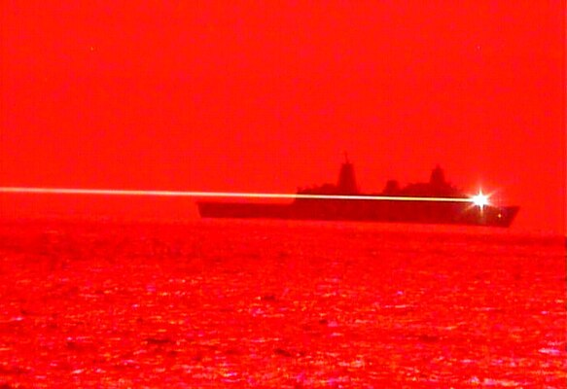
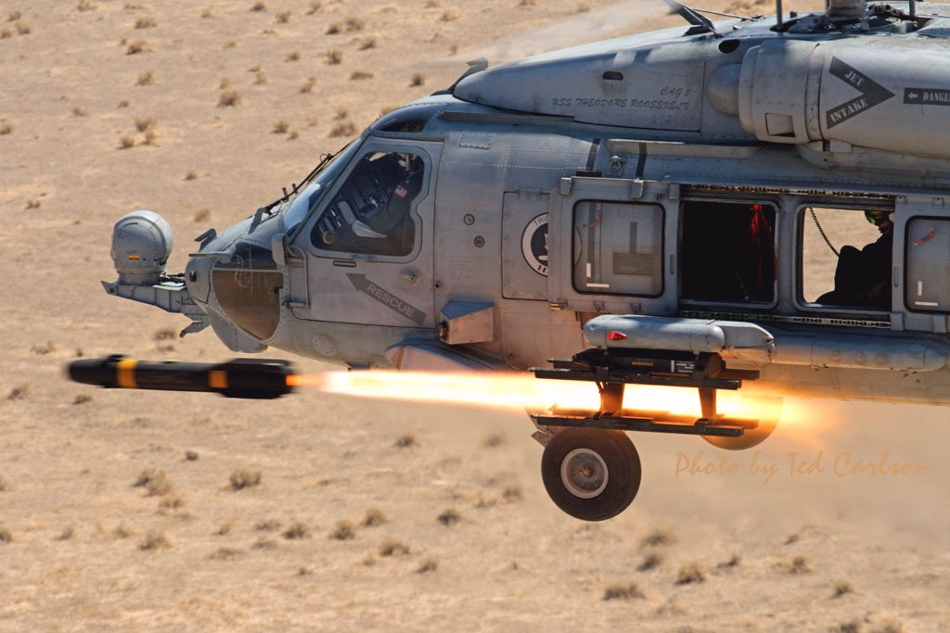
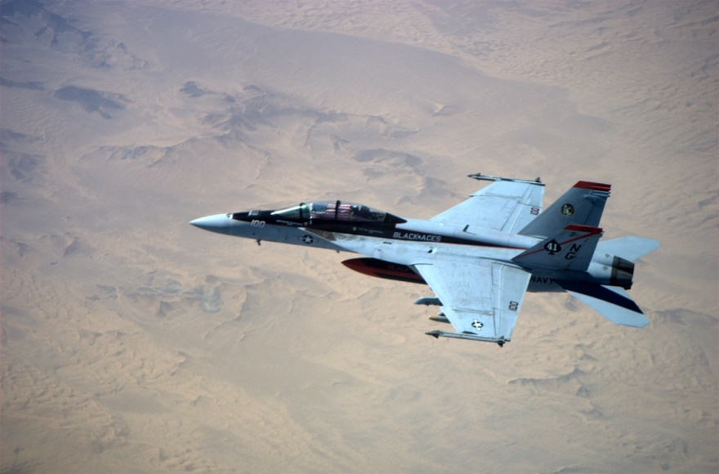
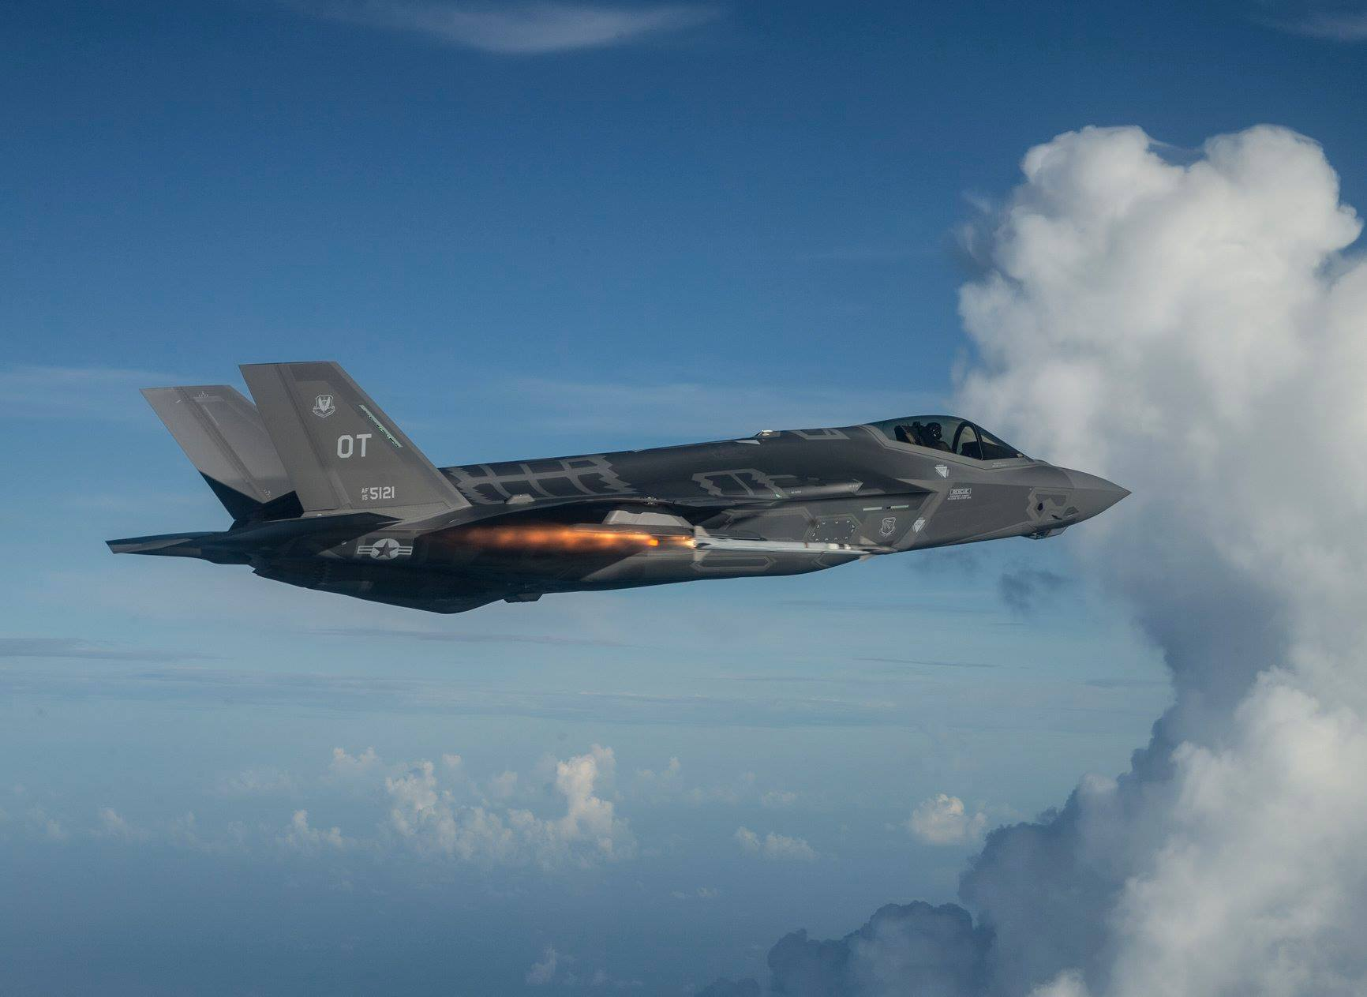
LASER Operations/Testing
Notes:
Modeling and Simulation and laboratory testing are important in addressing technological challenges and assessing risk, but live Test and Evaluation and training ensure the LASER is effective and safe to use by personnel.
F/A 18: https://www.public.navy.mil/airfor/VFA41/PublishingImages/DSC_5229.jpg
F35: https://www.jsf.mil/themes/f35/gallery/images/07.jpg
SH60: https://www.public.navy.mil/airfor/hsc9/PublishingImages/history1.jpg
Ship: https://media.defense.gov/2020/May/26/2002305720/600/400/0/200521-N-ZZ999-001.JPG

Slide 8
LASER Policy
Department of Navy policy is to identify and control LASER radiation hazards early during design and development and maintain those controls throughout the life cycle of the LASER system
Department of Navy policy also specifies that all LASER system acquisition agents ensure that DoD exempt class 3B and class 4 LASER systems are reviewed by the LASER Safety Review Board during each phase of the acquisition life cycle
Each LASER range is evaluated by Navy Surface Warfare Center, Corona Division for LASER range certification to determine the degree of LASER radiation hazard and identify risk management mitigation controls
All military LASER ranges must have a trained Range LASER Safety Officer (RLSO)
Notes:
The Department of Defense LASER Protection Program directs all components that own and operate LASERs to establish and maintain a LASER protection program.
The Department of Navy has established detailed policy for LASER safety, some of which are highlighted on this slide
Naval Surface Warfare Center, Corona Division certifies every Department of the Navy LASER range and updates the certifications every four years. The certification includes specific HEL system scenarios.
The RLSO ensures any event conducted at the LASER range is planned and executed safely

Slide 9
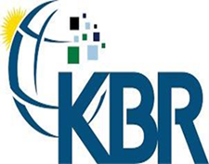
Fleet Forces Atlantic Exercise Coordination Center
(FFAECC)
Commanding Officer: Stephen Lamoure
FFAECC Director: CDR Jeffrey Sweitzer
Asst FFAECC Director: Mr. Duke Dietz
KBR/FFAECC Project Officer: Jay Clark
KBR/FFAECC Missile Exercise Coordinator/RLSO: Cedrick Reid
Notes:
For over 17 years the Atlantic Fleet has used the FFAECC organization to streamline the processes required to coordinate and schedule training and Research, Development, Test and Evaluation in the warning areas and ranges along the US East Coast and Gulf of Mexico

Slide 10
FFAECC Responsibilities
Provide a single point of contact and source of information for scheduling and obtaining assets to support training and ensure combat readiness of Atlantic Fleet units.
Scheduling and coordination for Fleet exercises, unmanned aircraft system (UAS) operations and live missile exercises
Fleet training data collection for US Fleet Forces Command
Provide coordination support and assistance in the safe execution of hazardous events
Notes:
FFAECC is the single point of contact for scheduling assets required for event execution to include Aerial and Surface targets, target recovery, range surveillance aircraft, telemetry services and special use airspace and altitude reservations. Range control services are provided by Fleet Area Control and Surveillance Facility (FACSFAC) Virginia Capes and FACSFAC Jacksonville. Some specific Research, Development, Test and Evaluation missile exercises are periodically conducted at Surface Combat Systems Center Wallops utilizing their designated Range Control Officer.
FFAECC provides admin support and coordinates assets required for Surface-to-Surface, Surface-to-Air, Air-to-Air and Air-to-Surface live-fire missile events conducted off the U.S. East coast. FFAECC also provides support for Combat System Ship Qualification, Foreign Military Ships and other non-fleet training hazardous missile exercise events. FFAECC also coordinates with Pacific Target and Marine Operations to provide supersonic targets supporting these missile exercises. FFAECC is the sole scheduling authority for Naval Air Systems Command, Atlantic Targets and Marine Operations Detachment Norfolk, which supports fleet missile exercises and training.
Hazardous event coordination is a primary focus for FFAECC to ensure these events are planned and conducted safely. Live-fire missile exercises and HEL operations are considered hazardous events and receive special emphasis during the planning and coordination phase.

Slide 11
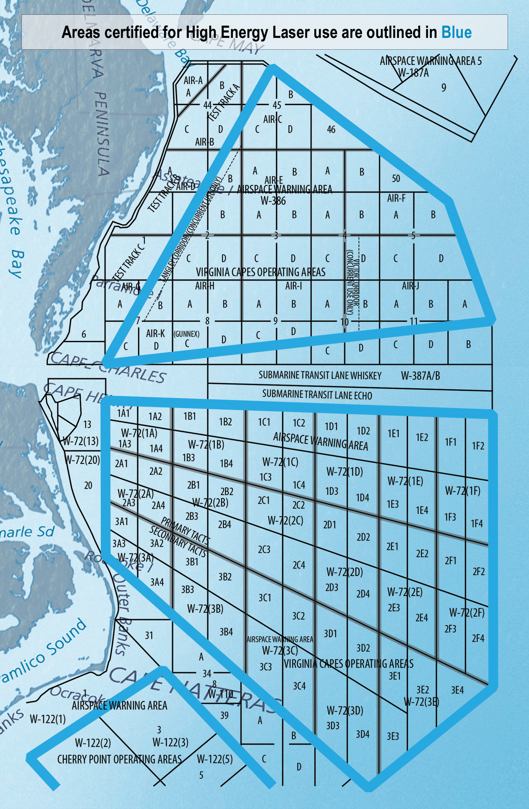
VACAPES Waring Areas Certified For LASER Operations/RDT&E
Notes:
As HEL systems increase in power and grow more complex, a large geographical area is required to safely conduct live testing or training. For the US East Coast, a prime location for conducting live HEL system testing is at-sea in the Virginia Capes warning areas.
The Fleet Area Control and Surveillance Facility Virginia Capes acts as the agent for US Fleet Forces Command in controlling access to the Virginia Capes warning areas.
FFAECC works under the direction of the FACSFAC Virginia Capes Commanding Officer to serve as the single point of contact for scheduling air and sea space, ranges, and Fleet training support for the warning areas along the US East Coast and the Gulf of Mexico. HEL system testing or training is conducted on the Virginia Capes LASER range within the Virginia Capes warning areas.
Three parts of the warning areas support HEL operations. The north section is W-386 which is 11,000 square miles, the central section is W-72, which is 16,000 square miles and the south section is W-122, which is 9,100 square miles. The sections are separated by Federal Aviation Administration controlled air corridors where HEL operations are prohibited.

Slide 12
FFAECC Responsibilities - LASER Operations
Provide a single point of contact (RLSO) and source of information for LASER range scheduling
Scheduling and deconfliction of water/airspace
Coordination of support assets including targets and support vessels
Coordination of telemetry and other support required for event execution
Coordinate range clearance and other safety requirements for event execution
Manage 23,400 square miles of water space certified for LASER operations
Notes:
FFAECC provides a trained RLSO to support all LASER system operations.
The RLSO assists the customer in coordinating with other parts of the FFAECC team to ensure all support requirements and range areas are coordinated and scheduled.

Slide 13
FFAECC RLSO Responsibilities
Provide Virginia Capes LASER range customers with Laser safety expertise
Ensure LASER T&E coordinators or units planning LASER operations have all required approvals and documentation
Assist in obtaining Range LASER Safety Certification for all LASER operations
Liaison with NSWC Corona LASER Safety Specialist / Range LASER Safety Specialist
Review Range Laser Safety Survey
Obtain Commanding Officer approval for LASER events
Manage 190 safe Lasing Scenarios
Notes:
The FFAECC RLSO is charged with providing the Virginia Capes LASER range customers with LASER safety expertise and operational guidance.
The FFAECC RLSO ensures HEL test plans are supported by LASER range operations and comply with current certification requirements and local regulations.
Once the FFAECC RLSO has ensured all LASER safety requirements have been met, he obtains approval from the Fleet Area Control and Surveillance Facility Virginia Capes Commanding Officer to execute the HEL event.

Slide 14
LASER Operations Request Documentation Process
Customers that desire to operate LASER systems on the VACAPES warning area must provide the following documentation:
An approved LASER Safety Review Board memorandum (New LASER systems not already operating)
Letter of Instruction, Concept of Operations, Tactics, Techniques, and Procedures, and / or Test Plans
LASER warning area requested
Notes:
The FFAECC RLSO works with the customer to ensure the documentation is complete and provides the information required to ensure safe execution of the HEL event
The LASER Safety Review Board memorandum provides details concerning the safe employment of the LASER system

Slide 15
Safe Lasing Scenarios
Scenario Type Firing From
Air-to-Air Fixed / Rotary Wing Aircraft
Air-to-Surface Fixed / Rotary Wing Aircraft
Air-to-Sub Fixed / Rotary Wing Aircraft
Surface-to-Surface Ships, Ground Units
Surface-to-Air Ships, Ground Units
Sub-to-Sub Submarine
Notes:
The scenarios are developed by Navy Surface Warfare Center, Corona Division Laser Safety Specialist via the Range Laser Safety Certification
Navy Surface Warfare Center Corona Laser Safety Specialist performs the following:
calculations and measurements of laser safety parameters such as the Nominal Ocular Hazard Distance and required optical densities for laser eyewear
Classify lasers and laser systems.
Conduct technical aspects of laser incident investigations
The Fleet Area Control and Surveillance Facility VIRGINIA CAPES Range Laser Safety Certification contains 189 safe lasing scenarios.
The safe lasing scenarios are scenarios that are analyzed by Navy Warfare Development Command Corona giving units permission to safely conduct laser operations, following the safety guidelines that are detailed in the report.
Example Air to Air scenario would involve an event with an Aircraft that is targeting an asset that is airborne.

Slide 16
LASER Exercise Timeline
TASK | Responsibility | Days out
Customer contacts FFAECC RLSO to schedule LASER testing or training | Customer | 60
RLSO contacts the Corona Range LASER Safety Specialist (New LASER systems) | FFAECC | 60
RLSO liaisons with Corona Range LASER Safety Specialist and RDT&E Program Manager (New LASER systems) | FFAECC | 50
Water and air space areas coordinated with all resident users | FFAECC | 50
Submit required documents to RLSO | Customer | 30
RLSO reviews all relevant paperwork and submits to Commanding Officer for approval | FFAECC | 20
Upon approval, all warning area water/air space is finalized and scheduled | FFAECC | 10
Customer is contacted with warning area schedule and Letter of Instruction / event approval | FFAECC | 7
Notes:
This Laser Exercise timeline is notional and may vary depending on several factors and is modified on a case by case basis. The key is early and frequent communication between all the parties involved with the process.
New LASER systems that have not been certified have to submit their request 60 days out. This gives the Range Laser Safety Officer time to gather all pertinent documents needed to get the LASER system certified to operate in the Virginia Capes warning area. All documents and points of contacts will be forwarded to Navy Warfare Development Command Corona Laser Safety Specialist.
AIRSPACE is finalized from the FFAECC’s schedulers for the dates requested by the customer
The AIRSPACE is deemed HOT for LASER operations in the warning areas.
Customers are contacted with the approved AIRSPACE request and are presented with a electronic copy
FFAECC will also work with the customer to ensure safety briefs are given to all participants in the event.

Slide 17
FFAECC Supported High Energy LASER RDT&E
Lockheed Martin’s High Energy Laser and Integrated Optical-dazzler with Surveillance system (HELIOS)
First HEL system outfitted onboard Arleigh Burke class destroyer
Designed to counter UAS and small craft attacks
Provides long range ISR
Notes:
The next two slides are HEL system programs the FFAECC is currently working with to coordinate and schedule events.
HELIOS is scheduled for risk reduction testing at Surface Combat Systems Center Wallops later this year and then will be integrated with the AEGIS combat system on and Arleigh Burke class destroyer next year.
FFAECC has weekly TELCONs with the program office and other stakeholders to ensure the HEL system testing is adequately coordinated and safely executed.
https://i0.wp.com/uasweekly.com/wp-content/uploads/2018/03/Lockheed_Martin_HELIOS_system-min.jpg?fit=678%2C381

Slide 18
FFAECC Supported High Energy LASER RDT&E
Boeing’s Compact LASER Weapon System (CLaWS)
Vehicle Mounted LASER installed on new Joint Light Tactical Vehicle
Designed to counter UAS
Notes:
The US Marine Corp has already begun testing with CLaWS at the ranges near Camp LeJeune North Carolina
The FFAECC RLSO was instrumental in ensuring the system had the proper safety protocols in place prior to this testing.
The FFAECC process for coordinating these hazardous, HEL system testing or training events is proven to be safe and effective. We look forward to working with any future HEL system customer to guide them through the process to a successful test or training evolution.
https://insights.globalspec.com/images/assets/148/12148/DroneLaser.jpg

Slide 19
“Simply Success”
QUESTIONS ?

