Slide 1
Cyber Survivability Attributes (CSA) Tool
JIM REILLY | PROGRAM MANAGER AFRL RIGA | 31MARCH-02 APRIL 2020
Approved for Public Release; Distributed Unlimited: Case Number 88 ABW-2020-1000; Dated 17 MARCH 2020

Slide 2
ACS Team and Partners
AFRL/RIGA – Cyber Assurance Branch
PAR Government Systems
International Cyber Institute
Adirondack IT Solutions
DCS
96 CTG
45 TS
47 CTS/OL-A
605 TES
Joint Staff J-6 Cyberspace Division
OUSD R&E, D-DT&E
DoD CIO
Approved for Public Release; Distributed Unlimited: Case Number 88 ABW-2020-1000; Dated 17 MARCH 2020

Slide 3
ACS Team and Partners, Cont’d
Quanterion Solutions
Alluvion Data Solutions
International Cyber Institute
Silverthread
LCMC
HB
HN
HI
CROWS
LOA2
NIST
MITRE
Estonian MoD
175 MDANG
Approved for Public Release; Distributed Unlimited: Case Number 88 ABW-2020-1000; Dated 17 MARCH 2020

Slide 4
ACS-IIMS-CTMF Software Life Cycle
End User Requirements
Product Release
Version Control
System (SVN)
Gradle / Jenkins
CTMF Continuous Integration Server
SDK
Secondary Developers
Primary Developers
Scheduled Poll of SVN
Upload
Jenkins Pulls Changes
Code Quality Checks
Architecture Analysis
Find Bugs
SonarQube
PMD/Checkstyle
3rd Party Library Vulnerabilities
Quality Trends Over Time
CAMP (AFRL) Scans
Lattix Architecture scans
Generate software metadata
Silverthread Technical Debt Scans
Build / Deploy
SDK Generation
Artifacts
(Builds – Releases)
Deploy
Defensive Cyber R&D
Code Quality Checks
CSA Tool
POAM
A&A
Download
Find Bugs
SonarLint
Profiling Tools
STIG, eMASS,RMF
CITE Network
Tester
Machine
Install
Infrastructure Updates
Log Issues in Trac
Notify Third Parties of their vulnerabilities
(JBoss,
Java, Oracle)
Cyber Condition
Perform Tests
(Automated, manual, scenario)
Third Party Libraries
Analyze Logs
(Enhanced Logging, ATC logs, Key logging)
Automated Testing (ATC)
- OWASP Dependency-Check
- National Vulnerability Database (NVD)
- Common Vulnerability and Exposure (CVE)
- Must be scanned with Antivirus software.
- The file integrity must be verified by comparing the checksum of the downloaded file to the one posted at the library site.
- The source code must be compiled per DoD regulations.
Manual Test Scripts
Evaluated Product List
(EPL) Test
Fielded System
With Enhanced Logging
96TW & 605 TES
With Enhanced Logging
Approved for Public Release; Distributed Unlimited: Case Number 88 ABW-2020-1000; Dated 17 MARCH 2020
Notes:
See Software Configuration Management and Build Automation Document
DevOps –
Code = Source code management (SVN)
Build = Continuous integration (Jenkins)
Test = Continuous Testing, Automated Test Controller (ATC)
Package = Binary Repository (LFS-RD)
Release = Configure = Cloud
Monitor = IT metrics

Slide 5
The CSA Tool
The CSA Tool provides users in all phases of the SDLC a customizable Adversary-Effects driven workflow process visualization tool utilizing the SSE process.
CYBER HYGIENE
RMF Workflow, Security Control Management, and Artifact Development Automation
CYBER RESILIENCY
Adversary Effects Heatmap, and System Security Engineering
CYBER SURVIVABILITY
Risk Category Cyber Survivability Attribute and System Security Engineering
AUTOMATED CT&E
Integration of Test Data, Security Assessment Report and Continuous Modernization
Approved for Public Release; Distributed Unlimited: Case Number 88 ABW-2020-1000; Dated 17 MARCH 2020
Notes:
Cyber Survivability Attributes (CSA) Tool
Software Development Life Cycle (SDLC)
System Security Engineering (SSE)
Automated Cyber Test And Evaluation (CT&E)
Risk Management Framework (RMF)

Slide 6
Cyber Resiliency and Survivability Joint Chiefs of Staff Cyber Survivability Endorsement Implementation Guide
Cyber Resiliency and Survivability require a sound foundation.
Nothing will overcome poor engineering and poor processes.
Approved for Public Release; Distributed Unlimited: Case Number 88 ABW-2020-1000; Dated 17 MARCH 2020

Slide 7
Automated Cyber Survivability Prerequisites
All Missions
All Systems
Reliable Systems
Survivable Systems
Have to be Resilient
Have to be Assured
Have to be Reliable
Have to be a System
Assured Systems
Resilient Systems
Survivable Systems
Approved for Public Release; Distributed Unlimited: Case Number 88 ABW-2020-1000; Dated 17 MARCH 2020

Slide 8
CSA Tool Process Flow
Continuous Monitoring
System Boundary
Resiliency Requirements
NTCTF
Data Flow
Cyber Survivability Attributes
Automated Cyber Test and Evaluation (CT&E)
System Categorization
Interconnection
Cyber Hygiene
SSE
STIGs
Cyber Testing
Test Reports
Risk Tolerance and Decision
Baseline/Tailored
Security Controls
Data Types
Security Artifact Development
Plan of Actions and Milestones (POA&M)
Mission Type
Self Assessment
Risk Assessment
Automated Cyber Testing
Approved for Public Release; Distributed Unlimited: Case Number 88 ABW-2020-1000; Dated 17 MARCH 2020

Slide 9
CSA Tool Cells
Cyber Survivability Attributes (CSA) Tool
Determine system categorization
Tailor system baseline
CCI Mapping Manager
Resiliency Analysis
System administration
Compliance statement management
Product Integration
Data Manager
User account permissions
Audit log configuration settings
Custom overlay development
Apply overlays
Import STIG .ckl files
Review all CCI’s and corresponding categorization and overlays
Determine applicable CSA’s
Search specific CCI’s for detailed information
Determine current resiliency status against resiliency techniques
Provides visualization on where improvements can be implemented
Import system boundary diagram(s)
Mapping CCIs to tickets
Determine mission type(s)
CSE Categorization
Determine Adversary Threat Tier (ATT)
Conduct threat analysis to determine adversary vs. defender work factors
Determine cyber dependency level
Determine Impact Level (IL) of system compromise
Determine Cyber Survivability Risk Category
NIST 800-160 Vol 2 detailed information and mapping to NIST 800-53 Rev 4
Maps Resiliency Controls to Resiliency Techniques
Determine required adversarial effects based on mission
Heat Map Analysis
Contract Language
Selection of initial draft acquisition language
Leverage the CROWS draft language
Incorporates CSA acquisition language from the CSE
RDT&E Gap Analysis
Manages current technical solutions provided in the Data Manager
Provides the mapping between current technical products and NIST controls to show gaps in technology
System Cyber Security Requirements
CSA System Requirements
CSA Lower Level Requirements
CROWS Cyber Testability
Approved for Public Release; Distributed Unlimited: Case Number 88 ABW-2020-1000; Dated 17 MARCH 2020

Slide 10
SOP Title | Man-hours without CSA | Labor Cost | Man-hours with CSA | Labor Cost
Access Control (AC) SOP | 90 | $9,000.00 | 32 | $3,200.00
Awareness and Training (AT) SOP | 32 | $3,200.00 | 12 | $1,200.00
Auditing and Accountability (AU) SOP | 80 | $8,000.00 | 24 | $2,400.00
Security Assessment and Authorization (CA) SOP | 24 | $2,400.00 | 12 | $1,200.00
Configuration Management Plan (CM) SOP | 80 | $8,000.00 | 24 | $2,400.00
Contingency Plan (CP) SOP | 80 | $8,000.00 | 32 | $3,200.00
Identification and Authentication (IA) SOP | 80 | $8,000.00 | 32 | $3,200.00
Incident Response (IR) SOP | 80 | $8,000.00 | 24 | $2,400.00
Maintenance (MA) SOP | 40 | $4,000.00 | 16 | $1,600.00
Media Protection (MP) SOP | 40 | $4,000.00 | 16 | $1,600.00
Physical and Environmental Protection (PE) SOP | 40 | $4,000.00 | 16 | $1,600.00
Planning (PL) SOP | 80 | $8,000.00 | 24 | $2,400.00
Personnel Security (PS) SOP | 32 | $3,200.00 | 12 | $1,200.00
Risk Assessment (RA) SOP | 24 | $2,400.00 | 9 | $900.00
System and Services Acquisition (SA) SOP | 84 | $8,400.00 | 32 | $3,200.00
System and Communications Protection (SC) SOP | 120 | $12,000.00 | 32 | $3,200.00
System and Information Integrity (SI) SOP | 120 | $12,000.00 | 32 | $3,200.00
Total | 1126 | $112,600.00 | 381 | $38,100.00
Approved for Public Release; Distributed Unlimited: Case Number 88 ABW-2020-1000; Dated 17 MARCH 2020

Slide 11
Demo and Discussion
Approved for Public Release; Distributed Unlimited: Case Number 88 ABW-2020-1000; Dated 17 MARCH 2020

Slide 12
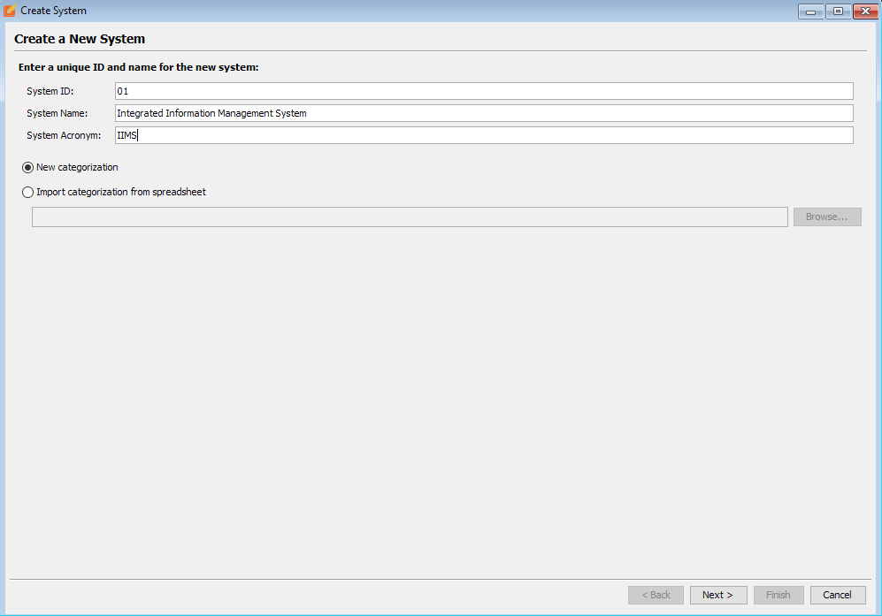
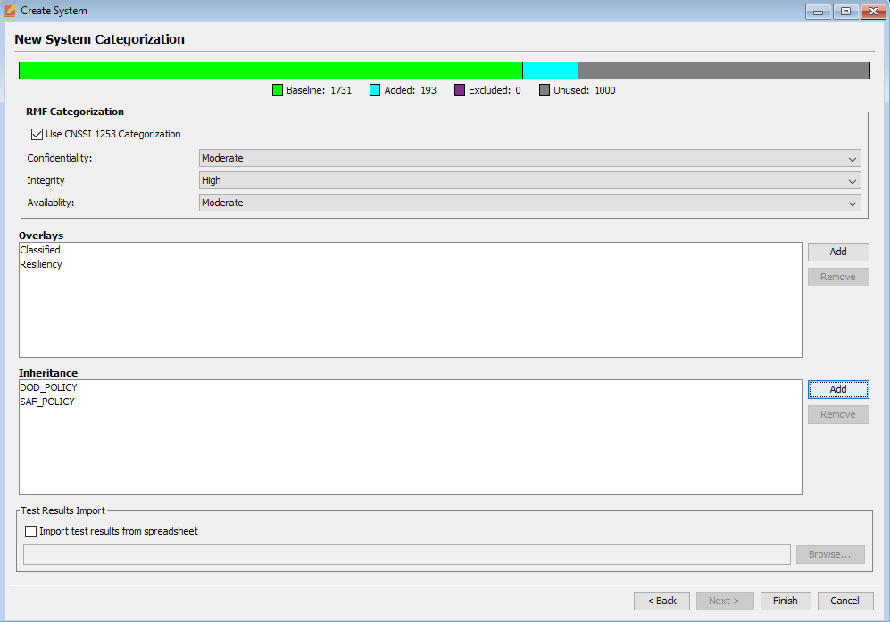
CSA Tool – CSA Tool Cell
This cell provides the baseline for adding a new system to the CSA Tool. This cell provides the basic support features required to implement the Risk Management Framework (RMF). This cell may change as a system continues through Acquisition process.
System Identification
Provide a System Overview
Determine Data Types
Categorize System (CNSSI 1253)
Select Required Overlays
Apply Baseline Security Controls
Apply Inheritance
Primary Stakeholders
ISSM
ISSO
Supporting Stakeholders
PM
ISSE
AO
Approved for Public Release; Distributed Unlimited: Case Number 88 ABW-2020-1000; Dated 17 MARCH 2020
Notes:
CSE (Cyber Survivability Endorsement) Group

Slide 13
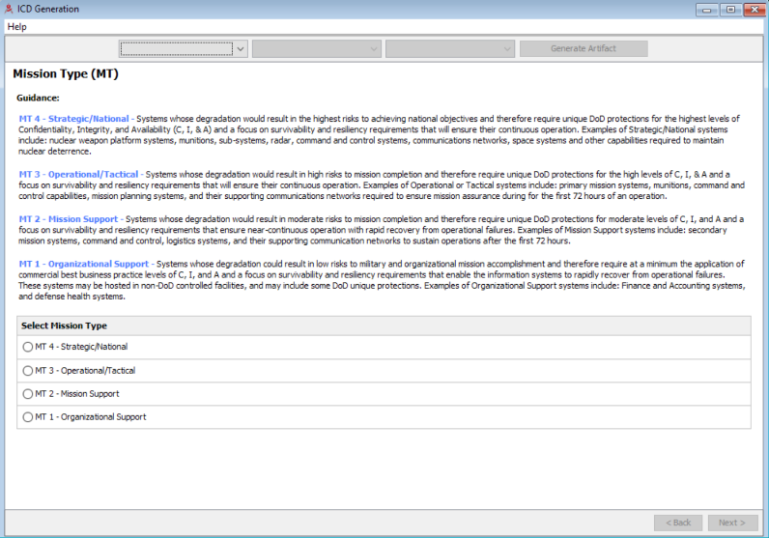
CSA Tool – CSE Categorization Cell
This cell assists programs in selecting the Cyber Survivability Risk Category (CSRC). Programs will then be able to determine the applicable Cyber Survivability Attributes (CSAs) and the corresponding NIST SP 800-53 Rev 4 security controls will be automatically mapped.
Utilize Joint Staff Cyber Survivability Endorsement Implementation Guide (CSEIG)
Calculate Program’s baseline Cyber Survivability Risk Category (CSRC) using a High-Water Mark (HWM)
At this point only the Mission Type (MT) and Adversary Threat Tier (ATT) are used for the initial calculation
The PM can leverage a Delphi calculation and tailor the initial CSRC by one value with proper justification, which will be maintained in the CSA Tool
The CSA Tool may provide a set of questions of guidance to support this decision matrix
Map selected CSRC to the applicable CSA’s and RMF security controls
Visualize “as designed” vs. “as tested” for cyber survivability
Primary Stakeholders
PM
AO
Supporting Stakeholders
ISSE
ISSM
ISSO
Approved for Public Release; Distributed Unlimited: Case Number 88 ABW-2020-1000; Dated 17 MARCH 2020
Notes:
CSE (Cyber Survivability Endorsement) Group

Slide 14
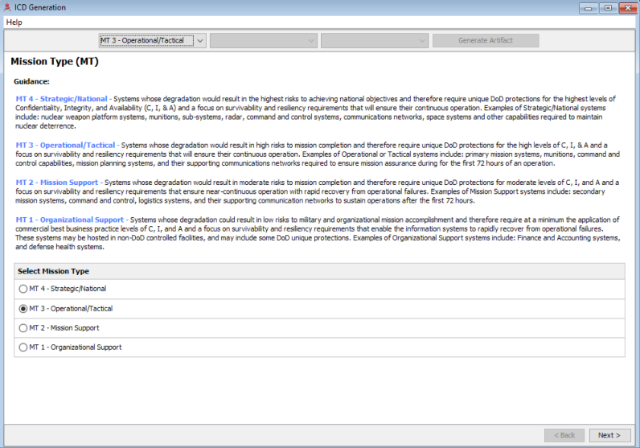
CSA Tool – CSE Categorization Cell
This cell assists programs in selecting the Cyber Survivability Risk Category (CSRC). Programs will then be able to determine the applicable Cyber Survivability Attributes (CSAs) and the corresponding NIST SP 800-53 Rev 4 security controls will be automatically mapped.
Utilize Joint Staff Cyber Survivability Endorsement Implementation Guide (CSEIG)
Calculate Program’s baseline Cyber Survivability Risk Category (CSRC) using a High-Water Mark (HWM)
At this point only the Mission Type (MT) and Adversary Threat Tier (ATT) are used for the initial calculation
The PM can leverage a Delphi calculation and tailor the initial CSRC by one value with proper justification, which will be maintained in the CSA Tool
The CSA Tool may provide a set of questions of guidance to support this decision matrix
Map selected CSRC to the applicable CSA’s and RMF security controls
Visualize “as designed” vs. “as tested” for cyber survivability
Primary Stakeholders
PM
AO
Supporting Stakeholders
ISSE
ISSM
ISSO
Approved for Public Release; Distributed Unlimited: Case Number 88 ABW-2020-1000; Dated 17 MARCH 2020
Notes:
CSE (Cyber Survivability Endorsement) Group

Slide 15
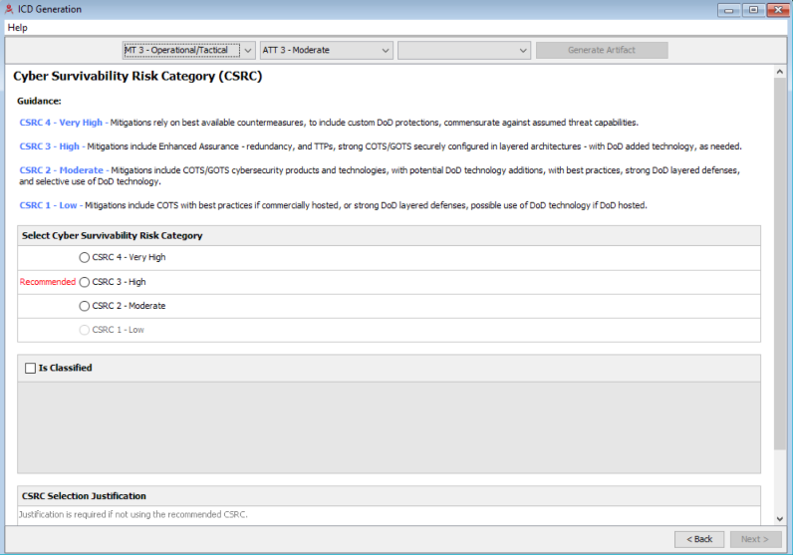
CSA Tool – CSE Categorization Cell
This cell assists programs in selecting the Cyber Survivability Risk Category (CSRC). Programs will then be able to determine the applicable Cyber Survivability Attributes (CSAs) and the corresponding NIST SP 800-53 Rev 4 security controls will be automatically mapped.
Utilize Joint Staff Cyber Survivability Endorsement Implementation Guide (CSEIG)
Calculate Program’s baseline Cyber Survivability Risk Category (CSRC) using a High-Water Mark (HWM)
At this point only the Mission Type (MT) and Adversary Threat Tier (ATT) are used for the initial calculation
The PM can leverage a Delphi calculation and tailor the initial CSRC by one value with proper justification, which will be maintained in the CSA Tool
The CSA Tool may provide a set of questions of guidance to support this decision matrix
Map selected CSRC to the applicable CSA’s and RMF security controls
Visualize “as designed” vs. “as tested” for cyber survivability
Primary Stakeholders
PM
AO
Supporting Stakeholders
ISSE
ISSM
ISSO
Approved for Public Release; Distributed Unlimited: Case Number 88 ABW-2020-1000; Dated 17 MARCH 2020
Notes:
CSE (Cyber Survivability Endorsement) Group

Slide 16
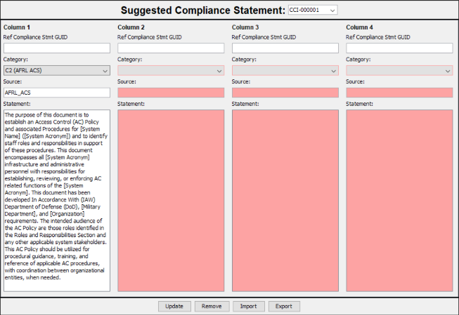
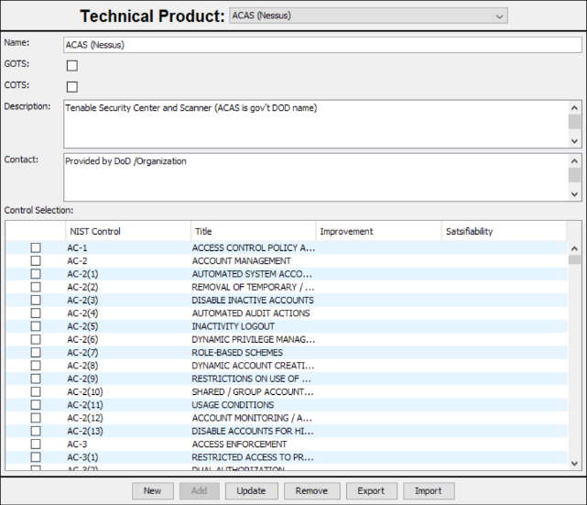
CSA Tool – CSA Data Manager
This cell allows Communities of Interest (COIs) to maintain approved alternative solutions which can be leveraged by other programs.
Provide programs with exemplar AoA language from the CSEIG
Primary Stakeholders
PM
AO
Supporting Stakeholders
ISSM
ISSE
ISSO
Approved for Public Release; Distributed Unlimited: Case Number 88 ABW-2020-1000; Dated 17 MARCH 2020
Notes:
CSE (Cyber Survivability Endorsement) Group

Slide 17
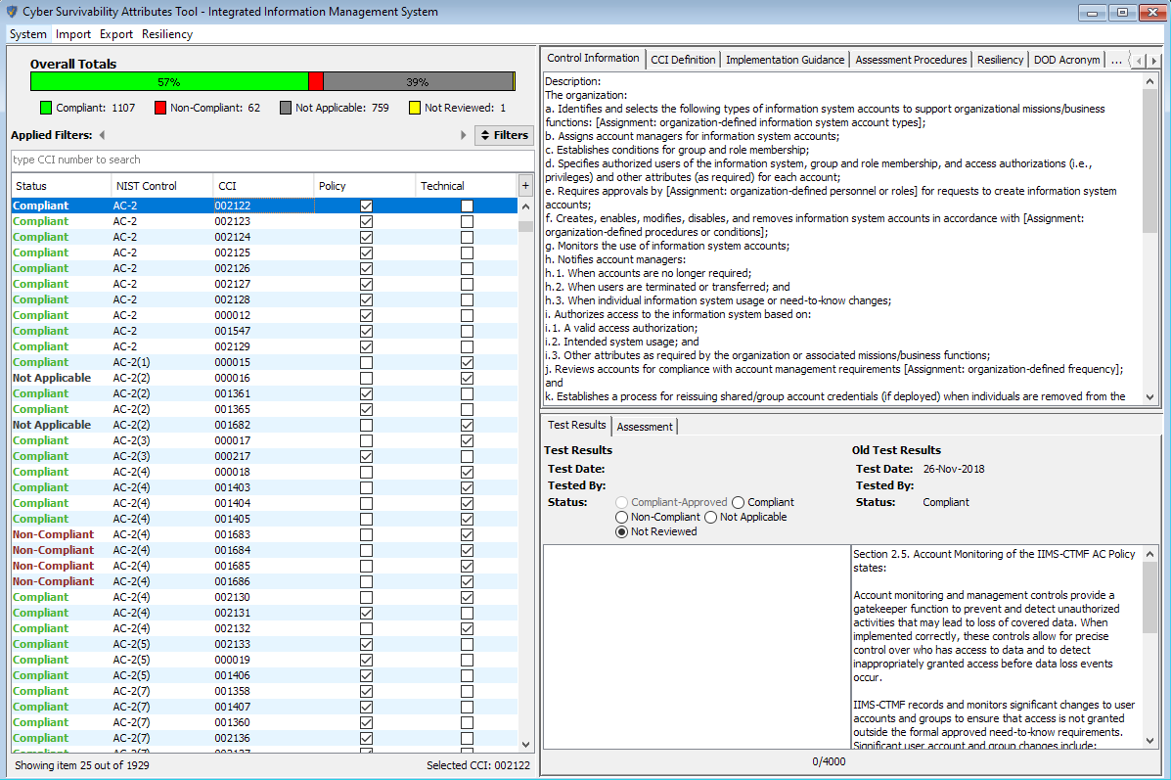
CSA Tool – CSA Tool Cell
This cell provides the user a simple and customize way to view cybersecurity requirements. It allows users to annotate the compliance status with the RMF security controls as applicable to their system. Test results can be imported in the format of a .ckl format.
Completed self-assessment PRIOR to independent testing
Upload .ckl files
Automated mapping to NIST controls
Complete manual testing of security engineering requirements
Develop and update security artifacts based on results
Primary Stakeholders
ISSM
ISSO
ISSE
Supporting Stakeholders
AO
PM
Approved for Public Release; Distributed Unlimited: Case Number 88 ABW-2020-1000; Dated 17 MARCH 2020
Notes:
CSE (Cyber Survivability Endorsement) Group

Slide 18
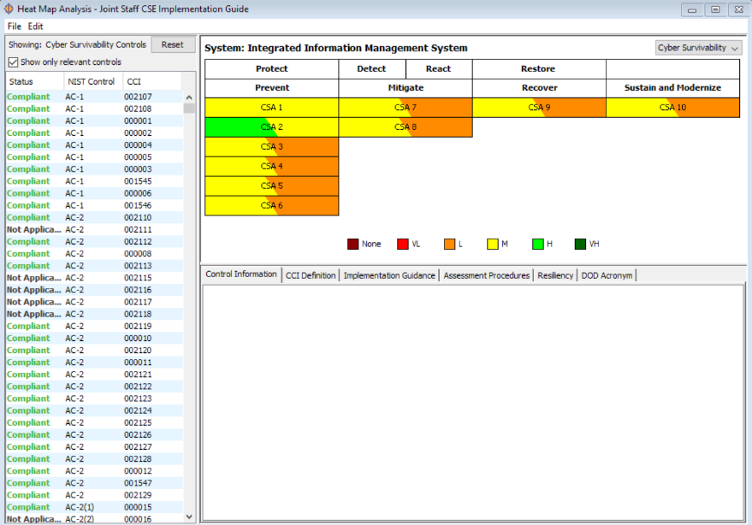
CSA Tool – Heat Map Analysis Cell
This cell provides a quick and simple heat map of the “as designed” vs. “as tested” against the security controls requirements.
Heat map views can be customized to provide the current user a role in which they are specifically interested (i.e. CSE, resiliency, RMF, etc)
Automated test results are added to the CSA Tool and the compliance status is populated
This cell is dynamic and will change as the system goes through OT&E
Primary Stakeholders
SCAR
SCA
AO
Supporting Stakeholders
ISSM
ISSO
ISSE
PM
PM
Approved for Public Release; Distributed Unlimited: Case Number 88 ABW-2020-1000; Dated 17 MARCH 2020
Notes:
CSE (Cyber Survivability Endorsement) Group

Slide 19
CSA Tool – CSA Tool Cell
This portion of the CCI Manager Cell is leveraged by the SCA teams to manage independent testing.
Import .ckl file from testing
Visualize “as designed” vs “as tested” for AO review
Proposed Enhancements
Develop Security Assessment Report (SAR)
Independent testing
Complete Risk Assessment
Primary Stakeholders
SCAR
SCA
AO
Supporting Stakeholders
ISSM
ISSO
ISSE
PM
Approved for Public Release; Distributed Unlimited: Case Number 88 ABW-2020-1000; Dated 17 MARCH 2020
Notes:
CSE (Cyber Survivability Endorsement) Group

Slide 20
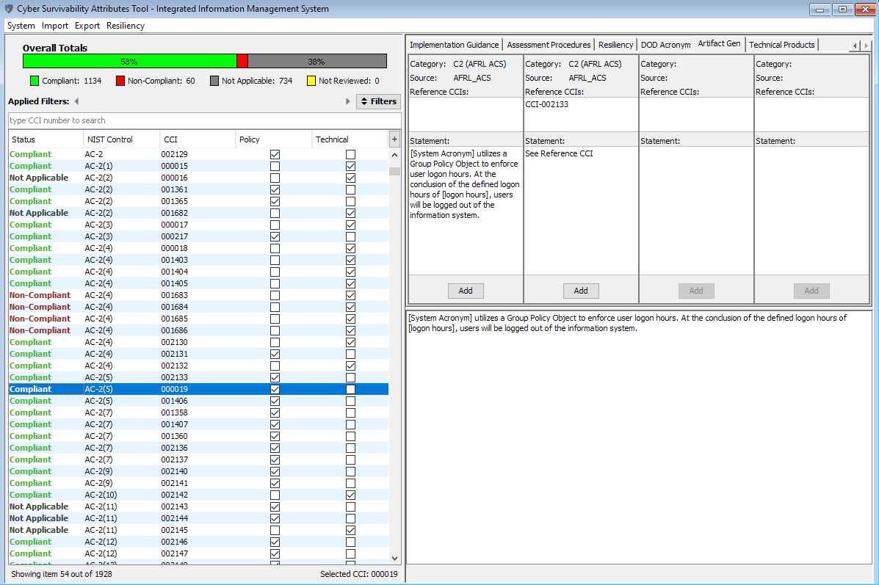
CSA Tool – CSA Tool Cell
This cell is the heartbeat of the CSA Tool. All requirements are tied back to this cell in which System Security Engineering (SSE) is tied back to approved DoD Security Controls.
A user can walk through the RMF 7-step process
Required security artifact templates can be developed based on the ISSO answers to the specific Control Correlation Identifiers (CCIs)
Built with pre-populated DoD best-practice solutions to assist programs in determining how to meet the intended requirements without over-engineering solutions
Communities of Interest can establish shared common solutions to enhance information sharing on cybersecurity, survivability and resiliency engineering
Primary Stakeholders
ISSM
ISSO
ISSE
Supporting Stakeholders
AO
PM
Approved for Public Release; Distributed Unlimited: Case Number 88 ABW-2020-1000; Dated 17 MARCH 2020
Notes:
CSE (Cyber Survivability Endorsement) Group

Slide 21
CSA Tool Support to the Risk Management Framework (RMF)
Step 1 – Create New System
System Categorization
Inheritance
Overlay Selection
Step 2 – RMF Tailoring and Control Selection
Overlay Customization
Step 3 – RMF Control Implementation
Step 4 – Assessment
Approved for Public Release; Distributed Unlimited: Case Number 88 ABW-2020-1000; Dated 17 MARCH 2020
Notes:
RMF (Risk Management Framework) Group

Slide 22
RMF Step 1 – New System CSA Tool – System Categorization Cell
This cell provides the baseline for adding a new system to the CSA Tool. This cell provides the basic support features required to implement the Risk Management Framework (RMF). This cell may change as a system continues through Acquisition process.
System Identification
Provide a System Overview
Determine Data Types
Categorize System (CNSSI 1253)
Select Required Overlays
Apply Baseline Security Controls
Apply Inheritance
Primary Stakeholders
ISSM
ISSO
Supporting Stakeholders
PM
ISSE
AO
Approved for Public Release; Distributed Unlimited: Case Number 88 ABW-2020-1000; Dated 17 MARCH 2020
Notes:
RMF (Risk Management Framework) Group

Slide 23
RMF Step 2 – RMF Tailoring and Control Selection CSA Tool – CSA Tool Cell
This cell is the heartbeat of the CSA Tool. All requirements are tied back to this cell in which System Security Engineering (SSE) is tied back to approved DoD Security Controls.
A user can walk through the RMF 7-step process
Required security artifact templates can be developed based on the ISSO answers to the specific Control Correlation Identifiers (CCIs)
Built with pre-populated DoD best-practice solutions to assist programs in determining how to meet the intended requirements without over-engineering solutions
Communities of Interest can establish shared common solutions to enhance information sharing on cybersecurity, survivability and resiliency engineering
Primary Stakeholders
ISSM
ISSO
ISSE
Supporting Stakeholders
AO
PM
Approved for Public Release; Distributed Unlimited: Case Number 88 ABW-2020-1000; Dated 17 MARCH 2020
Notes:
RMF (Risk Management Framework) Group

Slide 24
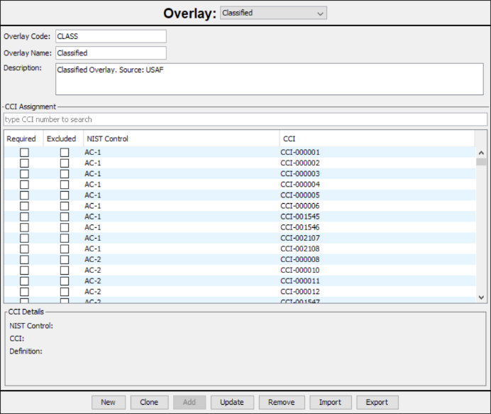
RMF Step 2 – Overlay Customization CSA Tool – CSA Data Manager
This cell allows approved users to customize overlays to their community of interest (COI) specified requirements. This supports the tailoring of NIST controls and CCI’s based on the specific system and mission.
AO’s must approve any changes to the baseline of security controls.
Primary Stakeholders
AO
PM
Supporting Stakeholders
ISSO
ISSM
ISSE
Approved for Public Release; Distributed Unlimited: Case Number 88 ABW-2020-1000; Dated 17 MARCH 2020
Notes:
RMF (Risk Management Framework) Group

Slide 25
RMF Step 3 – RMF Control Implementation CSA Tool – CSA Data Manager
This cell allows Communities of Interest (COIs) to maintain approved alternative solutions which can be leveraged by other programs.
Provide programs with exemplar AoA language from the CSEIG
Primary Stakeholders
PM
AO
Supporting Stakeholders
ISSM
ISSE
ISSO
Approved for Public Release; Distributed Unlimited: Case Number 88 ABW-2020-1000; Dated 17 MARCH 2020
Notes:
RMF (Risk Management Framework) Group

Slide 26
RMF Step 3 – RMF Control Implementation CSA Tool – CSA Tool Cell
This cell provides the user a simple and customize way to view cybersecurity requirements. It allows users to annotate the compliance status with the RMF security controls as applicable to their system. Test results can be imported in the format of a .ckl format.
Completed self-assessment PRIOR to independent testing
Upload .ckl files
Automated mapping to NIST controls
Complete manual testing of security engineering requirements
Develop and update security artifacts based on results
Primary Stakeholders
ISSM
ISSO
ISSE
Supporting Stakeholders
AO
PM
Approved for Public Release; Distributed Unlimited: Case Number 88 ABW-2020-1000; Dated 17 MARCH 2020
Notes:
RMF (Risk Management Framework) Group

Slide 27
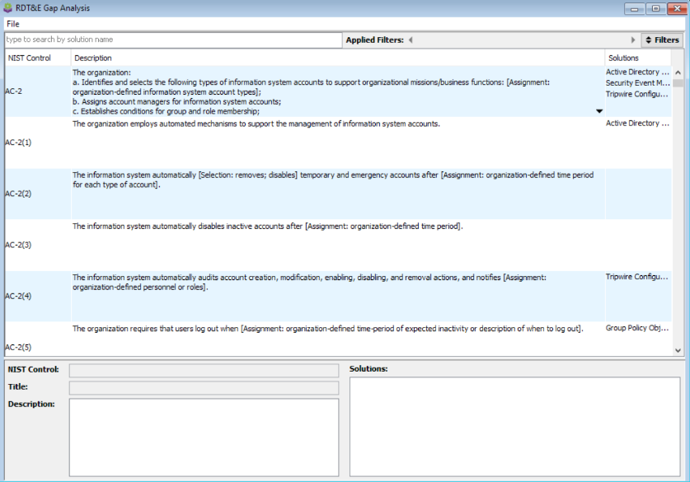
RMF Step 3 – RMF Control Implementation CSA Tool – RDT&E Gap Analysis Cell
This cell provides the user with current technologies (COTS and GOTS) that support the implementation of specific CCI’s
Approved users can customize the list of approved technologies based on their specific system types or organization
Primary Stakeholders
ISSM
ISSO
ISSE
Supporting Stakeholders
AO
PM
Approved for Public Release; Distributed Unlimited: Case Number 88 ABW-2020-1000; Dated 17 MARCH 2020
Notes:
RMF (Risk Management Framework) Group

Slide 28
RMF Step 3 – RMF Control Implementation CSA Tool – CSA Tool Cell
This cell provides the user with the ability to create draft policies for their current system based on the answers to the CCI’s required by their system categorization and control tailoring.
Approved users can customize the compliance statements to the way that their system(s) or organization(s) conduct business.
Allows for the reuse of information and quick application of inheritance.
Primary Stakeholders
ISSM
ISSO
ISSE
Supporting Stakeholders
AO
PM
Approved for Public Release; Distributed Unlimited: Case Number 88 ABW-2020-1000; Dated 17 MARCH 2020
Notes:
RMF (Risk Management Framework) Group

Slide 29
RMF Step 4 – Assessment CSA Tool – CSA Tool Cell
This portion of the CCI Manager Cell is leveraged by the SCA teams to manage independent testing.
Import .ckl file from testing
Visualize “as designed” vs “as tested” for AO review
Proposed Enhancements
Develop Security Assessment Report (SAR)
Independent testing
Complete Risk Assessment
Primary Stakeholders
SCAR
SCA
AO
Supporting Stakeholders
ISSM
ISSO
ISSE
PM
Approved for Public Release; Distributed Unlimited: Case Number 88 ABW-2020-1000; Dated 17 MARCH 2020
Notes:
RMF (Risk Management Framework) Group

Slide 30
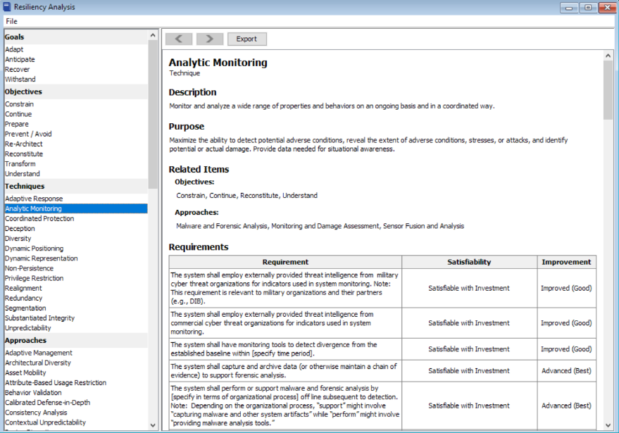
CSA Tool – Resiliency Analysis
This cell allows Program’s to use the current system categorization and RMF control mapping to determine the techniques in which the system is designed and/or engineered to support.
Leverage DRAFT NIST 800-160 Volume 2 for Resiliency engineering requirements
Select resiliency requirements based on an effects-driven model
Primary Stakeholders
PM
AO
Supporting Stakeholders
ISSM
ISSE
ISSO
Approved for Public Release; Distributed Unlimited: Case Number 88 ABW-2020-1000; Dated 17 MARCH 2020
Notes:
Resiliency Group

Slide 31
Resiliency Support CSA Tool – Resiliency Analysis
This cell allows Program’s to use the current system categorization and RMF control mapping to determine the techniques in which the system is designed and/or engineered to support.
Leverage DRAFT NIST 800-160 Volume 2 for Resiliency engineering requirements
Select resiliency requirements based on an effects-driven model
Primary Stakeholders
PM
AO
Supporting Stakeholders
ISSM
ISSE
ISSO
Approved for Public Release; Distributed Unlimited: Case Number 88 ABW-2020-1000; Dated 17 MARCH 2020
Notes:
Resiliency Group

Slide 32
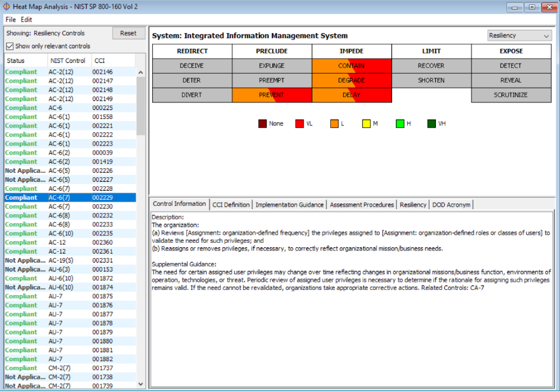
Resiliency Support NIST SP 800-160 Vol 2, Cyber Resiliency Heat Map
This cell allows Program’s to use the current system categorization and RMF control mapping to determine the “as-designed” vs. “as-tested” views of the system against the Resiliency Techniques and Tactics.
Leverage DRAFT NIST 800-160 Volume 2 for Resiliency engineering requirements
Select resiliency requirements based on an effects-driven model
Primary Stakeholders
PM
AO
Supporting Stakeholders
ISSM
ISSE
ISSO
Approved for Public Release; Distributed Unlimited: Case Number 88 ABW-2020-1000; Dated 17 MARCH 2020
Notes:
Resiliency Group

Slide 33
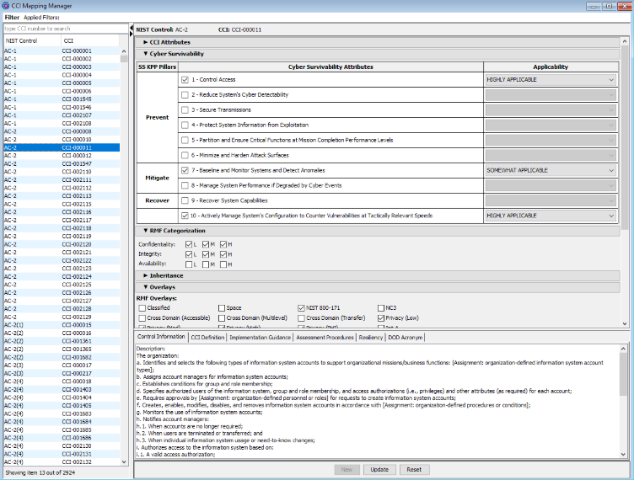
Resiliency Support CCI Mapping Manager
This cell allows Program’s to view all of the resiliency information included in NIST 800-160 Volume 2 as it relates to the NIST controls, DoD Control Correlation Identifiers (CCIs) and the overlays.
This view allows for the sorting and filtering of data based on required fields.
Users can quickly and simply view the requirements and assist in making tailoring decisions for resiliency.
Primary Stakeholders
PM
AO
Supporting Stakeholders
ISSM
ISSE
ISSO
Approved for Public Release; Distributed Unlimited: Case Number 88 ABW-2020-1000; Dated 17 MARCH 2020
Notes:
Resiliency Group

