Slide 1

TRMC Cyber Activities
Briefing for the 7th Cybersecurity Workshop
November 18, 2020
Chip Ferguson
Deputy Executive Agent, CIO/AO, Cyber Portfolio Lead

Slide 2

Agenda
Agenda
Cyber Range Approach
  Architecture
  Need for Cyber Ranges
Cyber Range Enterprise Assessment (CREA)
  Guidance
  Desired End State
  Process
  Goals
  Timeline
  Way Forward
Other EA/CIO/AO/Portfolio Lead Activities
2

Slide 3
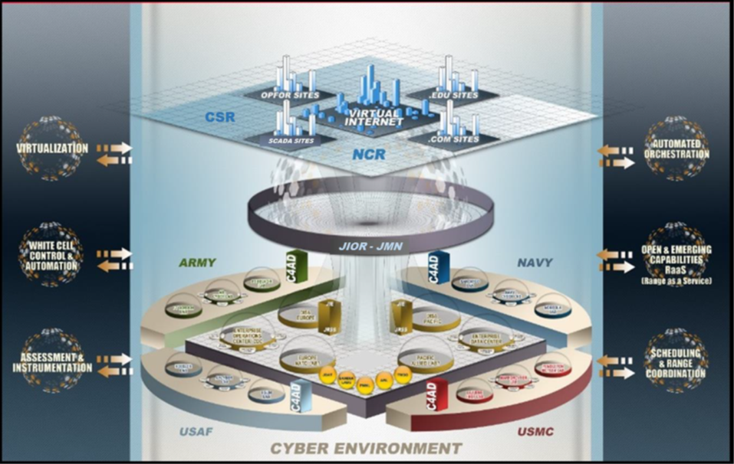

Architecture
Develop dual use DoD cyber range infrastructure that seamlessly integrates disparate capabilities through common architectures, standards, and processes to provide operationally realistic cyberspace environments for Cyber Mission Force training events and executing tests of cyberspace operations and resiliency to advanced threats.
3

Slide 4

Need for Cyber Ranges
Introduction
Problem
  Cyber Range investments have not been managed holistically. With increasing and urgent demands overwhelming the existing resources, the Department must rationalize its efforts and develop a comprehensive plan for the employment of cyber ranges to support cyber training, test and evaluation.
Solution
  In order to “ensure adequate cyber test and training range infrastructure to meet DoD needs”, 2019 DoD Line of Effort (LOE) 4-4, Cyber Range EAs completed a Cyber Range Pilot Enterprise Assessment.
    The Enterprise Assessment documents the state of DoD cyber range infrastructure and ability to meet increasing demand to inform future investment and prioritization decision.
    The Pilot Enterprise Assessment included 5 ranges/capabilities, the 4 designated cyber and the AF CTTR.
4

Slide 5

Cyber Range Enterprise Assessment
5

Slide 6

Background
Guidance
The PCA’s office has asked the EAs to expand the depth and breadth of their current oversight activities:
  More closely linking budget certification to BIP elements as defined in DoDD 5101.19e and Title 10 U.S.C.
  Extend the scope of the cyber range enterprise beyond the current list of Designated Ranges
Resulting effort:
  The EAs certified the pilot budget of the designated ranges and AF CTTR for the FY21 budget
  For FY 22, the EAs will conduct an assessment of the expanded cyber range enterprise (as define in the LOE 4-1-1) for the FY22 budget
6

Slide 7

Consistent with DoD Policy
-DOD Directive 5101.19e: DOD Executive Agents For The Cyber Test And Cyber Training Ranges
2.2. DIRECTOR, TRMC. Under the authority, direction, and control of the USD(R&E) and as the DoD EA for Cyber Test Ranges, the Director, TRMC:
c. Exercises DoD-wide responsibilities for planning and integrating investment activities across the cyber test infrastructure. Oversees strategic modernization…. collaboration with DoD Components and the DoD Principal Cyber Advisor (PCA)……to ensure they are adequately resourced…...
  (2) Oversees program elements associated with DoD cyber test ranges…..
    (b) Annually certifies that DoD cyber test ranges and aligned capabilities meet established standards, are adequately funded and capable…...
2.11. SECARMY. ….as the DoD EA for Cyber Training Ranges, the SECARMY:
e. Exercises DoD-wide responsibilities for planning and integrating activities…..
  (1) Monitors DoD Component investments in the designated cyber training ranges……
7

Slide 8
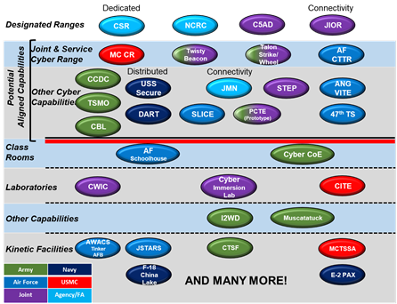

DPCA: Expand Scope
Must document the state of DoD Cyber Range Infrastructure, and ability to meet demand -- inform future investment and prioritization
  (following slides provide framework)
Must expand EAs scope beyond Designated Ranges
  EAs may need additional authority
Pilot Enterprise Assessment is critical to:
  Understanding cyber range infrastructure sufficiency
  Understanding critical metrics
  Achieving Service/Command/Agency willing participation moving forward!
X
X
X
X
X
X
X
X
8

Slide 9
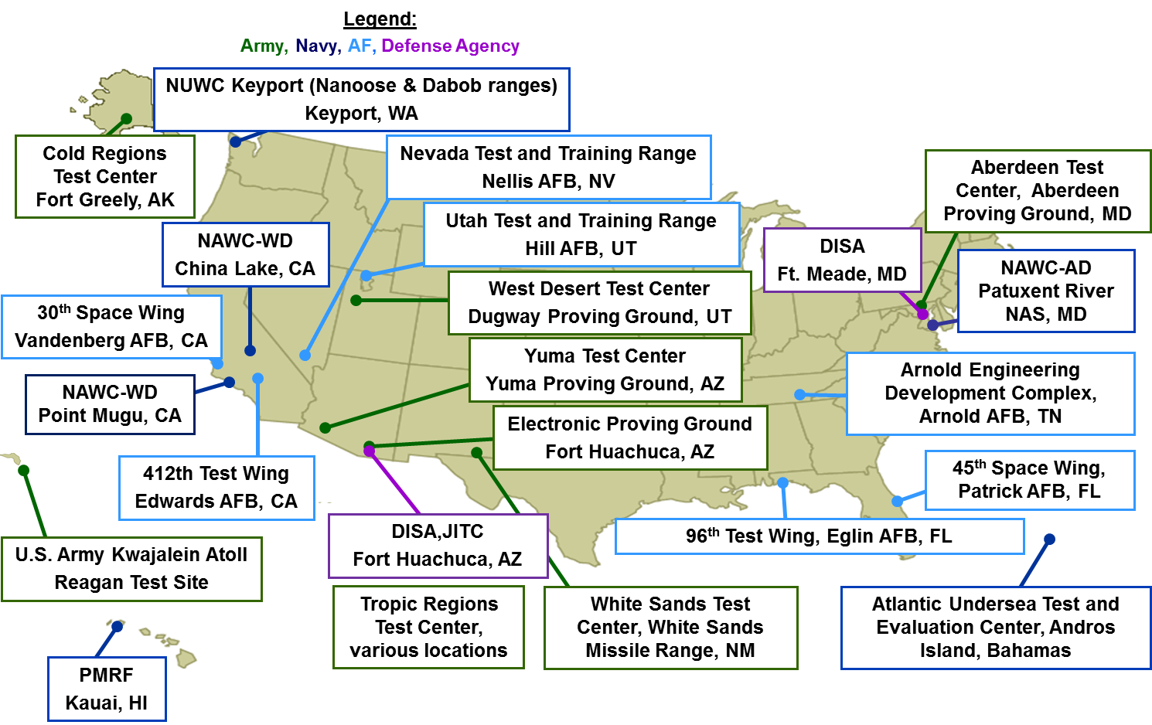
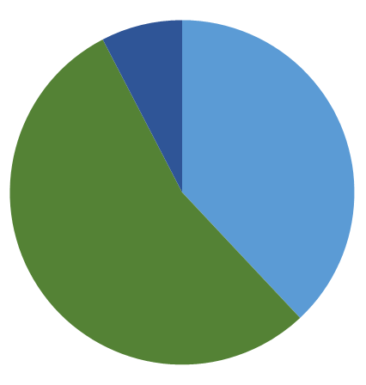
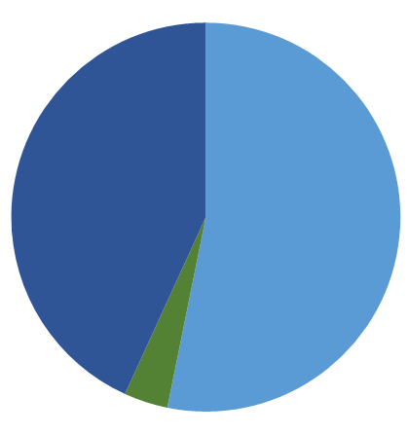
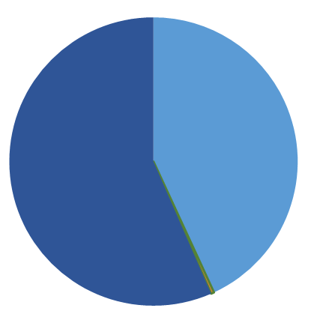
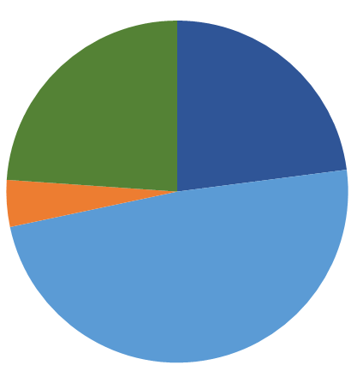

Major Range and Test Facility Base (MRTFB)
CREA Overview
  The process is modeled off the Infrastructure Readiness Reviews (IRR) used by TRMC in oversight of the MRTFB
  Originally an annul event in which range Commanders briefed the Director, TRMC
  Two way communication served as the basis of understanding between the Services/ranges and OSD oversight
  Informed TRMC’s major deliverables to congress:
    Budget Certification ~$3.6B (annual)
    Strategic Plan of DoD Test Resources (Biennial)
    List of DoD Major Range and Test Facilities Base (annual)
23 Sites: 8 Army, 6 Navy, 7 Air Force, 2 Defense Agency
Land Area
22K Square Miles
Airspace
336K Square Miles
Sea Area
381K Square Miles
Workforce
23K Personnel
8%
Army
24%
23%
Navy
38%
43%
57%
43%
4%
Air Force
54%
53%
DISA
49%
4%
<1%
Look familiar? Congress modeled the EA authorities after TRMC’s
9
Notes:
Strategic Partnerships:
National Partnership for Aeronautical Testing (NPAT), 2007-2018: Collaborate on mgmt. of aeronautical test facilities, workforce, and sharing of emerging test technologies. Results include: Transonic, Supersonic, and Hypersonic Wind Tunnel Assessments, NASA Mach 6 Nozzle Update, Workforce Exchanges.
Natl Rocket Propulsion Test Alliance (NRPTA), 2015: Collaborate on efficient and effective use of government investments in facilities that evaluate the performance of rocket stages, engines, and their subsystems. Resulted in de-conflicting investments with NASA investing in large capabilities supporting production-level space access and DoD investing in small to medium test capabilities supporting primarily missile systems and research.
DHS Reciprocal Use of T&E Facilities: Permits reciprocal-use of specific test ranges, such as the DHS Transportation Safety Lab for explosive vulnerability testing of commercial aircraft and testing of airport screening devices at Aberdeen Test Center. Resulted in reducing duplication of test capabilities across agencies and saving taxpayer dollars. There is also a DoD-DHS MOA for use of the Natl Cyber Range under the MOU.
Industrial Committee on T&E (ICOTE): Gov/industry forum to collaborate on T&E policy, practice, procedures, infrastructure, which impact military systems development, procurement and use.
International Test Infrastructure Collaboration: The second objective of the 2018 National Defense Strategy is to strengthen alliances: “ TRMC participates in multiple working groups and forums with our allies to identify areas for collaboration. For example, the TRMC and UK are conducting a US/UK Cyber Event Demonstration. The project explores sharing of cyber test and evaluation processes and facilities. The results will support distributed cyber testing between the US and UK to inform resilience and preparedness in cyberspace and pave the way for future collaboration with additional allies. Additionally, the TRMC is setting up working groups with Australia on the subjects of range upgrades, cyber testing, and instrumentation. Future meetings will address the ability of the TRMC to share test technologies remotely, share and replay test scenarios and formulate process and procedures for joint testing and interoperability. In the future, TRMC looks forward to expanding its partnering efforts with additional countries in order to build a futuristic robust capability supplemented with participating allies.
Shared / Inter-Service Utilization:
TRMC ensures that the MRTFB is a DoD enterprise/asset available for inter-service usage and use by other Non-DoD (Other U.S. Government, Foreign Military Sales, Foreign Governments, Commercial).
Army MRTFB example, past 10 years: 68% use is Army,16% is Navy and AF @ Army, rest is other Service/DoD/non-DoD

Slide 10

CREA Goals
The Pilot Enterprise Assessment was intended to:
  Assess the health and adequacy of cyber ranges to meet the needs of the enterprise
  Serve as a trial for conducting an assessment of all (then) 19 ranges and capabilities
  Open a channel of communication between the ranges and the EAs so that range commanders and directors can vocalize their near and future concerns affecting range operation
  Answer the DPCAs question regarding the demand for existing cyber ranges and their ability to meet it and provide data to advocate for ranges/capabilities
10

Slide 11

CREA Process
  Met with the ranges individually prior to data call to discuss EAs’ intent, data call (down to individual data elements and measures), listen to concerns, develop a working relationship
  Issued the data call and conducted weekly group telecoms to discuss issues, concerns, or updates to data call
  Two rounds of data validation and adjudication
    First round contained a lot of missing data, added data fields, incorrectly filled in fields
    Making sure the data elements tell the same story as the commander’s assessment
  Analysis of trends across ranges
  After Action Review of process and data call
11

Slide 12

Enterprise Assessment Way Forward
CREA Way Forward
Format
  Two Portions: Same data as pilot split into two formats.
    Quantitative: Excel Spreadsheet asking for data points
    Qualitative: Sent ~ 2 Weeks after Quantitative portion. PowerPoint Slide with prompts and charts. Will be used to brief Deputy EA’s.
  Timeline:
    Both qualitative and quantitative portions due back on 1 Aug.
    Range/Capability Commander’s brief to Deputy EA scheduled between 1 Sept and 1 Nov via VTC or Telecom.
    EA briefs DPCA early 2021.
  Data Categories
    Hardware
    Software
    Facilities
    Capabilities
    Workforce and Workload
    Funding
    Budget
    Utilization (By customers and events)
12

Slide 13

CREA Timeline
Ongoing Data Call Modification Telecoms
Data Compilation and Assessment
Commanders’ briefings to the Deputy EAs
Notice to participating Ranges
Complete analysis and assessment
Way Forward Discussion
Send Group 1 Data Call
Receive data from ranges
Complete Data Adjudication
Send Group 2 Data Call
Group 4 Data Call/Briefs
Brief DPCA on results
Brief PCA on Pilot
Send Group 3 Data Call
18 Mar
19 Mar
19 Apr
1 May
~7 Jul
~28 Jul
14th Sept
15– 31st Aug
1 Sept – 1 Nov
1 Dec
~ Jan 2021
~ Mar 2021
Conduct AAR with pilot ranges
Modify and create data calls based on pilot participants’ inputs
Brief expanded scope ranges for full Enterprise Assessment
Hold telecons with existing and new ranges to get input for updated data call
Bi-Weekly/as needed telecoms to help ranges complete data call and adjudicate data
Conduct Customer Outcomes and Demand Capturing Telecons
Compile Quantitative and Qualitative Data
Perform independent analysis of individual range/capability data to feed into Enterprise Assessment
Prepare Enterprise Level brief with conclusions and recommendations
GROUP 1 | GROUP 2 | GROUP 3 | GROUP 4 | OUT OF SCOPE
NCRC/JMN | USS SECURE | TSMO | JCTE Ops Group | CSR (Divested)
CEOD | ANG VITE | CBL |  | MCCR (Divested)
JIOR |  | CCDC |  | Talon Strike (Subsumed under PCTE)
318TH RANS |  |  |  | Twisty Beacon (Subsumed under PCTE)
47th TS |  |  |  | DART (Not Participating)
 |  |  |  | STEP (Determined out of scope)
Complete
On Track
Challenges Exist
Planned
13

Slide 14

Other EA/CIO/Portfolio Mgr Activities
Conclusions
SkyRange
Biennial Integrated Planning
TRMC Roadmap for Cyber Investments
Annual Budget Certification
Standards for Cyber Range Interoperability (SCRI) Working Group
Questions??
14

