Slide 1
Test and Evaluation of Industrial Control and Cyber-Physical Systems
Fred Wright, PhD
November 18, 2020
ITEA Cybersecurity Workshop

Slide 2
A Few Infamous Cyber-Physical Incidents
2008
2010
2015
Train Derailment
STUXNET
Black Energy
Notes:
August 2003 - The Blaster worm infected the communication system of a US railway company stopping trains for half a day
January 2008 - A Polish teenager derailed four trains with a
homemade remote device, leaving 12 passengers injured
June 2010 - STUXNET discovered
December 2015 - Black Energy attack on the Ukrainian power grid
March 2016 - Iran compromises industrial controls of a dam in New York
Real-world
Cyber=physical attacks are on the rise
Cyberwarfare is the future; particular for critical infrastructure
Why was stuxnet a big deal?
What could have happened (NY dam example)
Train incident report - ICISI gets reports ahead of everyone else

Slide 3
National Defense Appropriation Act
SEC. 1643. DESIGNATION OF OFFICIAL FOR MATTERS RELATING TO INTEGRATING CYBERSECURITY AND INDUSTRIAL CONTROL SYSTEMS WITHIN THE DEPARTMENT OF DEFENSE
SEC. 1650. PILOT PROGRAM AUTHORITY TO ENHANCE CYBERSECURITY AND RESILIENCY OF CRITICAL INFRASTRUCTURE

Slide 4
Basic Control System Components
Human Machine
Interface (HMI)
Remote Diagnostics
and Maintenance
Set points,
Control algorithms,
Parameter constraints,
Process Data
Controller
Controlled
Variable
Manipulated
Variable
Actuators
Sensors
Process
inputs
Controlled Process
Process outputs
Disturbances
NIST SP 800-82, Revision 2: Guide to Industrial Control Systems (ICS) Security (https://csrc.nist.gov/publications/detail/sp/800-82/rev-2/final)
Notes:
Use cruise control as an example -Insert exercise to identify parts of the cruise control in this diagram - break up into groups
Tesla hacks? https://www.newscientist.com/article/2198325-teslas-autopilot-tricked-into-driving-on-the-wrong-side-of-the-road/
Managing Risks

Slide 5
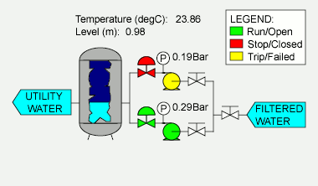
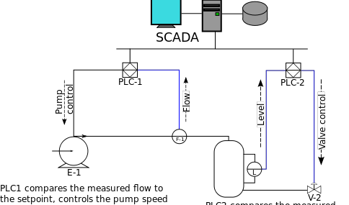
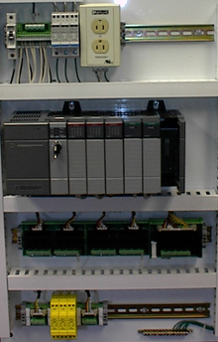
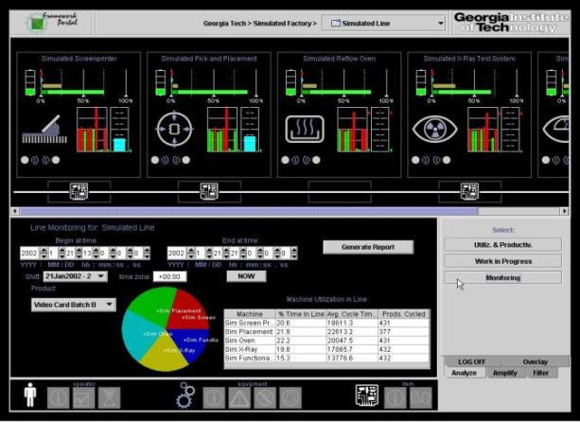
Enterprise view for Cyber-Physical Systems
Layers in the enterprise (ISA-95)
Level 4 — Business logistics systems — Managing the business-related activities of the manufacturing operation
Level 3 — Manufacturing operations systems — Managing production work flow to produce the desired products
Level 2 — Control systems — Supervising, monitoring and controlling the physical processes
Level 1 — Intelligent devices — Sensing and manipulating the physical processes. Process *sensors, analyzers, actuators and related instrumentation
Level 0 — The physical process — Defines the actual physical processes
http://en.wikipedia.org/wiki/Enterprise_control
Notes:
en.wikipedia.org/wiki/Enterprise_control

Slide 6
Types of Automation Systems
All Automation Is Not The Same
Distributed Control Systems (DCS)
Distributed and complex control usually within a facility (plant) (Local Area Network)
Supervisory Control and Data Acquisition (SCADA) Systems
Control systems distributed over large geographic areas (Wide Area Networks (WANs))
Programmable Logic Controller (PLC)-based Control systems
Typically smaller and less complex than DCS (Local Area Networks (LANs))
Emergency Shutdown (ESD) or Safety Systems
Simpler and robust controls to ensure safety and prevent damage
Can be quasi-independent from primary control loops
Often implemented with PLCs
NIST SP 800-82, Revision 2: Guide to Industrial Control Systems (ICS) Security (https://csrc.nist.gov/publications/detail/sp/800-82/rev-2/final)
Notes:
Safety culture

Slide 7
Verticals
Who’s Using Automation And What Kind
 | Agriculture | Chemical | Oil and Gas | Electrical Energy | Defense | Facilities MGT/Building Automation | Nuclear Reactors, Materials, & waste | Transportation | Water & Wastewater
DCS |  |  |  |  |  |  | 
SCADA |  |  |  |  |  |  |  |  | 
PLC-Based |  |  |  |  |  |  |  |  | 
ESD |  |  |  |  |  |  | 
Notes:
Add wikipedia reference
Cruise control
Aircraft response
Versus locomotive
Use step function examples
Old analog -> now digital
What could a threat do? … if they can change the weights, K - unstable system
737max

Slide 8
State of Cyber-Physical Systems
Security through Obscurity
Proprietary protocols are usually not secure
Systems increasingly connected
Numerous critical systems with long life (security through obsolescence?)
Can’t take many systems off-line to patch
Austere physical environments in some cases
Safety is king
Wireless connections increasing… Industrial IoT
Notes:
Presenter's thoughts and rhetorical questions

Slide 9
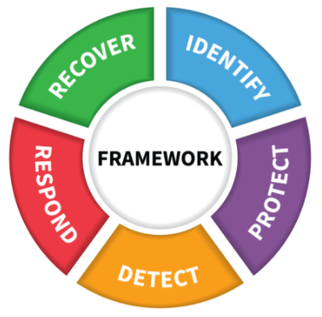
Test and Evaluation Challenges
Where to instrument?
How to instrument?
Many verticals, standards, and vendors
System security versus device security
Increasing use of RF communications
Representing threats
Cyber “So What”
NIST Cybersecurity Framework

Slide 10
Test and Evaluation Challenges
Where to instrument
field busses
austere environment
How to instrument
Multicast
HMI logs and views
Many verticals, standards, and vendors

Slide 11
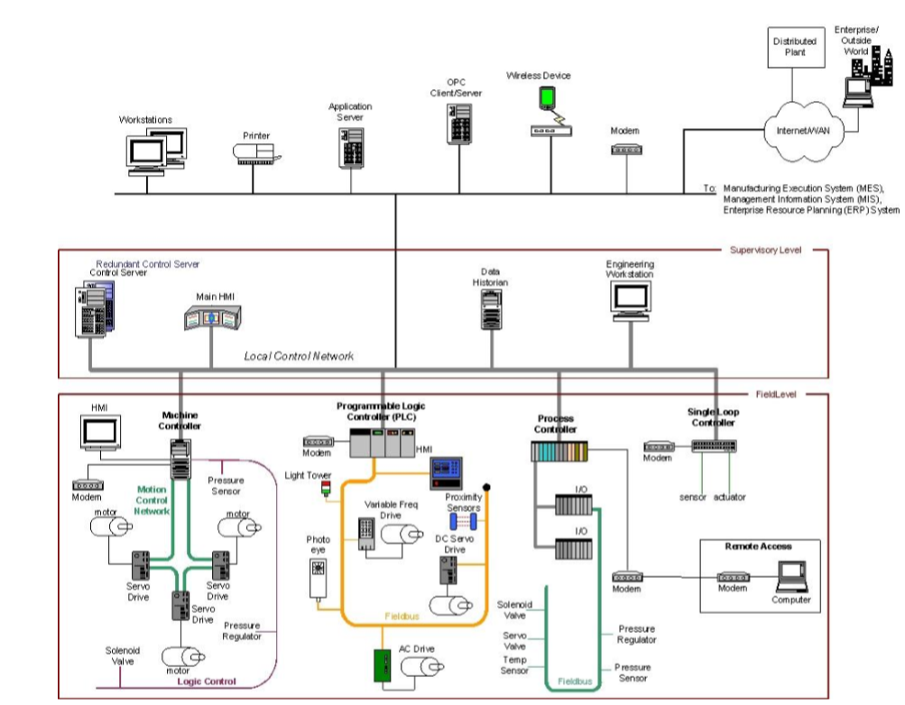
Example Architecture (DCS)
The Instrumentation Options
Logs from Human Machine Interface (HMI)
Instrumenting field busses is doable but cumbersome
Monitor LAN segment with “Tap” or mirrored port on switch
Notes:
multicast
Cruise control

Slide 12
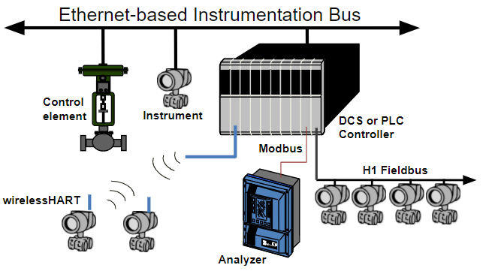
Instrumentation and Field Bus Standards
On the Right Bus: Instrumentation and Data Reduction Challenges
Numerous Standards:
Vendor Proprietary
Modbus
HART
Profibus
World FIP
Foundation Fieldbus
DeviceNet
SDSnet
LONworks (building automation)
BACNet (building automation)
CAN bus (automotive)
MIL-STD 1553 (aviation)
ARINC-429 (aviation)
Implementations may be built on “open” standards but not necessarily interoperable with other vendor’s products
Products may be capable of using standard protocols but proprietary protocols are often used in practice
How field and SCADA Messages/Protocols are encapsulated for Ethernet segments can also cause issues
Notes:
Many standards and this is not comprehensive.
Standards vary as to layers and specifics covered
There are Ethernet versions of many of these standards with gateways

Slide 13
Test and Evaluation Challenges
System security versus device security
Vulnerability testing
Verify controls for network devices
Increasing use of RF communications

Slide 14
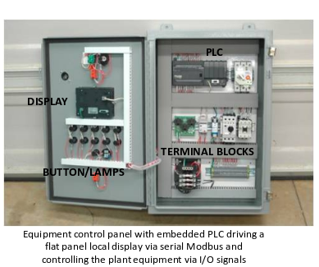
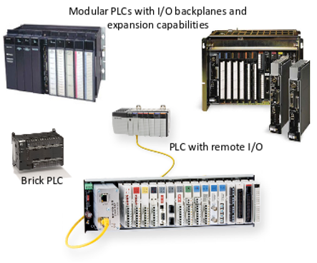
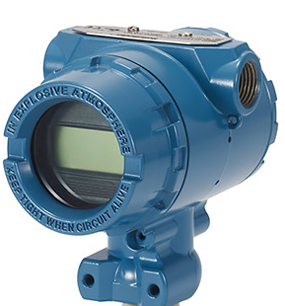
Finding Vulnerabilities in ICS Devices
A Little Deeper
Fuzzing interfaces
Code analysis
Physical security evaluations when needed
Field Device “Transmitter”
Notes:
Add wikipedia reference
Cruise control
Aircraft response
Versus locomotive
Use step function examples
Old analog -> now digital
What could a threat do? … if they can change the weights, K - unstable system
737max

Slide 15
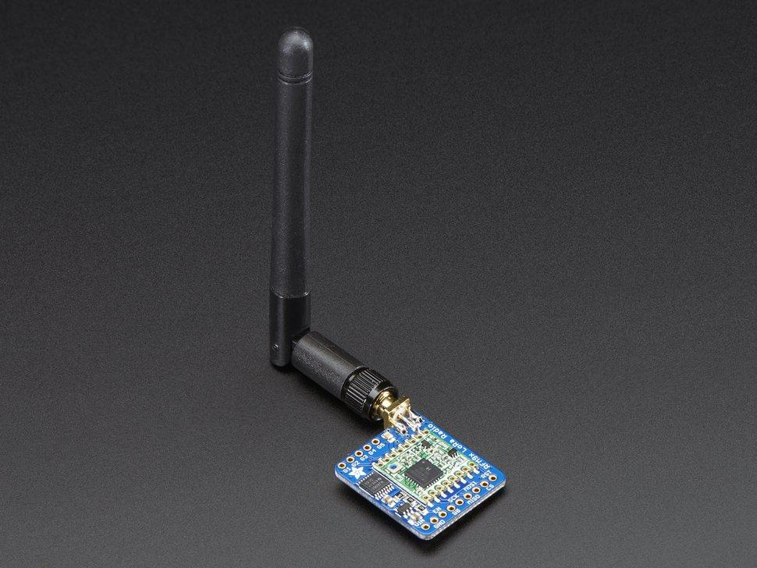
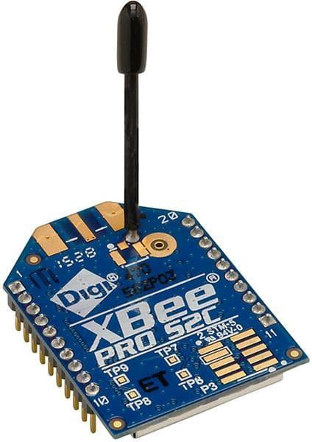
RF Communications for Industrial Automation
Adafruit Low power Long Range (LoRa)
Radio Transceiver (433MHz) >1km
Microwave point-to-point
Cellular (3G and 4G)
Various industrial, scientific, and medical (ISM) unlicensed radio band systems
Wifi
Bluetooth
Zigbee (IEEE 802.15.4),
LoRaWAN
Other IoT radios
Satellite Communications (SATCOM)
Digi International Zigbee Module (2.4GHz)
(Low power mesh network) ~10 to 20m
Notes:
What are the vulnerabilities? C-I-A?

Slide 16
Test and Evaluation Challenges
Representing threats
Safety concerns
Threat Intelligence
Red team familiarity with ICS technology
Testing physical security
Increasing use of RF communications
Another threat vector
Cost of replicating the operating environment

Slide 17
Test and Evaluation Challenges
Cyber “So What”
Assessing impacts to operations
Testing incident response and recovery
Tied to safety
Disruption to operations

Slide 18
Basic Control System Components
Human Machine
Interface (HMI)
Remote Diagnostics
and Maintenance
Set points,
Control algorithms,
Parameter constraints,
Process Data
Controller
Controlled
Variable
Manipulated
Variable
Actuators
Sensors
Process
inputs
Controlled Process
Process outputs
Disturbances
NIST SP 800-82, Revision 2: Guide to Industrial Control Systems (ICS) Security (https://csrc.nist.gov/publications/detail/sp/800-82/rev-2/final)
Model physical process
Notes:
Use cruise control as an example -Insert exercise to identify parts of the cruise control in this diagram - break up into groups
Tesla hacks? https://www.newscientist.com/article/2198325-teslas-autopilot-tricked-into-driving-on-the-wrong-side-of-the-road/

Slide 19
Conclusions
Challenges for test and evaluation are numerous but can be managed to identify and manage risks
End-to-end system testing can be costly and not feasible. Step-by-step test events, augmented with modeling, are need to build a view system security

