Slide 1
Virtualization: A Tool and a Challenge for T&E
November 18, 2020
Scott Brookes
Draper

Slide 2
About Me
Contact: sbrookes@draper.com
Graduated from Dartmouth College with my PhD in 2018
Studied secure OS and Hypervisor architectures
Currently working at Draper in Cambridge, MA
Working on fuzzers and hypervisors with TRMC
New to the T&E Community

Slide 3
Virtualization
What is it?

Slide 4
Defining Virtualization
Specifically, “Hardware Virtualization”:
From Wikipedia: “Hardware virtualization is the virtualization of computers as complete hardware platforms, certain logical abstractions of their componentry, or only the functionality required to run various operating systems.”
A set of abstractions
Presents software a view of virtual hardware
Allows multiple OSs to share a single physical hardware instance

Slide 5
Hypervisor: an OS for OSs
A process is to an OS what an OS is to a hypervisor
Application 2
Application
Virtual Machine 2
Virtual Machine
INT
RET
VMCALL
VMRESUME
Kernel
Hypervisor

Slide 6
Example Hardware Abstraction
Virtual Address
63
57
56
48
47
39
38
30
29
21
20
12
11
0
Sign
Extend
PML4
Offset
Page Dir Ptr Offset
Page Dir Offset
Page Table Offset
Physical Page Offset
Page
Map
Level-4
Table
Page Directory Pointer
Table
Page
Directory
Table
Page
Table
PML4E
PDPE
4k Physical
Page
PDE
PTE
Physical
Address
51
12
11
0
Page Map Level-4
Base Address
CR3 Hardware Register Per Core

Slide 7
Example Hardware Abstraction
Guest Virtual to ‘Guest Physical’ Address
Guest ‘Physical’ == Hypervisor Linear Address
63
48
47
39
38
30
29
21
20
12
11
0
63
48
47
39
38
30
29
21
20
12
11
0
Sign Extend
PML4
PDP
PD
PT
Page Offset
Sign Extend
EPT
PML4
EPT
PDP
EPT
PD
EPT
PT
Page Offset
EPT
Page
Map
Level-4
Table
Page
Map
Level-4
Table
EPT
Page Directory
Pointer
Table
Page Directory Pointer
Table
EPT
Page
Directory
Table
Page
Directory
Table
EPT
Page
Table
Page
Table
4k Physical
Page
PML4E
PDPE
4k
Guest
‘Physical’
Page
PML4E
PDPE
PDE
PDE
PTE
Guest
Physical
Address
PTE
True
Physical
Address
51
12
11
0
45
12
11
0
Guest PML4
Base Address
Guest CR3
PML4 Address
EPT Pointer
Paging
Extended Page Tables
(Simplified)
*Simplified

Slide 8
Hypervisor Types
App
App
App
App
App
App
Guest OS
Guest OS
Guest OS
Hypervisor
App
App
Hypervisor
Host OS
Hardware
Hardware
Type 1 Type 2

Slide 9
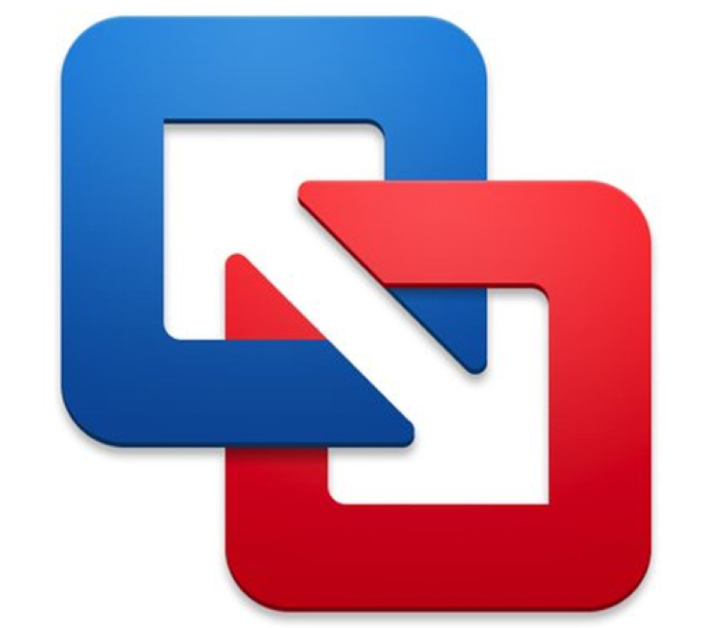
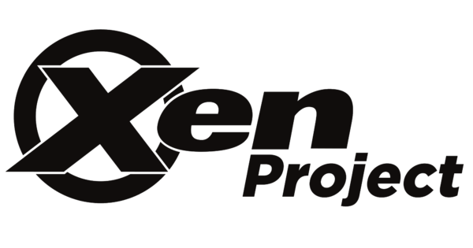
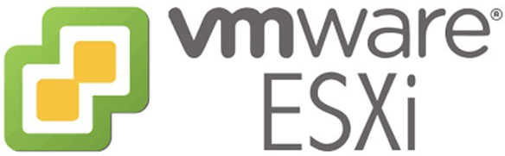
Commercial Hypervisors
vmware
Fusion
Type 1 Type 2

Slide 10
Virtualization as a tool

Slide 11
SUT: Application
App
App
Operating System
To test this, we may want to:
Interact with the application manually
Write software to interact with the application
Dynamic analysis (e.g. Fuzzers)
Static analysis (e.g. formal verification)
Automated tests
Install it on another computer
Hardware

Slide 12
SUT: Application
App
App
Operating System
To install it on another computer
There may be dependencies
Specific software versions
Of the application itself
Of the dependencies
OS compatibility issues
The difficulty of installation may result in the application sitting on the shelf!
Hardware

Slide 13
SUT: OS + Application
App
App
Operating System
Similar to the application alone, we may want to:
Interact with the system manually
Write software to interact with the system
Dynamic analysis (e.g. Fuzzers)
Static analysis (e.g. formal verification)
Automated tests
Install it on another computer
Hardware

Slide 14
SUT: OS + Application
App
App
Operating System
Installation is even harder than application-only
Installing an operating system is difficult
Compiling a custom kernel is even harder
Specific software versions
Of the application itself
Of the dependencies
Of the kernel
The difficulty of installation may result in the application sitting on the shelf!
Furthermore, running software to interact with the system requires modifying the SUT! At that point you’re no longer testing the same system you mean to deploy.
Hardware

Slide 15
Virtualizing an OS and Application
Install the system in a virtual machine
Virtual Machines can be easily migrated from one machine to another
App
Virtual Machine
App
Virtual Machine
Operating System
Hypervisor
Hypervisor
Hardware
Hardware
Hardware

Slide 16
SUT: System of Systems
Installation is EVEN HARDER’
You now need multiple machines, each configured and connected correctly
App
App
e.g. ethernet
App
App
Operating System
Operating System
Hardware
Hardware

Slide 17
Virtualizing a System of Systems
App
App 1
e.g. ethernet
App 2
App
Operating System 1
Operating System 2
Hardware
Hardware
Each system is a virtual machine
The hypervisor can connect VMs virtually
Virtual Machine
Virtual Machine 2
Hypervisor
Hardware

Slide 18
SUT: Virtualized system
Virtual Machine
What if the SUT uses a hypervisor?
Nested virtualization!
Requires special support in the “host hypervisor”
Support varies from hypervisor to hypervisor
Guest Hypervisor
Virtual Machine
???
Hypervisor
Host Hypervisor
Hypervisor
Hardware
Hardware

Slide 19
Virtualization as a Challenge

Slide 20
Virtualization Challenges
Compatibility between different hypervisors
Most virtual machines can be converted from Hypervisor A to Hypervisor B
Support can depend on which two hypervisors are being used
Support for common type 2 hypervisors (e.g. virtualbox and vmware) is well-documented
Virtual Machine
???
Hypervisor A
Hypervisor B
Hardware
Hardware

Slide 21
Virtualization Challenges
What if the application is on different hardware than the hypervisor
Non-native hardware is not well-supported
May investigate emulation with e.g. qemu
New work for non-native virtualization is Captive¹
1. Spink, Tom, Harry Wagstaff, and Björn Franke. "A Retargetable System-Level DBT Hypervisor." 2019 USENIX Annual Technical Conference (USENIX ATC 19). 2019.
App
App
App
???
Host OS
Hypervisor
Hardware A
Hardware B

