Slide 1
Intelligence, Surveillance and Reconnaissance (ISR)
Analytics Exploitation

Slide 2
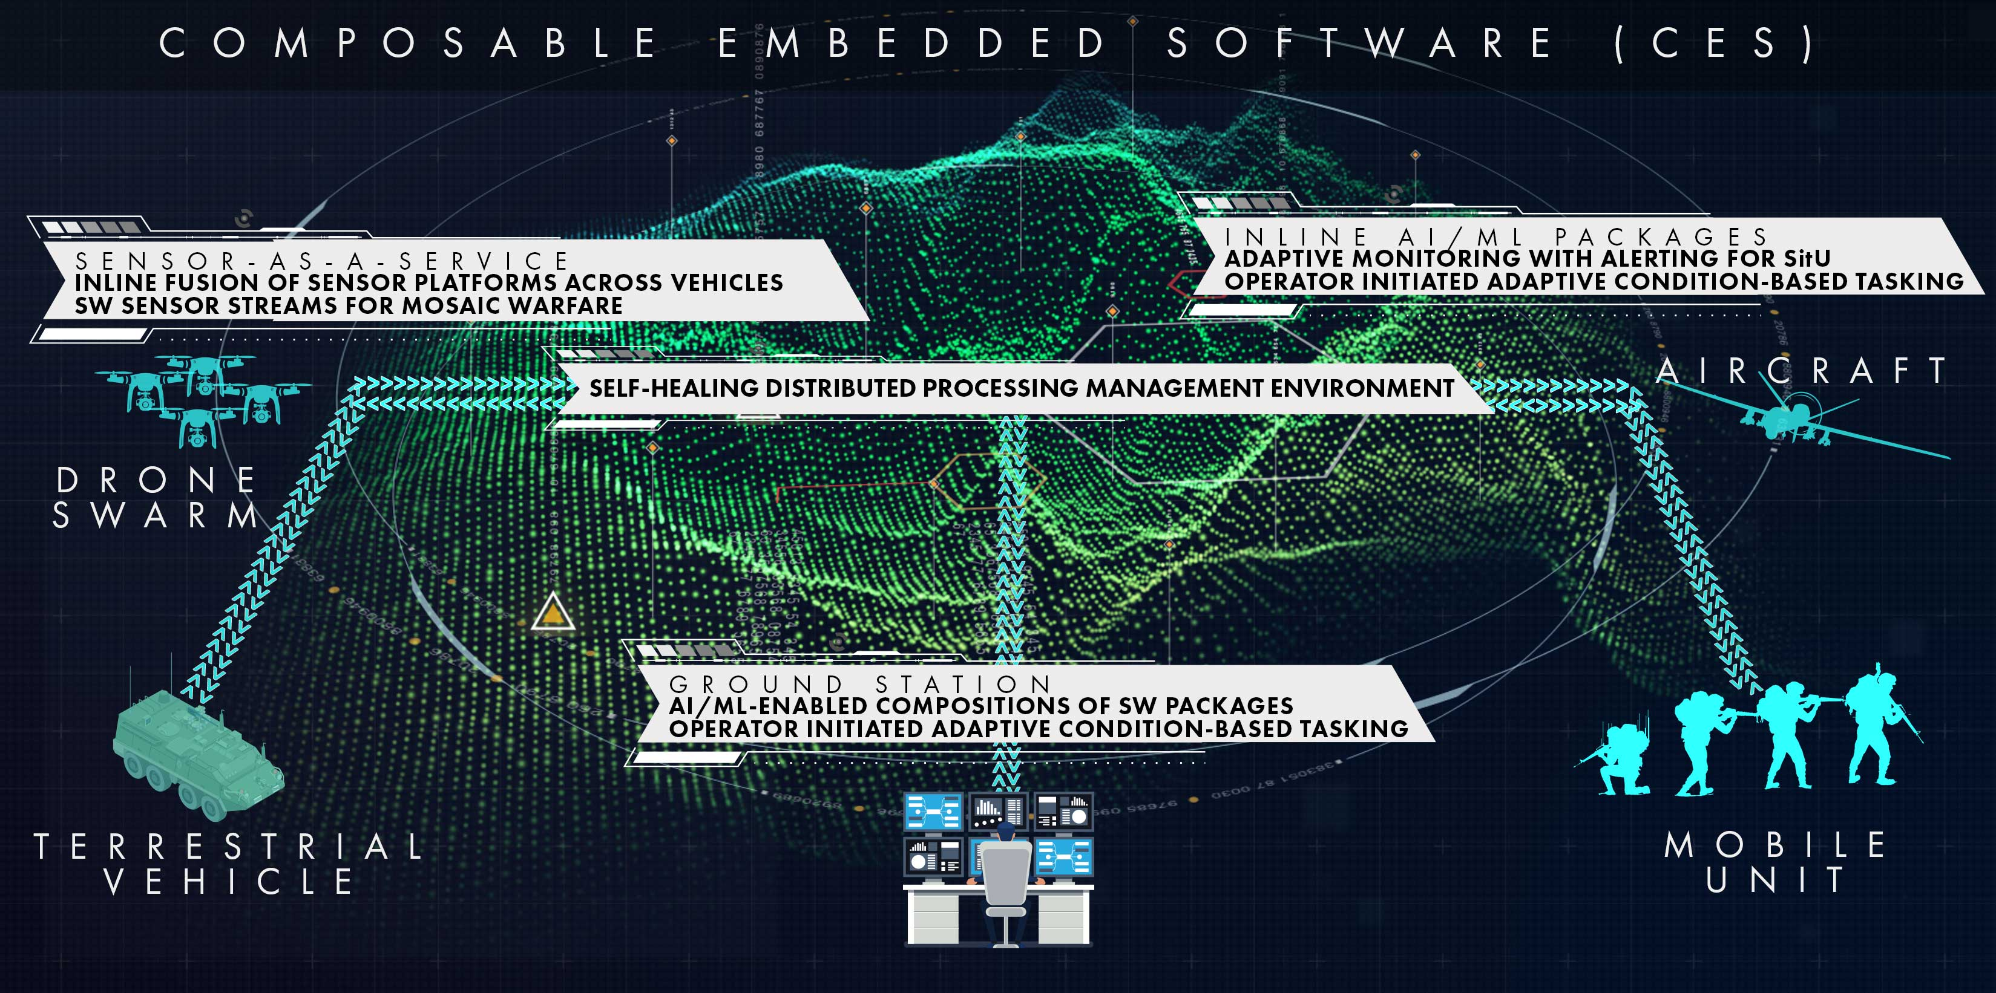
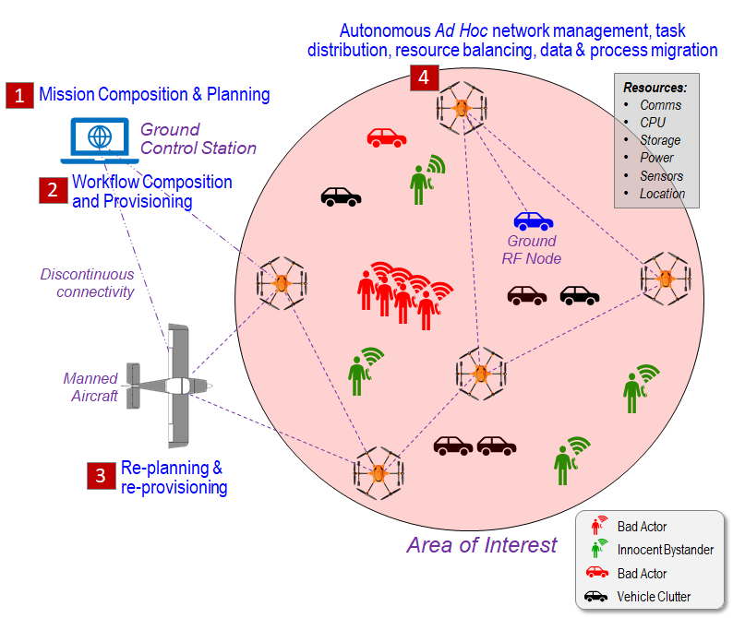
ISR Analytics Exploitation Composable Embedded Software / Multi-Observation Point ISR
Objective: SWaP-C edge sidecar delivery platform to rapidly compose and insert new capabilities, using novel approaches and software, into existing platforms (satellite, airframe, UAV, terrestrial, naval, small unit) to provide new means of integration and convergence of extraordinary responsiveness for data and decision dominance
Key Solution Objectives of Composable Embedded Software (CES)
Real-time collection and fusion of sensor / source streams made available real-time to all platforms; Synthetic/SW sensors; all sensors to all platforms to all shooters
Composable inline analytics pipelines for “speed of action”:
Situational Awareness with tailorable decluttering & exception management
Insight Generation: Topic, entity & activity correlation; Behavior characterization; Threat / attack level estimation
Sensor coverage analyses and dynamic tasking responses
Analyses of predictive and precursor threat and attack activity
Anomaly detection, dynamically initiating human-in-the-loop and automated event / conditions-driven response(s)
Dynamic Mission/Task Adaptation: Enabling tailorable automation for adjusting and/or initiating speed of action responses and recommendations to objectives, conditions, threats and/or anomaly events
Shorten the Kill Chain for Data and Decision Dominance
⇧ Speed (from months/weeks/days -> hours/minutes/seconds)
Time and Cost; Performance and Responsiveness
INLINE FUSION OF SENSOR PLATFORMS ACROSS VEHICLES
SW SENSOR STREAMS FOR MULTI-DOMAIN OPERATIONS
Stand Off
Defensive/
Offensive
Forward Base
Protection
Long Range
Stand Off
Defensive/
Offensive

Slide 3
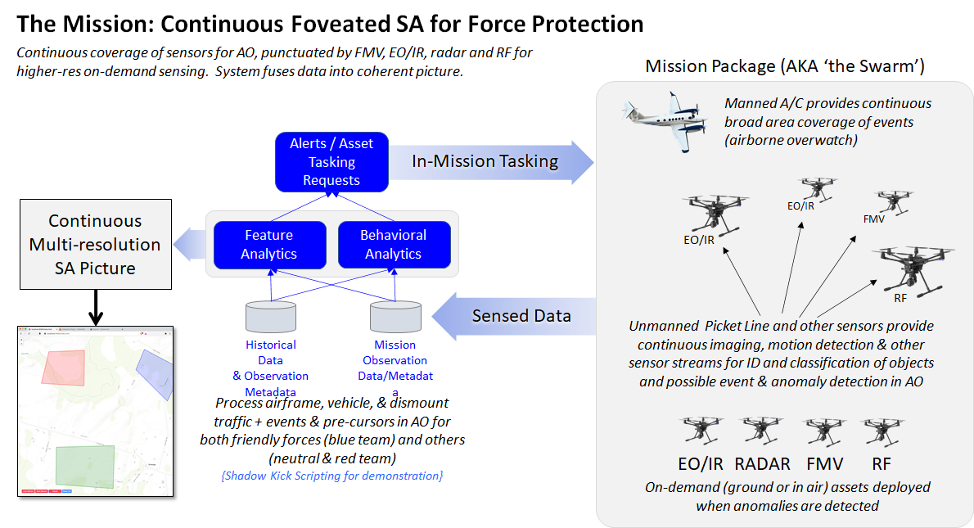
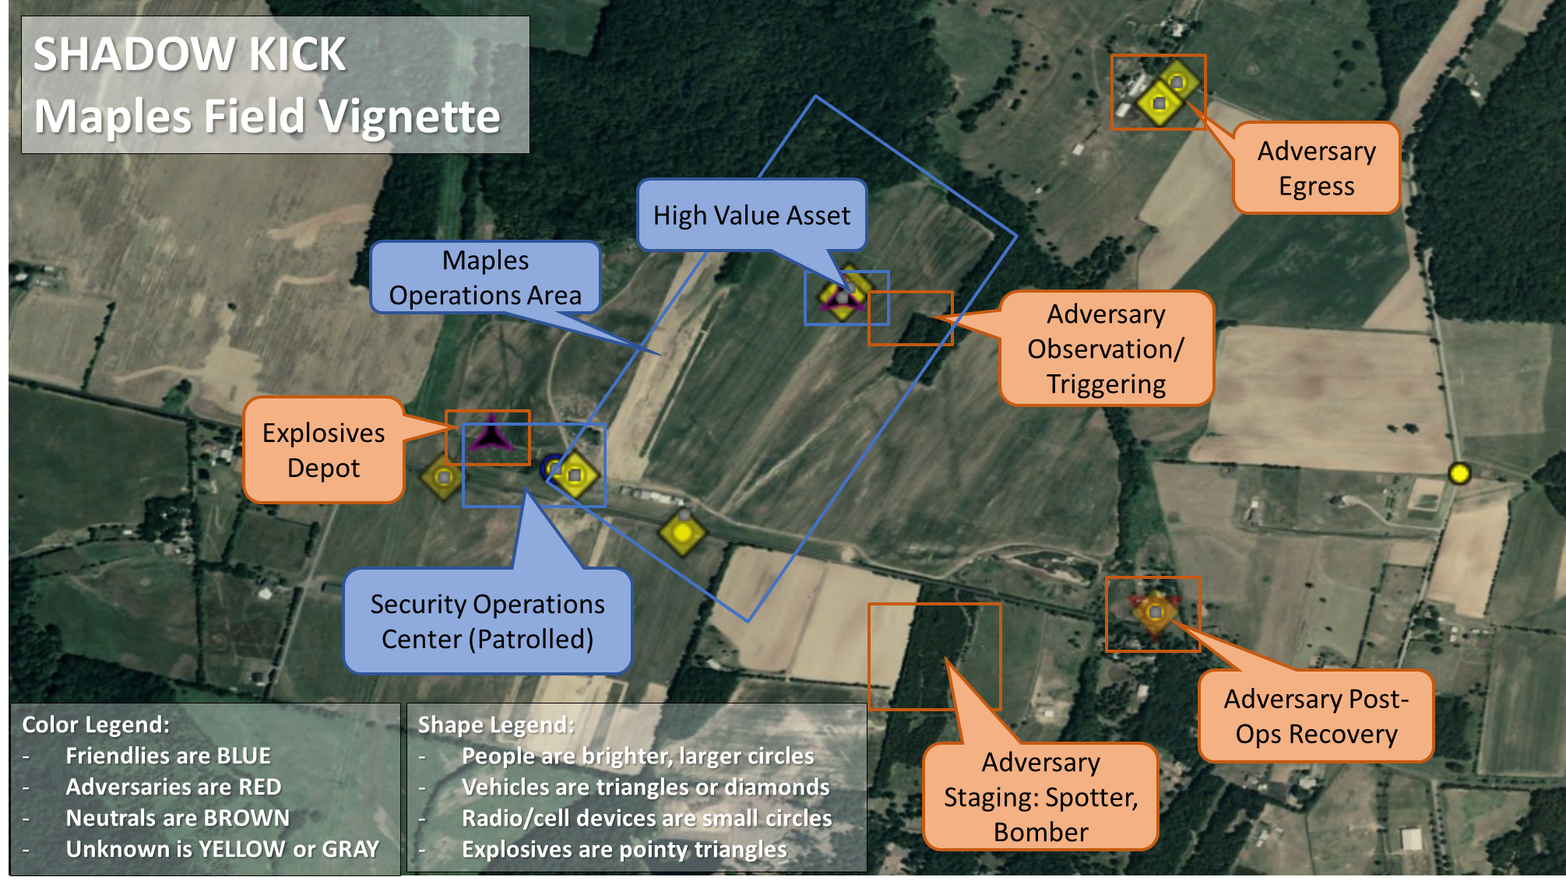
ISR Analytics Exploitation Multi-Observation Point ISR with Defensive/Offensive Response

Slide 4
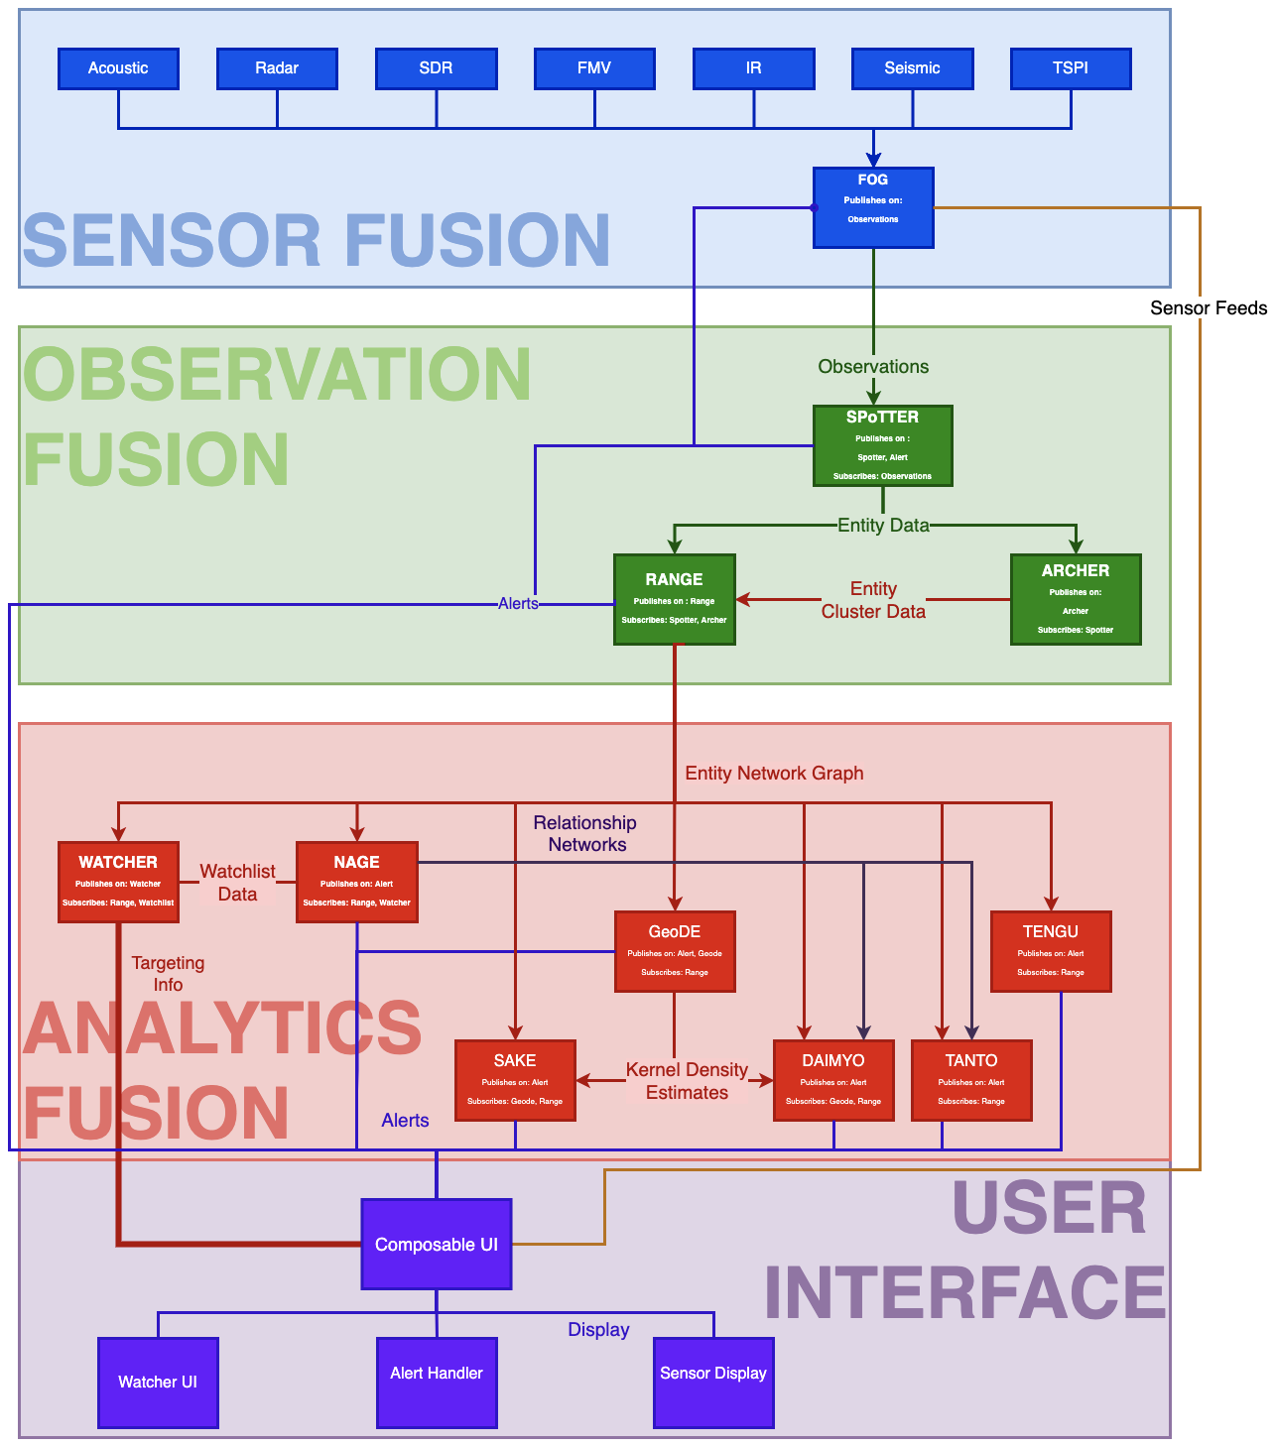
ISR Analytics Exploitation Composable Inline Analytics for ISR Collection & Response
Composable Analytics Suite
Robust, customizable supervised & unsupervised learning inline analytics framework adaptable to any environment
Achieved through lightweight analytics modules & visualization that combine
Sensor fusion (information fusion from different data and sensor feeds)
Observation fusion (integration of sensor fused data to create a holistic data series on observed entities)
Analytics fusion (the integration of different, layered analytics outputs)
over and across Observation Points
Continuously identify and correlate topics, entities/groups, assets and activity; Generate and assess behavior of observed entities
Monitor behavioral characteristics and provide behavior detection;
Threat and attack level estimation
Dynamically identify gaps in data/sensor coverage;
Recommend new mission parameters to cover potentially unobserved areas
Analyses of predictive and precursor threat and hostile activity
Insights, assessments and alerts associated with observation points
Automated detection and highlighting of conditions, threats, & anomalies
Conditions / Event-driven human-in-the-loop and automated response(s
Situational awareness and Estimation iN the Sensing
Environment Using Intelligent analytics (SENSEI)

Slide 5
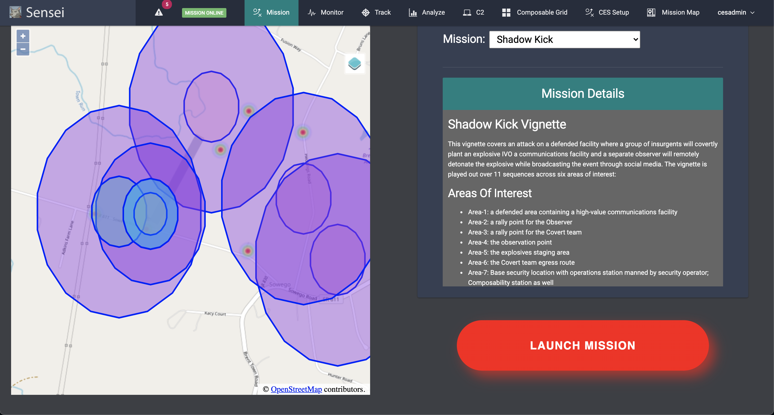
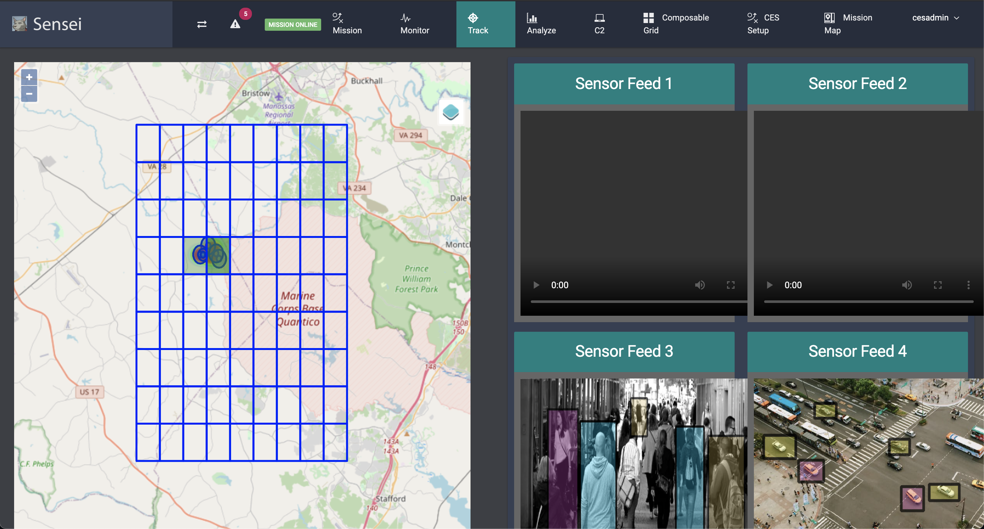
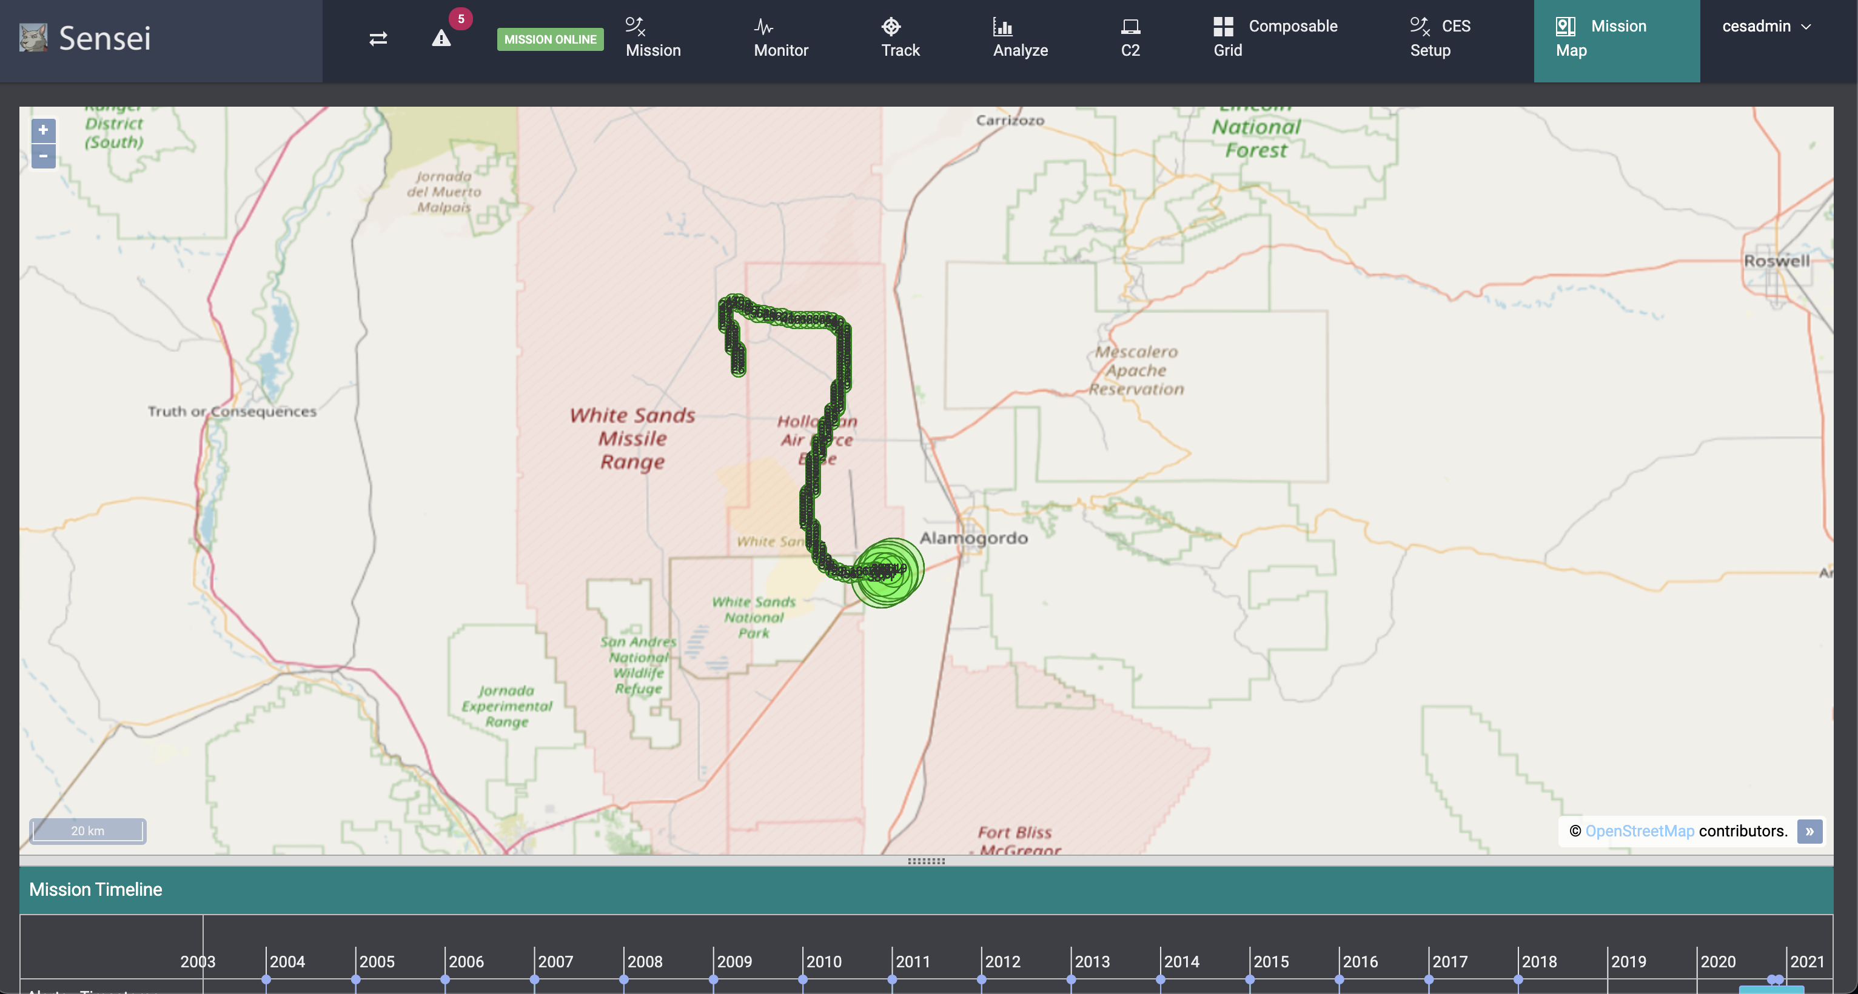
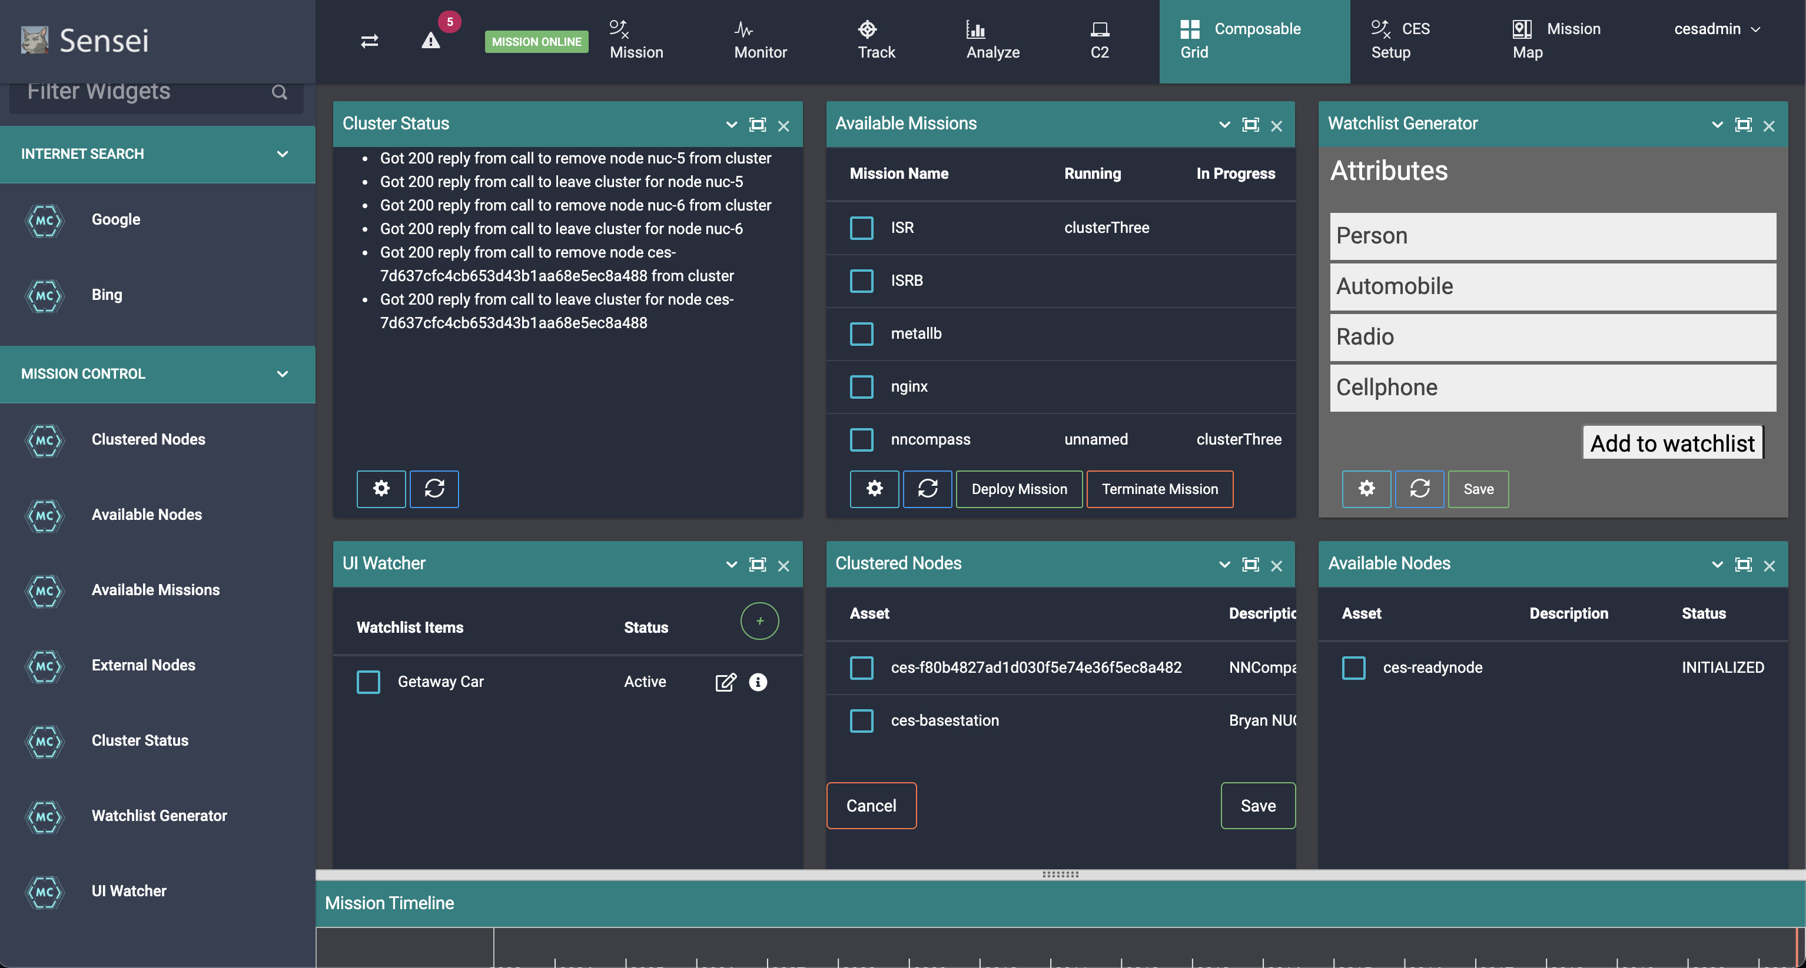
ISR Analytics Exploitation Composable Operator UI
Intelligent Operator UI – Composable at start-up & completely configurable on the fly
Multiple UI views, per Operator desire, for human monitoring and response to “mission(s)”
Intelligent notifications in window(s) and addition of new windows based on alert automation
Human-in-the-loop to fully automated responses – configured to conditions, threat & anomalies

Slide 6
ISR Analytics Exploitation Composable Embedded Software (CES) Architecture for ISR, Defensive & Offensive Fusion & Response
Notional CES Architecture for Continuous ISR Assessment & Response (OODA Loop)

Slide 7
ISR Analytics Exploitation Multi-Observation Point ISR with Defense & Offensive Assessment
Depiction of Sequence / Movement of Parties across AoIs
Seq 1: A facility in Area-1 is patrolled on-foot by one security officer. The facility uses several radio feeds; the security officer has a cell phone and radio. Airframe(s) patrol the Base AOR. Airframe(s) collect and store sensor data from patrols to aid in building patterns of life and boundary norms for anomaly determination over time.
Seq 2: The Observer is staged at Area-2 on-foot with an active cell phone and remote detonator.
Seq 3: The Observer transitions to Area-4 and begins posting to social media.
Seq 4: The Covert team is staged at Area-3 in a vehicle with three operatives and an explosive. The two operatives have cell phones.
Seq 5: The Covert team transitions to Area-5 by car and unloads the explosive for placement.
Seq 6: The security officer moves to a position in Area-1 that creates a blindspot for the Covert team.
Seq 7: Two operatives of the Covert team move on foot from Area-5.
into the Area-1 blindspot, place the explosive, and arm it.
Seq 8: The two operatives redeploy from Area-1 to Area-5 on foot. An operator signals the Observer that the device is set.
Seq 9: The Observer remotely detonates the device (via radio), heavily damaging the facility. Several videos of the explosion are posted and circulate online. Detonation identified by patrol airframes and generates an alert to base station (and initiates automated disaster recovery ISR airframe mission to view damage and identify if entities remain in the damage area for determining disaster recovery actions).
Seq 10: The Covert team hastily departs Area-5 by vehicle away from the AOR.
Seq 11: The Observer hastily escapes the area towards Area-2 leaving the detonator at Area-4.

Slide 8
Demonstration

