Slide 1
Automation of Legacy Test Systems
July 14, 2021
Dennis Shen

Slide 2
Agenda
Why Automation?
Integrated Support Station (ISS) System and History
Challenges and Approaches to Automation
ISS Automation Overview
Questions

Slide 3
Why Automation?
Time is Money
Confidence in Consistency
Documentation Driven
Automating repeatable tasks is an upfront investment with long-term dividends
Automated tests perform deterministic actions ensuring repeatability of testing
Can provide self-building documentation that ensures engineers are provided to properly investigate, repeat, and diagnose the issue
Notes:
For Managers – Cost savings, less time spent repeating tasks
For Engineers – Less time building documentation, more time figuring out why it broke
Repeatable results vital to testing capabilities

Slide 4
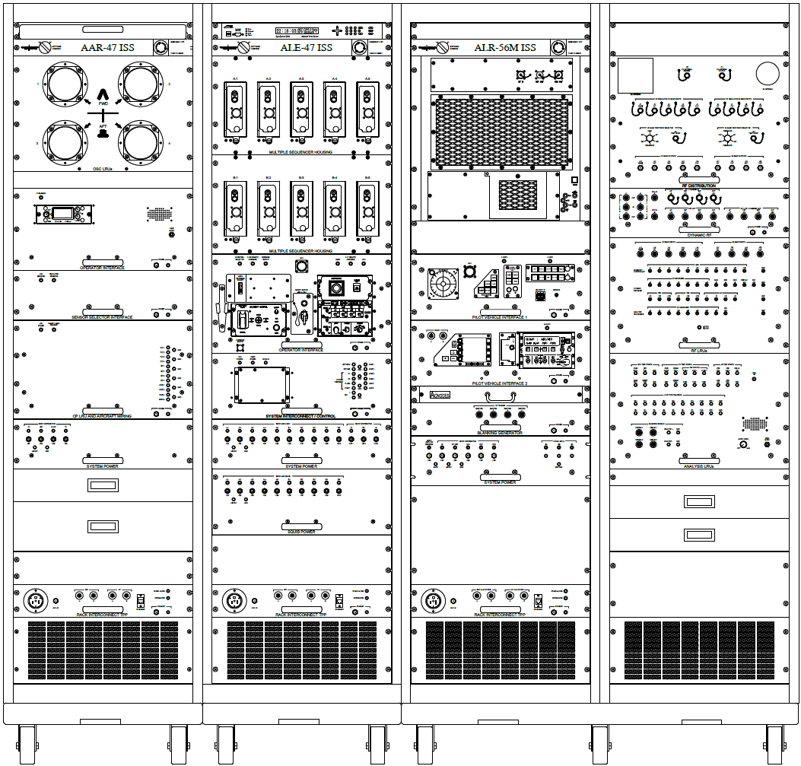
The System Under Test
Integrated Support Stations (ISS) consists of Hardware in the Loop testing of 3 systems
Missile Warning System
Countermeasures Dispensing System
Radar Warning Receiver
Perform Testing, Verification, and Validation of systems and programs prior to flight tests
Custom solutions for specific test environments
Notes:
ISS consists of 3 systems, MWS, CMDS, RWR
Representative picture on the slide
Built to perform testing, V&V, and programs for those systems
Each ISS is custom built to address the systems/platforms/needs of the end user

Slide 5
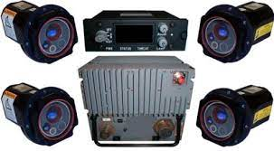
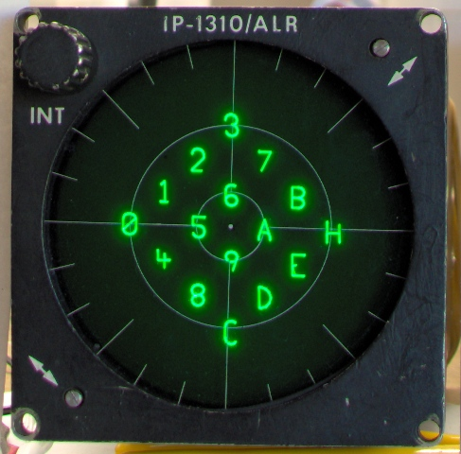
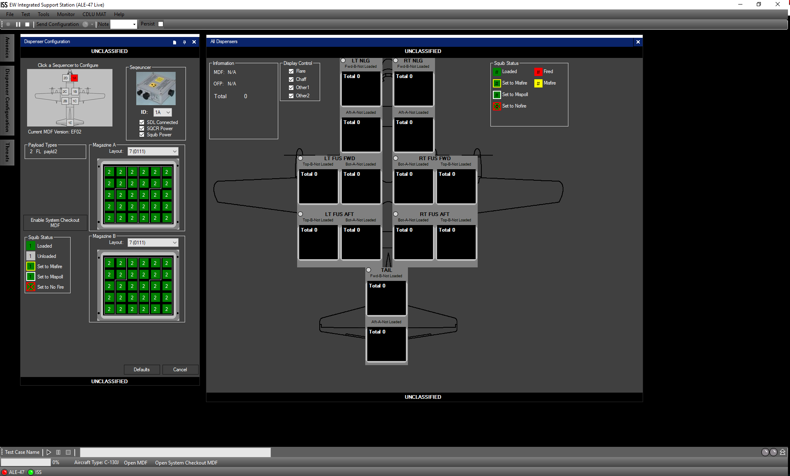
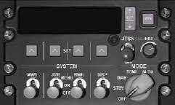
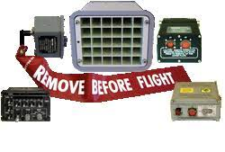
ISS History
Initial ISS’s delivered in 2003
Currently 20-30 are in the field
Each ISS utilizes common software (ISS Core) and hardware
Each ISS is tailored towards needs of specific implementation
Notes:
ISS’s have been in the field since 2003. Currently about 20-30 in the field being used.
Each of these utilize common HW components and a common SW base.
However, each of these ISS’s have custom parts that may be unique to that implementation.

Slide 6
Challenges to Adopting Automation
User trust
User buy in
Ensure reliability
Maintaining consistency
Design and implementation
Into existing architecture
Building around existing test assets
Automation
Notes:
Quick overview, get through this slide.
The picture on the right shows what could happen if you try to shoehorn in automation.
A solid wall starts to show some cracks and gaps.

Slide 7
User Trust – Buy In
Users are familiar with the system already
Changes must be agreed upon by all
Benefits
Hands on Demos, Mock-ups of capabilities
Easier Repeatability of tests
Possibilities
Overall process and test improvements
Better and easier regression tests
Familiarity
Notes:
Familiarity –
Don’t have to resell system, can emphasize improvements and additional capabilities
Any changes can be met with resistance of “it works”, must pitch in a way to get buy in from all
Show how this can improve the current process
Benefits –
See benefits of Automation for earlier
Identify areas of concern that can be addressed by automation
Always had questions about repeatability, better defined test processes
Demos and Mockups to put features in front of the user.
Get better feedback to tailor the solution
Users can see what they are getting
Possibilities
Better testing, both live and regression
Can demonstrate what is possible, not everyone using the system is a sw/hw engineer. Good way of introducing what is in the realm of the possible

Slide 8
User Trust - Reliability
Capabilities
Logging
Error Handling
Reliability
Capabilities
Expansion on current capabilities
Tests must be repeatable with same/similar results
Error Handling
Handle any errors that may occur
Include recovery capabilities
Remote Server
Logging
Log all events that occur in a test
Useful logs for the user
Notes:
Capabilities
System must still operate in the same way in manual mode
Lose trust if they get automation, but can’t test XYZ
Tests must be repeatable
Small things change between runs, but if user does X and expects Y, it should do that consistently
Error Handling
Must handle error conditions as they occur
If something doesn’t turn on, log so user can investigate further, failure of test system? Or system itself
If possible, have recovery options
Continue on?
Our design decision was to continue the test while logging all errors/warnings
Also, run from a remote server, so if the software closes, we maintain a log of that event to hopefully reproduce
Logging
Test Log of what happened to come out
Helps with error handling
Sanity Check, Proof that test was run as expected
Manual Testing for repeatability
Outputs should be useful to the user
Use to run as a manual test
Human readable to identify what happened, or use as V&V

Slide 9
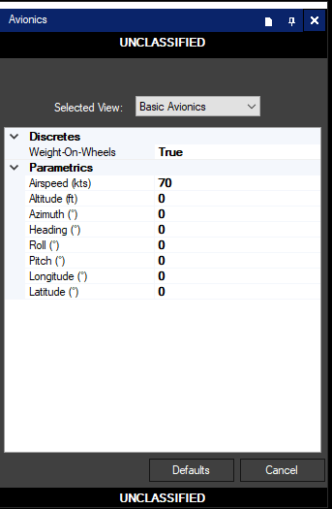
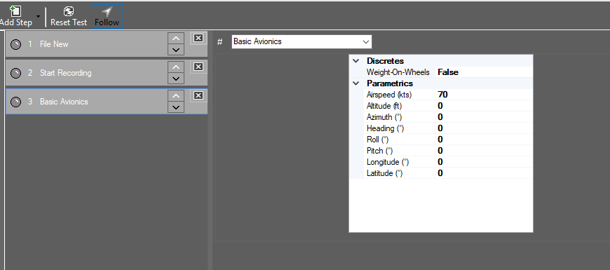
Consistency
Systems Under Test are complicated
Lots of training on the system, and lots of training on the test tools
Familiarity can help adoption and ease transition
Reduce learning curve
Can be used as future training tools for the system and test environment
Notes:
Complicated Systems
These are complicated systems that require a lot of training
Tools use for test are also complicated and may require training as well
Users are already familiar with the SIL and test SW, try to utilize as much as possible
Familiarity
Users have been using these for years
Reduce the learning curve as much as possible
Can ease user concerns and increase adoption rate
Can be used as a training tool for new users

Slide 10
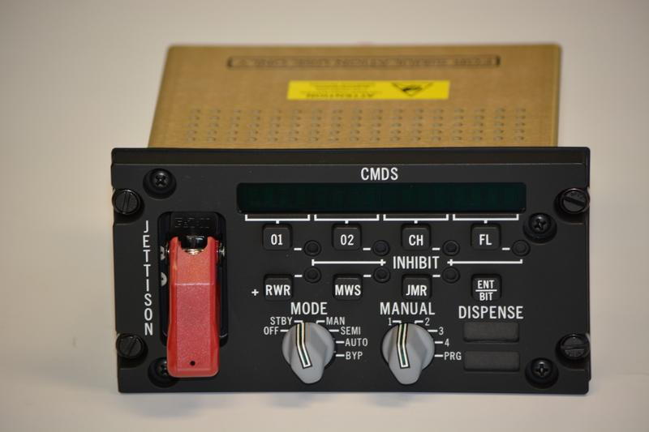
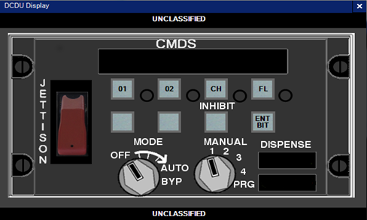
Design and Implementation – Around Existing Assets
Existing test environment must be utilized
Already paid for, and familiar to the user
Original design may not account for automation
How to handle actions that require operator
Can replace with simulations, but another sell to the user
Could be contrary to original intent
Notes:
Assets already exist
Already paid for and exisiting
Tying back to consistency these systems have been in use for a long time
Often designs may not have thought ahead to automation
Original designs from 2003, improvements made through the years, but not a lot towards automation
Work into existing architecture and design
Certain items may not have solutions
E.g., some ISS’s have physical switch components. These cannot be automated via sw
Simulations are a possible solution, but depending on the use case may not be acceptable
Current solution if required is to have a “wait for input step”, not perfect, trade-offs must be considered
So far no one has accepted our “build a robot arm” proposal

Slide 11
Design and Implementation - Architecture
Frameworks
LambdaTest
Selenium
Robot Framework
GTRI Automation Framework
Identify methodologies and framework
GUI based, too many unique implementations
GTRI Framework, too much time on development
Robot + GTRI Framework, addressed needs and provided flexibility
Application to Architecture
Must address needs of (specific) users
Notes:
Frameworks
Each have their pros/cons
GUI Based did not work for us
Must identify by names/locations
Too many programs with different UI layouts, types.
Too many coders, tried to enforce coding standards/styles, but inevitably there’s one or two panels that don’t work.
Own developed solution did not work
Too much time spent developing/testing
Nothing to show users, not a lot of confidence in output product
Ultimately decided on combination of Robot and self developed
Keywords gave us flexibility across all the different programs, which maintaining a solid base
Gave us the recovery capabilities with the remote execution server
Decisions must be made on what exists currently
Had to account for multiple iterations of ISS

Slide 12
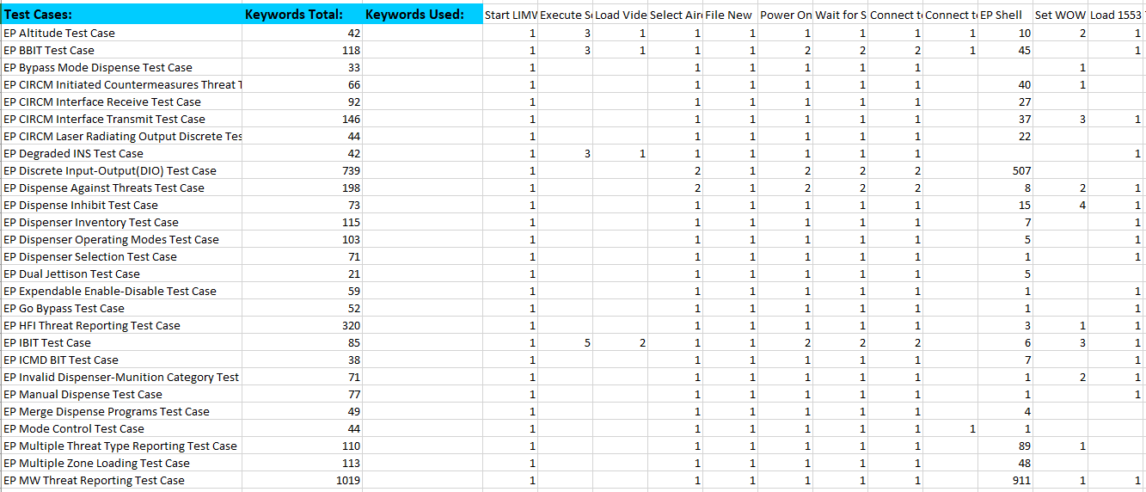
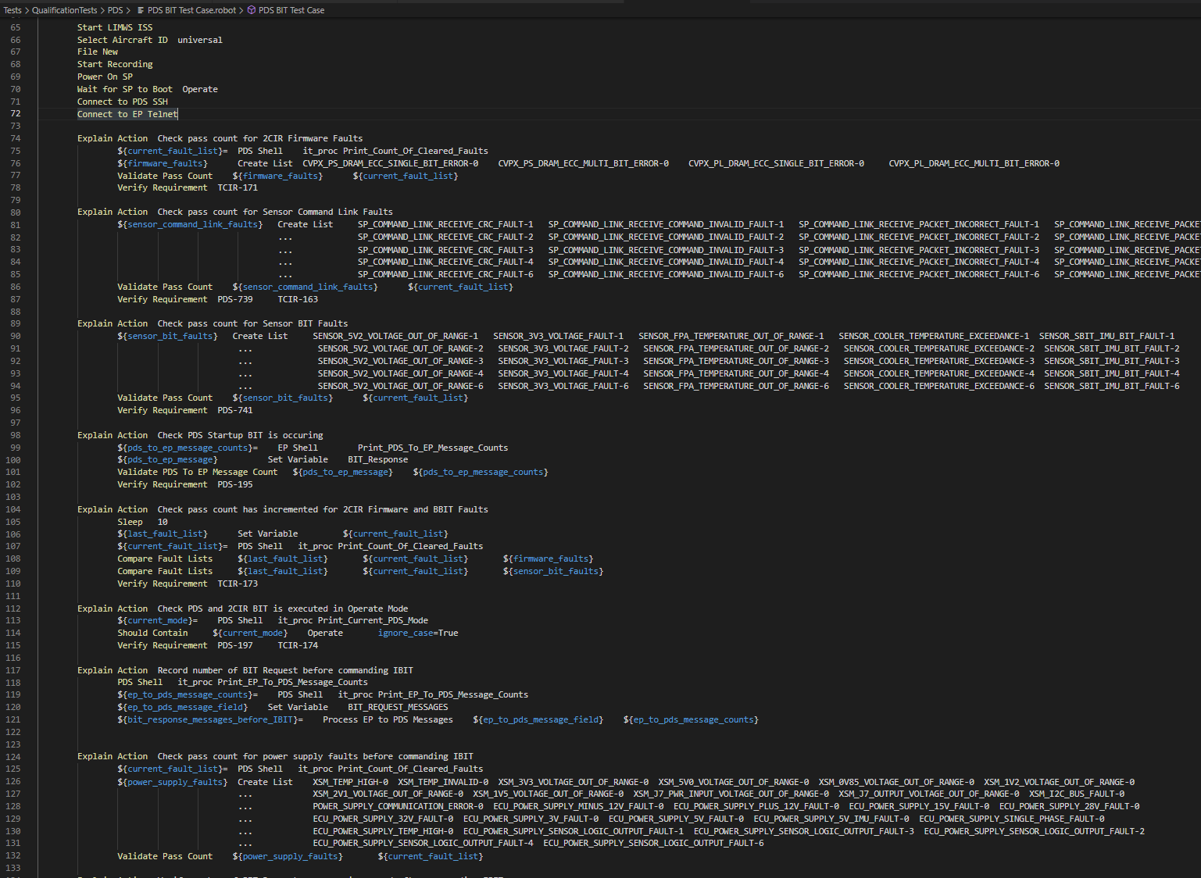
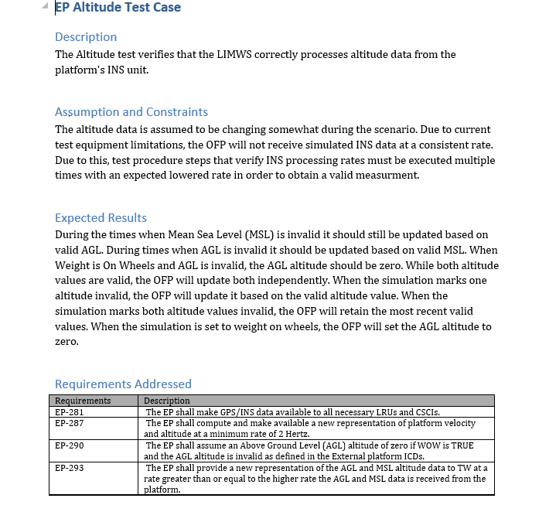
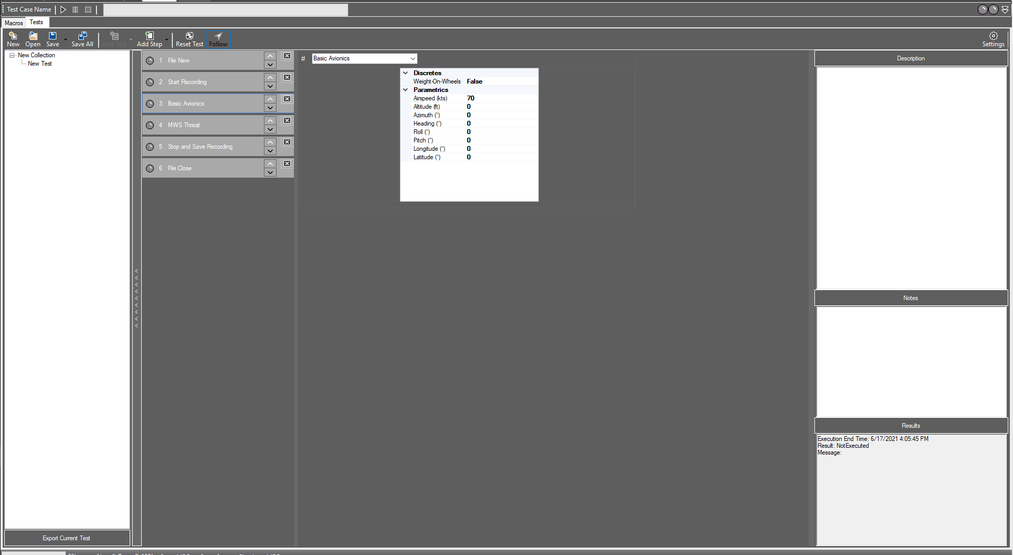
ISS Automation Implementation
Written Scripts
Logged Results and Outputs
Remote Execution Server
GUI Scripts
ISS Under Test
Notes:
Talk through the process
Green – Inputs
Written Scripts
Used by users that want to write things themselves
Utilizing Robot keywords
GUI Scripts
Utilizes the GUI elements that users are familiar with
Will generate the written out script for save/loading
Blue – Execution
Remote Execution Server
Takes in tests/test collections
Runs against the ISS SW/HW
Logs commands and outputs of the system
Gold – Logging and Outputs
Documentation
Human readable (and executable) test procedures with results
Can be tailored to match an Output log format
Details execution for that test
Rollup Summary
Contains a high level summary of the test collection that was run.
Will identify high level errors, details will be in the above output tests

Slide 13
Conclusion
Automation is a powerful tool that can be used in T&E environments
Legacy T&E Systems provide unique challenges when adopting automation
On one program, Qualification testing went from ~120 hours to ~35 hours
These challenges can be overcome by:
User Buy In
Ensuring Reliability
Maintaining Consistency
Utilizing Existing Assets
Careful Design and Architecture
Notes:
Powerful too automation is.
QTD for a program went from about 3 weeks, to 1 week. Huge time savings.
Utilized overnight testing as well, just check the results in the morning.
These time savings will be dependent on whoever is accepting.
Overcame the challenges with the items we talked about today.

Slide 14
Acknowledgements
Thanks and Acknowledgements:
Josh Deremer
Chris Henderson
Dontel Newton
Jovan Munroe
Philip Reese
David Zurn

Slide 15
Questions?
Contact Information
Dennis Shen, GTRI
dennis.shen@gtri.gatech.edu

