Slide 1
Command, Control, Communications, Computers, and Intelligence & Software Intensive Systems Test (C4T) Synthetic Data Generation & Assessment Infrastructure
(C4T Data Lake)

Slide 2
Agenda
Test Resources Management Center (TRMC) Guidance
Synthetic Data Generation Overview
C4T Synthetic Data Use Cases
C4T Synthetic Data Generation

Slide 3
TRMC Guidance

Slide 4
TRMC BDA Software Architecture
C4T Project performer product architectures should align with this Software Architecture

Slide 5
Cloud Hybrid Edge-to-Enterprise Evaluation & Test Analysis Suite (CHEETAS) 3.0

Slide 6
Synthetic Data Generation Overview

Slide 7
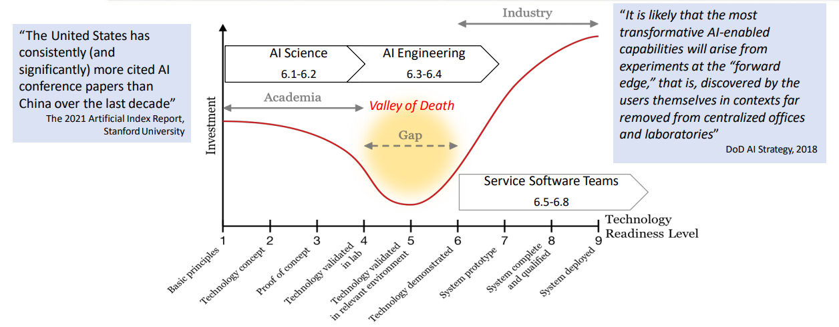
Joint Artificial Intelligence Center (JAIC) Valley of Death for AI Technology
“The United Stated has consistently (and significantly) more AI conference papers (which are also more heavily cited) than China over the last decade.”
The 2021 Artificial Index Report, Stanford University

Slide 8
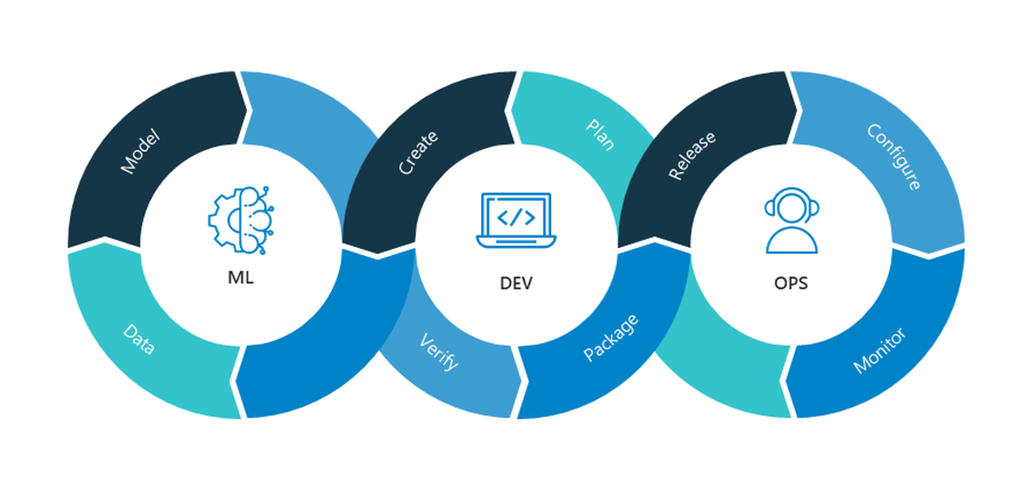
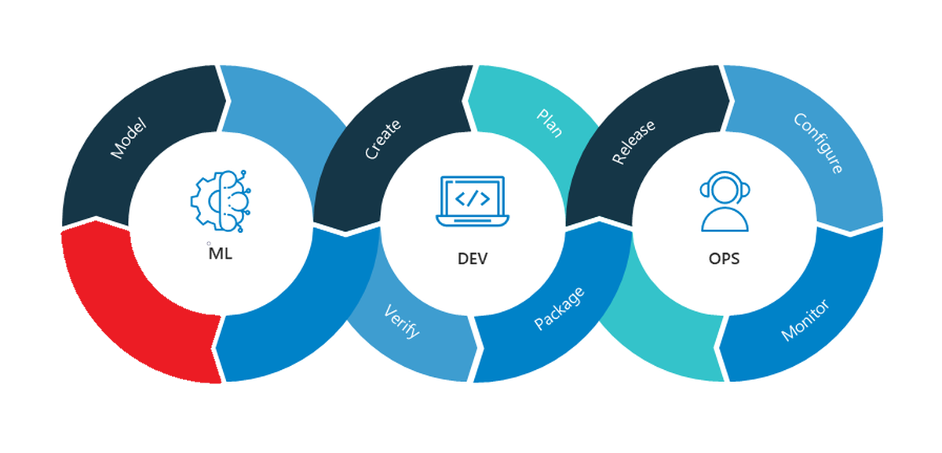
Synthetic Data Enable Machine Learning Development Operations (ML DEV OPS)
IDEAL
REALITY
Machine Learning Dev Ops
To apply machine learning effectively into operations it needs to be part of the DevOps Pipeline
The Problem
In the 6.1-6.4 investments there is a lack of Unclassified data provided to performers
The Solution
Synthetic data that has characteristics of data that is provided in 6.5-6.8 investments
Notes:
Lack of Date Ownership
Unclassified Data to performers
Lots of Data not a lot of Unclassified data

Slide 9
Types of Synthetic Data
Artificial data is produced by an explicit probabilistic model via sampling
Data built by sampling model
Restricted by expert domain knowledge
ML techniques not used to build model
Synthetic data is produced by a learned generative model of original data
Uses Data to build an ML model
Model represents original data
Deep learning improves the generated data
Model
Model
Artificial Data
Original Data
Synthetic Data

Slide 10
Successful Example of Synthetic Data Use in Sensors
Toyota Research Institute (TRI): Learning to Track with Object Permanence
Conclusions
Certain problems only solvable with synthetic data
Synthetic data coupled with real data can outperform other approaches
The DoD has several GOTS products that can enable synthetic and artificial data approaches
Problem: Tracking by detection
Strongly depends on the quality of instantaneous observations
Human performance of object permanence:
Once an object is recognized we are aware of its physical existence
Can approximately localize it even under full occlusions.
Approach:
Use large-scale, synthetic dataset for multi-object tracking, which provides ground truth annotations for invisible objects,
Fails when objects are not fully visible
TRI trained jointly on synthetic and real data to outperform benchmarking datasets

Slide 11
Synthetic Data Benefits
Scalability
Lower cost
Automated Labeling
Less annotation mistakes than manually labeled data
Variability
Various weather conditions
Balance Data with edge cases
Generate variations of test events
Experimentation
Rapid experimentation for new algorithms from data diversity
Ground testing new sensors
Enables state information for Reinforced Learning
Programmatic
Does not require high level of classification
Can lower risk of high-risk data collection
Can solve problems like object permanence

Slide 12
C4T Synthetic Data Use Cases

Slide 13
Vision of Synthetic Data Generation From Data Model for T&E Events
C4T sits on the edge of a revolution
in analysis procedures for the ranges and DoD Labs
A test event is defined
A SUT data model of the test event will be constructed using a collection of individual models
The data model will be applied to the test event
The T&E analyst will be focused on the analysis of data anomalies and across tests trends
Notes:
The event maybe a simple one time stress of the SUT or multiple steps within a larger more complex operational based test.
The SUT data model be constructed using synthetic data from a previous event or from artificial data
Meta-data to drive BDA will be defined
Data wrangling/ingestion standards from CHEETAS
Data that differs form the data model will be highlighted as anomalous
As the data model matures it will be automatically applied to the current test data and also across a range of previous tests.

Slide 14
Synthetic Data Generation From Data Model T&E Use Case
C4T’s Data lake is focused on creating the technology base to support Data Model creation satisfying the following criteria to be adequate (TRL 4/6) for Transition to the Ranges.
Sensitive to the expected variances in data values of the test event
Scalable to large amounts of data
Operate using data formats of either range collectors or analyst

Slide 15
The Importance of “Real Data Content” to C4T Projects
C4T projects
Methods to develop the NN vary from project to project
C4T must Validate the NN technology the project developed
Validated models must have tests run with Range databases that represent “clean data” and “anomalous data”.
Based on various forms of Neural Net (NN) Technology
“Data Model” produced by many projects is a complex NN
Validate the NN technology data models are range useful prototypes
Validated models must be trained on data representative of expected range collected data

Slide 16
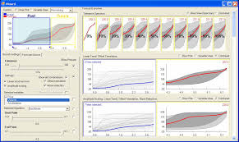
Multi-Platform Target Location Error (TLE) Analysis T&E S&T BDA Use Case
Goal
Problem Statement
Data
T&E S&T Technology Needs
The Project will accurately analyze target location errors (TLE) shared across multiple platforms in order to reduce the current intensive manual analysis task.
Aircraft systems lethality is highly dependent on interoperable datalinks, radios, and sensors
Data sets with 25+ aircraft spanning 7+ different aircraft types that contribute to the TLE of 4+ targets at any given time, over 2+ hours of data collection
Parallel analysis and comparison of reported target locations v. ‘truth’ across advanced sensor data – data is shared and manipulated over radios and data links
Analyzing target location errors (TLE) shared across multiple platforms is a manpower intensive task
The targets can be aircraft, stationary ground targets, or ground movers. All targets have ‘truth’ data (time-tagged location data).
The data sets of interest are all classified
Some tool development currently exists at the unclassified level and is then tested against real data, but this adds time to the process.
A scalable adaptable algorithm should be applied to the post-test data analysis and be capable of easily incorporating new sources of information, such as new sensors or aircraft
Platform A
Target Location A
Target
Target Location B
Platform B
Platform TSPI + Target Logs

Slide 17
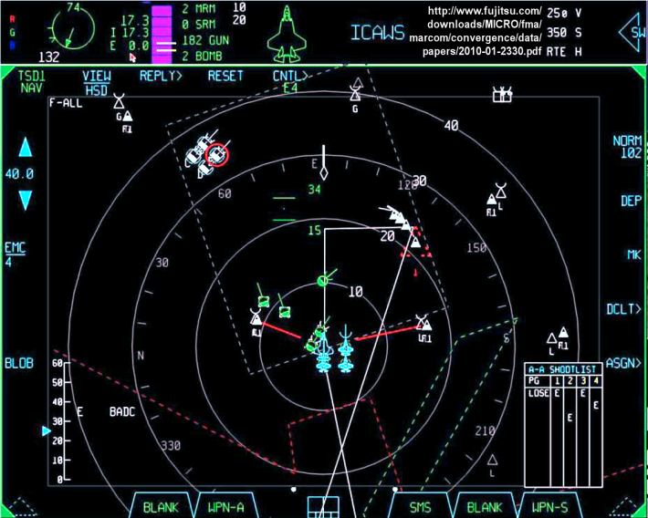
Accelerate Post-Test Analysis for Platform Tactical Situation Display (TSD) T&E S&T BDA Use Case
Goal
Problem Statement
Data
T&E S&T Technology Needs:
Provide automated analytics to accurately analyze TSPI data collected across multiple sensors for a given system under test and targets (ground and or air)
Post flight video review of complex displays such as a TSD are time consuming, and for complicated tests can be incomplete due to the significant amount of information being displayed
The data sets of interest are all classified, therefore pose a potential risk
A scalable machine learning algorithm should be applied to this complex post-test data analysis challenge and be capable of incorporating new source of information
An algorithm that can identify and log symbols, and then compare them to truth data would focus the limited analysis capacity on the areas of most interest
Some tool development currently exists at the unclassified level and is then tested against real data, but this does add time to the process.
For example, if a new sensor or aircraft is included the algorithm should still be able to analyze it.

Slide 18
C4T Synthetic Data Generation

Slide 19
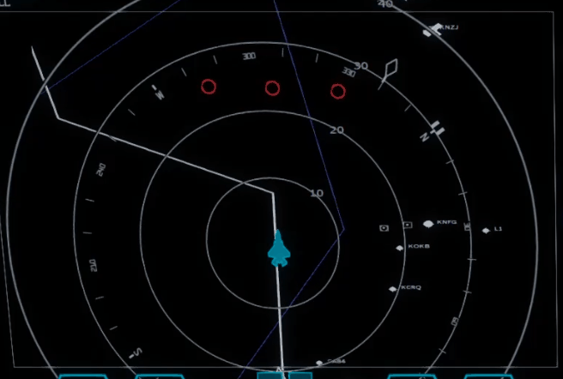
C4T Synthetic Data Generation V1
Scenario & Assets
Flight Simulator
DIS
“Truth Data”
TSD
Video
DIS Gateway 2 (Target Location Error Generator)
Platform
DIS
Data Lake

Slide 20
Synthetic Data Generation Simulation Component
Next Generation Threat System
Modeling and simulation environment
Classified models exist but are not used in this environment
Provides TSPI data via DIS
Truth Data provides an extensible method for synthetic data generation

Slide 21
Synthetic Data Generation Features
Features
DIS provide TSPI “truth data” of both blue and red platforms to any listening entity
DIS “Truth Data” Modification can provide over/under reporting datasets
Target Location Error (TLE) Generator will introduce TLE to Platforms
PREPAR3D can provide Tactical Situation Displays

Slide 22
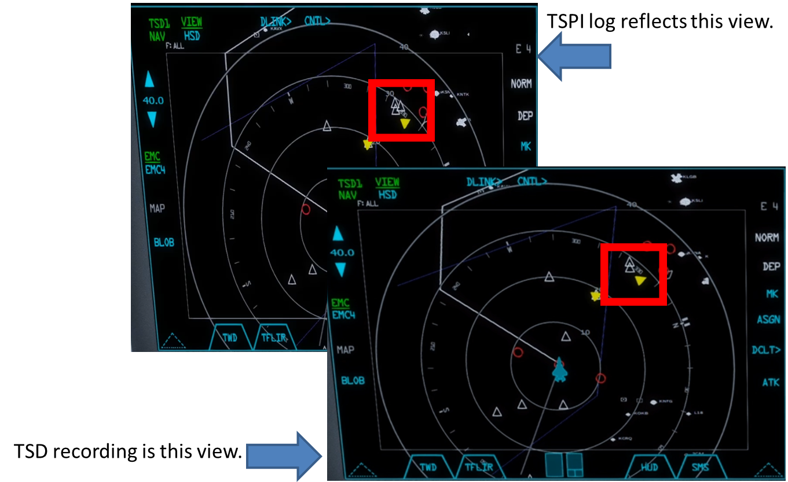
Tactical Situation Display (TSD) and Truth TSPI
Recreate “Ghost Tracks” for TSD / TSPI simulation recording.
Summary
Record TSD that correspond a pair of TSPI logs. When comparing the two, the TSD should be missing an icon that represents a track in the logs.
Acceptance Criteria
TSPI logs generated with full set of entities.
Video captured of scenario with at least one entity missing.
Work Completed
Logs captured of original scenario.
Altered scenario with one missing SAM entity recorded.

Slide 23
TLE Datasets
Create TLE for TSD / TSPI simulation recording.
Summary
Record TSD and a corresponding pair of TSPI logs. When comparing the two, the TSD should have the icons that represents a track that is not in the true location of the entity.
Acceptance Criteria
TSPI logs generated with full set of entities.
Video captured of scenario with the difference between the truth data TLE
Work Completed
Datasets recorded in lab

Slide 24
Conclusion
Synthetic Data Shows Promise
Enables better data labeling
Affordability
Produces better models
C4T Data lake Needs
Partnerships
Use Cases
Synthetic Data Users
Unclassified Data

