Slide 1
Test & Evaluation in a Multi-domain Operational Environment
“Employing a CLONE to Enhance JADC2 Testing”
CAPT Jeff Hoyle (USN, Ret.)
jhoyle@scalable-networks.com
15 July 2021

Slide 2
Agenda
Joint All Domain Command and Control (JADC2)
Comprehensive Live-Virtual-Constructive (LVC) Operational Network Environment (CLONE)
Defining, Creating and Using a JADC2 CLONE
JADC2 CLONE Mission Simulation Example

Slide 3
Joint All Domain Command and Control
Connects platforms and sensors from all Services into a single network of networks
Provides cloud-like environment for the Joint force to share intelligence, surveillance, reconnaissance and targeting data
Transmits across many communications networks to allow faster decision-making
Enables better decisions using artificial intelligence to identify targets and recommend optimal weapons—both kinetic and non-kinetic
Relies on test and evaluation of network innovations for better command and control in challenging communications environments

Slide 4
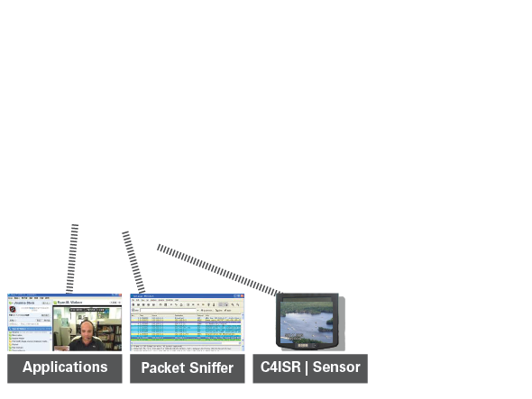
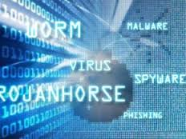
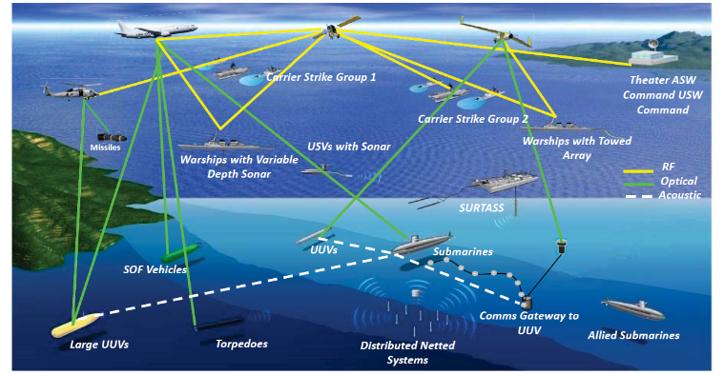
Comprehensive LVC Operational Network Environment
JADC2 CLONE
Cyber Behavior
Network Model
Environment Path loss, fading, interference, terrain, urban, weather DDIL …
Operations Mobility, , messages , mission threads, …
Live Interactions Humans, devices, applications, …
Cyber warfare Vulnerabilities, attacks, defenses, …
Accurate
Physical networks and models virtually indistinguishable
Scalable
Small live nets interoperate with large virtual nets
Real-Time/Faster
Response synchronized to live network or faster
Application- Centric
C2, Link 16,… apps
®
®

Slide 5
Defining a JADC2 CLONE – Required Characteristics
Fidelity – Captures specific configuration, topology, traffic load and dynamics at sufficient fidelity so the model can accurately reproduce the behavior of the physical network infrastructure
Ease of use – Provides ability to create a representative model using existing data sources for network topology, configuration and traffic in an automated manner using standardized formats
Scalability – Allows large number of network and infrastructure devices to be included with the ability to emulate end-to-end traffic transmission
Comprehensive device and cyber models – Includes rich set of pre-constructed device models so it can be configured and assessed rapidly
Live/Virtual/Constructive – Enables integration with live software (e.g. network manager) and/or live traffic to assess realistic operational scenarios as well as integration live hardware components for testing

Slide 6
Creating a JADC2 CLONE – Three Components
Network Digital Twin – Combine a rich set of military and commercial network and communication models to emulate JADC2 network of networks
Real-Time Interfaces - Connect the JADC2 CLONE with other relevant live or simulated components (for example, tactical radios, sensors and applications such as MIDS JTRS and/or mission simulators such as OneSAF, AFSIM and NGTS)
Cyber/Electronic Warfare (EW) Models – Provide a comprehensive library of live or simulated models of relevant cyber and EW attacks and defenses (e.g., malware, man-in-the-middle, jamming, frequency hopping, LPI/LPD, etc.).

Slide 7
Using a JADC2 CLONE – Three Use Cases
Wargaming and Operational Analysis – Incorporate high fidelity cyber, communications and network simulation capability into wargaming and concept development activities to identify the most promising JADC2 solutions for investment and further development
Network Analysis and Testing – Identify detailed performance characteristics of capabilities under consideration to optimize configurations and deployments based on real-world conditions
Cyber Resiliency and Survivability – Ensure thorough assessment of JADC2 network’s ability to provide connectivity in contested environments while under constant attack by determined adversaries

Slide 8
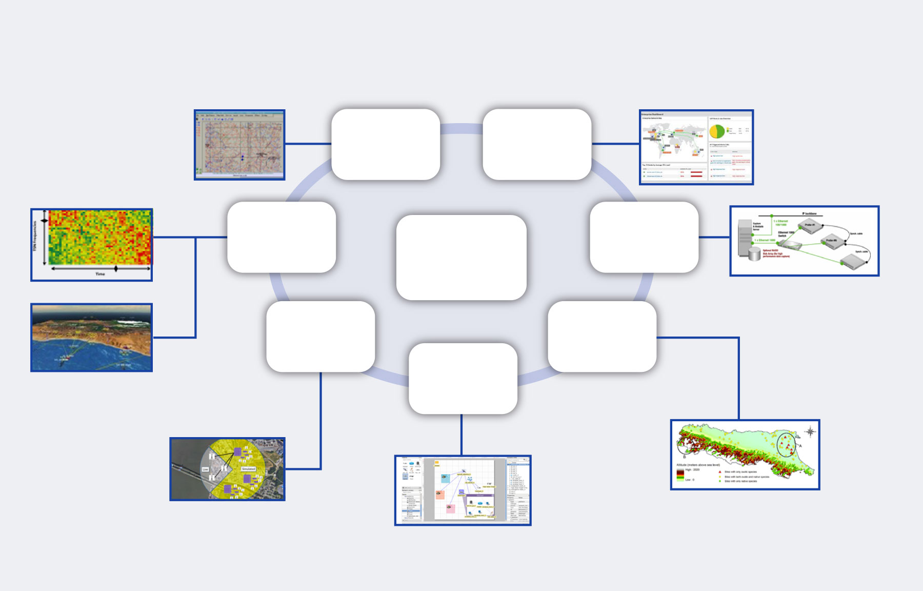
JADC2 CLONE Development/Analysis
JADC2 CLONE: (Automated) Generation & Use
Network Topology
and Traffic Import
Mobility & Traffic
Constructive Entities (e.g. SAFs)
Network Managers
StatisticsDatabase
Analysis & Visualization Portal
Network Equipment
JADC2
CLONE
Live Network Probe
and Device Configurations
External Systems
Scenario Data
Simulation Builder
Operational
Visualization
3rd Party Simulators, Applications
Define
Simulation
Experiments
Terrain, Weather, etc.

Slide 9
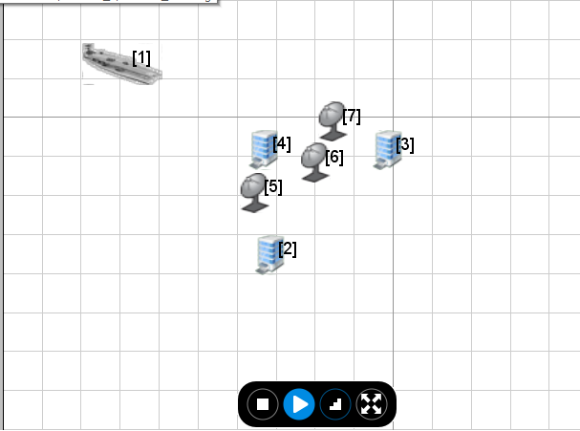
JADC2 CLONE Interface to Mission Simulators
Time advances down page
1
JADC2 CLONE
Mission Simulator
2
3
JADC2 CLONE matches unit positions and movements
Nodes share ISR&T information via JADC2 CLONE only
Communications affected by environment, propagation, jamming, etc. modeled in JADC2 CLONE
Initial Positions
2
Unit/Node movement
3
Comms Availability/Results

Slide 10
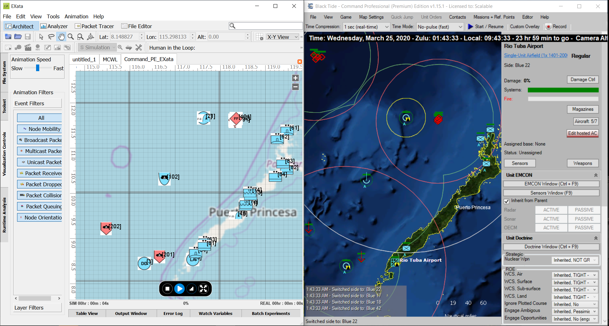
JADC2 CLONE Mission Simulation
USMC Expeditionary Advanced Base Operations in Western Pacific
Naval Strike Missile Platoons and Forward Area Refueling Platoons operating in Philippines with orders to support engaging Red surface ships detected in exclusion zones
Navy ships/aircraft and USMC F-35B’s monitoring exclusion zone
Command PE tracks and targeting information transmitted via Link-16 network in EXata
JADC2 CLONE (Link-16 Network)
EABO/DMO Mission Simulation
10

Slide 11
Current Agency and Service CLONEs
Missile Defense Agency - Overhead Persistent Enterprise Architecture Real-time Transfer Service Communications Analyzer CLONE
Army PM Tactical Networks - Integrated Tactical Network (ITN) CLONE
Army Redstone Test Center - Combat Aviation Brigade (CAB) Architecture Integration Lab (AIL) CLONE
Naval Air Warfare Center China Lake - Airborne Network CLONE
Naval Air Warfare Center Orlando – Cyber Defender Training CLONE
Navy PEO Integrated Warfare Systems - Undersea Warfare Decision Support System (USW DSS) CLONE
Marine Corps Systems Command - Marine Corps Enterprise Network CLONE
Marine Corps PM Wargaming Capability - Wargaming CLONE
Air Force Research Laboratory - Electronic Command & Control Defeat (EC2D) CLONE
CLONE approach supports JADC2 T&E across DoD

Slide 12
JADC2 CLONE Summary
Provides capability for distributed LVC multi-domain (undersea-to-space) communication and network simulations with cyber effects
Directly embeddable in or interoperable with other LVC simulators, virtual systems, ranges, and live components
Supports T&E of network innovations for better command and control in challenging communications environments

