Slide 1
Edge Infrastructure As Code
Will Lester, VP of Engineering
NexTech Solutions

Slide 2
Cloud vs. Cloud Native
Cloud Desirables:
Elasticity
Infrastructure Abstraction
Consumption-based
Scalability & Resiliency
Cloud Strategy Evolution:
“Move”, “lift & shift”, “all new workloads”
Reminded that the Edge Exists…
Cloud-to-Edge Service Projection
Cloud-Native Methodology to the Edge

Slide 3
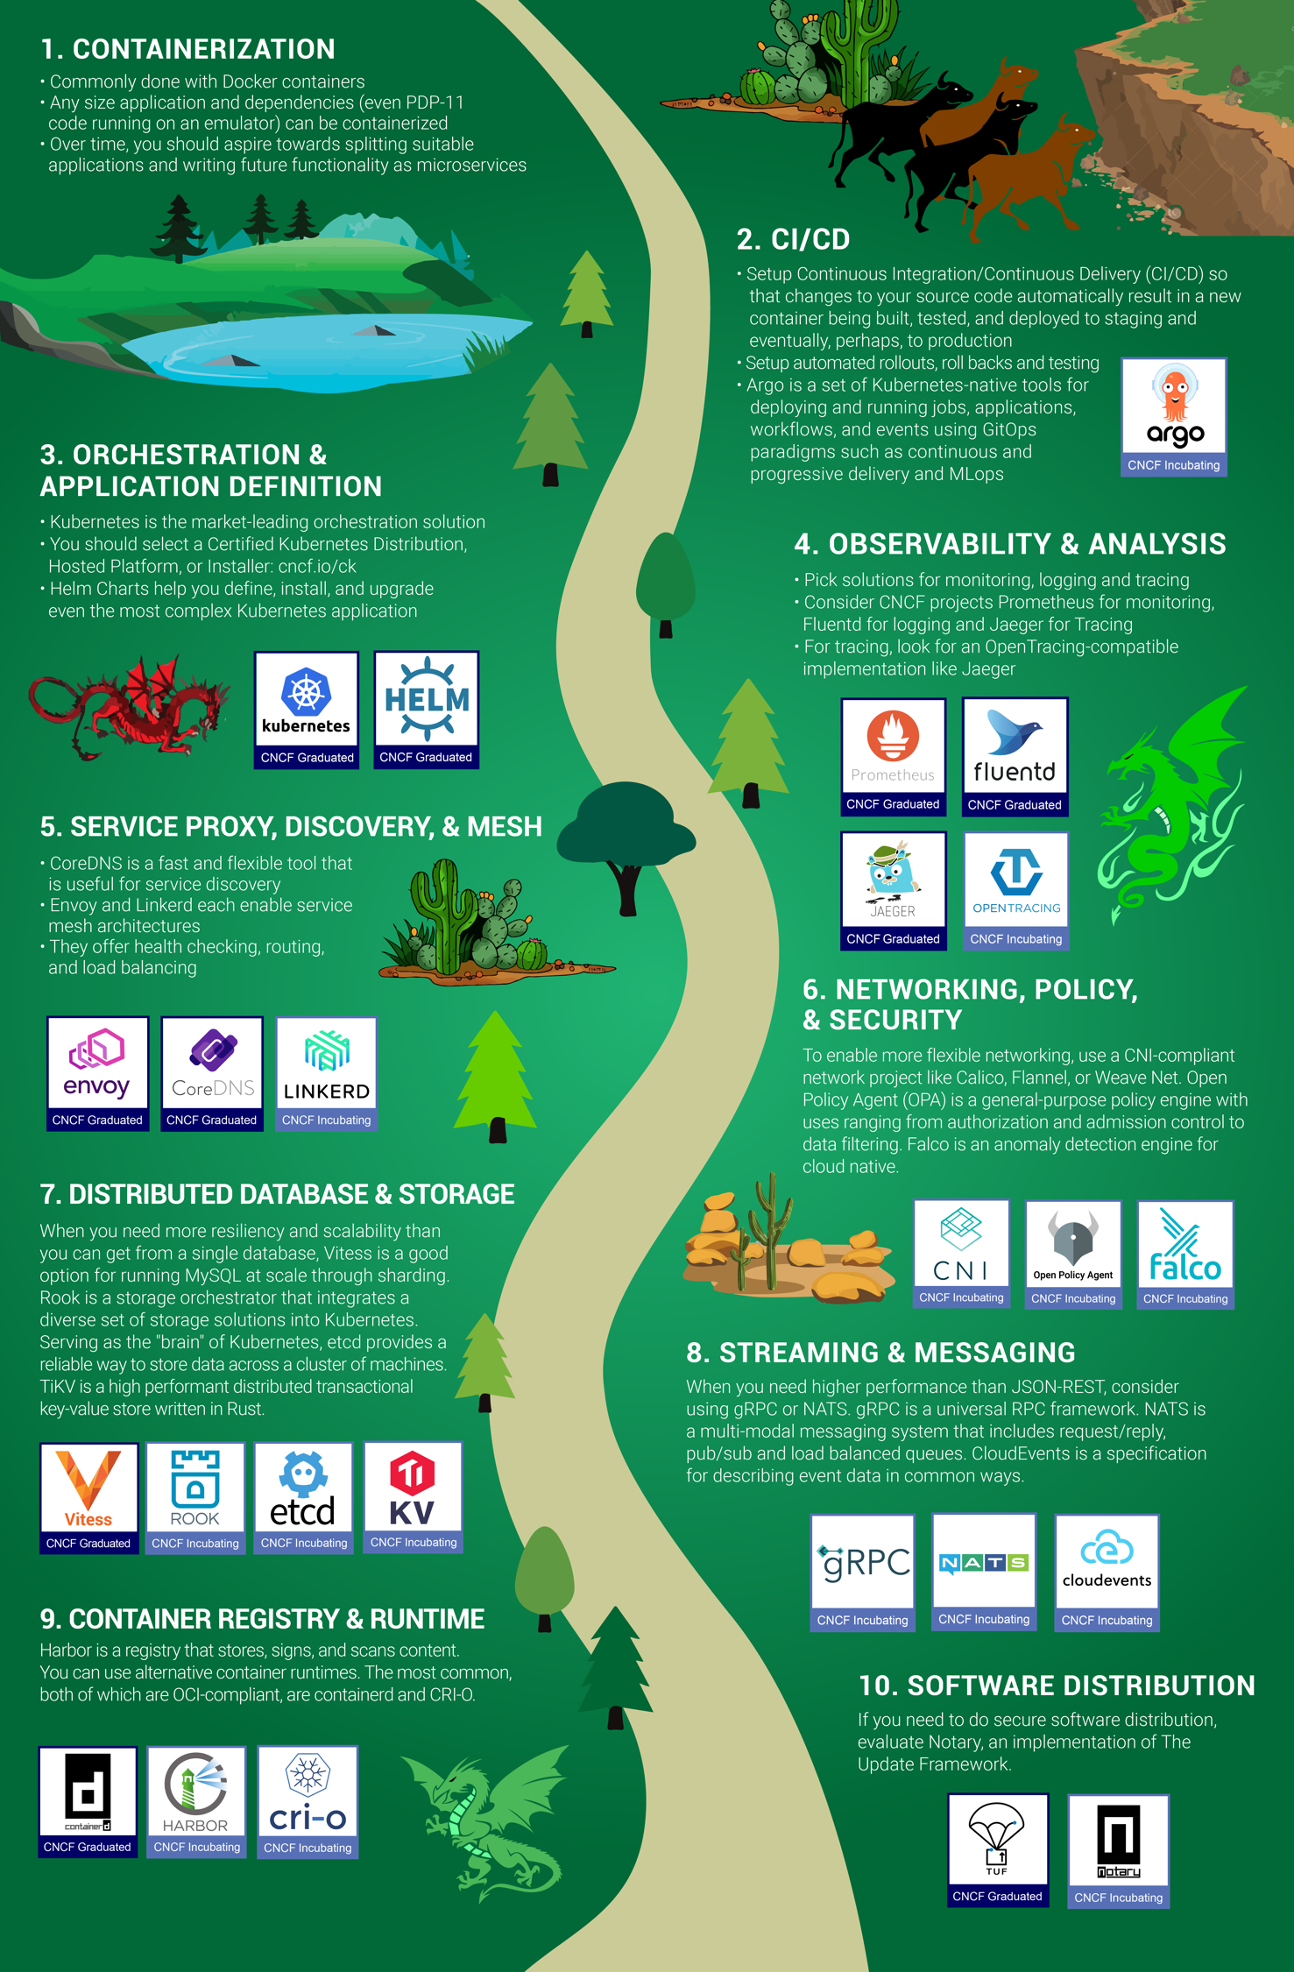
Cloud Native
“Cloud native technologies empower organizations to build and run scalable applications in modern, dynamic environments such as public, private, and hybrid clouds.
Containers, service meshes, microservices, immutable infrastructure, and declarative APIs exemplify this approach.”
Source: https://github.com/cncf/landscape/blob/master/README.md

Slide 4
Software Eats Everything
Stop bringing hardware to the software fight
Software mindset brings:
Agile, MVP, Fail Fast
Modeling & Test-Driven Development
Infrastructure as Code
Cloud brought Ephemerality through Software

Slide 5
INFRASTRUCTURE
AS
CODE
“below or under”
“arrangement of supporting elements”
“built with or defined by”
“plain-text, human readable/writable format”

Slide 6
Enabling Declarative Models for T&E
JADC2 highlights Complexity across All Domains
Mixture of Modern & Legacy Applications/Hardware
Autonomous Systems built from smaller (software) parts
Modeling & Simulation becomes Deployment method
Facilitates scale up & down thru Software

Slide 7
Recap
Cloud Native doesn’t require the Cloud
IaC helps deploy & consume the Edge-as-Code
Declarative software-driven models benefit T&E
Software Scaling enables Cloud-like consumption

Slide 8
Q&A
(with feedback, please!)
Will Lester
will@nextechsol.com

