Slide 1
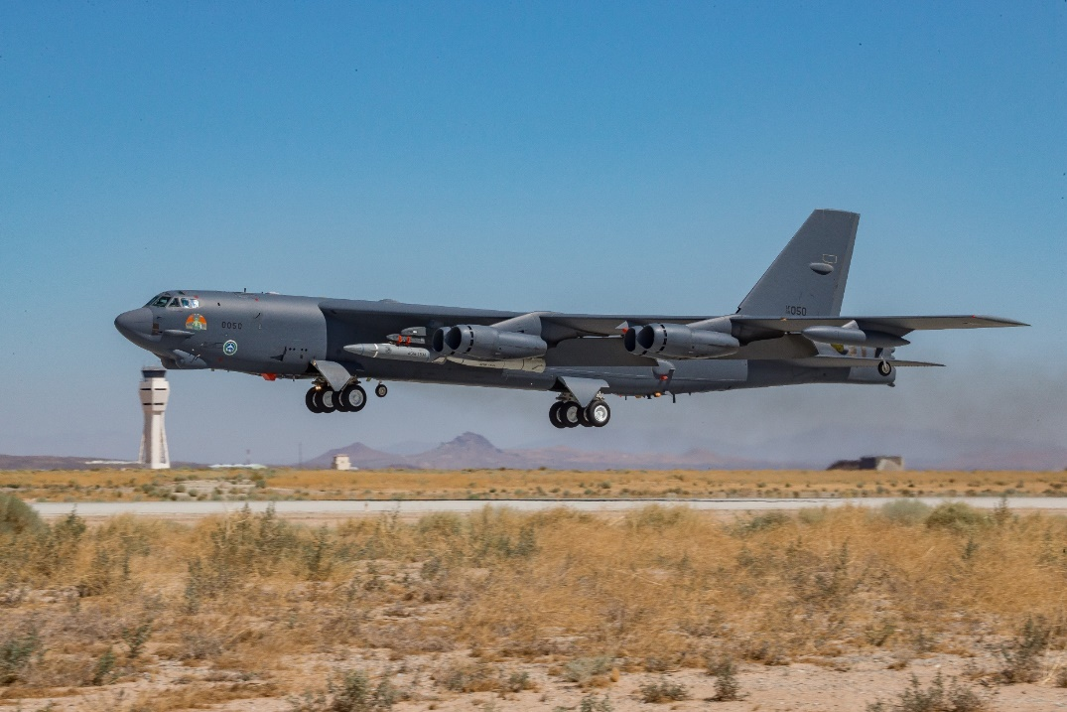
Bomber Modular Data Acquisition System Overview
419 FTS / 412 TW / 812 AITS
JT4 LLC Bomber Design Team
ITEA Virtual
11 May – 14 May 2021
DISTRIBUTION STATEMENT A - Approved for public release; distribution is unlimited. 412TW-PA-21215
Notes:
This presentation will consist of an overview of the Bomber Modular Data Acquisition System, or as we call it BMDAS that is currently installed on two B-52s. This design was a collaboration between Air Force Civilians and JT4 contractors from the 419th Flight Test Squadron, the 412th Test Wing, and the 812th Aircraft Instrumentation Test Squadron. [0:22]

Slide 2
Presenter
Trevor D. Londergan
JT4 Bomber Design Engineer Lead
Mechanical Engineer
5 years
Notes:
My name is Trevor Londergan and I will be your presenter today. I was hired on to JT4 in 2015 as a Mechanical Engineer. I started working on BMDAS designing the racks that you will see later on in this presentation. Two years ago I became the JT4 Bomber Design Engineer Lead. [0:20]

Slide 3
Presentation Agenda
Design Requirements
BMDAS Base
BMDAS Modularity
BMDAS Expandability
Operations
Future Efforts
Challenges & Lessons Learned
Successes and Benefits
Notes:
I will start off by reviewing the initial design requirements that were used to shape our current system. From there I’ll review the core BMDAS design and then demonstrate the systems modularity and expandability, and how those were incorporated into both the electrical and mechanical designs. This will lead into how the system has effected operations with respect to our customer and our internal teams. Finally I will end with how we plan to use and adapt the system for future instrumentation efforts, the challenges we faced, and the overall success of the system,.[0:33]

Slide 4
Design Requirements
Bomber Modular Data Acquisition System
Modular, Scalable, Reconfigurable
Reduce aircraft down time for mods
Gov’t Designed, Installed, and Maintained
Data Independence
Based on COTS Components
Fully Networked (Ethernet Based)
Inside the Mobile Control Room (MCR)
Notes:
Here are the requirements that were presented to the System Program Office by the Bomber Instrumentation Chief for a new and improved instrumentation system from which the Bomber Modular Data Acquisition System was born. The first design requirement for BMDAS was to ensure it was modular, scalable, and reconfigurable. The desired effect was to decrease the time that the aircraft would be down for future mod actions. Current aircraft mods take up to 6-9 months and the intent is to have the follow on mods take only two months. The idea is that the modules would be easily removed then reconfigured or replaced and only slight aircraft wiring would be needed. The second requirement was to have a government designed, installed, and maintained instrumentation data acquisition system. This is the first step in allowing the Air Force to have “Data independence” from the defense contractors. Historically the flight test data is captured, processed, and results interpreted by the contractors that own the designs. Having an Air Force owned system, the Air Force will have a second independent means of verification. The last requirement was to design the system based on easy to obtain commercial off-the-shelf components. At its core, the system needed to be a fully networked Ethernet based system which was the key to solving the first requirement. [1:24]

Slide 5
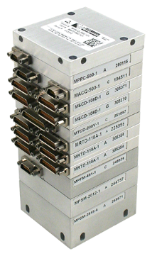
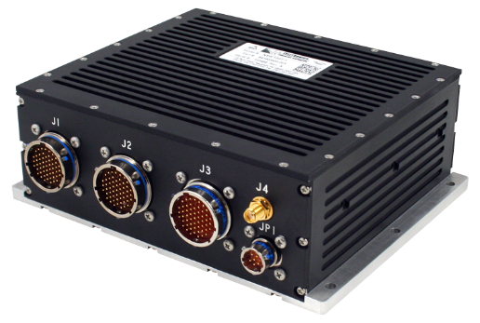
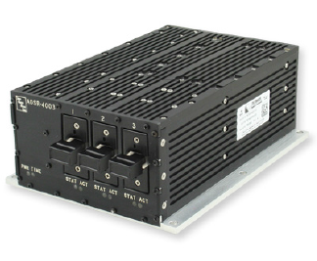
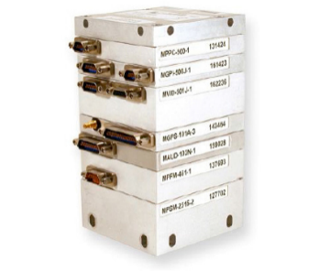
BMDAS Base (Electrical)
Miniature network data acquisition and encoding unit (MnACQ)
Antenna
Network Data Selector
Sensor/Bus Data
Camera/Displays Video
Rugged Ethernet Switch
Miniature network high-speed data acquisition unit (MnHSD)
Camera Manager
Advanced Data Server and Recorder
Control Panel
Notes:
To start off we will look at the high level electrical overview of BMDAS. On the top left you can see that it starts with the instrumented sensor data and production bus data that then goes to the miniature networked encoding unit that processes and delivers packetized data to designated network nodes. This stack accepts up to 31 plug-in signal conditioning and converter modules which allows the design to be able to process current and future instrumentation needs. On the bottom left you can see that it starts with the camera video and the multifunction display video that then goes to the miniature network high speed data acquisition unit. This stack accepts a wide variety of input and output modules from standard to high resolution video and audio, with operation speeds up to 40 Mbps. From there the packetized data is sent via Ethernet to the Ethernet switch. Once the data is on the network the data can controlled and directed back and forth across the network via the data selector, camera manager, and control panels. The data selector with engineering unit processor selects parameters in route to the recorder and formats an IRIG Chapter 4 PCM stream for output to a telemetry transmitter. The camera manager provides the configuration and control between the cameras and the control panels supply a user interface for the flight crew. Finally the data can be telemetered down to the ground via antenna and/or recorded with the on board recorders. The design uses COTS TTC components which satisfies the third requirement. [1:35]

Slide 6
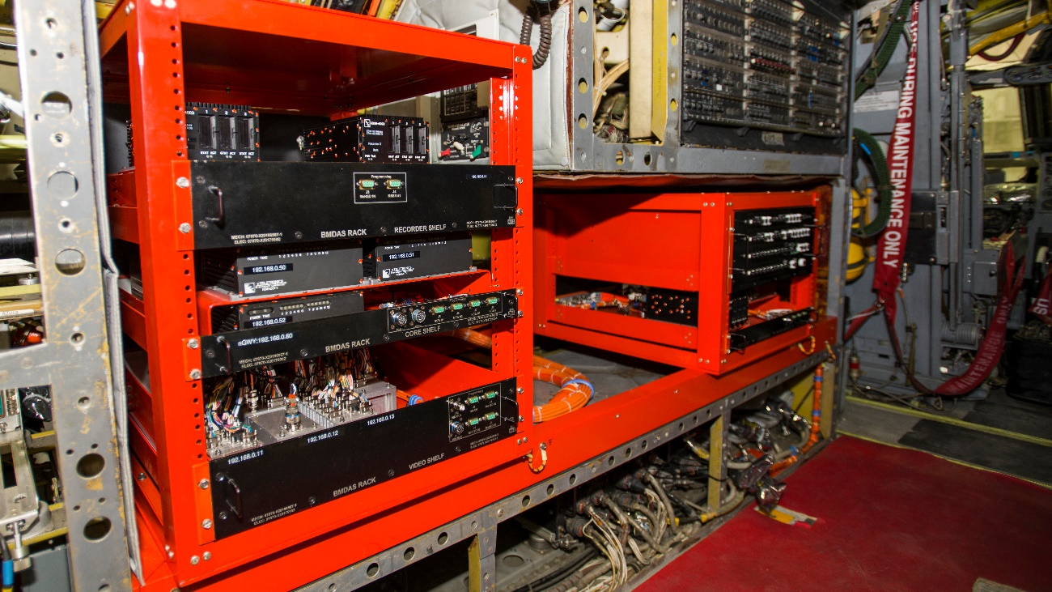
BMDAS Base (Mechanical)
EIA-310
Current/Future Design
Lab use
Pre-existing production mods
ARINC 404A / DZUS
Interchangeability
Production mounting
Notes:
Mechanically the system uses three commonly used industry standards, EIA-310, ARINC 404A, and DZUS. The system has racks and trays that use EIA-310 standard, which is the Cabinets, Racks, Panels, and Associated Equipment standard that was used to define the size and mounting pattern. This standard allows us to test the trays in the standard server racks that were already in our instrumentation test laboratory, then easily move them over to the BMDAS racks on the aircraft. Trays that follow this standard can even be installed on pre-existing production instrumentation racks that already use the EIA-310 standard. Other Line-Replaceable Units follow ARINC 404A, the Air Transport Equipment Cases and Racking standard, and standard DZUS mounted panels. ARINC 404A was used for LRUs that do not need user interfaces where the DZUS mounted panels are primarily used for user interfaces. Since these standards can be found across the aircraft, this gives us greater interchangeability between LRUs and the ability to mount using pre-existing production mounting locations. [1:12]

Slide 7
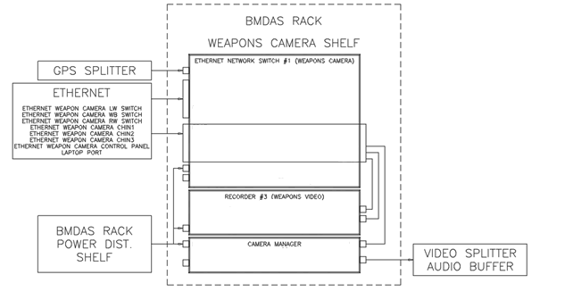
BMDAS Modularity (Electrical)
Standalone Subsystem
Location independent
Packaging independent
Ethernet based system allows for more remote Data Acquisition Units
MnACQ in the Pylons
Power Junction Box and Ethernet Switch in the wings
Notes:
BMDAS’s network backbone allows the system to be extremely modular. A prime example of the modularity of BMDAS is the Weapon Camera Tray shown here on the left. As you can see it’s a LRU that has its own Ethernet switch, camera manager, and recorder. This allows it to be a standalone subsystem that is independent of it’s location with respect to the main network hub and independent of the mechanical packaging. This independences allows for these modular data acquisition nodes to then be placed in remote locations across the aircraft. An example of that is the miniature network data acquisition unit in the pylon that sends data to the Ethernet switch in the wings. That switch then connects to the rest of the network that resides in the crew area. The benefit to these remote nodes are if we need to pull large quantities of data say off the wing, we can process and packetize the data at the wing and therefore only need to run power and Ethernet out to that remote node which reduces wire routes and prevents the need to rerun wire for future efforts. More remote nodes are being considers for future efforts that have large quantities of data on the wings. [1:12]

Slide 8
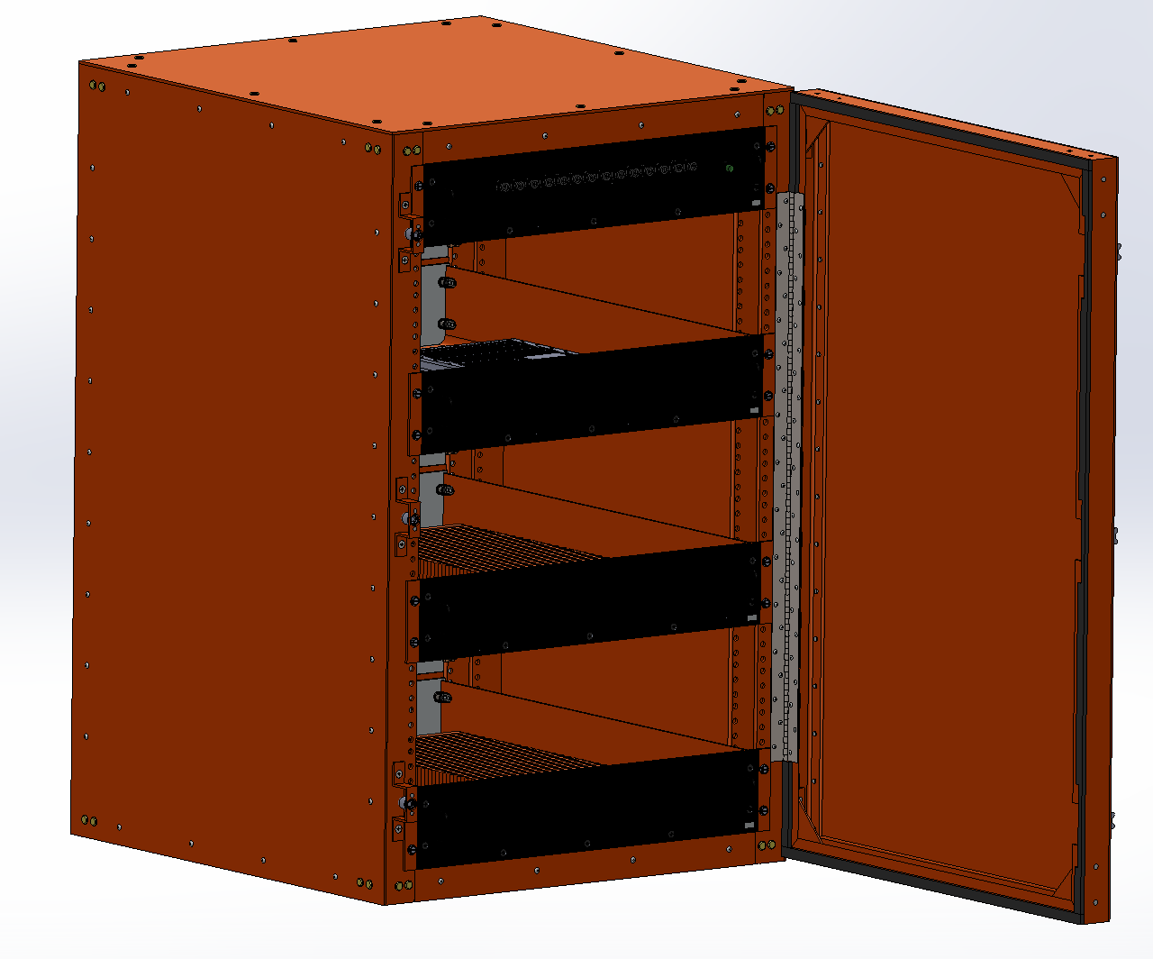
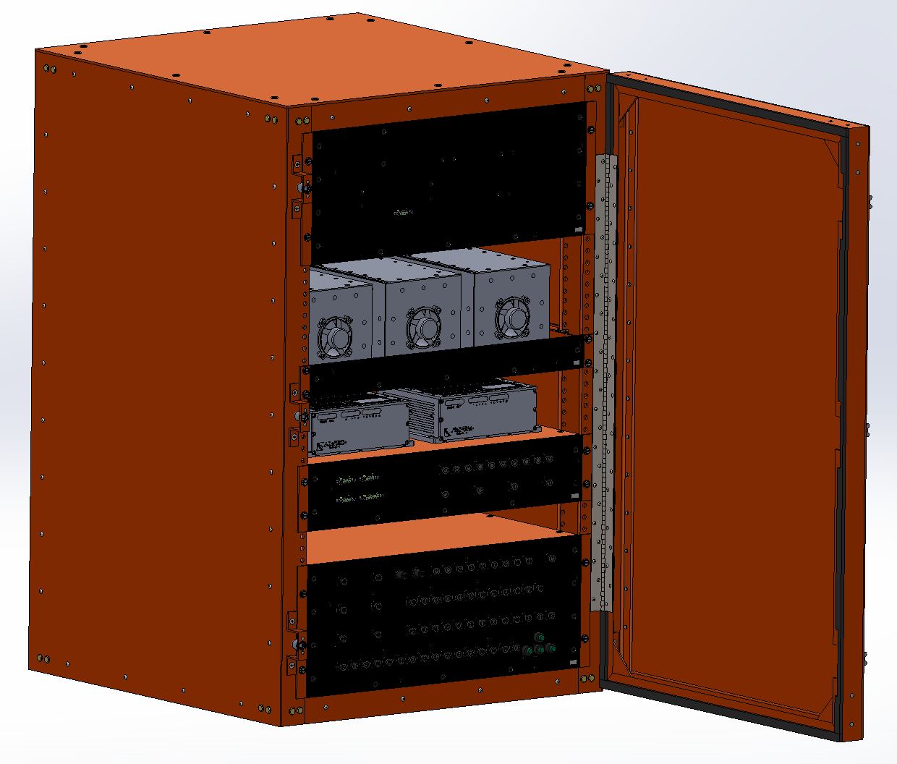
BMDAS Modularity (Mechanical)
Network Weapon Separation Camera to BMDAS
Rack upgrade
WSC Tray reutilization
B-52 Network Weapon Separation Camera to B-1
Repackage Electrical to new mechanical
Notes:
Because the mechanical design primarily used the three industry standards previously discussed, it allows us to easily move subsystems around to best fit the current projects needs. An example of this is when two separate B-52s were receiving two separate mods both using a common subsystem. While the first BMDAS aircraft was down for its extensive modification, another B-52 went down for a quick modification to have the network weapon separation cameras installed in order to support the customers flight test needs. That aircraft received the aforementioned weapon camera tray installed into a previous production instrumentation rack and our third BMDAS rack was installed and populated with a power distribution unit, an Ethernet switch, and two existing units, as you can see on the left. When that aircraft returns it will be receiving the full BMDAS upgrade, and the non BMDAS trays will be removed and repopulated with the required BMDAS subsystem as seen on the right. For the weapon camera tray, it will be moved over to the BMDAS rack in the crew area. This demonstrates how easy it is to move these modular subsystems around the aircraft and even across mods. The same weapon camera tray has also been mechanically repackaged to fit a different rack design on the B-1 to network that camera system. The B-1 currently has the high speed cameras but are in a stand-alone configuration. The weapon camera tray will network 12 cameras that will also be tied into the telemetry system for real-time situational awareness. [1:37]

Slide 9
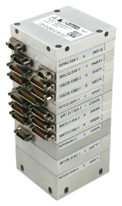
BMDAS Expandability (Electrical)
MnACQ
Rugged Ethernet Switch
New Mod Data
New Instrumentation
Existing BMDAS
Notes:
This fully networked modular design built on TTC COTS components allows for the design to be easily expanded on. As previously mentioned the TTC stacks can accept up to 31 modules and because they can readily be plugged in or added to the existing stack, our system can quickly be expanded or even reconfigured to accept new data types. If the amount of new data exceeds the current stack, a new stack can be added to an existing tray, or if desired we can create a separate subsystem and use it as a remote data acquisition node, shown here on the left. If you notice the new subsystem shown on the left looks similar to the weapon camera tray previously discussed. These subsystems follow a easy almost cookie cutter approach that minimizes the required electrical engineering design time to add a news subsystem. Simply put when future instrumentation need arise, all that is required is find the required TTC card that accepts the desired data and then connect it to the existing network. Once on the network the existing Bomber Modular Data Acquisition System can be programmed and/or reconfigured to capture the required data. [1:15]

Slide 10
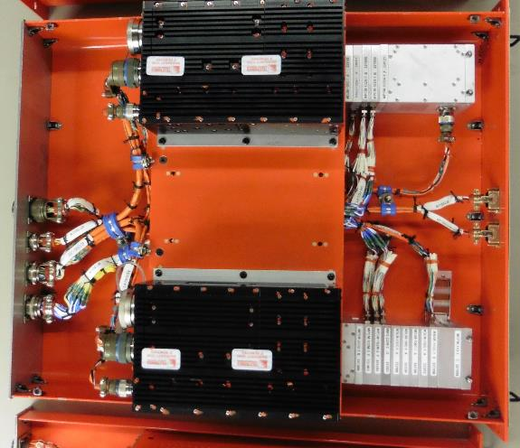
BMDAS Expandability (Mechanical)
3
TTC Stacks
Multiple MDUMs (Dummy Module)
Provisioned for additional recorder
ADSR mounting Provisions
Connectors
Oversized for extra pins
1
2
Notes:
The existing BMDAS trays were also designed mechanically to have built in expandability to match the systems electrical expandability. You can see here at point 1 the TTC stacks were assembled and mounted using MDUM cards. These cards are blank placeholders that can be easily replaced with a functioning card that meets the projects needs without effecting the mounting hole pattern that is drilled into the tray. The trays were also designed with additional mounting provisions for future COTS items, this can be seen at #2 where a 3rd recorder can be mounted. Finally the connectors are oversized with additional blank pins for future expansion. The third shipset of trays have already started to see expansions to include more 1553 buses as well as the capability to record Ethernet for CONECT. The forth shipset is being designed to expand the network and power distribution, and will be adding provisions for future Wheels and Brakes System Improvement modification. The last few slides demonstrated how we successfully completed the first design requirement for the system to be modular, scalable, and reconfigurable. [1:13]

Slide 11
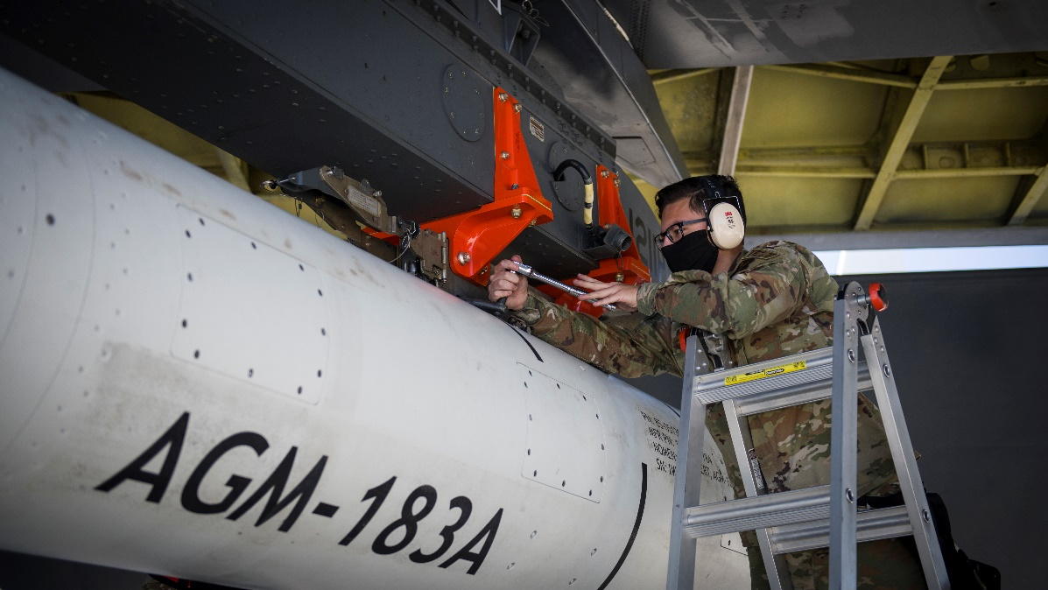
BMDAS Operations (Customer)
For the first time in bomber history at Edwards, real time video has been telemetered to the control room allowing them to watch live asset releases
Test data can be delivered to customer the same day instead of 3-4 days
Used for troubleshooting
Increases operation tempo
Notes:
BMDAS has made several improvements for our customers. For the first time in bomber history at Edwards AFB, real time video has been telemetered to the control room allowing them to watch the asset release in live time. The video is crew selectable from any of the nine network high speed camera locations and will make it possible for the Air Force SEEK Eagle Office to determine when the asset is quote unquote “clear” between multiple weapon separations during the same test flight. This can reduce the number of missions required and therefore will increase the overall test efficiency. Post flight, the test data can be delivered and reviewed the same day allowing the customer to quickly plan their next flights instead of waiting for days to review the data. This allows for an increased flight schedule and therefore reduces the overall flight test schedule duration. Another example of the benefits of this system is when a recent flight test did not go as intended the customer was able to review the over the shoulder camera video to determine weather or not it was an operator error that day. [0:52]

Slide 12
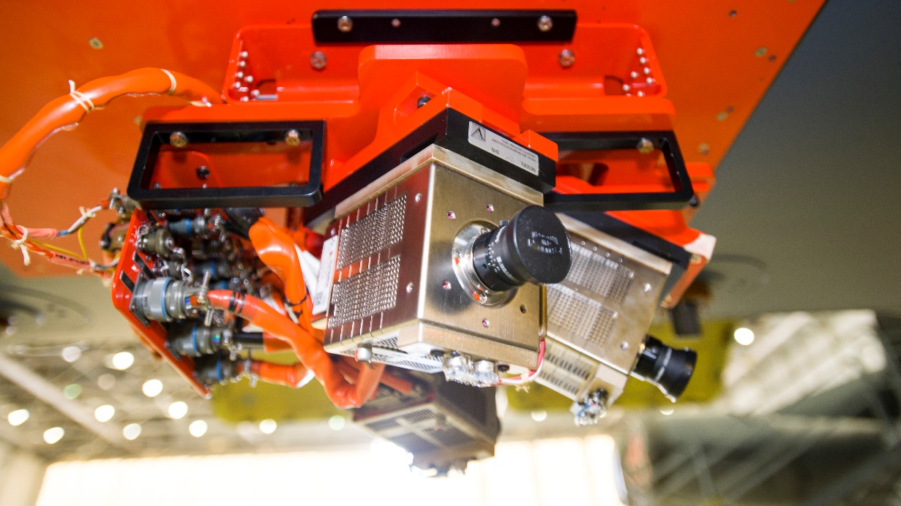
BMDAS Operations (Internal)
Modularity allows for ease of subsystem troubleshooting
Network backbone allows for a single tapping point during ground test
Compatibility with Lab
Common Hardware
Spare Shipset
Notes:
Internally our Instrumentation Operations Engineers has seen numerous benefits as well. The modular nature of the system allows for subsystem testing to more easily identify issues. The network backbone allows for a single tapping point during ground test and preflight providing access to most of the data over the Ethernet connection. Compatibility with the development lab allows us to easily preform functional test of different LRU’s with the same lab setup. The common use of electrical hardware has also aided in the ease of troubleshooting. All these factors decrease the needed time on the back end of the modification to get the system up and running on the aircraft and reduces the time the aircraft is grounded for troubleshooting purposes. Once we complete the upcoming BMDAS aircraft modification, the intent is to build a spare shipset of all LRUs that will be used to prevent grounding the aircraft for troubleshooting. The lab tested LRUs will be ready to be switched with a malfunctioning LRU at a moments notice. The malfunctioning LRU will then go through corrective maintenance and then will become the spare LRU once fixed. [1:06]

Slide 13
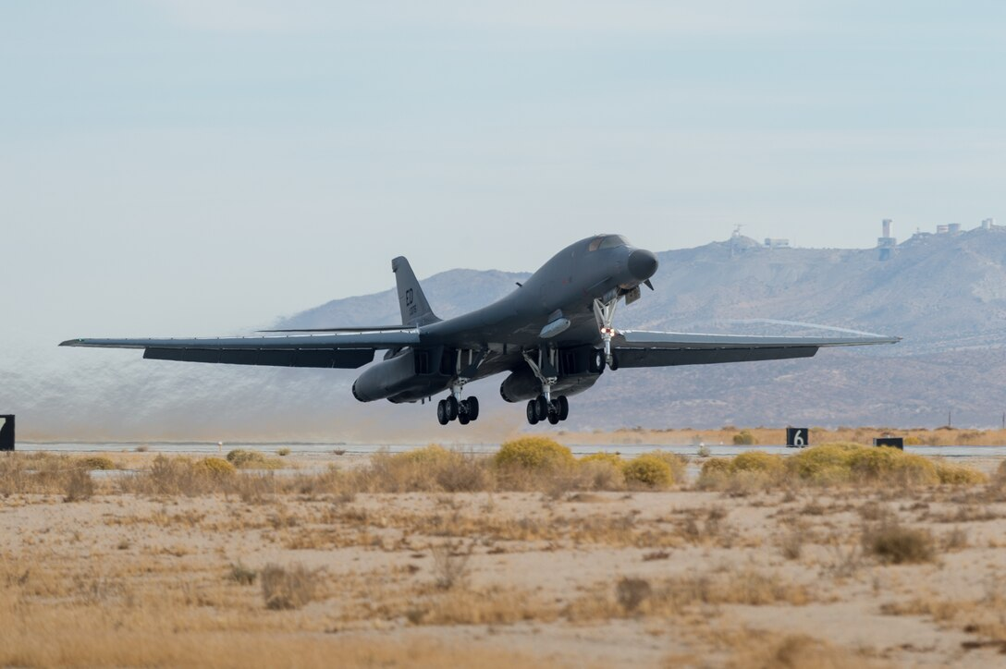
Future Efforts
Expansion BMDAS on next two aircraft
Increase maintainability
Expand Ethernet capability
Use BMDAS as backbone for future projects
Radar Modernization Program (RMP)
Commercial Engine Replacement Program (CERP)
Implement BMDAS on B-1 platform
Feasibility study
Notes:
With those operational successes, the Bomber Modular Data Acquisition System is currently seeing an expansion of its Ethernet capabilities to the next two aircraft as previously discussed and an increase to the systems maintainability and capacity mechanically. As we started diving into initial assessment of future projects, it was determined that the rack in the crew area would need to be expended to accept the production equipment along with our instrumentation. To meet this future need the rack is being updated to almost double the capacity. These future projects are the Radar Modernization Program and the Commercial Engine Replacement Program that will have BMDAS at its core. For those upcoming programs we are currently investigating the use of separate networks for classified and unclassified data to allow for ease of customer’s post flight analysis. This will be especially beneficial for the large amounts of unclassified analog data that will be required. We are currently working with our security team to determine at what point, if any, can this classified network connect to the existing BMDAS. Lastly we have been looking into the feasibility of mechanically modifying BMDAS to be implemented on the B-1. Initial assessments have shown promising results and in the upcoming years there will be a greater push into turning it into a reality. [1:15]

Slide 14
Challenges and Lessons Learned
Balancing end user desires with scope creep impacts to cost and schedule
Procurement supply chain issues for non COTS items
Resource sharing and management with other projects
Update trays as we go
Inside the Mobile Control Room (MCR)
Notes:
The challenges during the system design and installation were balancing the end user desire with scope creep impacts to cost and schedule. As discussed in the previous slide, BMDAS’s core system was extremely important to get right in order to have successful integration for future projects. This caused constant desires to always improve the base system but needed to be balanced out with the customers need to have a useable system as soon as possible. We also had issues with procurement of non COTS items which caused some compromises in the design that are currently being designed out. And finally resource sharing and management with other projects. Our shops and processes were primarily designed to support single jet modification and this large of an effort on numerous aircraft back to back to back, required large amounts of out sourcing fabrication. In essence be became an assembly line of instrumentation, to which we were not fully suited for. In the past couple of years we have updated existing design, logistical, and T2 mod processes to accommodate for this level of effort. The beautiful part of this system is with how easy it is to expand or reconfigure the system, after each aircraft mod we can take the lessons learned and update the required subsystem for the upcoming mod. Those improved subsystems will then swap out the previously used version when the aircrafts flight schedule allows. [1:21]

Slide 15
Successes and Benefits
Successfully integrated subsystems on multiple platforms
Increased control room capability
Drastically decreased time to get data/video to customers
Provided an expandable and flexible backbone to build off of for future instrumentation needs
Inside the Mobile Control Room (MCR)
Notes:
To recap the successes of the bomber modular data acquisition system, we have successfully integrated individual subsystems, in this instance the weapon camera subsystem on multiple platforms, the B-52 and the B-1. We have increased the capability of the control room by allowing crew selectable video feed that can be telemetered live to the control room. We have drastically decreasing the time it takes to get data/video to the customers by consolidating the data onto easily accessible removable media that can be downloaded and delivered the same day. Most importantly we provided an expandable and flexible Ethernet based backbone to build off of for future instrumentation needs. Two aircraft have been successfully be modified, two more are currently being modified, and we will be potentially be modifying four more aircraft for future efforts. [0:52]

Slide 16
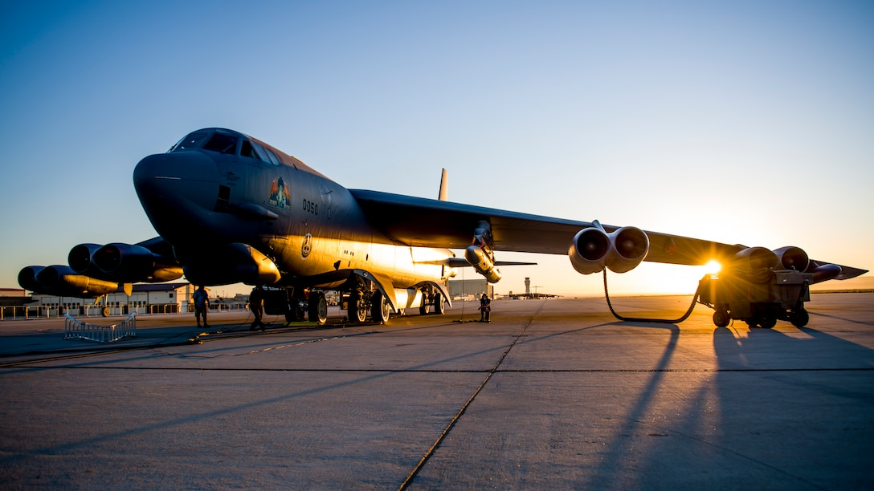
QUESTIONS???
Notes:
That concludes the presentation and now I will be opening up the floor to questions. [0:05]

