Slide 1
Machine & Deep Learning at NMSU
Application to space weather
Laura E. Boucheron
College of Engineering
Klipsch School of Electrical & Computer Engineering

Slide 2
Introduction to Space Weather

Slide 3
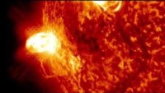

Introduction to Space Weather
Space weather: changes in the environment between the Sun and Earth
  Largely affected by solar storms
  Can have adverse effects at Earth
Solar storms
  Flares: radiation, reaches Earth ~8 min
  Energetic particles: near relativistic particles, reaches Earth ~20-30 min
  Coronal mass ejections: mass (ionized plasma) travelling with the Solar wind ~500-800 km/s, reaches Earth ~2-3 days
Prediction of space weather
  Solar storms usually emanate from active regions
  Given the appearance of an active region, can we predict future activity?
Video from NASA Goddard’s YouTube channel:
https://youtu.be/OvEKT8X3Bko
Information source:
https://www.swpc.noaa.gov/content/education-and-outreach

Slide 4
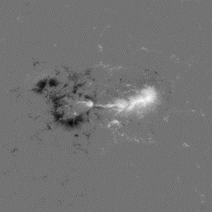
Data
Example LOS magnetogram image of an active region:
Gray: near zero flux
Black: strong negative flux
White: strong positive flux
Line of sight (LOS) magnetograms
  Measurements of the Sun’s magnetic field
  From NASA’s Solar Dynamics Observatory (SDO) Helioseismic and Magnetic Imager (HMI)
  1642 active regions
  600x600 pixel images
  01 May 2010 - 31 December 2018
  Cadence of 720 seconds
  1,372,004 images (950,047 after preprocessing)
Images labeled by whether the region flares within 24 hours
  Flares categorized by intensity using the Geostationary Operation Environmental Satellites (GOES)
  >C1.0 flares are considered positive
  Others are considered negative
GOES Class | Peak Flux (Wm⁻²)
<C (“non-flare”) | <10⁻⁶
C | 10⁻⁶-10⁻⁵
M | 10⁻⁵-10⁻⁴
X | >10⁻⁴

Slide 5
Solar Flare Prediction
Collaborators / Contributors:
Ellery Wuest¹, Amani Al-Ghraibah², R. T. James McAteer, Ty Vincent⁴, Jeremy Grajeda³
Support: Army Research Lab Grant W911NF1810484
¹Current PhD student, ²Former PhD student, ³Current MSEE student, ⁴Former MSEE student

Slide 6
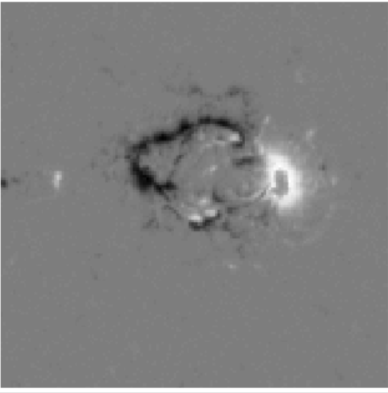
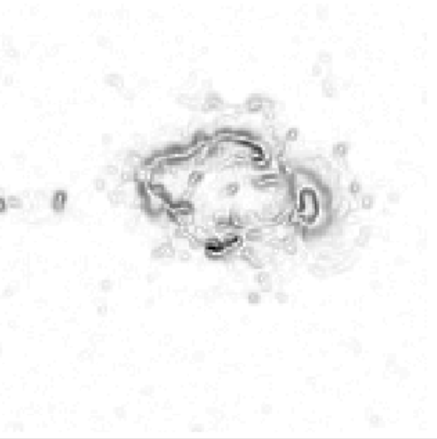
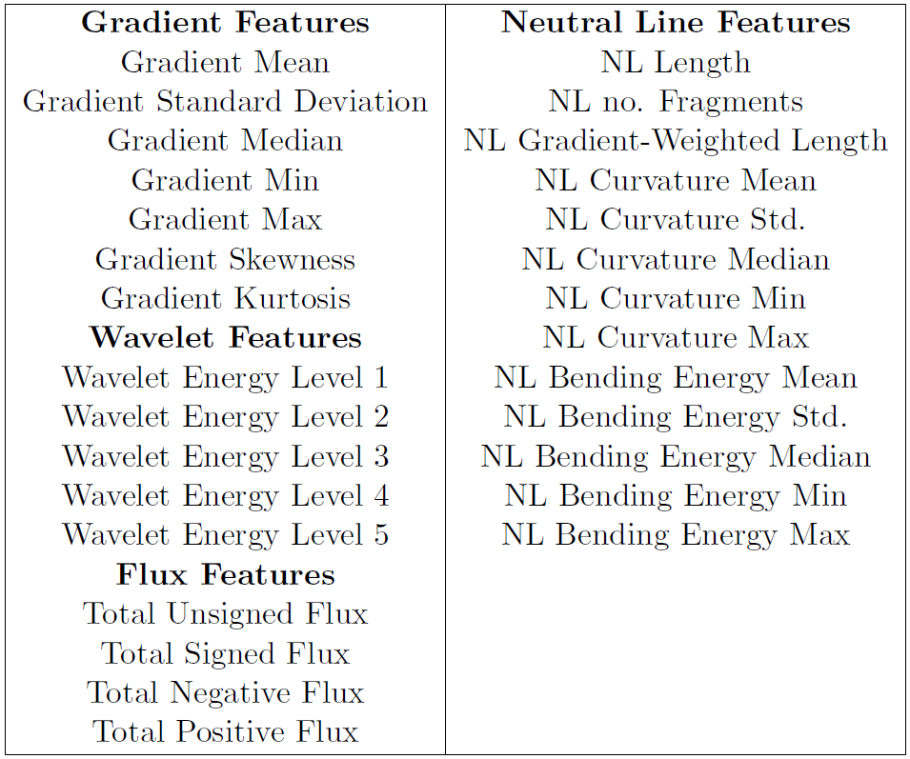
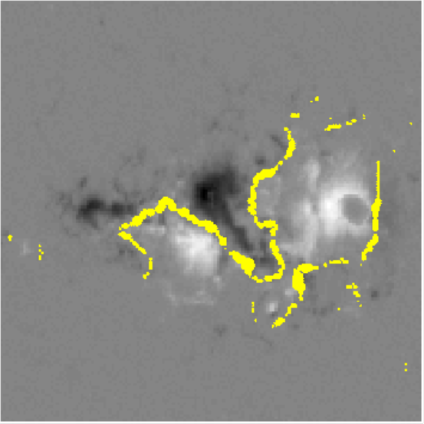
Baseline: Classical Machine Learning
29 spatial features describe active region complexity, i.e., “hand-designed features” [1]
Support vector machine (SVM) classification to predict flaring
Train on 759,357 images, test on 93,645 unseen images
[1] A. Al-Ghraibah, L. E. Boucheron, and R. T. J. McAteer, “An automated classification approach to ranking photospheric proxies of magnetic energy build-up,” Astronomy & Astrophysics, vol. 579, p. A64, 2015.

Slide 7
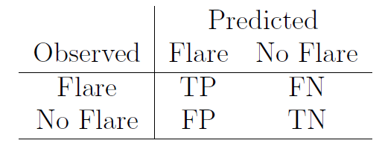
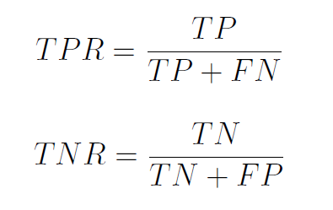
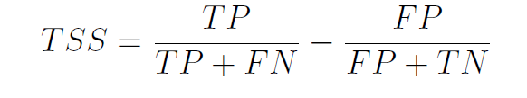
Performance
Metrics taken from the confusion matrix
  True Positive Rate (TPR): proportion of flares correctly classified, ϵ[0,1]
  True Negative Rate (TNR): proportion of non-flares correctly classified, ϵ[0,1]
  True Skill Statistic (TSS): Combines both TPR and TNR; note that TSS=TPR-(1-TNR)ϵ[-1,1]
  TP: true positive, TN: true negative
  FP: false positive, FN: false negative
Method | TPR | TNR | TSS
Baseline (Classical ML with features) | 0.79 | 0.68 | 0.47
LSTM (feature sequences)
CNN-LSTM (LSTM with CNN features)
Flaring regions are better predicted than non-flaring using complexity features.

Slide 8
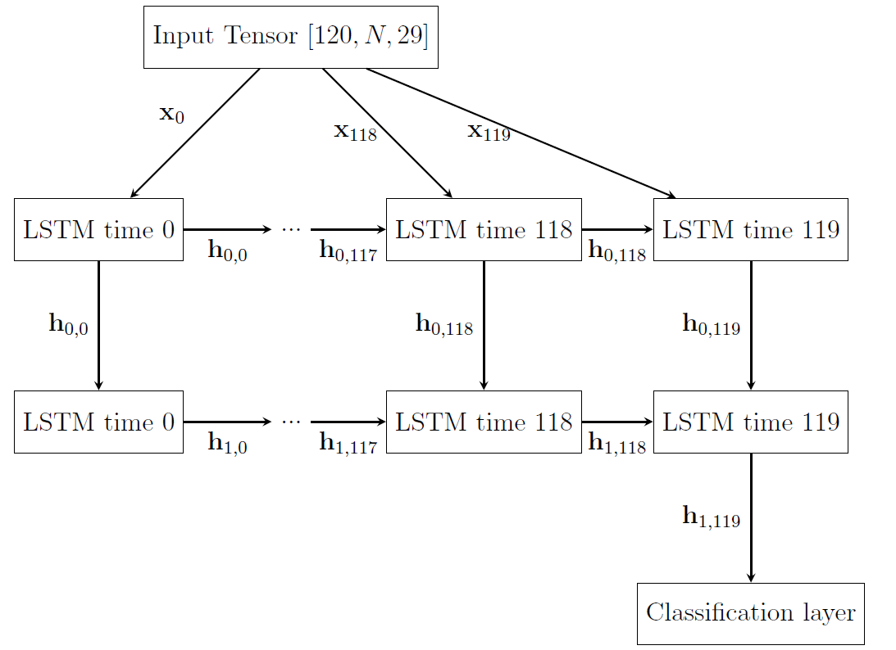
Deep Learning: Incorporate Temporal Evolution with an LSTM
Can temporal information help?
Features arranged into sequences covering 24 hours (120 images)
Sequences with temporal gaps are discarded; this reduces the sample size of the dataset:
  448,497 training sequences
  56,824 validation sequences
  55,432 testing sequences
Sequence label comes from final image label

Slide 9
Performance
Metrics taken from the confusion matrix
  True Positive Rate (TPR): proportion of flares correctly classified, ϵ[0,1]
  True Negative Rate (TNR): proportion of non-flares correctly classified, ϵ[0,1]
  True Skill Statistic (TSS): Combines both TPR and TNR; note that TSS=TPR-(1-TNR)ϵ[-1,1]
  TP: true positive, TN: true negative
  FP: false positive, FN: false negative
Method | TPR | TNR | TSS
Baseline (Classical ML with features) | 0.79 | 0.68 | 0.47
LSTM (feature sequences) | 0.71 | 0.79 | 0.50
CNN-LSTM (LSTM with CNN features)
Using temporal information results in better prediction for non-flaring regions than flaring

Slide 10
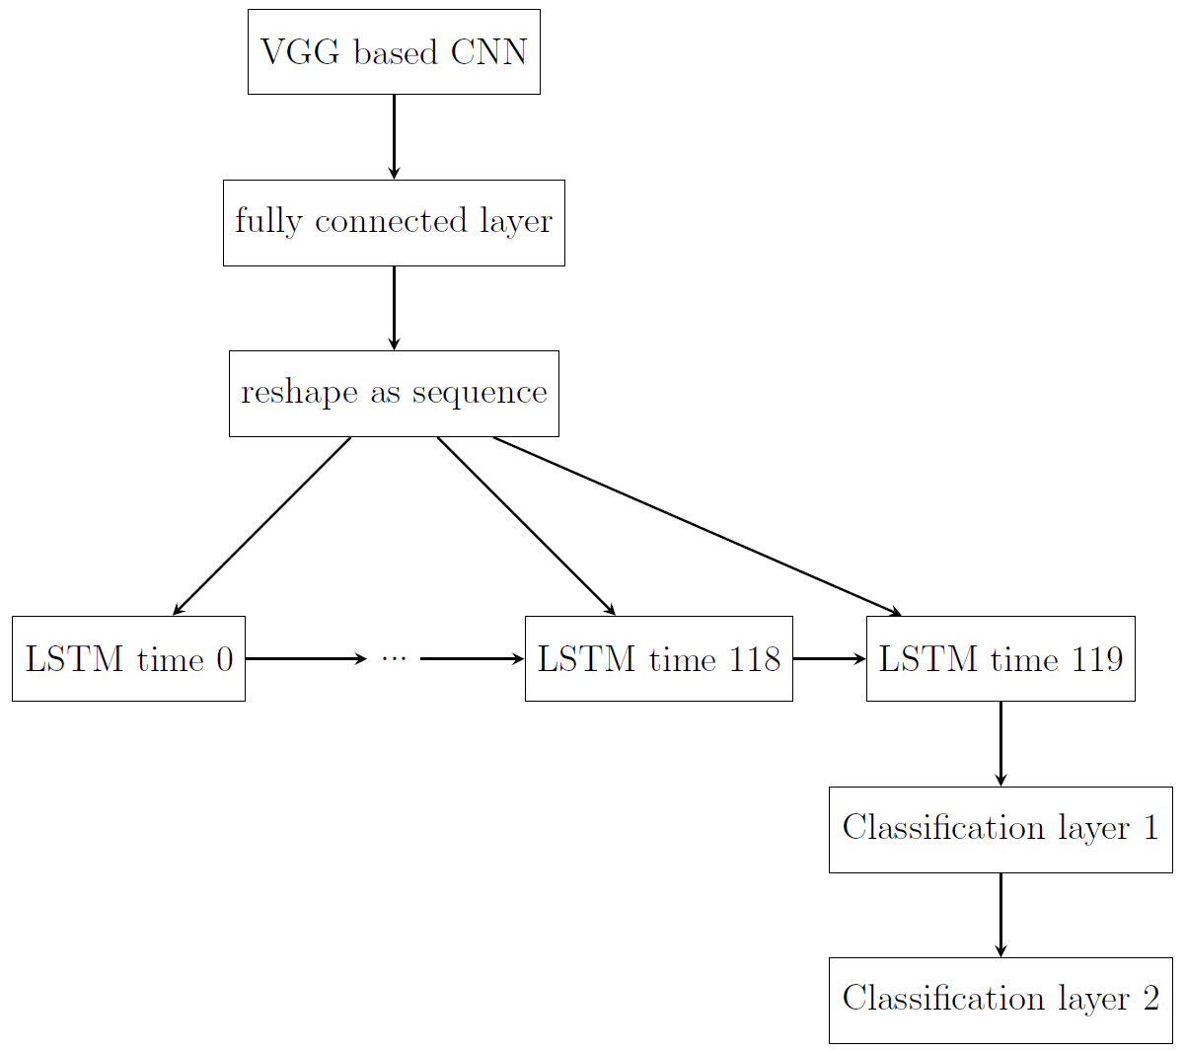
Deep Learning: CNN-LSTM
Can other features learned by deep learning help?
Use sequences of 32x32 images rather than features
First 3 convolutional layers of VGG11 as CNN backbone to extract features
1 fully connected layer to reduce number of features
2 LSTM layers (only one illustrated)
2 fully connected layers for classification

Slide 11
Performance
Metrics taken from the confusion matrix
  True Positive Rate (TPR): proportion of flares correctly classified, ϵ[0,1]
  True Negative Rate (TNR): proportion of non-flares correctly classified, ϵ[0,1]
  True Skill Statistic (TSS): Combines both TPR and TNR; note that TSS=TPR-(1-TNR)ϵ[-1,1]
  TP: true positive, TN: true negative
  FP: false positive, FN: false negative
Method | TPR | TNR | TSS
Baseline (Classical ML with features) | 0.79 | 0.68 | 0.47
LSTM (feature sequences) | 0.71 | 0.79 | 0.50
CNN-LSTM (LSTM with CNN features) | 0.72 | 0.76 | 0.49
Deep learning derived features, even on significantly smaller images, performs almost as well

Slide 12
Image Modality Transfer
Collaborators / Contributors: Zena Stevenson³, R. T. James McAteer
Support: Army Research Lab Grant W911NF1810484
¹Current PhD student, ²Former PhD student, ³Current MSEE student, ⁴Former MSEE student

Slide 13
Deep Learning: Image Modality Transfer
Can we use deep learning to predict the magnetic structure of the Sun given an extreme ultraviolet (EUV) image?
Expand SDO/HMI dataset with SDO/AIA (Atmospheric Imaging Assembly) images at 304 Å
Use AIA image as “source”
Use absolute value HMI image as “target”
“source”
“target”
Fully Convolutional Neural Networks (FCNNs) provide a means to do this.

Slide 14
Deep Learning: Image Modality Transfer
The fully convolutional network replaces the label prediction with a pixelwise prediction
The Unet architecture replaces the pixelwise prediction with an upconvolution structure
We use the modified Unet architecture validated for modality transfer in microscopy [2]
[2] C. Ounkomol, S. Seshamani, M. M. Maleckar, F. Collman, and G. R. Johnson, “Label-free prediction of three-dimensional fluorescence images from transmitted-light microscopy,” Nature Methods, vol. 15, p. 917, 2018.

Slide 15
Training
We increase the size and variation of the training data
We test on unseen active regions (ARs) rather than unseen images
  Test A: unseen images from training ARs
  Test B: unseen images from unseen ARs
# ARs | # Training Pairs | # Test Pairs (Test A/Test B) | Iterations | Training Time | Notes
1 | 10 | 3/6 | 50,000 | 4 hr (CPU) | Modeled after [2] as proof of concept and baseline
10 | 5014 | 503/512 | 500,000 | 12 hr (GPU) | Establishes 500k as suitable # iterations
52 | 5081 | 498/568 | 500,000 | 12 hr (GPU) | Increases data variety without increasing data volume and training time.
[2] C. Ounkomol, S. Seshamani, M. M. Maleckar, F. Collman, and G. R. Johnson, “Label-free prediction of three-dimensional fluorescence images from transmitted-light microscopy,” Nature Methods, vol. 15, p. 917, 2018.

Slide 16
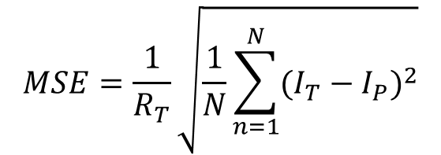
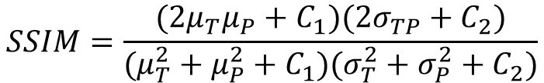
Performance Metrics
Metrics taken from pixel-wise or region-wise comparisons
  MSE: Normalized root mean-squared error
    Averages pixel errors
    ϵ[0,1]
  SSIM: Structural similarity index measure
    Quantifies similarities in structure
    ϵ[-1,1]
$$MSE=\frac{1}{R_{T}}\sqrt{\frac{1}{N}\sum_{n=1}^{N}{{(I_{T}−I_{P})}^{2}}}$$
$$SSIM=\frac{(2μ_{T}μ_{P}+C_{1})(2σ_{TP}+C_{2})}{(μ_{T}^{2}+μ_{P}^{2}+C_{1})(σ_{T}^{2}+σ_{P}^{2}+C_{2})}$$

Slide 17
Performance: Metrics
(lower better)
(higher better)
Test A: unseen images from training ARs
Test B: unseen images from unseen ARs
1 AR results appear to be overfitting
10 and 52 ARs close the performance gap between Test A and Test B
It is important to consider the variety of your training data to assure generalizability

Slide 18
Performance: Predicted Images
It is important to consider the variety of your training data to assure generalizability
These deep learning architectures have great potential for image modality transfer in scientific domains

Slide 19
Conclusions

Slide 20
Other Work
Machine Learning and Deep Learning at NMSU: Application to space weather
  Flares: radiation, reaches Earth ~8 min
    Prediction of future flare activity based on appearance of active regions (this talk)
  Energetic particles: near relativistic particles, reaches Earth ~20-30 min
    Spatiotemporal analysis of solar energetic particle events using the Combined X-ray and Dosimeter (CXD) instrument data from the GPS constellation
  Coronal mass ejections: mass (ionized plasma) travelling with the Solar wind ~500-800 km/s, reaches Earth ~2-3 days
    Segmentation of coronal holes (source of the fast solar wind)
Machine Learning and Deep Learning at NMSU
  Other applications? (precision agriculture, biomedical, smart grids,…)

