Slide 1
T&E Modernization for All-Domain Warfighting
Craig Miller
President, Viasat Government Systems
July 2021

Slide 2
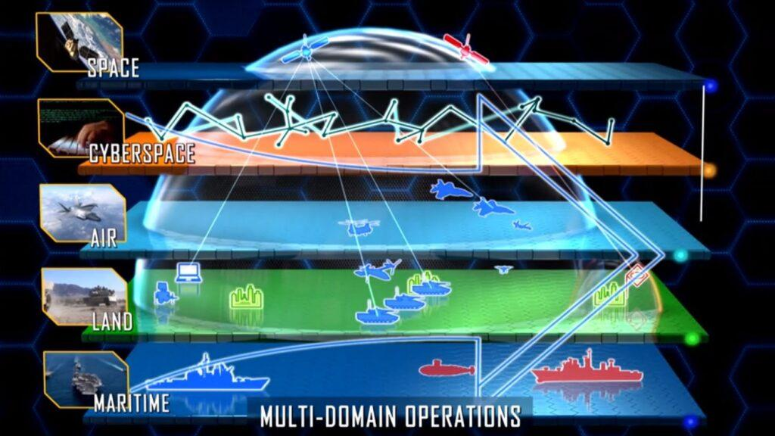
MDO Presents Interoperability, Security and Testing Challenges
Why are Multi-Domain Operations So Critical?
What are the Interoperability Concerns to Achieve MDO?
How Do We Address Security Concerns as Capabilities Mesh?
When and How Do We Test & Evaluate MDO Capabilities?
Image Credit: Breaking Defense
2

Slide 3
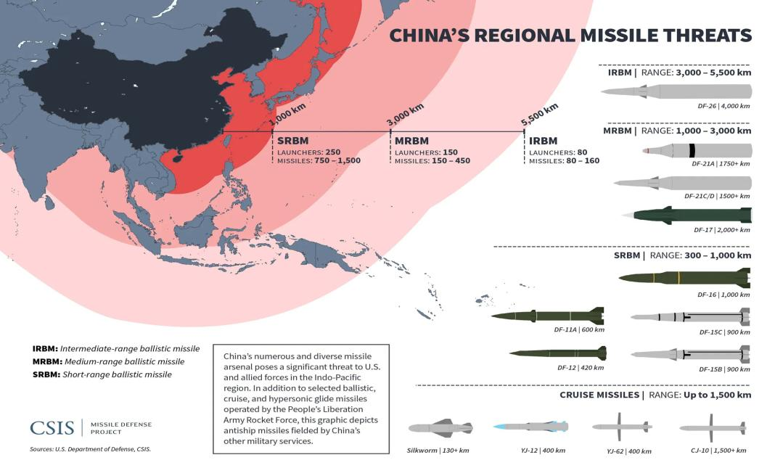
Multi-Domain Operations are Crucial in Modern Warfare
Preparing for Near-Peer Threats
Not all domains assured
Operations across a full spectrum of conflict and domains
Requires a New Way of Sensing, Control, and Action
Image Credit: Center for International Maritime Security

Slide 4
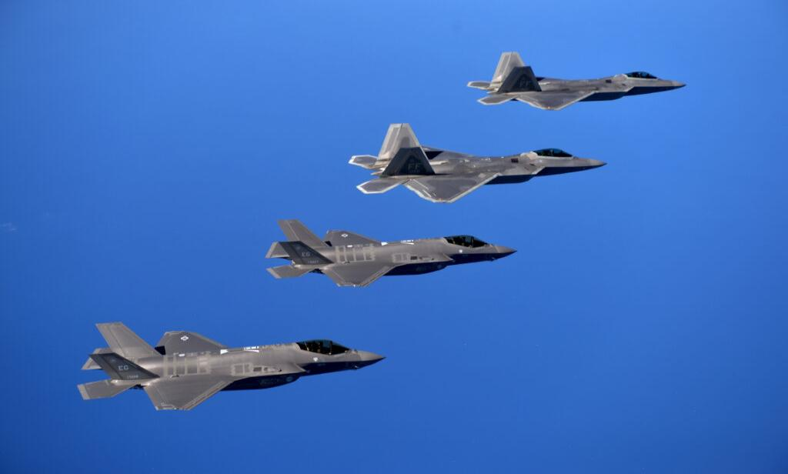
Multi-Domain Operations are Crucial in Modern Warfare
Leverage Network Effects for, Distributed Sensing and Real-Time Control of Handoff Weapons
Formerly stove-piped capabilities must work together
Need to reduce friction in bringing capabilities together
Performance and vulnerabilities must be understood
Can We Talk?
Image Credit: Breaking Defense
Notes:
F22-IFDL, F35-MADL
Fielded capabilities must be enhanced without hardware refresh

Slide 5
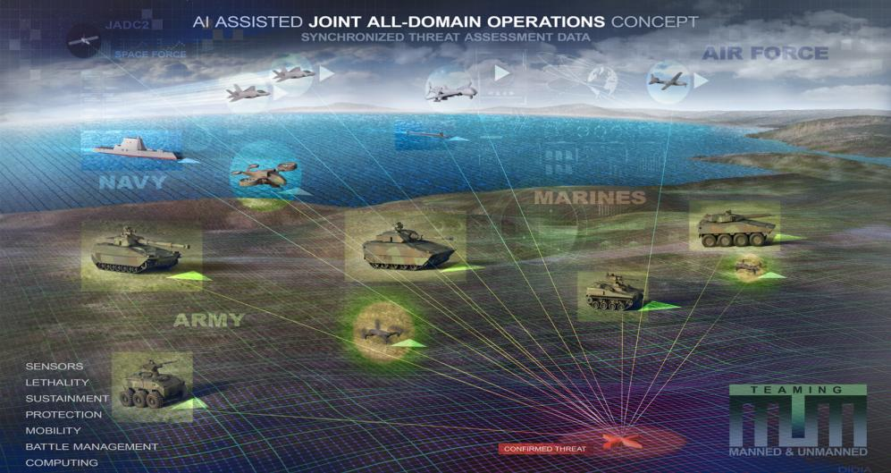
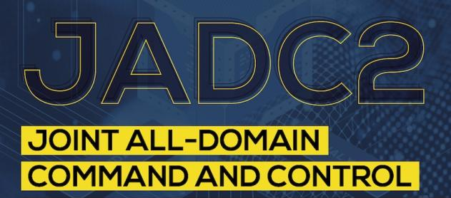
JADC2
Interoperability Challenges
and Considerations
Image Credit: Doug Didia

Slide 6
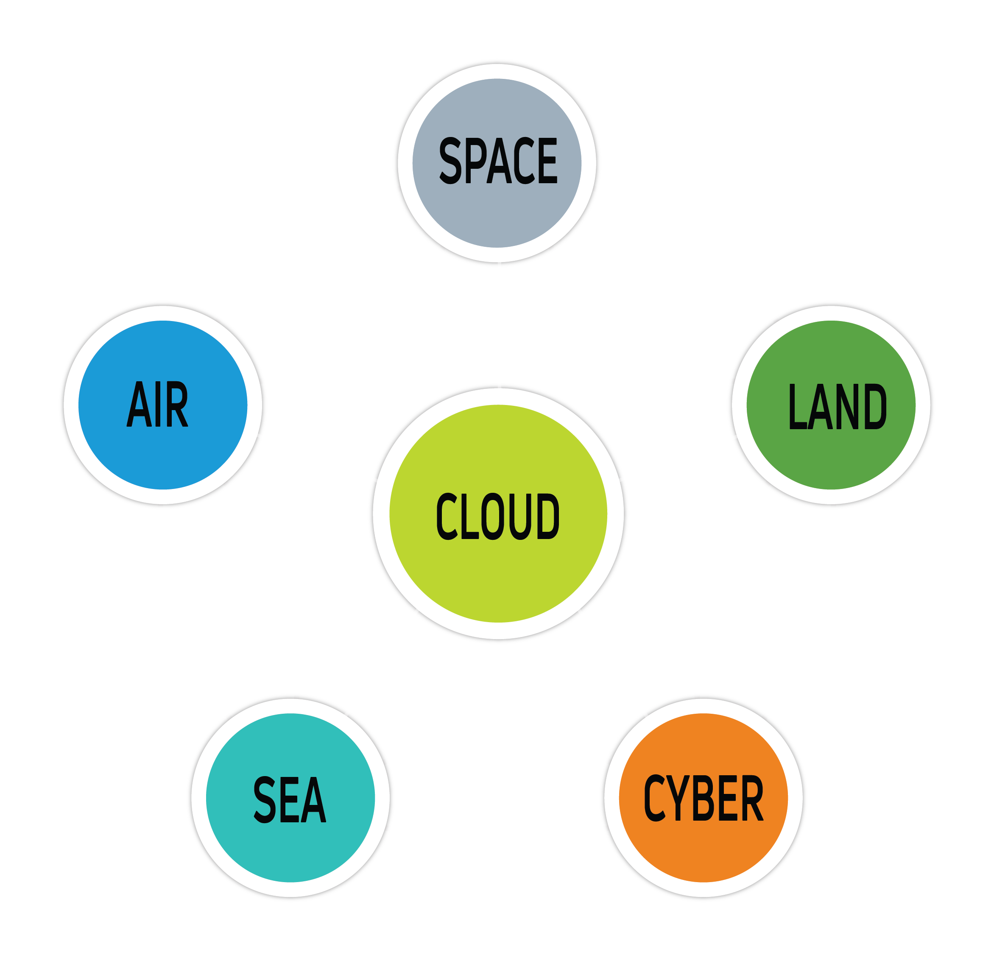
TODAY
Many Incompatible Networks Across DoD
FUTURE MDO
Integrated Capabilities & Collaboration
Streamlined Sensor-to-Shooter-to-Cloud Data Exchange
Assured, Interoperable Communications in Highly Congested & Contested Environments
Simple, Scalable Interoperability Standards & Methods Are Needed
Stove-Piped Capabilities Impair Joint Warfighting Ability

Slide 7
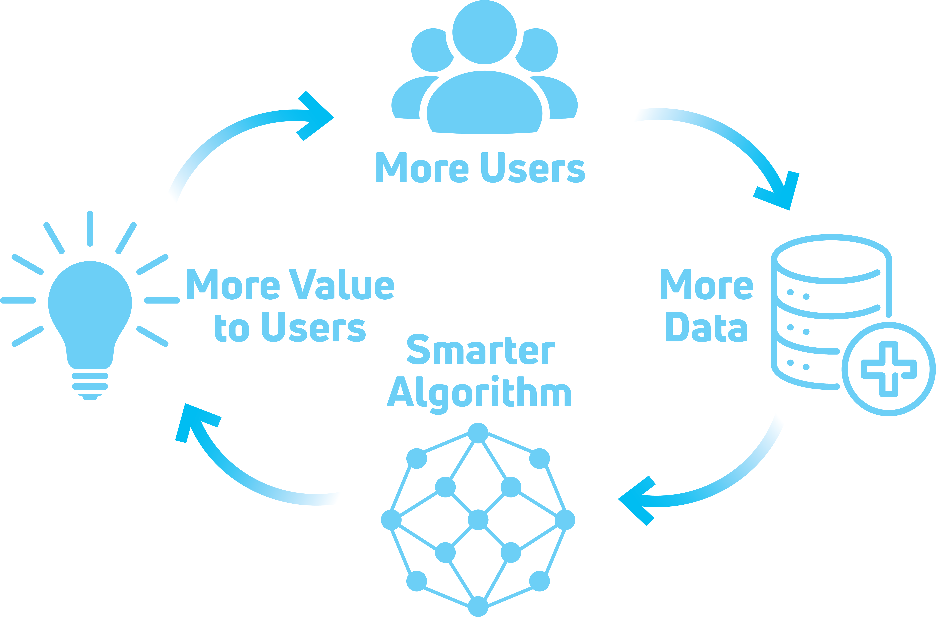
Bringing Users Together Creates More Useful Capabilities
Defense Analog to Commercial Markets
Scalability
Reduced Friction
More Data
Sensors and Actuators
Metcalfe's Law: The usefulness of networks increases with the square of their number of users (Network Effect)

Slide 8
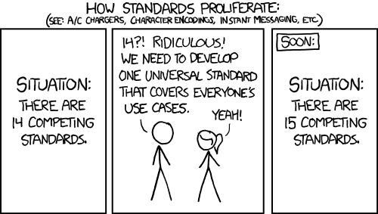
What Are Interoperability Concerns?
C2 Must Be Separate from the Infrastructure
Networked Link Diversity
Physical Layer Convergence
Image Credit: xkcd

Slide 9
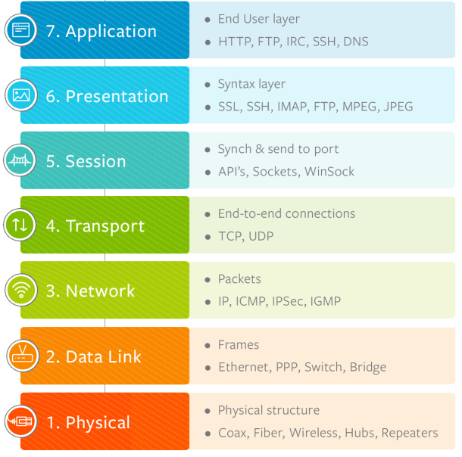
Physical Layer Interoperability Standards » Not Scalable
OSI Networking Model
Creating Interoperability Standards at Layer 1:
Not scalable
Requires hardware changes
Easier for enemy to take down the network
Notes:
Physical layer does advance quickly, and also is the current core for LPI/LPD.
There’s some cases where this makes sense—FSO links, but still tend to be overstandardized.

Slide 10
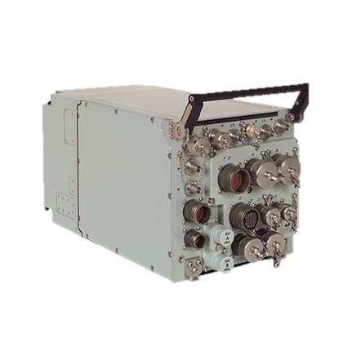
Physical Layer Convergence Is Possible Without Standardization
Physical Layer “Convergence”
SDRs allow for interoperability and preservation of network functions
Extensibility
Flexibility
Can function as Gateways
Only a Partial Solution
Image Credit: Viasat
Notes:
Simultaneous 4-channel operation for expanded functionality
The MIDS JTRS terminal from Viasat combines the network-centric communications capabilities of tomorrow with the real-time operating situations of today – all in one unit. This four-channel software-programmable radio delivers Link 16 and tactical air navigation system (TACAN) functionality, plus three channels for future growth, including JTRS advanced networking waveforms such as those meeting Joint Aerial Network – Tactical Edge (JAN-TE) requirements.

Slide 11
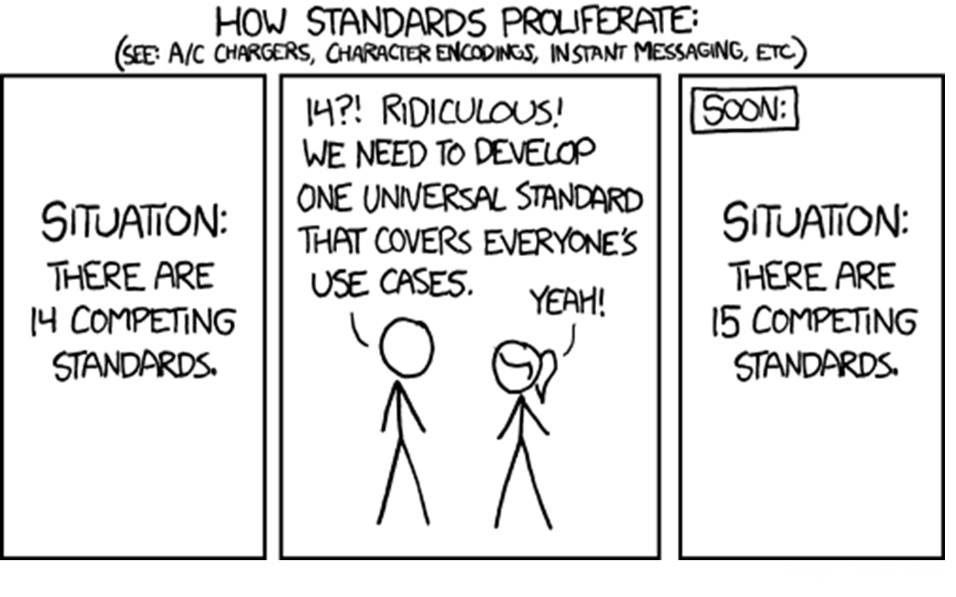
Network & Application Layer Interoperability » Scalable
OSI Networking Model
Creating Interoperability at Layers 3 and/or 7 (e.g., the Internet) :
Scalable Solution, but new standards create friction especially among commercial capabilities
Notes:
We have pretty good existence proof that this works.

Slide 12
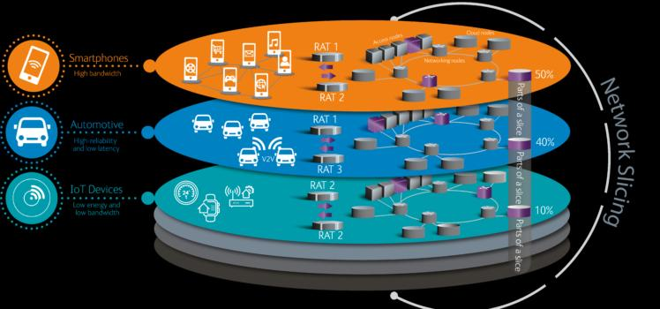
Best Approach: Adopt Commercial Interoperability Standards Rely on Existing Commercial Interoperability Standards Whenever Possible
Incorporate Networking Innovations to Enable Flexibility, Resilience and Performance
Network Slicing and Real-Time QOS
Create flexibility with common protocols, not waveforms
Image Credit: Viavi Solutions
Notes:
SD-WAN and 5G network management
TCP/IP, VXLAN, common protocols

Slide 13
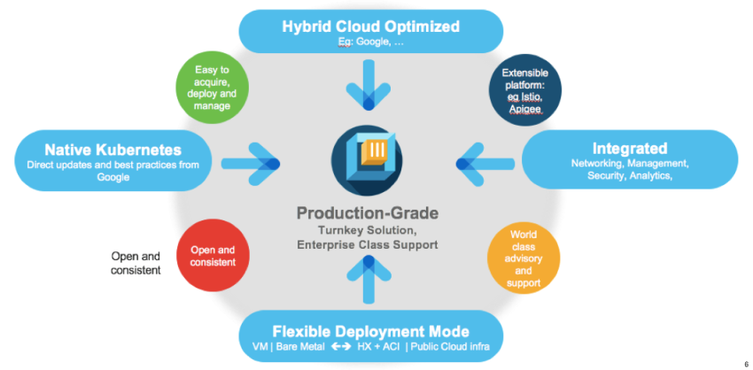
Best Approach: Adopt Existing Infrastructure Models Rely on Existing Commercial Interoperability Standards Whenever Possible
Cloud as the Medium of Exchange
Leverage Big Data advantages
Smart Push and Pull
Capabilities Must Remain Cloud-Agnostic
Includes Hybrid Cloud or Tactical Edge processing as well
Image Credit: KSU Sentinel
Image Credit: Cisco
Notes:
What AWS did to Parler.

Slide 14
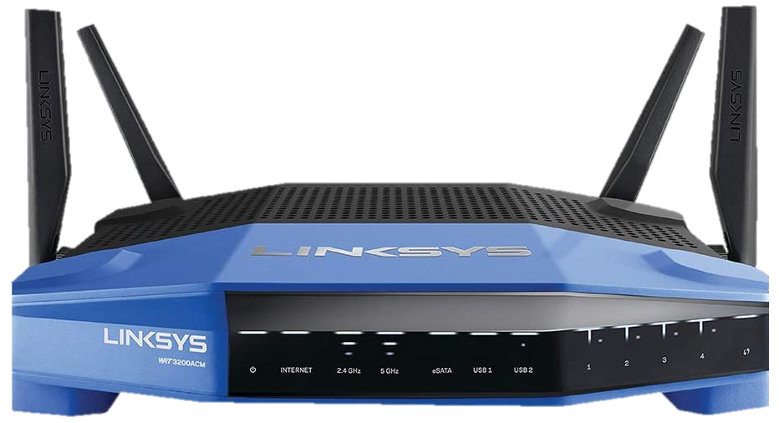
Bridging the Gap with Gateways
Image Credit: Technology Reviewer

Slide 15
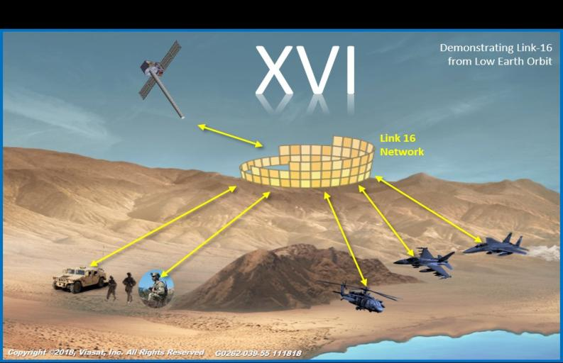
Gateways Allow Incremental Deployment
Defense Industry Examples
BACN
MOJO
XVI
Image Credit: Biley Technologies
Gateways Can Be Choke Points
Good (Cyber Defense, Data Aggregation)
Bad (Single Point of Failure)
Image Credit: Viasat

Slide 16
Image Credit: ForAllSecure

Slide 17
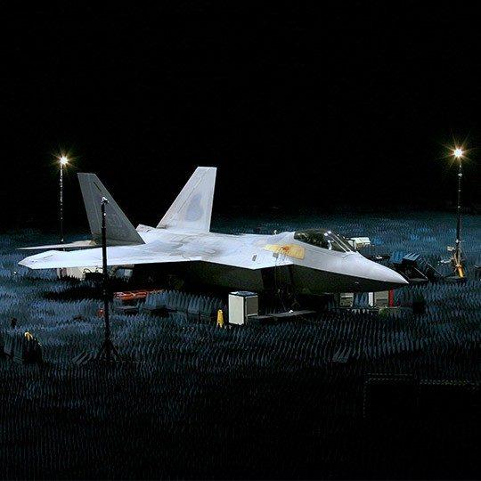
RF Simulation Environments Are Needed
Scale, Complexity are issues, But “Component”-Based Testing Is Crucial
Image Credit: Viasat

Slide 18
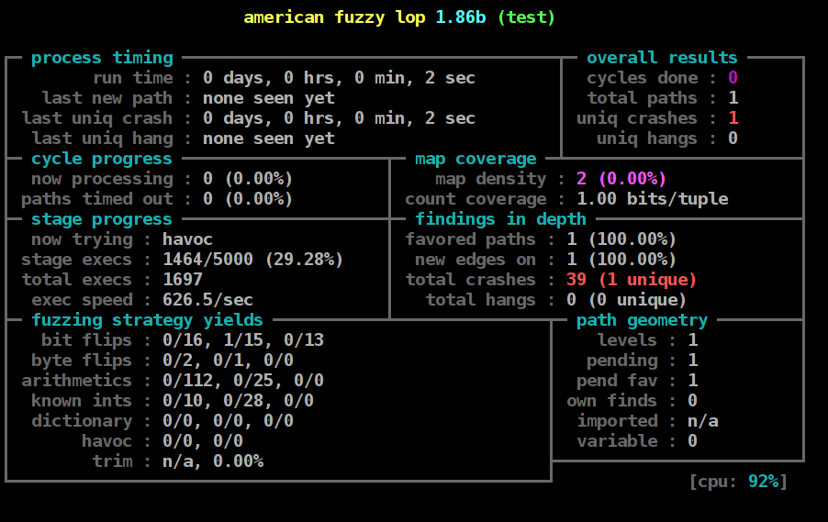
Automated, Intelligent Testing Is Necessary
AI Based Test-Algorithms Can Rapidly Find and Characterize Vulnerabilities
Image Credit: WikiPedia
Notes:
VS-3 testing from months to hours with automation.

Slide 19
Digital Twins Enhance Scalability
Virtual Replicas and Model Based Design for faster, more affordable testing of complex, multi-layered enterprise systems
Pairing Real-World Assets with Digital Twins enables testing and evaluation of connected systems within the Internet of Battlespace Things

Slide 20
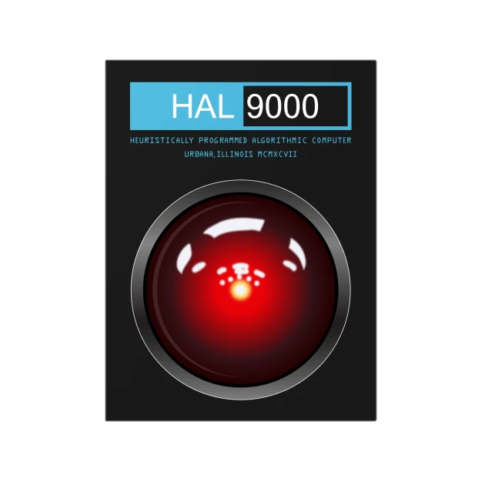
Digital Twins Aren’t Perfect
Sometimes subtle changes to inputs and constraints make a big difference
Image Credit: TeePublic

Slide 21
Cyber Defense Across Integrated Networks
Protecting A Broader Attack Surface Against Cyber Threats

Slide 22
The Need for Adaptive, Intelligent Cyber Defense
Bringing New Networks Together creates an exponentially greater attack surface for cyber effects

Slide 23
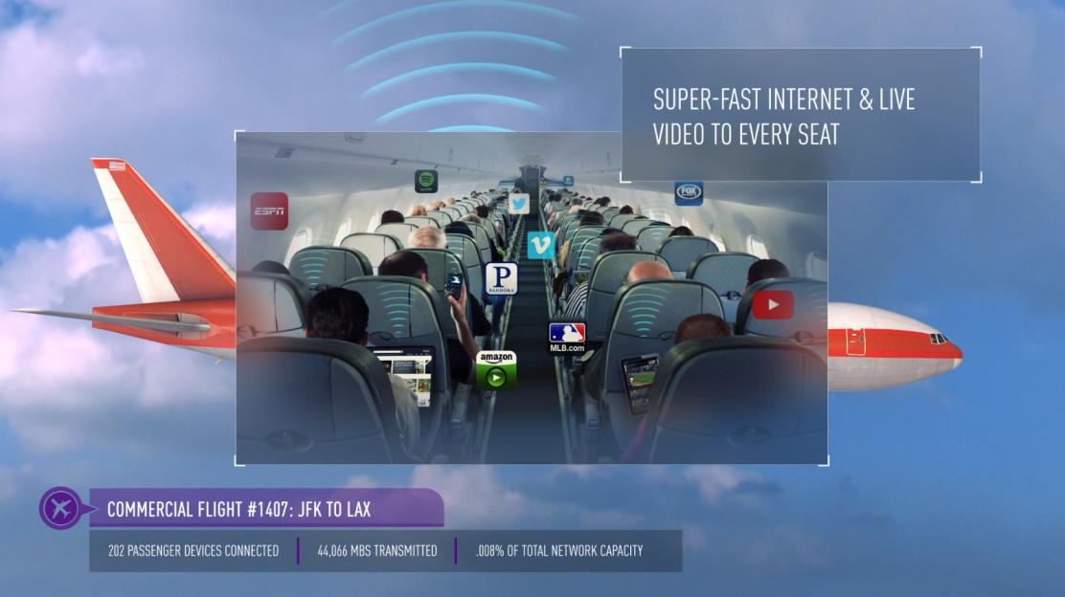
An Inconvenient Truth: Not All Networks or Systems Meet Desired Cyber Posture
Every Day On Viasat’s Network…
2,000,000+ Personal Electronic Devices (PEDs) connected worldwide
500+ Terabytes of data delivered
700,000+ Homes and Community Wi-Fi hotspots connected throughout the world
Senior Leader Aircraft Operate
Image Credit: Viasat
The Network Must Stay Operational and Safe for All Users, Despite Poor Cyber Posture of Some

Slide 24
Network Management Informed By Cyber Threat Intelligence
Every Day On Viasat’s Network…
2.4 Billion cyber events analyzed
35 Terabytes of data ingested, analyzed, and archived
13 Million+ Indicators of Compromise (IOCs) or threat indicators used daily
100% of users are proactively protected from inbound malware
Image Credit: Viasat
Big Data Analytics Enables Better Protection and Real-Time Response

Slide 25
Crowdsourcing* of Trust and Cyber Threat Indicators
Department of Homeland Security Enhanced Cybersecurity Services
Trusted Cyber Sensors can be deployed remotely to improve security without bringing data back to trusted location
Data from Distributed Sensors & Gateways can provide threat intelligence
Cloud & Edge processing to Divine Intent
Metcalfe's Law: The usefulness of networks increases with the square of their number of users (Network Effect)
* As MDO Operations Scale, Algorithms Used to Manage Commercial Networks Become Useful

Slide 26
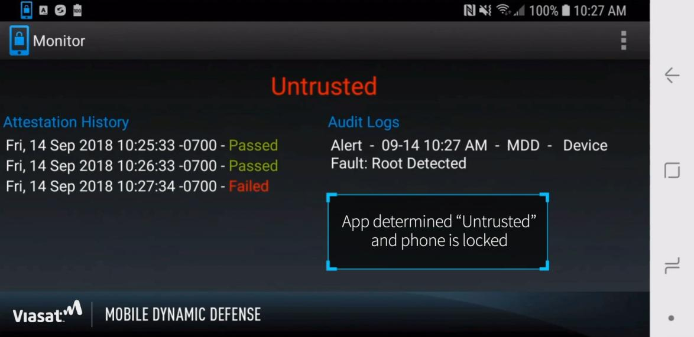
Variable-Trust Architectures Based on Behavioral Analytics
With Proper Situational Understanding…
Data can be Moved and Processed (or not) based on Mission Imperatives
New Capabilities Can Rapidly be Added or Discarded

Slide 27
Preparing for Tomorrow’s Battlespace: Keys to T&E Success
Understanding Where Standardization is Needed
And where it isn’t
Scalability, Reducing Friction
Simulation, Modeling, Automated, Intelligent Testing and Digital Twinning
Integrating Commercial and Government Capabilities
Adaptive, Variable Trust, Hybrid Networks with Cyber/Threat Intelligence

Slide 28
Thank You
Craig Miller
President, Viasat Government Systems
CraigM@viasat.com

Slide 29
PNTAX 20 Sensor-to-Shooter-to-Cloud
Collaboration Between Government & Industry
Drives Success

Slide 30
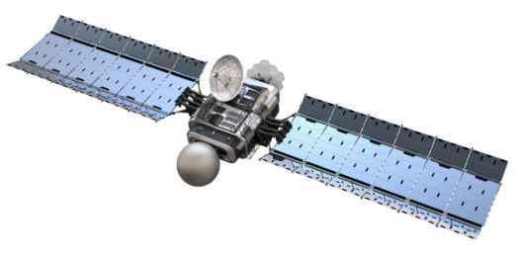
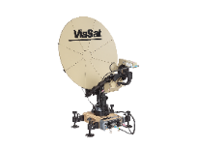
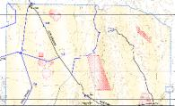
PNTAX 20 » Joint Sensor-to-Shooter Mission Connectivity
Purpose
Demonstrate collaboration between the military and industry using SATCOM and Link-16 networking for JADC2 Sensor to Shooter (S2S) and Sustainment Tactical Network (STN) capabilities
Key Stakeholders
OSD TRMC, Fort Bliss Fires Center of Excellence, Viasat
Outcome
Generated 320+ End to End Fire Missions, resulting in ~ 2560 K-series AFATDS to AFATDS messages between the MDTF and SFB while:
Simultaneously pushing a continuous Air Picture
Simultaneously passing JADOCS Federated information
Simultaneously conducting Ground to Air engagements
Viasat High-Capacity Satellite
Exceeded goal of simultaneously tracking 250 targets by simultaneously tracking 4,000 targets, due to abundant bandwidth available in Viasat's high-capacity commercial Ka satellite
Viasat Multi-Mission Terminal
TITAN Surrogate
TADIL J
MoJo
ADV
J3.5
S3.05
Viasat Multi-Mission Terminal
USMTF
(TIDAT)
Receive Air Tgt
TFE
JADOCS
FBTx CDI Cell
ADSI
FFEADS
JBLM ADV
JADOCS
Receive Ground Tgt
AFATDS
AFATDS
FSMP
FIRESIM
Strategic Fires Battalion (SFB)
Fires Battle Lab
Viasat Multi-Mission Terminal
Sim Shooter
EXCIS
HIMARS
Notional Targets
ADSI
BATS-D
Link 16 RF (Attenuated)
IRIS
MFOCS
Stallion Range, WSMR
JADOCS
AFATDS
BATS-D
Link 16 RF (Attenuated)
JADOCS
AFATDS
FBTx CDI Cell
IRIS
Multi Domain Task Force (MDTF)
IRIS
PF-D

