Slide 1
Classified Ready Employee Workforce CREW Dr. Marcella Shelby, Strategic Initiatives Officer
Physical Science Laboratory
July 2021

Slide 2
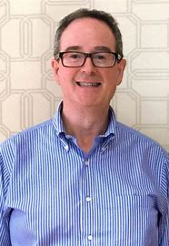
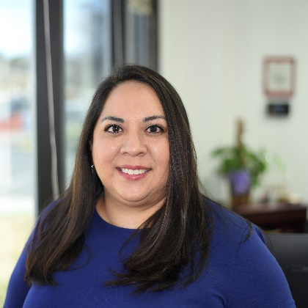
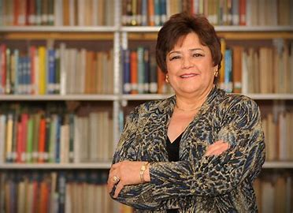
PSL Current Capabilities and Partners
PSL has 75 years supporting science and technology efforts. Established in 1946 in the Physics Department to support V-2 rocket exploitation at White Sands Proving Grounds.
Aerospace
UAS Test Site
Flight test design, testing and demonstrations
Visual observers and ground station design
UAS Design, Small/Micro UAS
Regulatory support
High Altitude Aircraft and Airships
Balloon program support
Telemetry and Missile Systems
Telemetry Products (Catalog)
TM System Development
Integration and Launch Support
Mechanical and Electronics Services Center
Antenna Production/Plating
Production Capabilities
-Product Line ( Flight hardware, Ground hardware)
-Electronics, Mechanical and Antenna Service Centers
Information Sciences and Security Services
Electronic Warfare systems
Air and Missile defense operations and support
Modeling
Cybersecurity assessments
Department of Defense Partners:
U.S. Army: DEVCOM, ACC-APG/Adelphi Cont Div, Picatinny Arsenal, Space and Missile Defense Command, White Sands Missile Range, Army Research Labs
U.S. Air Force
U.S. Navy, Naval Surface Warfare Center-PHD and WSMR Detachment
Missile Defense Agency
Other government partners:
FAA, NASA, National Geospatial-Intelligence Agency, U.S. Department of Interior/Bureau of Reclamation, Los Alamos National Laboratory,
Sandia National Laboratories

Slide 3
CREW Classified Ready Employee Workforce Physical Science Laboratory at New Mexico State University
Mission
To develop a diverse pool of classified-ready professionals with the necessary technical, professional and interpersonal skills required to pursue successful careers in support of national security.
Vision
To be a national resource for preparing highly skilled classified-ready employees through public-private partnerships focused on cooperative education experience in national security research and emerging technology innovation and application.
Program Goals
Innovative education and work experience
Clearance-ready internships and Co-ops
Specialized background in National Security
Opportunity for future employment

Slide 4
CREW Classified Ready Employee Workforce Physical Science Laboratory at New Mexico State University
Year 1
Summer
Year 2
Mission: To develop a diverse pool of classified-ready professionals with the necessary technical, professional and interpersonal skills required to pursue successful careers in support of national security.
Demographics of the inaugural CREW cohort of 16 NMSU Students:
11 are from diverse racial/ethnic backgrounds-Hispanic (10), African-American (1)
2 Veterans (U.S. Army)
4 Women
3 first-generation college students
Range in age from 20-31 years old
Represent the following majors: Electrical Engineering, Computer Science, Aerospace Engineering, Engineering Physics, Mechanical Engineering, Information and Communication Technology
Clearance initiated for 100% of cohort by January 2021. Today, 100% of students have Secret clearance (4 Top Secret)
National Security Seminar Series
DoD Clearance with DOE Reciprocity
Paid Co-op
20 hrs. ( Fall/Spring)
40 hrs. ( Summer)
Year 1-Unclassified
Year 2-Classified
Security Clearance Initiated

Slide 5
National Security Seminar
Students who complete the course will :
Be prepared to be effective participants and employees in the environment of a national security organization.
Articulate and apply national security academic materials, theory, history, contemporary issues through the lens of national strategic documents, professional publications, and other sources.
Demonstrate the ability to think critically and creatively through reasoned argument and professional communication.
Competencies:
Awareness of national security issues
Insight on varied perspectives
Critical thinking skills
Analytic rigor/skills
U.S. national security affairs environment
Global security affairs environment
Institutions
Political theory
Historical and contemporary issues
Ethics
Decision-making approaches

Slide 6
Meet the Instructor
Colonel Jayme Sutton, United States Army (Retired)
Texas girl, raised on the plains of Texas and in the oil fields of West Texas.
Served in the Army for 27 years in a variety of command and staff positions to include multiple hazardous duty and combat tours. She is an airborne paratrooper, jumpmaster and parachute rigger.
Served with "historied" units such as the 82nd Airborne Division, 2nd Infantry Division, a Special Missions Unit, 3rd Infantry Division (twice), the 101st Air Assault Division and with the 1st and 2nd Marine Expeditionary Forces.
Attended Texas Christian University where she majored in Business and received her commission as a Second Lieutenant through the Reserve Officers Training Corps program.
Attended and was on faculty at the Naval War College where she earned her Master's degree in Strategic Studies and International Security Affairs and taught in both the Strategy and Policies department and International Security Affairs Department.
Commanded at the platoon to brigade level and served as senior advisor or special staff on topics ranging from Support to Victims of Sexual Assault for Secretary Rumsfeld to Senior Logistics Advisor for matters of Defense Support in Support of Civil Authorities.
She now lives in San Marcos, Texas with her mom, Carolyn, and few special cats -- Mojito, Cosmo, Michael-Straycat, Goose, and O.G

Slide 7
CREW Leadership
Advisory Council
Christopher Long, General Dynamics
Manny Mora, General Dynamics
Steve Omick, Riverside Research
Diane Peebles, Sandia National Laboratories
Mike Steinzig, Los Alamos National Laboratory
Allyson Yarbrough, Aerospace Corporation
PSL Team
Eric Sanchez, Director of PSL
Patricia Sullivan, NMSU Office of Strategic Initiatives
Marcella Shelby, PSL Strategic Initiatives
Jayme Sutton, CREW Instructor

Slide 8
Cohort Model
“Cohort internships strive to deepen students’ learning and growth by combining professional experience, career development and academic content to a single program. Cohort learning experiences add greater value as student’s develop personal and professional skills and dispositions, cultural competencies, and content knowledge that further prepares them for life and careers.” (McGlashan)
Cohort Models Help Students:
Increase motivation/timely graduation
Build a professional network
Serve as a support group
Common Thread in Research
Cohort programs are most successful with a strong cohort administrator
http://www.middlebury.edu/newsroom/archive/2017-news/node/550492, http://scholar.google.com/scholar_url?url=https://journals.sagepub.com/doi/abs/10.1177/105382590803100207&hl=en&sa=X&ei=Z9OzX8DENcucygTotaXYBQ&scisig=AAGBfm26xFsmO8ZBw56aLnCNJlAIvGZG_g&nossl=1&oi=scholar, https://academicpartnerships.uta.edu/articles/healthcare/value-of-cohort-learning.aspx, https://www.stateuniversity.com/blog/permalink/The-Advantages-of-a-Cohort-Program.html, https://search.proquest.com/openview/24f62a7c264bb9ad995e504321e44395/1?pq-origsite=gscholar&cbl=44724 , https://journals.sagepub.com/doi/abs/10.1177/105268469300300405 , file:///C:/Users/mshelby.PSL/Downloads/ASEE_2014_Cohort_Final_.pdf , https://repository.library.northeastern.edu/files/neu:cj82pw09w/fulltext.pdf

Slide 9
CREW Program Operation
Co-op
Clearance
CREW Student Experience
National Security Seminar
Program Management
Student Experience Oversight
Program Evaluation
Instructor/Curriculum
Employer Relations
NMSU Liaison ( NMSU Foundation, NMSU Online, PSL)
Fund Development and Government Relations

Slide 10
Program Funding
Student Experience and Program Management
PSL
NMSU Foundation
Private or Government Employers
Direct Hire
PSL Contract
Project Cost
Indirect Cost (ONR)

Slide 11
Co-op
CREW
Program Fee
Includes National Security Seminar Series, Program Management and Clearance
Student Wages and Fringe Benefits

Slide 12
Investment Opportunities
Co-op/ Employer Sponsors
Commit to provide paid Co-op experience on national security and defense projects. (2-year program)
PSL or Company can hire students utilizing Handshake system (in partnership with NMSU Co-op Office)
Organizational MOU between company and PSL
Students sign program Code of Conduct
***BEST FOR COMPANIES WISHING TO STRENGTHEN THEIR WORKFORCE PIPELINE
Program Sponsors
Sponsor student participation in national security seminar and Co-op with PSL Division.
National Security Seminar Series- faculty stipend up to endowed “Professor of Practice”
Student experience and mentorship
National Security Textbooks
Program oversight and management
Fund development and partner stewardship, legislative and policy action to scale program.
Curriculum Partners
Support the curriculum development and implementation of Year 2 Classified Seminar ( 90 min, 8-16 sessions)
Faculty-In-Residence at PSL
Host Classified Case Study Session (s)
Host Facilities/Capabilities Tour ( In-person or Virtual Format)
Provide high-level guest speaker or panel of speakers highlighting national security and defense agencies, institutions and career pathways.

Slide 13
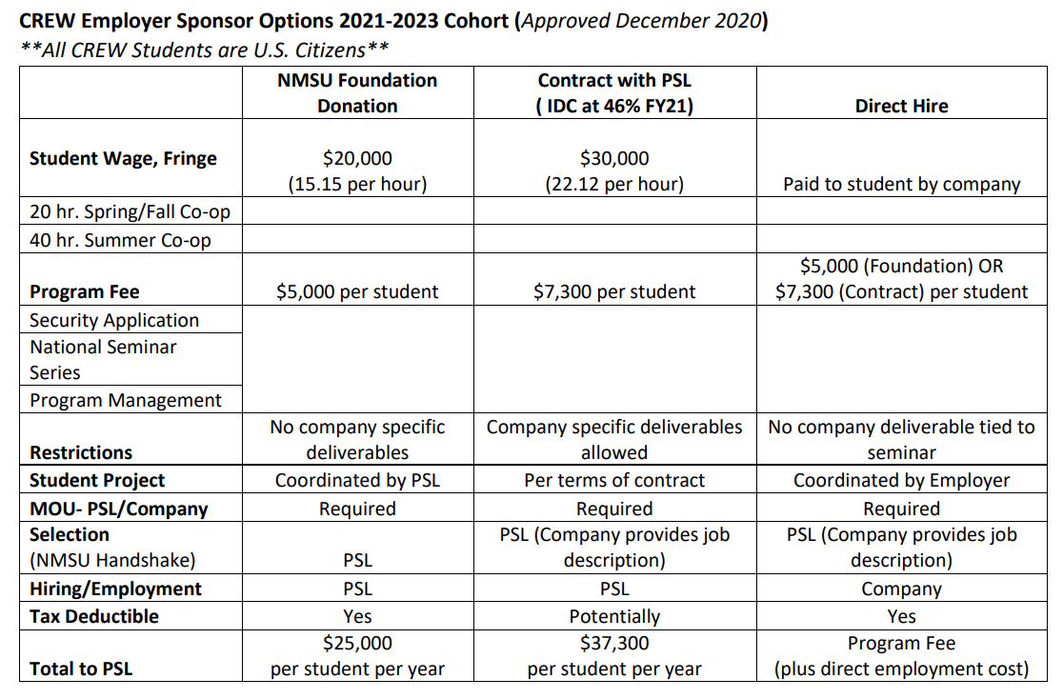
Year 1 Program Cost (per student)

Slide 14
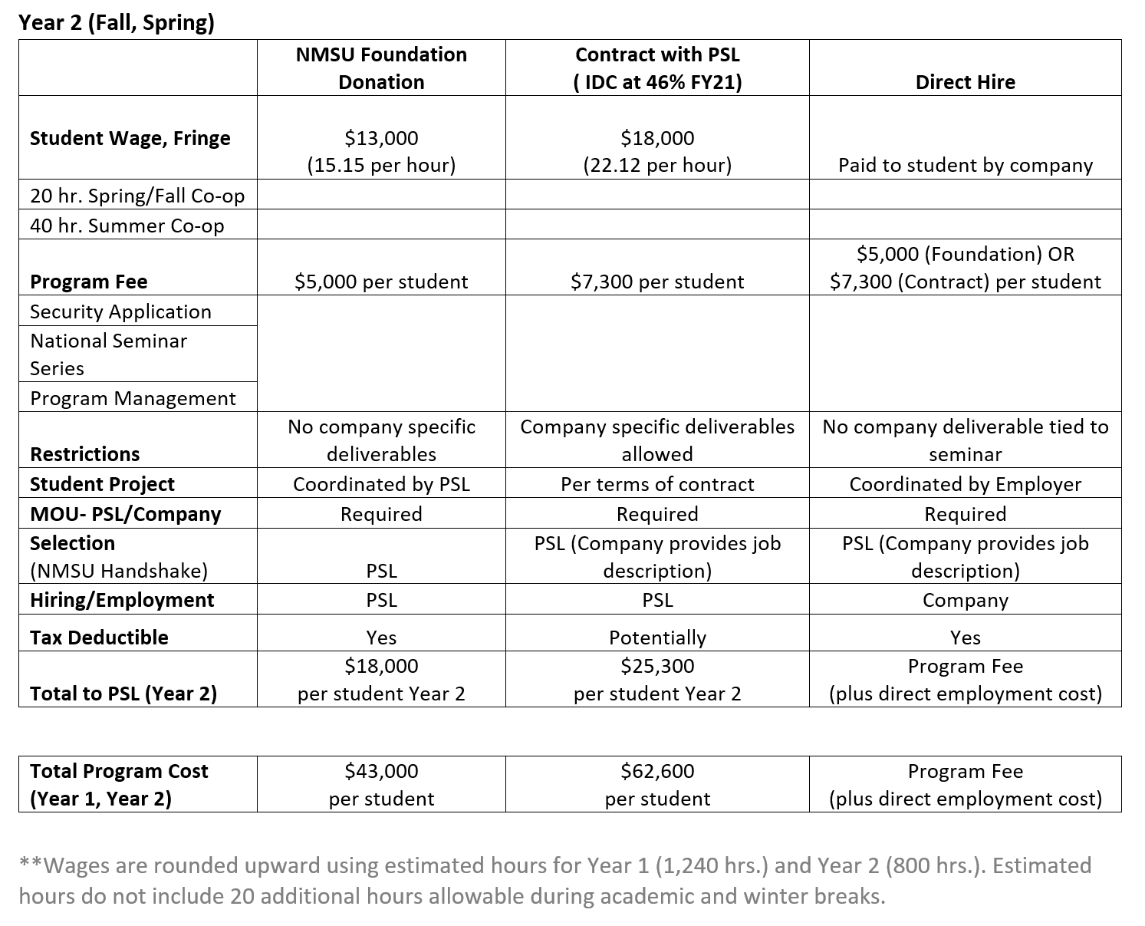
Year 2 Program Cost (per student)

Slide 15
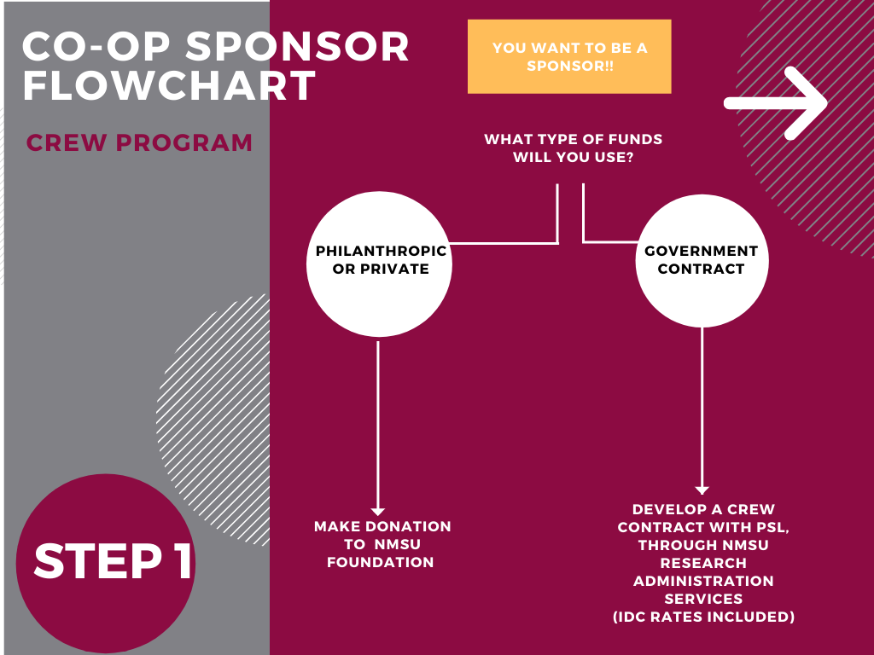

Slide 16
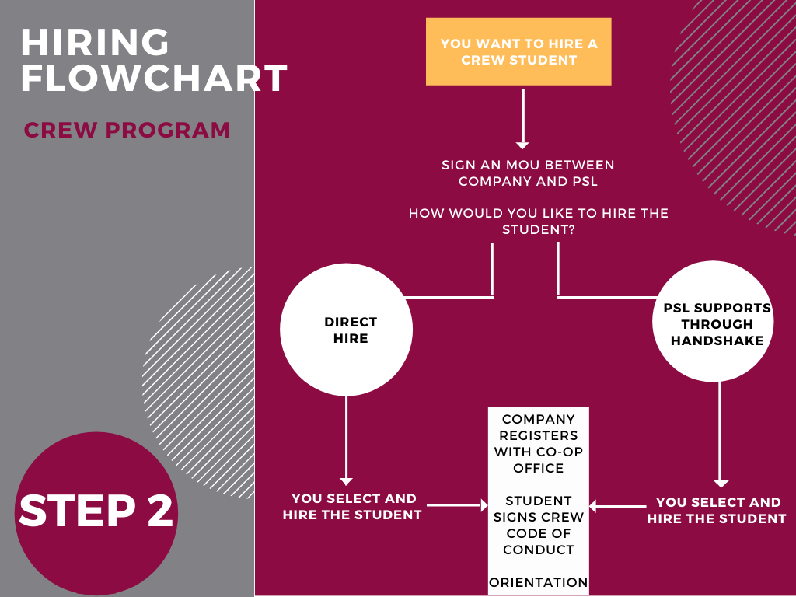

Slide 17
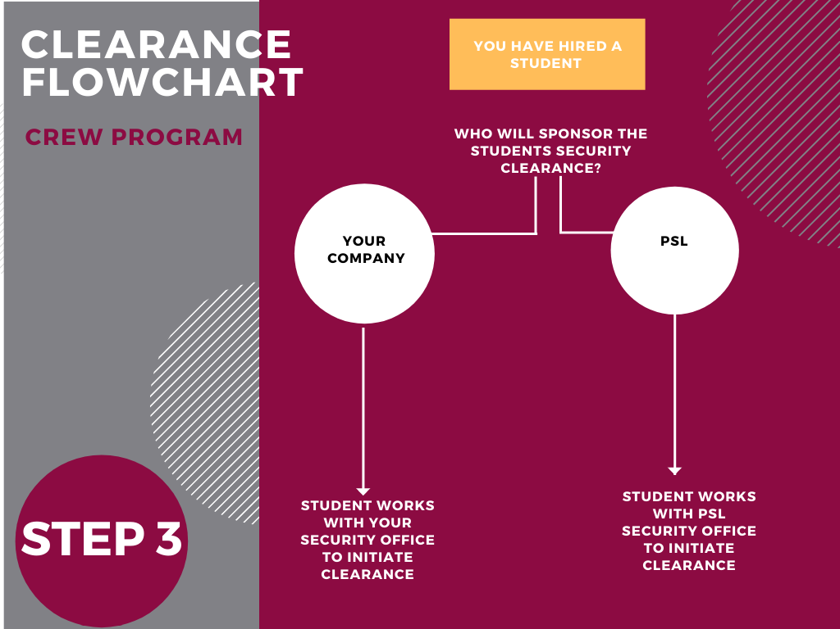

Slide 18
Investment Now has Long-Term Value
Higher Worker Retention-annual study by National Association of Colleges and Employers found that nearly half of employers reported a higher five-year retention rate among employees they hired from their paid internship programs.
Employers save $15,000 in training, hiring, and turnover costs for each employee they hire from their intern pool. (Management Review)
The average cost of a bad hiring decision is at least 30 percent of the individual’s first-year expected earnings. (U.S. Department of Labor) The results of a bad hire include:
-Time and expenses associated with onboarding & training new employees
-Hours spent reviewing resumes and interviewing candidates and recruitment advertising fees
-Time and energy managing poor performance
-Drain on productivity from disrupted projects and lack of continuity of work
-Impact on team morale and stress
-Risk of diminished customer service
-Increased risk of legal fees from unlawful termination or discrimination claims

Slide 19
What do our students say?
"This is an opportunity not many people will have on their resume. [CREW] is giving me a unique edge."
"I think [having my national security clearance] has positively changed my life. I am more aware of my actions and how they might reflect on future checks.“
"[The CREW Program and having my national security clearance] is going to open many doors for me. Blessed to have this opportunity..."

Slide 20
Process for Becoming a Co-op Sponsor
Contact Marcella Shelby, Strategic Initiatives Officer at PSL mshelby@psl.nmsu.edu
Schedule a call to discuss the best next steps. Critical Questions:
First, we need to determine whether we set up the partnership through the NMSU Foundation or NMSU Research Administration Services (RAS). If the answer to the either of the following questions are “Yes”, we will need to work through NMSU RAS.
Will there be a specific deliverable attached to the CREW students participation?
Will government funds be used?
Based on the results of (a), we will review the cost structure required to support each student.
Final Question: How many students would you like to sponsor? For how long?
We work with the right NMSU representative to draft a “gift agreement” or contract and proceed toward final signature.
Co-op sponsors are also asked to sign a Memorandum of Understanding and participate in an CREW Employer Orientation.
Co-op sponsors can recruit and hire students directly or can work with PSL to post job announcements on Handshake.

Slide 21
Process for Making a Donation
As a Business Entity or an individual making a donation over $5,000:
Contact Marcella Shelby, Strategic Initiatives Officer at PSL mshelby@psl.nmsu.edu
Marcella will connect you with the appropriate representative from the NMSU Foundation.
NMSU Foundation representative works with Investor/Donor to develop a customized "gift agreement” for signature.
Fund delivery is coordinated with the NMSU Foundation and made available for use by PSL ( per donor wishes)
As an individual making a donation under $5,000:
Visit http://giving.nmsu.edu/CREW.html
Please contact Marcella Shelby at mshelby@psl.nmsu.edu to confirm receipt

Slide 22
CREW Program Contacts
Eric Sanchez, Director
Physical Science Laboratory
New Mexico State University
esanchez@psl.nmsu.edu
575-646-9200
Dr. Marcella Shelby, Strategic Initiatives Officer
Physical Science Laboratory
New Mexico State University
mshelby@psl.nmsu.edu
575-646-9206
Dr. Patricia Sullivan, Director, Strategic Initiatives
Office of the Chancellor
New Mexico State University
575-646-2913
patsulli@nmsu.edu
Link to CREW Program e-brochure
https://cdn.flipsnack.com/widget/v2/widget.html?hash=cnavqa8hp8
CREW Program Fund Giving Page
http://giving.nmsu.edu/CREW.html

