Slide 1



MRTFB Support of JADC2
Jerry Tyree
Deputy Commander/Tech Director
White Sands Test Center
norman.g.tyree.civ@mail.mil
575-678-1959

Slide 2
MRTFB Support of JADC2
AGENDA
INTRODUCTION
MRTFB INTEGRATION
CHALLENGES AND INTIATIVES
A PERSISTENT TEST BED – CASE AND CONCEPT
INFORMED RISK MANAGEMENT APPROACH
SUMMARY

Slide 3
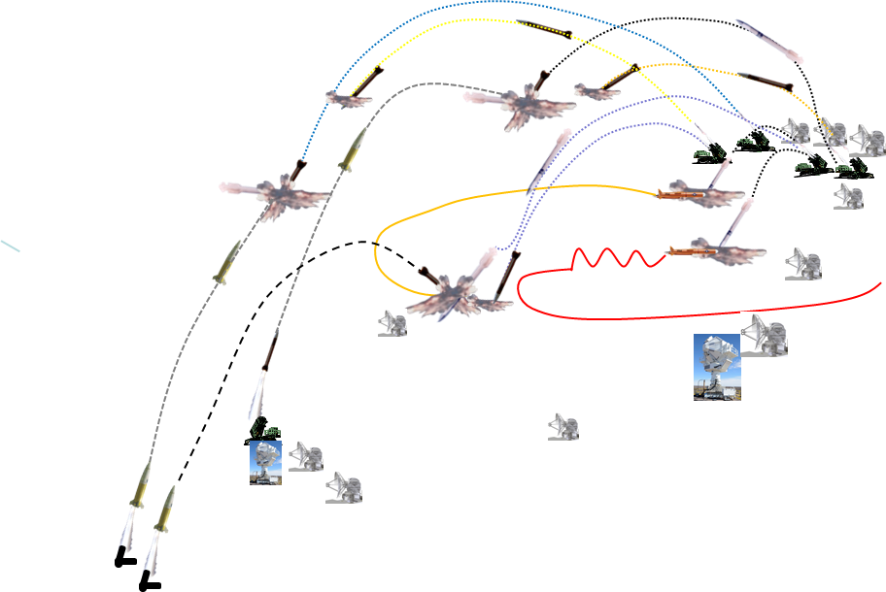


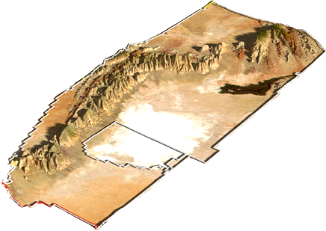
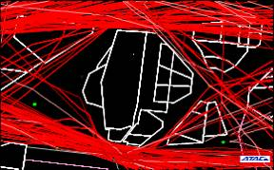
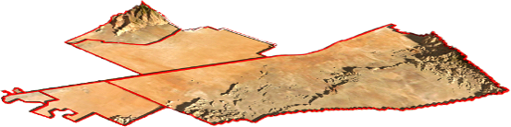
MRTFB Support of JADC2
INTRODUCTION
Army, Navy, Air Force
DOTE, NASA, NRO, DTRA
Cyber Range
White Sands proper is 3,421 sq. miles (8,859 sq. kilometers)
Lease agreements add 2,453 sq. miles (6,353 sq. kilometers)
Northern Call-Up Area ~40x40
Partner with Ft. Bliss add 1,745 sq. miles (4,520 sq. kilometers)
Western Call-Up Area ~20x80
~40 Miles (64 Km)
~40 Miles
WSMR
~183 Miles (294 Km)
~100 Miles
Ft. Bliss
Special Use Airspace
Total Land Space
7,619 sq. Miles
WSMR =17% of Army Land Holdings World Wide

Slide 4

MRTFB Support of JADC2
INTRODUCTION
Boise
IDAHO
Shoofly
NEVADA
Shoofly - 750 miles
Dugway
34 Acres
Salt Lake City
Las Vegas
Green
River
Green River - 435 miles
Shoofly, Idaho
UTAH
ARIZONA
3628 Acres
Green River, Utah
Denver
Phoenix
Gallup
Ft. Wingate
NEW MEXICO
Albuquerque
Albuquerque
Ft. Wingate, NM
Phoenix
WSMR
Dallas
Ft. Wingate - 250 miles
El Paso
White Sands
Las Cruces
Post
Missile Range
6520 Acres
Alamogordo
El Paso, TX

Slide 5
MRTFB Support of JADC2
MRTFB INTEGRATION
Joint All Domain Battlespace will require interconnectivity of 2 or more of the DoD Test and Training Ranges
Land, Air, Sea, Space, Cyberspace
Capacity, Capability, Realistic Area of Operations
Requires a non-traditional approach to Distributed Test and Training
Interoperability – not just connectivity – including COCOMs, MDTF - common architecture
Denied environments – GPS denied, electronic warfare, electronic attack
Advanced Battle Management System
Project Convergence
Jukebox, Valiant Shield

Slide 6
MRTFB Support of JADC2
CHALLENGES & INITIATIVES
Multiple Simultaneous Engagements
  Number of instruments / personnel for operations and data collection
  Area coverage – Time Space Position Information, Telemetry
Asynchronous Operations
  Processes – planning, scheduling, resource allocation – range control -”at the speed of combat”
Safety Danger Zone Overlap
  Risk management
  Remote Classified Operations
  Autonomous Flight Safety - miniaturization
Threat Presentation
  Denied Environment compatibility with instrumentation and control systems
  Asymmetrical presentation
  Spectrum compatibility – in denied environments
Security
  Physical, info, operations, personnel
  Cross Domain Solutions
Data Collection Reduction Analysis
  How much is enough – to inform solutions to gaps, shortfalls, failures – to inform decisions
Live Virtual Constructive
  M&S validation, sustainment and availability
Cost and Schedule
  Affordability
  Responsive - change at the speed of threat, software, technology

Slide 7
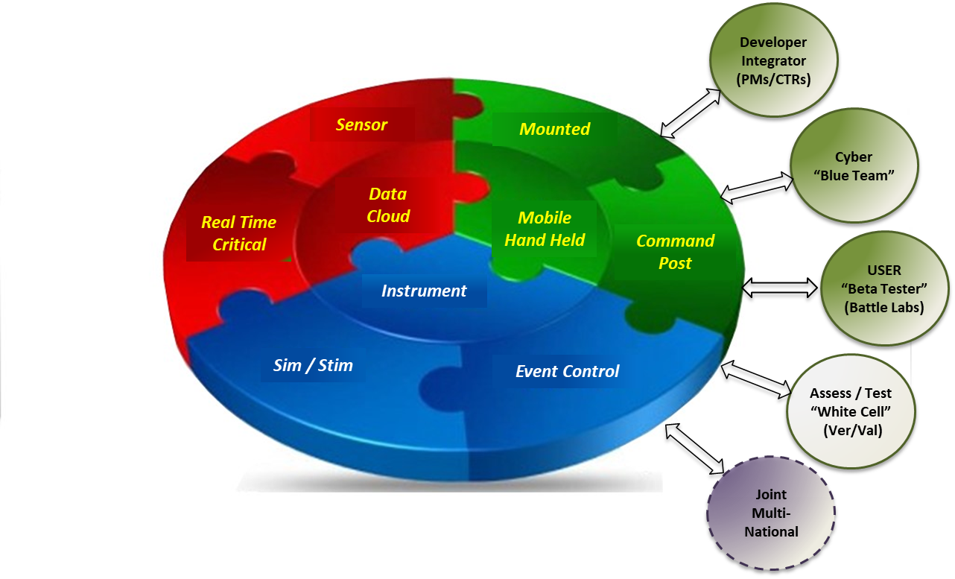
MRTFB Support of JADC2
PERSISTENT TEST BED
JADC2 Environment is one of persistent change
Acquisition RDT&E Methods Must Be Responsive to Need
  Changes in threat – capabilities, TTP
  Changes in Network, Software intensive and Artificial Intelligence Systems
Affordability
  Cost to plan, muster, execute and redeploy is costly – time and money
  Integration of multiple capabilities is impossible to synch – development cycles, funding profiles, maturity
Persistent Test Bed Concept – incremental approach
  Core capability to provide live, live virtual and emulations of MDO
  Threat, instrumentation, analysis, developer and operational SMEs
Composition - CONOPS
Re-purpose, interconnect, or consolidate existing resources
Core transport and computing HW/SW live
Distributed connectivity to labs/sources/ranges
Persistent SME Team – scheduled resources/configs
Supports all Phases of Integration, informs operational assessment through risk/cost/benefit/impact running estimate
Characteristics
Replicates /Emulates Tactical Net
Reconfigurable Network Version
(~2 hrs Past Current and Future)
Reconfigurable Architecture
(Div/BDE/BN/PLT slice)
Class / Unclass Connectivity to existing transport nets
Repeatable ‘canned’ threads, scenarios, configuration ver/val
Configuration Management and Control “Golden Brick”
Instrumented so support diagnostics and validation
Managed to systematically control processes and variables

Slide 8
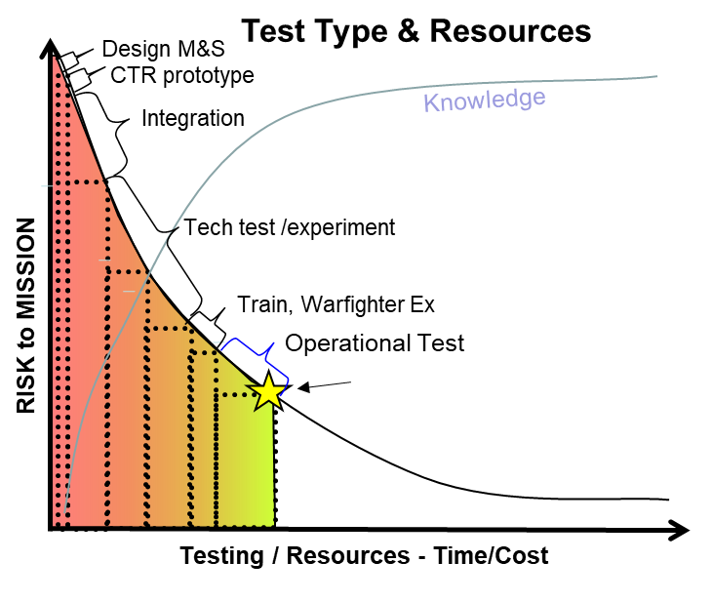
MRTFB Support of JADC2
INFORMED RISK MANAGEMENT APPROACH
It’s ALL about LEARNING - Reducing RISK - Increasing Confidence
REQUIRED INFORMATION
Performance
Effectiveness
Suitability
Survivability
DOTLmPF
WHERE DO YOU GET IT? > M&S, DT&E, OT&E, Phased Integration
HOW MUCH IS ENOUGH? > Knowledge / Risk Management Plan
Balancing Act:
What Tool / How Much = Acceptable Risk?
Too Little Test = Too Much Risk
Too Much Testing = Too Much Cost/Schedule for Return
Test Managed by Value Ratio = Risk Reduction / Cost
Decision point – Acceptable Risk
JADC2 itself is not testable – the Warfighting Functions it delivers are

Slide 9
MRTFB Support of JADC2
INFORMED RISK MANAGEMENT APPROACH
Risk
Knowledge / Confidence
GOAL
Knowledge
Requirements
Tech-Operation
By POR
- KPP/KSA…
- COIC
IS/NeMC CDD
DOTLmPF
Architecture
Task Org
MOP / MOE
POR(s)
Test
TEMP
Developmental / Operational
-climatic, emi
-ew
-integration
-log demo
-safety
Phased Integration
Phase 0-3
Developer API
Control Points
FIE based
Integration
Test
User jury
Cyber
Operational Assessment
Task/Org/Arch
-Knowledge Gap
Risk based
- unit size
- threat
- scenario
- instrument
- data
Fielding Decision
RISK Management Based decision
Risk
Impact
Cost
Benefit
FIELD & SUSTAIN
Iteratively
Test to the Gaps
What do we need to know
What do we know,
What don’t we know
Risk Report
Risk/Impact
Cost/Benefit
Ver/Val knowns in operational environment
Running Estimate of Gaps drives OA design
Responsive
Evolve
When Needed, When Available
Changes in Threat Technology, CBA/ONS…
Iterative

Slide 10
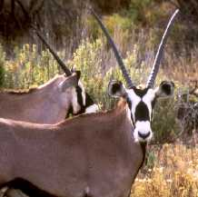
SUMMARY
MRTFB INTEGRATION IS CRITICAL TO JADC2 FIELDING AND SUSTAINMENT
CHALLENGES REQUIRE JOINT CONTRIBUTION / INVESTEMENTS
CHANGES TO RDT&E ARE REQUIRED TO BE RESPONSIVE, EFFICIENT AND EFFECTIVE TO JADC2 FIELDING
QUESTIONS / DISCUSSION?

