Slide 1
The 2021 ITEA T&E Professional Awards

Slide 2
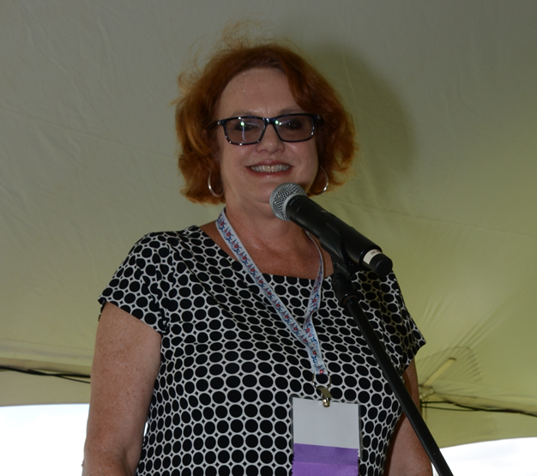
The 2021 ITEA T&E Professional Awards
Committee Chair, Mrs. Stephanie Clewer

Slide 3
Association Awards

Slide 4
Board of Directors Award
Charles G. Garcia

Slide 5
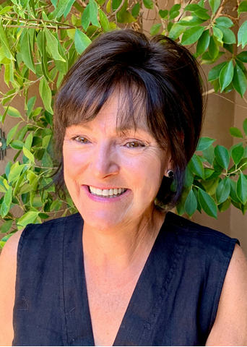
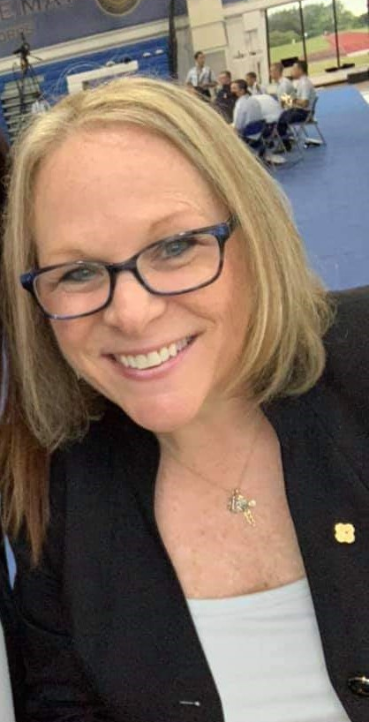
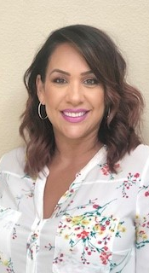
President’s Award
ELK Management Group

Slide 6
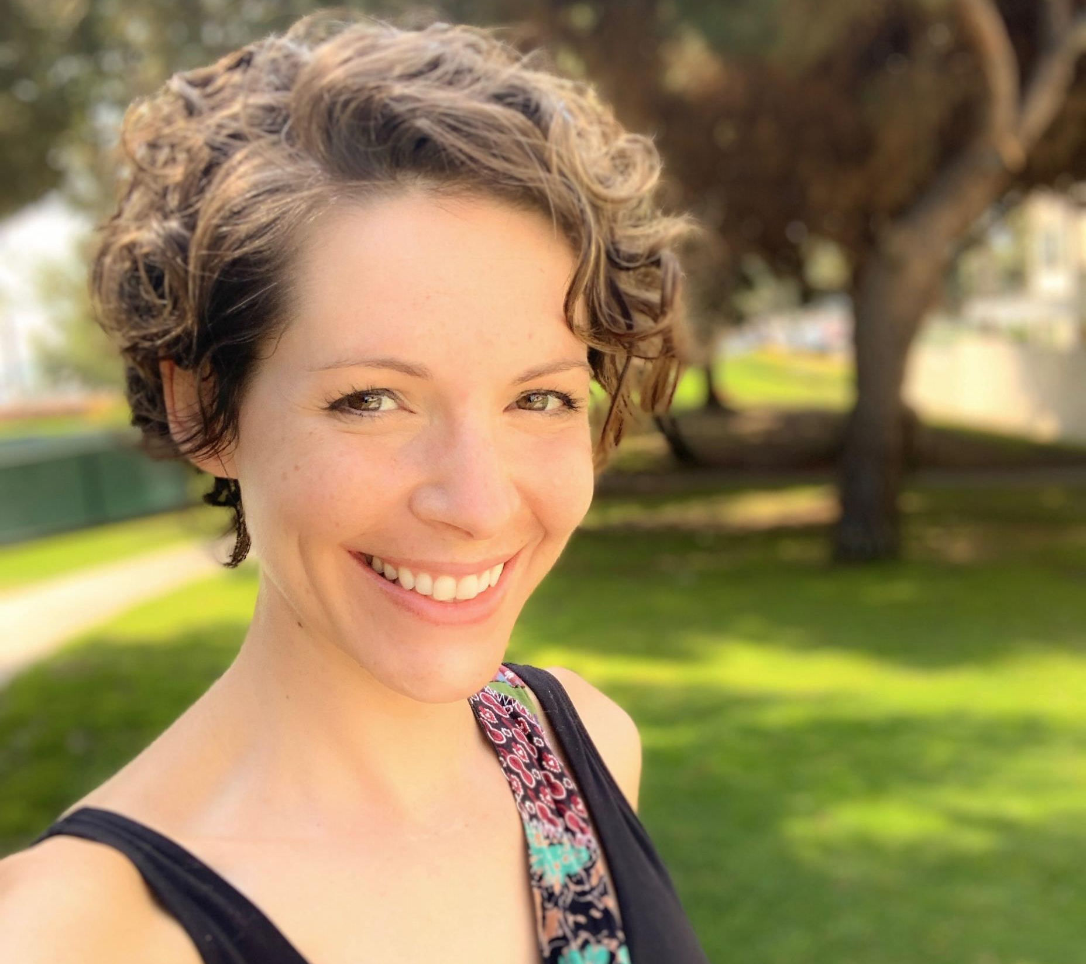
Energizer Award
Wendy M. Peterson

Slide 7
Test and Evaluation Professional

Slide 8
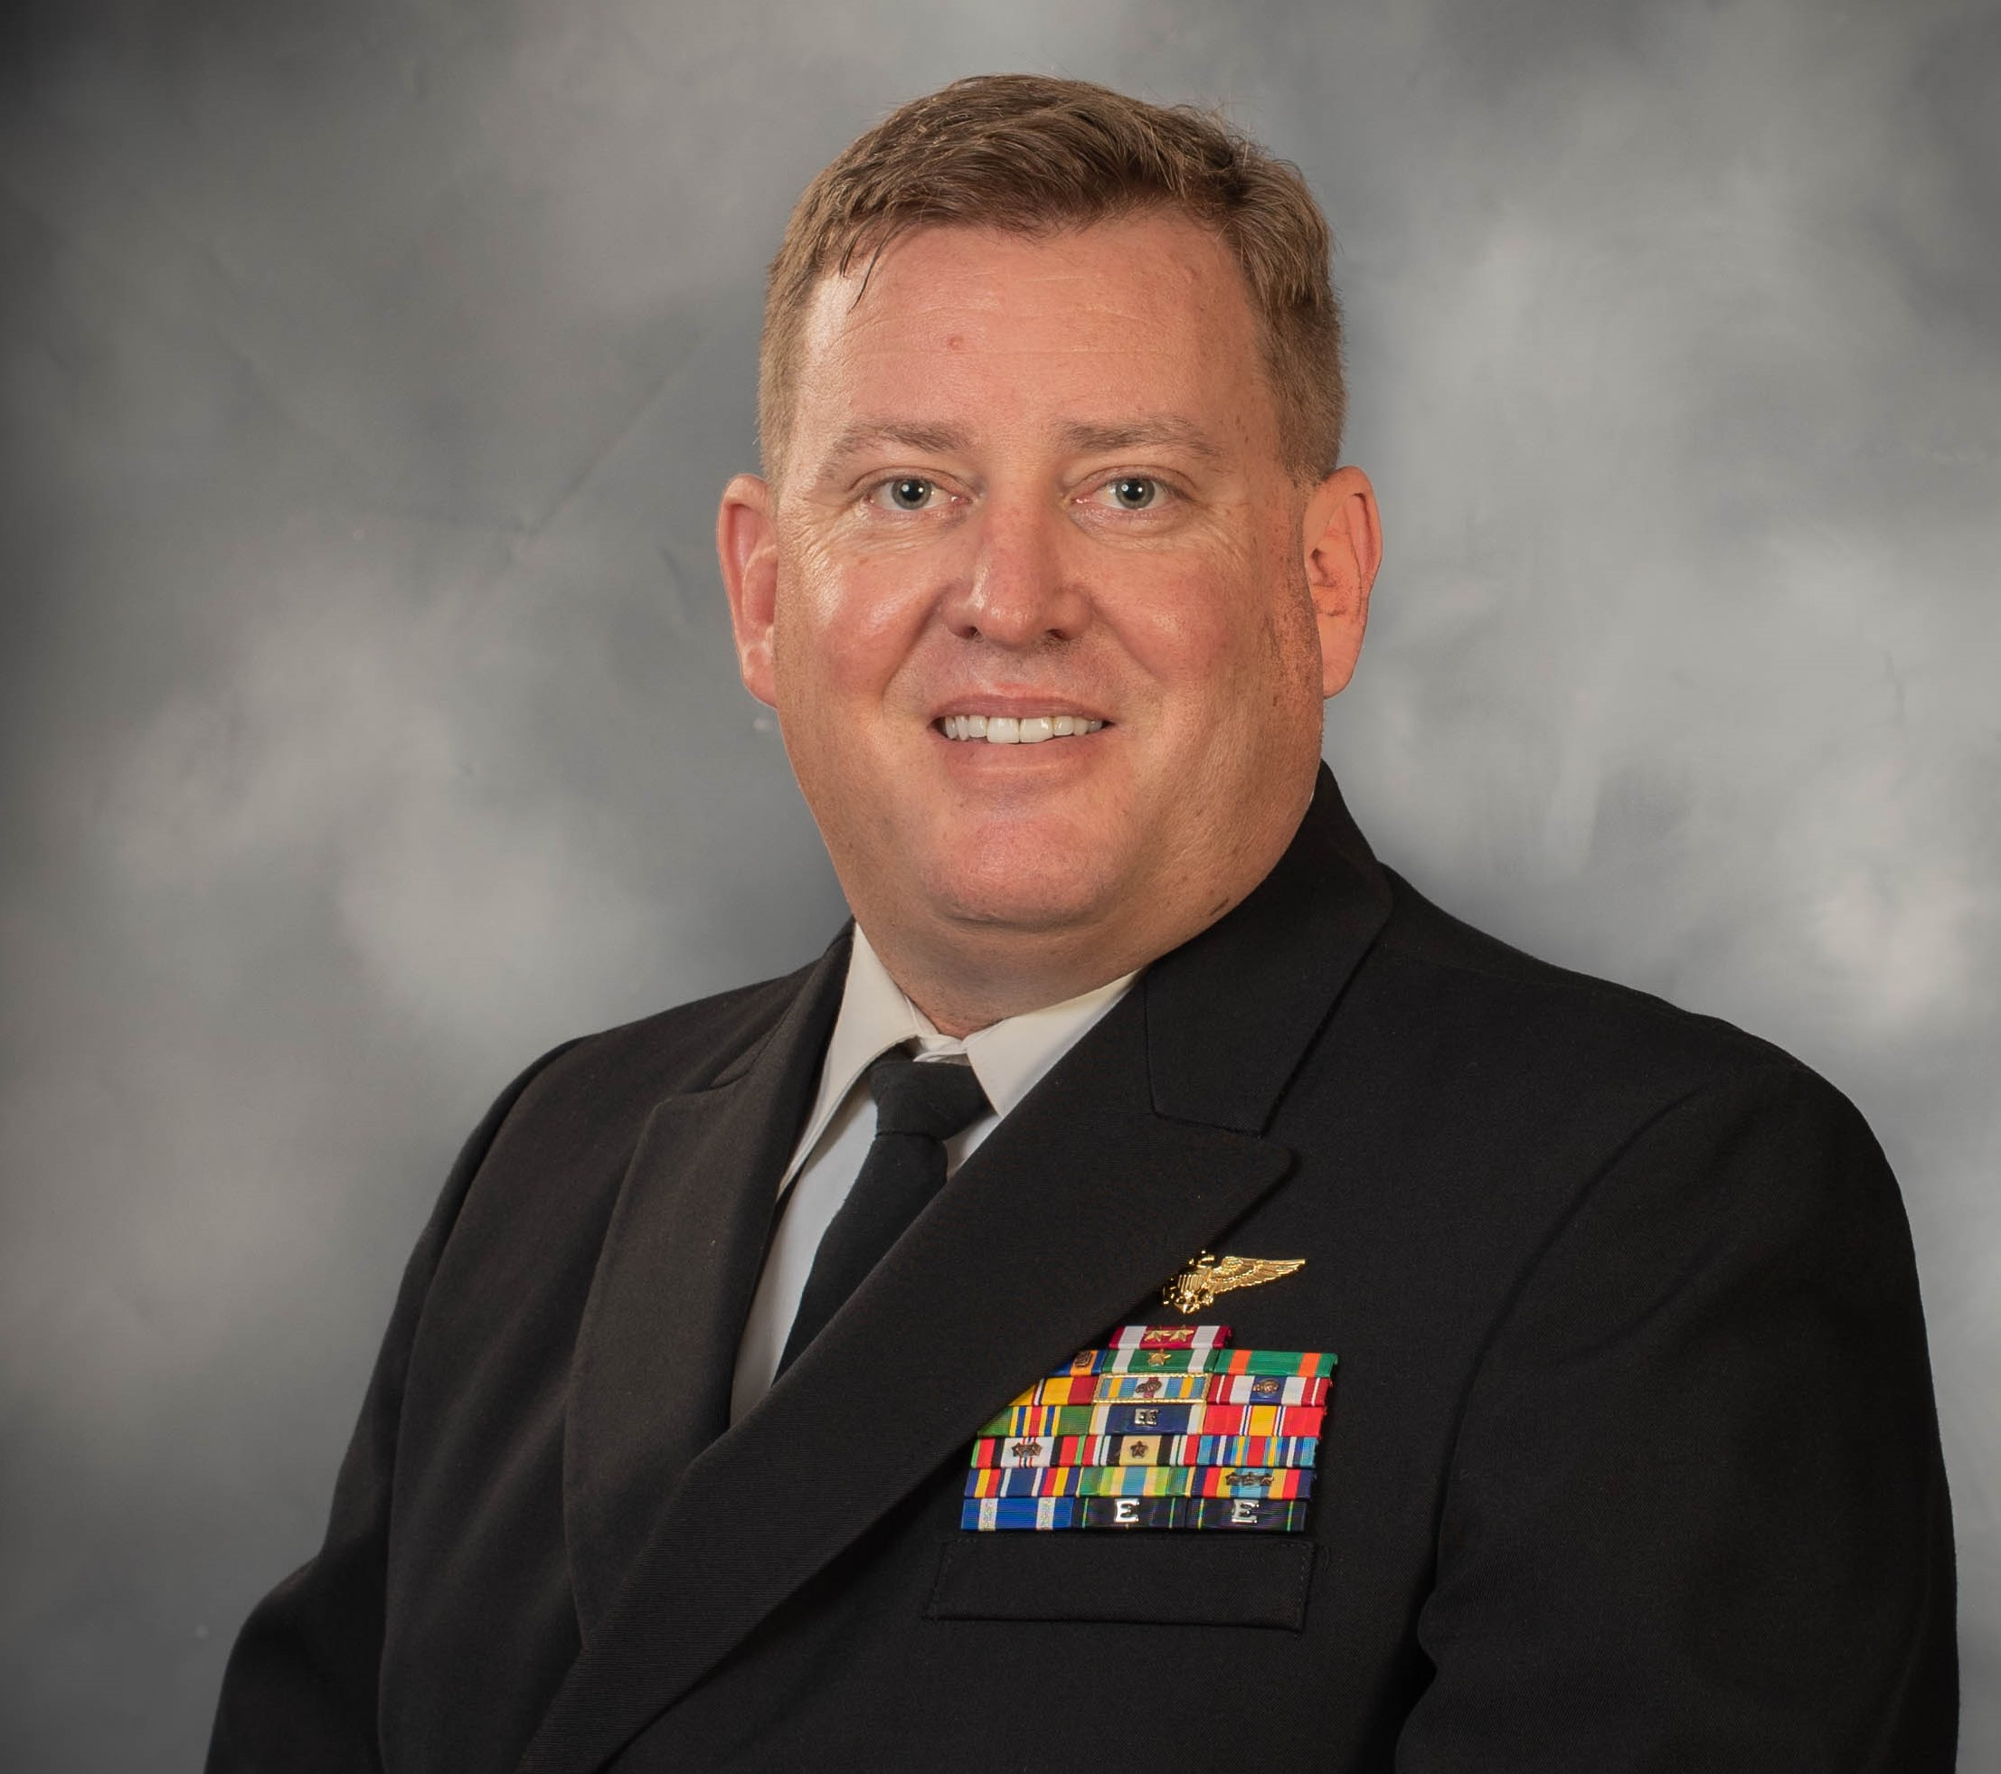
Publications Award
CDR Donald Costello, USN

Slide 9
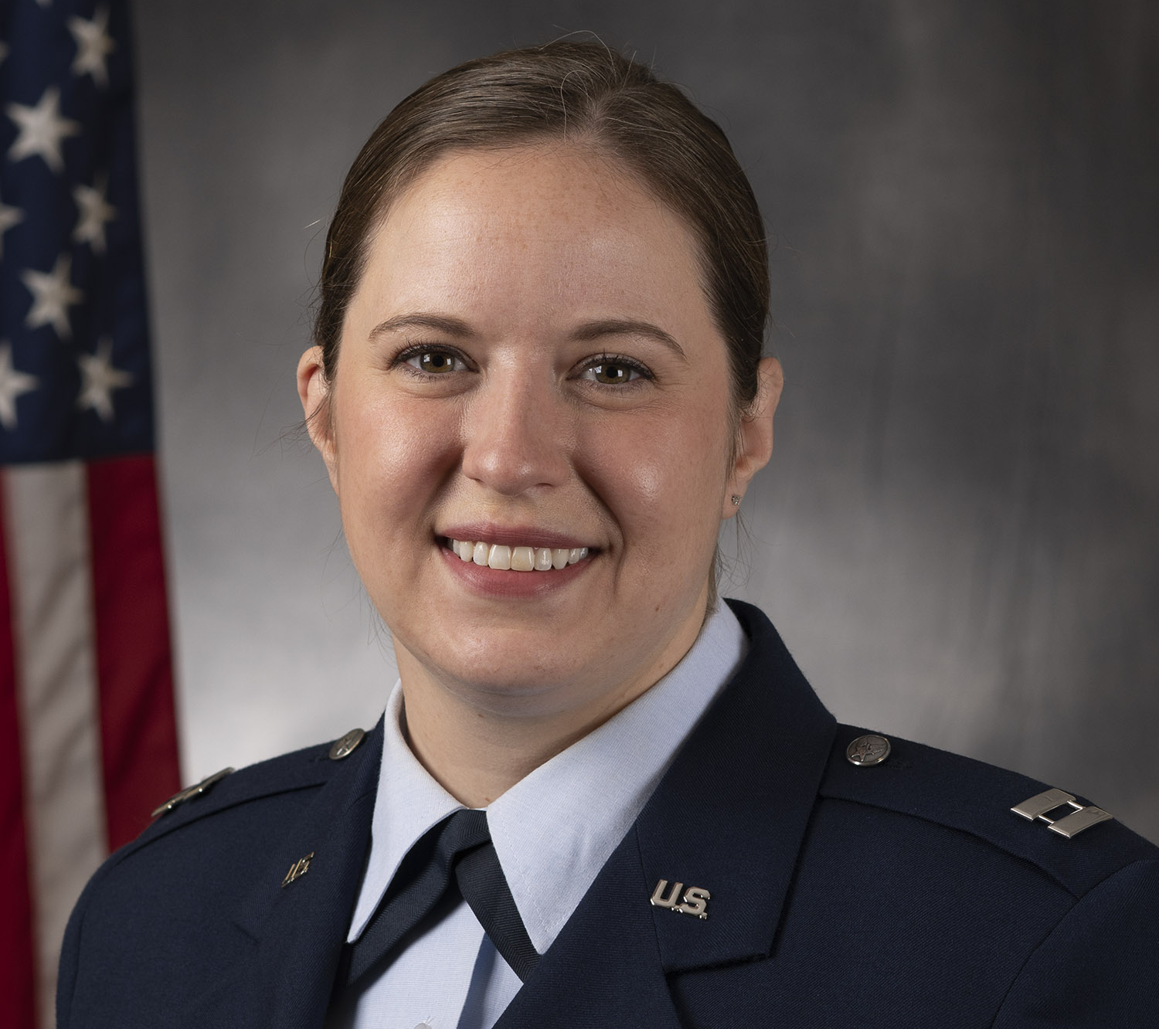
Junior Achiever Award
Capt Lauren Mount, USAF

Slide 10
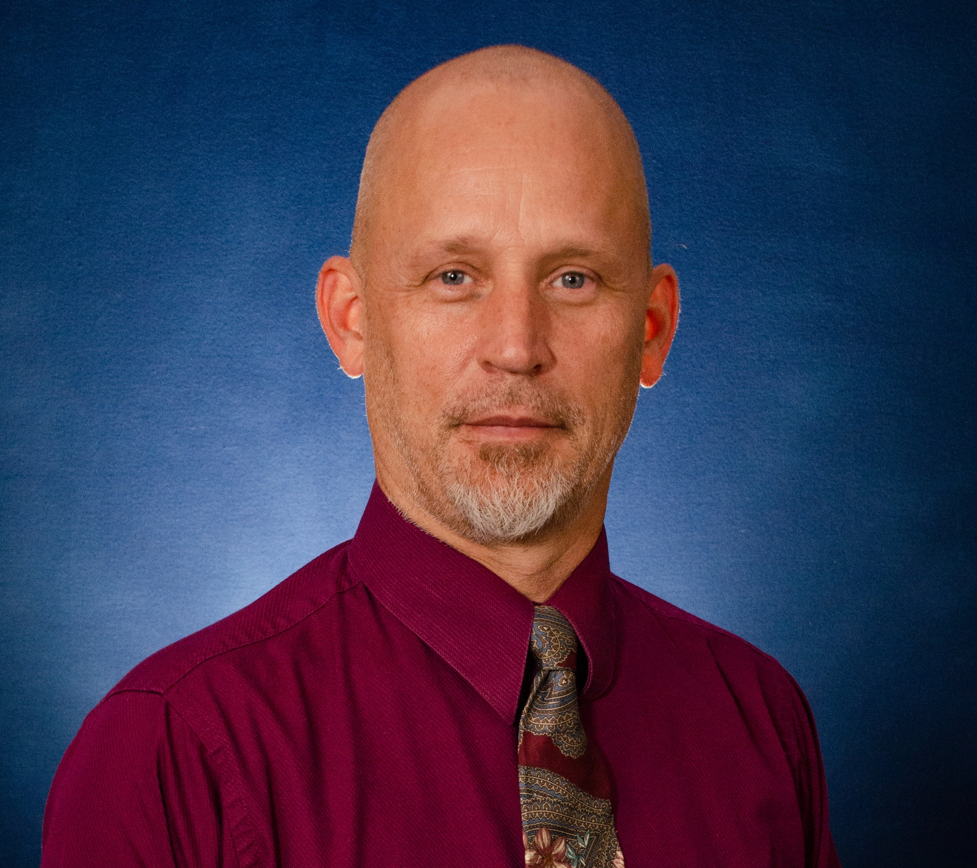
Technical Achievement Award
Dr. Peter L. Wick, Jr.

Slide 11
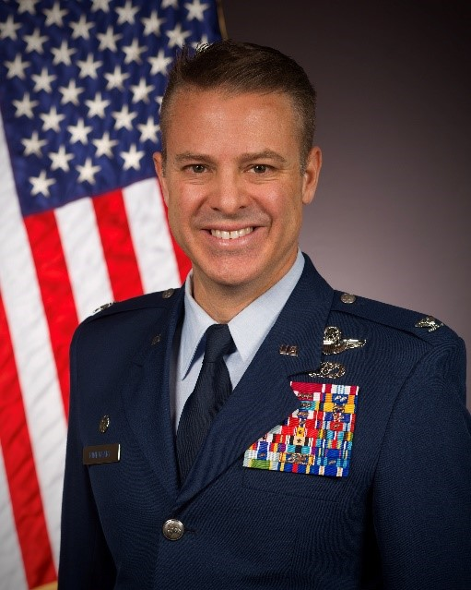
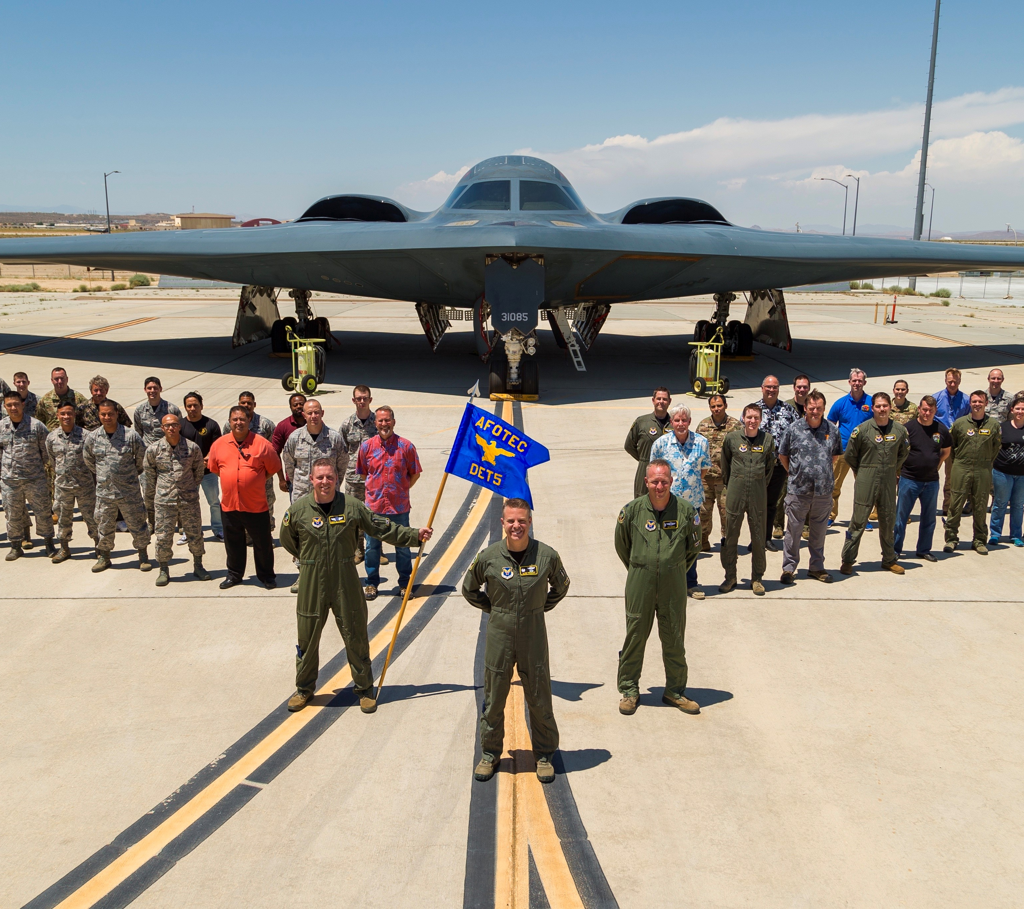
Special Achievement Award
AFOTEC Detachment 5

Slide 12
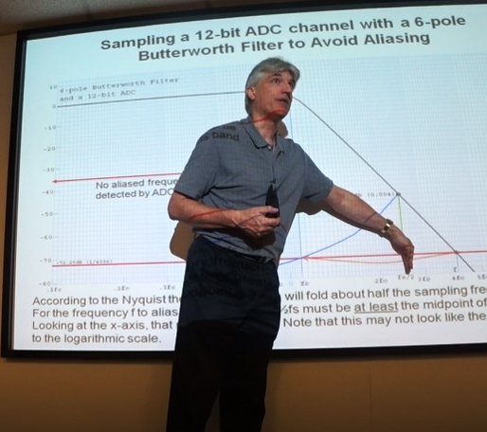
Maj General Richard G. Cross Award
Ken Miller

Slide 13
Dr Allen R. Matthews Award

Slide 14
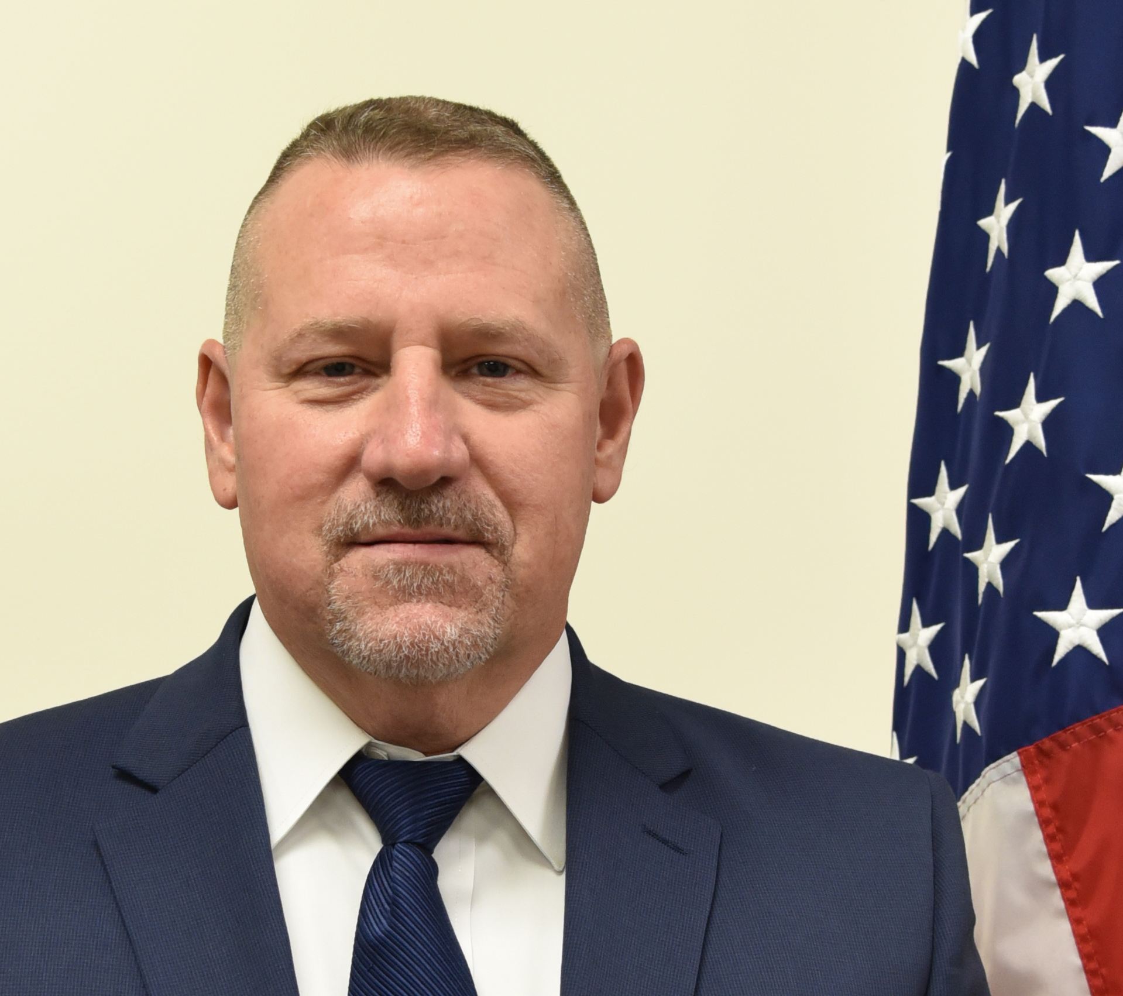
Allen R. Matthews Award
Kenneth LeSueur
LIFETIME ACHIEVEMENT AWARD

Slide 15
Allen R. Matthews AWARD Recipient

Slide 16
Congratulations to our 2021 Winners!

