Slide 1
Applying Scientific Test and Analysis Techniques in the Agile/DevSecOps T&E Environment
Bill Rowell, PhD, CISSP, CEH Cybersecurity/Software STAT Expert, OSD STAT COE
www.AFIT.edu/STAT
937-255-3636 x 4592
Scientia Prudentia et Valor
DISTRIBUTION STATEMENT A. Approved for public release; distribution
is unlimited. CLEARED on 19 July 2021. Case Number: 88ABW-2021-0657

Slide 2
Overview
Background
Non-functional requirements (NFRs)
Risk-based approach to software test coverage
Software development process metrics
Automated software testing
Conclusion

Slide 3
DevSecOps
Organizational software engineering culture and practice
Goal: Unify software development, security, and operations
Automate, monitor, and apply security at all phases of the software lifecycle plan
Testing and security are shifted left through automated unit, functional, integration, and security testing
Security and functional capabilities are tested and built simultaneously
Source: DoD Instruction 5000.87 Operation of the Software Acquisition Pathway, 2020

Slide 4
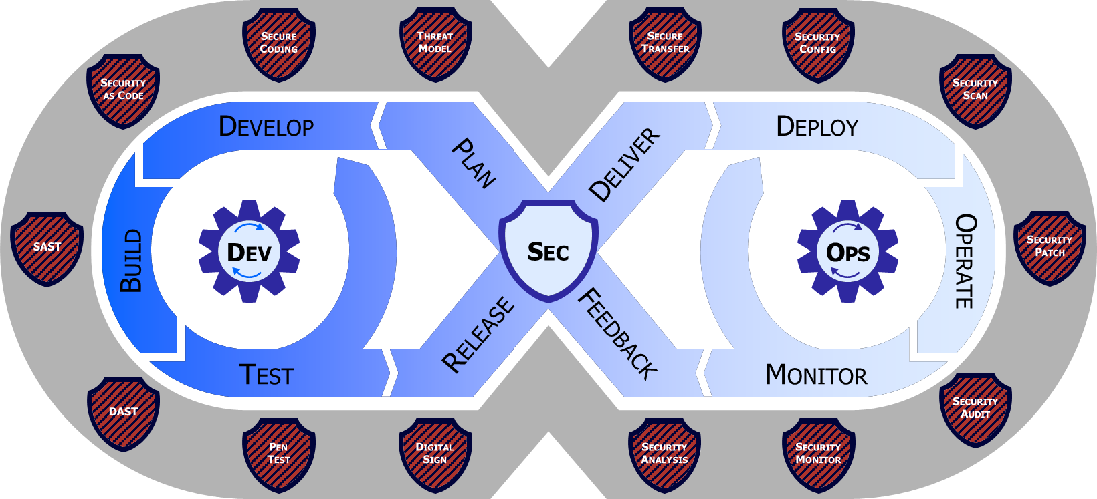
DevSecOps Lifecycle Phases
Source: DoD Enterprise DevSecOps Fundamentals Version 2.0 March 2021

Slide 5
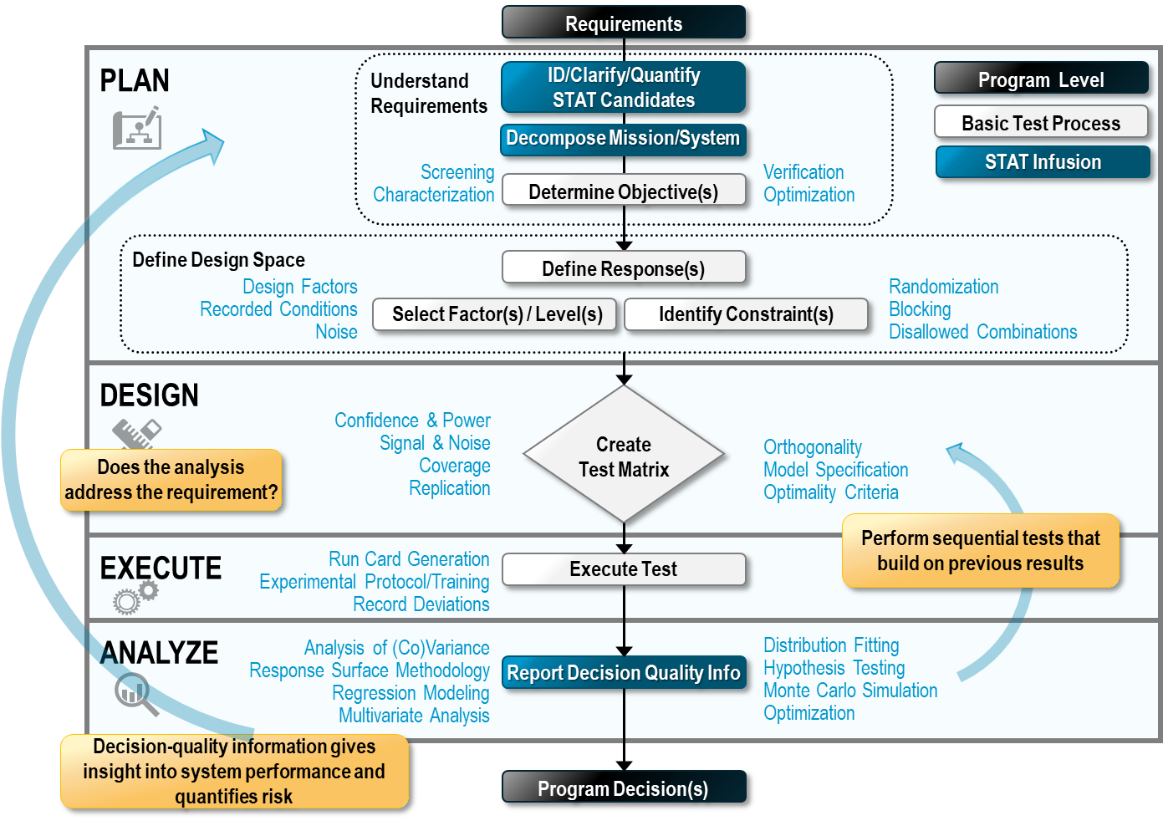
STAT Process

Slide 6
Non-functional Requirements (NFRs)
“How well” a system does something instead of “What” it does
Scaled Agile Framework (SAFe®) NFR system attributes
Performance
Scalability
Reliability
Maintainability
Usability
Security
Forms of NFRs
Key Performance Parameters (KPPs)
Key System Attributes (KSAs)
System Performance Measures (SPMs)

Slide 7
Example - Performance NFR Test Planning Information (1/2)
Item | Description
Requirement | Reports from 80 percent of all queries will be displayed to user within 12 second or less once query is submitted
Test Objectives | 1: Screen factors to identify statistically significant factors (those that influence report retrieval response time) 2: Characterize report retrieval response time over range of test factor values 3: Rigorously verify satisfaction of the requirement
Response | Elapsed time from when user submits request until report is displayed to user
Constraints | None

Slide 8
Example - Performance NFR Test Planning Information (2/2)
Levels/Factors | Report Type | Report Size (MB) | User Location | Download Speed (Mbps)
Level 1 | 1 | 5 | A | 10
Level 2 | 2 | 20 | B | 40

Slide 9
Summary of Key Test Results: Test Objectives 1 and 2
Test Objective | Results
1: Factor Screening | Report Type and User Location are statistically significant User location is likely to have a negative impact on satisfying requirement No significant factor interactions
2: Factor/Response Characterization (Predicted Response) | Significantly increases when User Location is “B” Exceeds response time when User Location is “B” and Report Type = “2”

Slide 10
Predicted Report Retrieval Response Time Confidence Intervals (seconds)
 | Report Type “1” | Report Type “2”
User Location “A” | 5.1 - 6.1 | 9.0 - 10.2
User Location “B” | 12.9 - 14.1 | 19.5 - 20.9

Slide 11
Requirement Verification Test Results
Test Run # | User Location | Report Type | User Location “A” | User Location “B”
1 | A | 1 | 4.81
2 | A | 2 | 9.84
3 | B | 1 |  | 12.80
4 | A | 1 | 4.18
5 | A | 2 | 10.31
6 | A | 1 | 5.65
7 | A | 2 | 7.66
8 | B | 2 |  | 19.90
9 | A | 1 | 6.21
10 | A | 2 | 8.11

Slide 12
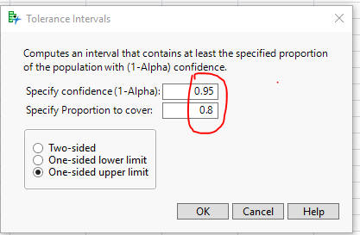
Analysis - Requirement Verification Test Results
Note: Because the value of the upper limit of the tolerance interval statistic (13.51366 seconds) exceeds the requirement (12 seconds), the hypothesis is rejected, that is, there is insufficient evidence to verify that the requirement has been satisfied.

Slide 13
Scalability
Capability of a system, network, or process to handle a growing amount of work, or its potential adaptability to accommodate growth
Number of concurrent users the system can handle without degrading System Response Time (SRT)

Slide 14
Typical Scalability Verification Test Steps
1. Incrementally generate users in the same proportion that the user types appear in the set of concurrent users.
2. Wait for system to stabilize after each increment of users is added.
3. Determine when SRT begins to degrade
- Clear increase in average transaction response time (latency)
- Clear decrease in total transactions per second (throughput)
4. Record number of concurrent users when SRT degradation begins

Slide 15
Single Sign-on Reliability Verification Example
Reliability NFR: 98% of time users successfully execute the Single Sign-on command
Rigorous hypothesis test
H₀: Single Sign-on success rate is 0.98 or higher (null hypothesis)
H_{A}: Single Sign-on rate is less than 0.98 (alternate hypothesis)
p̂ = 0.97 (observed proportion in sample)
$p_{0}$= 0.98 (null hypothesis value of 98%)
$n$ = 500 (sample size adequate to verify with 95% confidence)
$z$_{.05}= -1.645
Compute $z$-statistic using the formula below and compare to value of $z$_{.05}
$$z= \frac{\hat{p}−p_{0}}{\sqrt{\frac{\left.p_{0}(1−p_{0}\right)}{n}}}$$
= -1.60 >-1.645 => cannot reject null hypothesis H₀

Slide 16
Risk-based Approach to Software Test Coverage
Shift from non-functional to functional testing
Focus on whether test results equal expected test results (Oracle)
Understand risks in doing functional testing
Failing to find real bugs
Failing to adequately test all functionality
Wasting time finding bugs that are not real or have already been identified
Writing tests that have bugs that need to be fixed
Problems with testing functions with large input spaces
Combinatorial Optimization (CO) to the rescue
Generates significantly fewer test cases than exhaustive testing
Empirically proven to identify high percentage of unidentified software faults
Offers built-in coverage metrics to compare risk of different test designs

Slide 17
Parts Ordering Form for User Story
Availability | Delivery Mode | Urgency | Delivery Location | Funding Source
Available | Military Plane | Overnight | CONUS | Working Capital Fund
Back-Ordered | Re-supply Ship | 2-5 Days | OCONUS-E | General Fund
Discontinued | USPS | 6-10 Days | OCONUS-W | Transaction Fund
Replaced | UPS | > 10 Days

Slide 18
Analysis of Factor Interactions in Parts Ordering Form
Item | Number
Factors | 5
Levels per Factor | 3-5
Total Levels Across All Factors | 18
Total Possible Combinations (w/o constraints) | 576
1-Way Interactions | 18
2-Way Interactions | 129
3-Way Interactions | 460
4-Way Interactions | 816
5-Way Interactions | 576

Slide 19
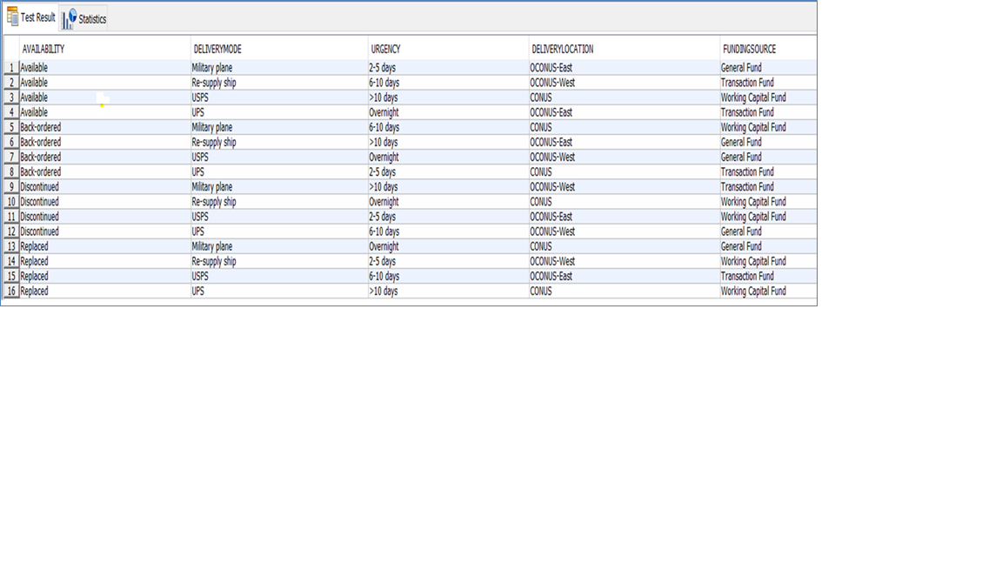
Analysis of 2-way Factor Interaction Solution (16 Test Cases)
Factor Interaction | Coverage | Percentage
1-way | 18/18 | 100
2-way | 129/129 | 100
3-way | 159/460 | 35
4-way | 80/816 | 10
5-way | 16/576 | 3

Slide 20
Software Development Process Metrics
Decision maker needs Specific, Unambiguous, Measurable, and Of practical consequence (SUMO) metrics
Rigorous application of STAT process to the definition, refinement, and measurement of software development metrics and assessment of their predictive power can produce invaluable metrics for the decision maker
Promising candidates for rigorous application of STAT process
Time to production: total time for new software features to be running in production environment
Lead-time: total time to deliver and deploy a new capability to the production environment
Deployment speed: total time to deploy a new software feature into production environment
Deployment frequency: how often new releases are deployed into production environment
Production failure rate: frequency application fails in production environment
Time to recovery: total time from failure to recovery of application in production environment

Slide 21
Automation Lifecycle Phases for Managers and Practitioners
Assess Is automation feasible? | Plan What should we automate? | Design What tools, framework, personnel, data collection system? | Test Where are the errors in SUT and automation? | Analyze & Report How good is automation performance? | Improve & Maintain What needs to be done to grow?
Source:
“Automated Software Testing Implementation Guide for Practitioners and Managers” (Simpson et al, 2018)
https://www.afit.edu/STAT/statdocs.cfm?page=1126

Slide 22
Minimum Set of Automation Tasks
Research automation opportunities and learn which automation tools are best. Know the costs.
Obtain leadership support by presenting the ROI and quickly identify the barriers to success.
Learn which parts of your testing are best for automation, design the automation framework, and determine the suite of tools needed for your automation program.
Select the automation frequency based on the software development cycle and testing needs.
Find, hire, or grow the automation expertise. Growing can be easier than you think.
Start with simple automation tasks and increase complexity as automation capability matures.
Use STAT methods to optimize coverage of the input test space and get the most out of the output from automated tests.

Slide 23
Assessment of Automated Software Testing Implementation
Pre-visit webinar to organization on opportunities to optimize automated testing and tools
Pre-visit request to organization for information on current AST program
Planning & Design
Setup & Execution
Validation and Reporting
Site visit to gather additional information from organization on current AST efforts
Analysis & Recommendations report

Slide 24
Conclusion
DOE and other statistical methods are essential for rigorous testing of performance, reliability, and scalability NFRs
Combinatorial optimization techniques enable both explicit identification of testing risk and optimal test coverage
Rigorously derived software development process metrics provide decision maker with invaluable information for making sound, defensible decisions
Implementation of automated software testing following the STAT best practices within the Agile/DevSecOps lifecycle significantly increases likelihood of achieving desired ROI
STAT process, methods and techniques powerful enablers for effective, efficient, defensible, and resilient Agile/DevSecOps testing process
STAT best practices provide a solid, well-documented foundation for initiating and improving the T&E of software intensive systems using the Agile/DevSecOps lifecycle

