Slide 1

Testing Mixed-Use Networks – Insights into a Complex Test Process
Dan Pleasant
Jarrod Tsukada
Kelly Caulk
September 2021
Keysight Technologies, Inc.

Slide 2
What Is a Mixed-Use Network?
Often fully or partly wireless
A unified network that merges different types of network nodes, capabilities and data
  Communications
  Radar and electronic warfare
  COMINT and surveillance
  Navigation
  Battlefield awareness
May be an ad-hoc network that is fielded when needed
  Automatically discovers and manages network endpoints as needed
May exist in a congested or contested environment
  Interfering signals
  Intentional jamming
  Cyber attacks
  Network nodes may be at risk of destruction or capture by an adversary
Notes:
Electromagnetic spectrum operations within defense applications are quickly moving toward multi-device networks. Along with communications and data networking, this encompasses sensors and electronic disruptions.
Network nodes can be either nearby or at remote locations such as in aircraft or satellites. No matter the location, these devices will exist on a single network, or on a network-of-networks. Data from all sources will be compiled into a single view of the field of action for commanders and individual warfighters to access. These networks may be fixed or ad-hoc, set up in the field as needed and able to handle flexible numbers of endpoints that may come and go.
Critically, these networks must operate in a highly contested environment that could be subject to electromagnetic, cyber and physical attacks of all kinds. Network communication can be affected by background RF signals that are otherwise benign, or physically captured by an adversary. This operating scenario requires robust networking capabilities which then translates into complicated test requirements. This paper considers such testing as a thought experiment and illustrates some of the complexities of testing mixed-use networks.

Slide 3










Conceptual Mixed-Use Network
Ad-hoc mesh network
Background RF signal
Sensors
Sensors
Sensors
Jammer
Notes:
For illustration, this image shows a potential battlefield networking situation. The blue team has set up an ad-hoc ground-based network that includes remote sensors and communication with both aircraft and satellite assets. The red team likewise has a similar network but is also attacking the blue team network physically, kinetically, and in the cyber realm. In the background, other RF signals exist that may interfere with network communications.

Slide 4
Testing Considerations
Physical/RF/protocol functionality | Ruggedness Signal integrity Basic connectivity Simple operation
Performance | Scalability Multi-function baselining Complex workflow Measure user experience
Interoperability | Open standards help but do not ensure interoperability
Resilience | Congested/contested/environmental conditions Redundancy/recovery/failover mechanism
Cyber | Authentication Encryption Potential attack vectors Fuzzed signal robustness Risk mitigation
User Interface | Ensure that users can easily deal with the most complex scenarios in real time
Notes:
Let’s look at some of the broad categories of testing requirements for mixed-use networks.
First, each network device must be tested on its own to ensure the device is working and can survive in any environment. Then the devices must be tested together in a network for basic functionality, network performance, and to make sure that users can easily operate them.
Then, more robust test scenarios come into play. Network devices may be designed and manufactured by different sources, but will they play together nicely? Will the devices work properly under stressful network conditions? Are they secure?
Finally, the software applications that run on the network using data collected must efficiently and effectively exhibit information via an interface that the operator can manipulate under extremely stressful conditions. Nobody wants to accidentally click the wrong button when in life-or-death situations.

Slide 5
Many Issues to Navigate
They must all be tested
Interoperability
  Legacy networks and evolving networks, and the bridges between them
  Aggregating data between subnets – how to test that?
Traffic prioritization:
  Whose data is most critical if the network becomes congested?
  How much do you rely on software defined networks and automated orchestration to control traffic priority?
Considerations moving from proprietary military specs to open IP standards:
  How do you achieve military-grade robustness and redundancy?
  What is the new acceptable amount of latency, throughput, loss tolerance?
  How do you ensure mission apps are built within these ever-evolving parameters of the network?
Test procedures must be efficient and comprehensive
  Don’t forget to test the out-of-band network monitoring/health system
5G, satellite, legacy networks and the chaos of existing signals complicate everything
Notes:
Drilling down into test requirements one level, we can see that interoperability testing is critical. Here we are referring to not only individual devices but also to various networks that must work together and the bridges between them. When the network becomes congested, it’s important to make sure that the most important traffic takes priority, and this must also be tested. Open standards may help with interoperability but also create new threat vectors that an adversary might take advantage of, making thorough testing of network cyber robustness critical.
While covering all this ground, the test procedure must be efficient. It makes no sense to build networks that take months or years to be tested. And the use of multiple types of networks, including both new and legacy systems, increases the number of test scenarios exponentially. All these factors must be considered when designing test systems.

Slide 6
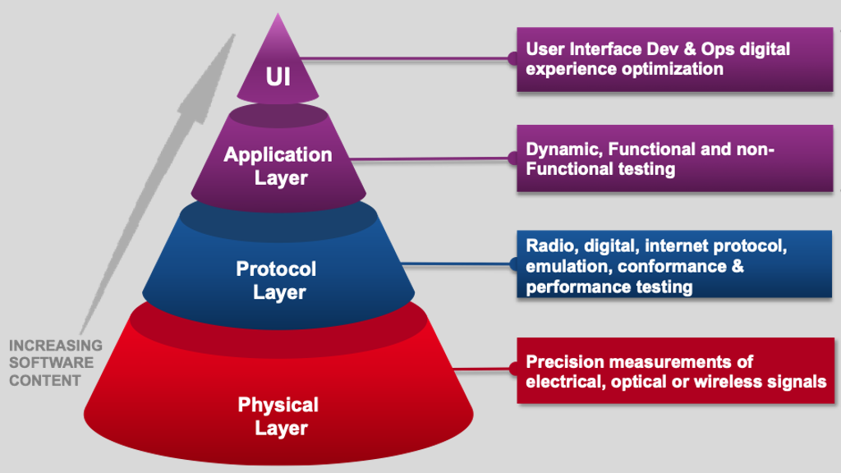
Testing Mixed-Use Networks
Requires many steps and test scenarios
Starts with functional test of each network node
  Assure functionality
  Different types of equipment – digital, RF
  Environmental tests
Test network functionality and performance
  …under quiescent conditions
  …under stressful conditions
  …under cyber attack
Huge number of potential test case scenarios
  Cannot test them all
  Identify key test cases
Field testing is expensive, slow and insecure
  Do most testing in the lab
Notes:
Let’s consider test solutions from the bottom up, starting with individual components and moving up through network functionality to the top application layer. As we move up this stack, the bottom layers are more hardware oriented with software becoming more and more prevalent as you move higher. This requires the use of entirely different test methods. Testing a radio’s ability for communication is not the same as testing a software application that compiles data from various sources and presents it to the user.
The overall number of potential test scenarios, especially for an ad-hoc network with network endpoints that can come and go and can move around, presents a huge problem for testing. It’s impossible to test every possible scenario that might be seen in the field. Instead, the most important and relevant test scenarios must be identified and tested. At the same time, testing in the field is impractical as it takes too long, and costs are high. Most testing must be done in a laboratory environment that emulates the conditions that would be seen in the field. This requires sophisticated test methodologies.

Slide 7
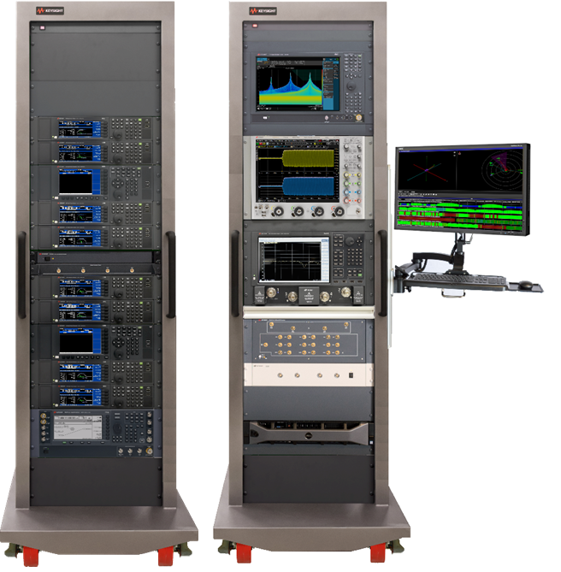
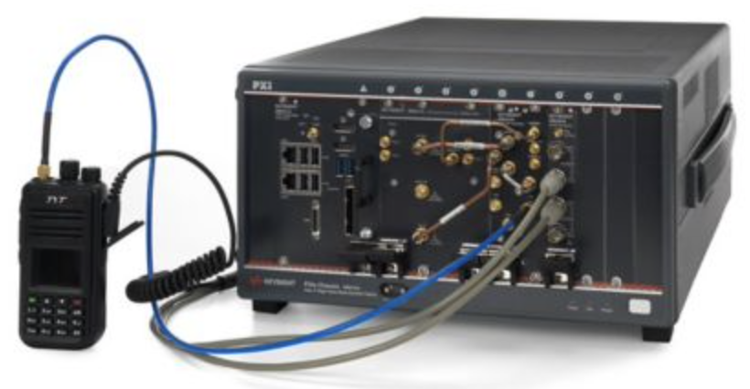
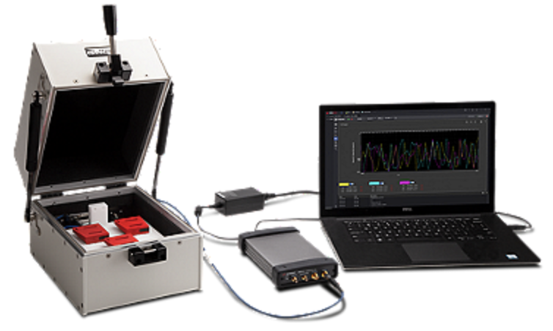
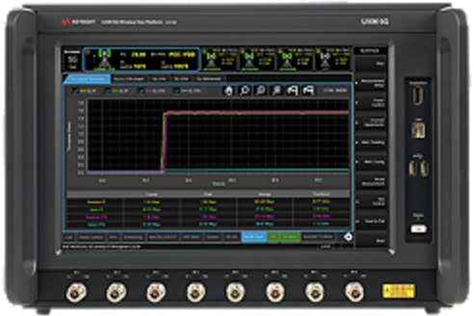
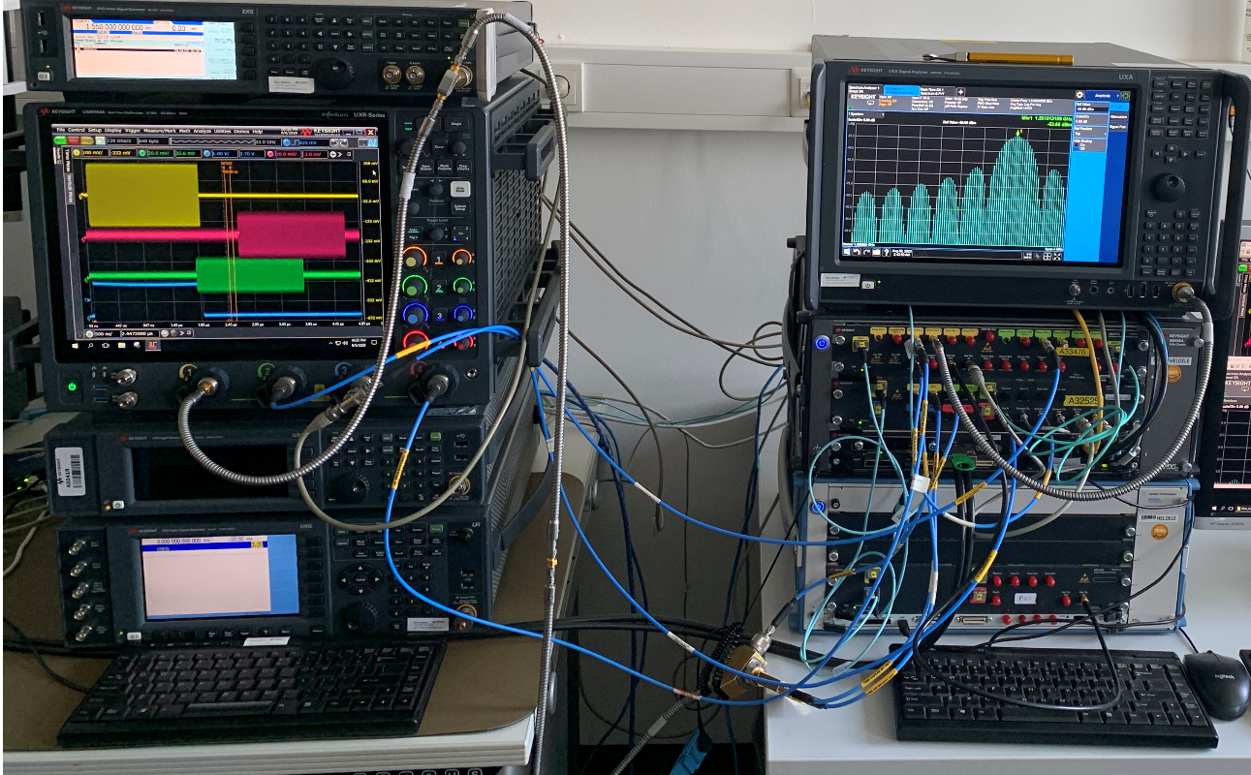
Functional Testing
This is the easy part
Test each network node in isolation, not as part of a larger network
Classical functional tests with pass/fail results
Complicated by the presence of different types of nodes
  Testing a surveillance camera is different from testing a radio is different from testing a radar
EW test system
Handheld radio test system
IoT WiFi test system
5G UE tester
Radar target simulator
Notes:
We’ll begin the discussion at the level of individual network devices. Each device that will become part of a mixed-use network must be individually tested before it can be connected to a larger network. The techniques that are used to test individual devices are well-known, and the world has many test equipment manufacturers who can help with this. For this reason, we call this the easy part, even though it is frequently not very easy and may require sophisticated test systems. Testing a simple handheld radio does not require the same kind of test system complexity that’s needed to test a radar. But in general, these types of test systems are well known and available off the shelf. Therefore, we’ll skip quickly past this topic and drill down into the kinds of tests that are required when devices are connected over a network.

Slide 8
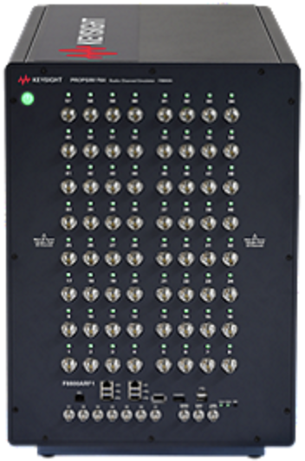




Testing RF
…in normal operation
One solution: Channel emulator
  Emulates signal paths including multipath, fading, scattering, kinetics
    Beware: Some are designed for cell phone applications
    May not meet frequency, bandwidth, latency requirements
  Limited number of connections
    If network has hundreds or thousands of nodes, better move outdoors!
Test network connectivity and performance
  …as network nodes log on and off
  …as network nodes move around
Ensure signals don’t interfere with each other
  e.g., radar/EW signals should not disrupt the network WiFi
Calibration may be necessary (for AoA or geolocation)
Notes:
If the network is wireless, which will usually be the case for battlefield networks, the RF signals that travel between the various devices will be subjected to all sorts of degradation. Even if man-made interference is ignored, multipath problems, multiple reflections, path losses and other types of noise will degrade the signal. Devices on the network must be tested to prove that they can handle these kinds of signal problems.
To test this situation in a laboratory, signals from each network device must be routed to all the other devices with RF degradations included. Fortunately, the mobile phone industry has faced this problem for many years, and the industry has created a potential solution. Known as channel emulators, these instruments have many RF input/output ports, and they can degrade and distribute signals accordingly. They can create Doppler shifts and emulate devices that move around.
One issue with some channel emulators is that they were designed for use with mobile phone signals and have frequency ranges and bandwidths to match. These emulators may not be suitable for defense applications. Other models have enhanced capabilities that are a better match. When choosing an emulator, be sure to consider all the requirements. Also note that channel emulators have a fixed number of ports (the one shown here has 64), and calibration will be required for applications that are phase-sensitive like direction finding.

Slide 9

Testing RF
…under stressful conditions
Add interfering signals to the environment
  Make sure network can detect jamming/interference
  Make sure network can reconfigure to avoid jamming/interference
  Requires RF sources to create the interference
    Emulating a jammer is not trivial
Background RF
Intentional jamming
Notes:
Channel emulators can be used to create interfering signals, by simply creating the appropriate signal(s) and applying them to one or more of the input ports on the emulator. This allows testing devices against passive, unintentional interference quite easily. Testing against intentional interference (jamming) requires more sophistication. Unless an actual jammer is used, emulating a jammer can be a difficult task, especially if the jammer is smart and can react to the signals it receives. But such tests are necessary to ensure that the network can respond to attacks as needed by switching to new frequencies, changing power levels, or moving to different modulation schemes as needed to avoid interference and jamming.

Slide 10
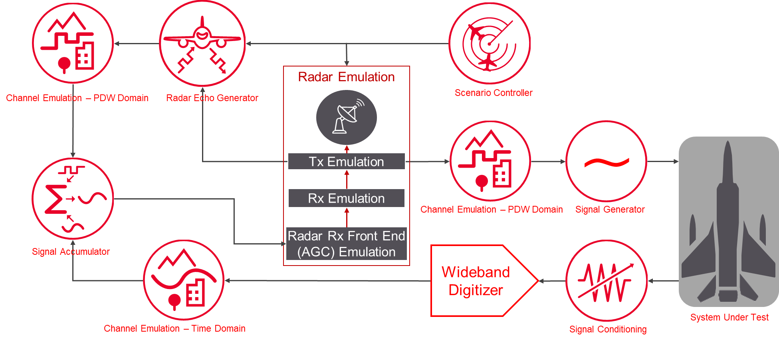
Testing RF
…if devices are autonomous
Autonomous devices can do wherever they want to
  Test system must follow the DUT’s intended path
  DUT may create signals at will without warning
Test system and DUT must have two-way communication and coordination
  Requires test-specific hardware and software interfaces in both the test system and DUT
  Must be designed and built in from the beginning of the project
Notes:
When testing against RF signals it’s important to remember that the network nodes may move around. Normally the channel emulator’s software would handle kinetic effects associated with device movement, but if the device under test uses artificial intelligence techniques and is autonomous, it may navigate on its own. This means that two-way communication between the DUT and the channel emulator is necessary. The channel emulator needs to know where the DUT is navigating, and the DUT needs to know if it is about to navigate into the side of a mountain. Furthermore, the DUT may decide to increase or decrease its output power levels at any time; a fact that must be known to the test system for signal conditioning purposes (to ensure that a high-power signal from the DUT doesn’t destroy a sensitive receiver in the test system). The block diagram shown here illustrates a system that is intended to test a single cognitive jammer. The situation becomes exponentially more complex as more devices are added to the test scenario. If devices are autonomous, test systems must be very carefully designed, and the DUT must likewise be carefully designed so that it includes the necessary test interfaces (hardware and software).

Slide 11
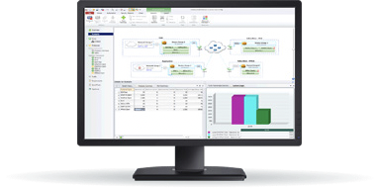
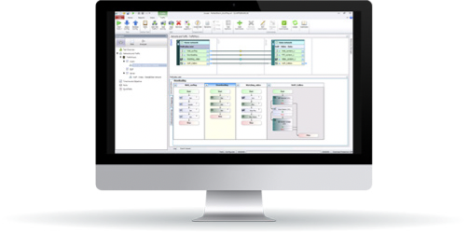
Testing IP
…in normal operation
Control plane network (content delivery management)
  Protocol conformance: given input = expected output
  Protocol fuzzing: unexpected input = expected output
  Scalability baseline: attach rate and concurrent connections
  Interoperability: vendor-lock vs open standard
  Relevant network architectures: tactical links, software defined networks, zero trust, cross-domain, 5G, satellite, WiFi, multicast, IPv4/IPv6 routing, tunneling techniques
Data plane network (content delivery)
  Throughput at line-rate
  Latency/jitter with nanosecond resolution
  Packet loss with acceptable tolerance
  Encryption/decryption information assurance
  Quality of service adherence
  Quality of experience under ideal conditions
Protocol emulation and analysis
IP/multimedia traffic generation and analysis
Notes:
Moving up the OSI stack, there is a lot to consider when testing an IP network but it’s a well-understood and straightforward approach when up against normal operating conditions. We start by separating the control plane tests from the data plane before testing them in unison. Generally, this is because the transport nodes-under-test use different processors for each plane. In other words, isolate and test the functions assigned to a processor, like an x86, apart from the other processors that reside on the node, including ASICs, FPGAs, crypto-processors, network-processors or other x86s.
Though it’s highlighted under control plane, protocol conformance and fuzzing has its place under data plane as well. This step is the foundation for interoperability success, minimizing bugs and by extension, potential attack vectors. It is also important to measure and establish your own performance baselines instead of relying on the advertised specs on the manufacturers’ datasheet. We’ve noted some of the relevant network topologies that incorporate numerous underlying protocols that may be called upon in a mixed-use network.
Data plane testing often boils down to performance. How much throughput can I get? Cleartext versus encrypted? What’s my latency hit? What is the warfighters perceived quality of experience? But data plane testing can also include leakage scenarios where different VLANs, VPNs, tunnels, QoS policies should not allow traffic to cross boundaries, something that is important in classified networks. This is also a good time to emphasize that it is insufficient to test L4-7 aware transport nodes with simple packet blasting. They must be exercised with real-world applications, protocols and high-fidelity payloads because these devices are often required to maintain state, inspect traffic and perform proxy functions.
In order to appropriately assess a node or network, the test tools must ultimately be more precise, flexible and powerful than the system-under-test itself. This often necessitates the use of test tools with purpose-built hardware and tunable software that can test beyond the performance thresholds of industry standards. But when and where it makes sense, some test tools can leverage COTS hardware or even virtual machines to affordably address these more basic test cases.

Slide 12
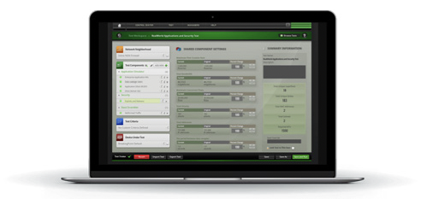
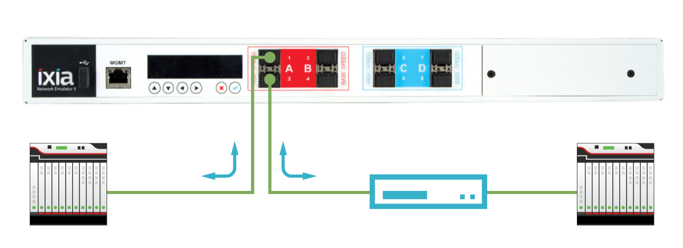

Testing IP
…under STRESSFUL CONDITIONS
All critical services must function even if the network becomes oversaturated
  Must inject scalable background traffic to congest the links
Network must function even if the terrain/weather is unfavorable
  Intentionally inject delay, jitter, drops, reorder, duplications, corruption
  Measure the impact to content delivery
Network must function even if nodes are destroyed
  Test high-availability (active/active) or redundancy (active/standby)
  Test disaster recovery mechanism and measure failover time
Realistic and scalable application traffic generation
HW-based impairment injector
Traffic
Traffic
DUT A
DUT B
Notes:
Now that your node or network under test has passed the test scenarios under normal operating conditions, it is time to move on to stressful conditions. We break this down into three subcategories, starting with an oversubscribed situation. The goal is to assess whether critical mission traffic is properly handled apart from the low-priority traffic. This requires software that allows you to accurately craft the background traffic profile and hardware that can scale up to and exceed the network capacity.
The next stressful condition is unfavorable terrain and weather. This is difficult to reproduce in a test lab, but it is vital to ensuring battlefield success. The functional limits of the network and mission traffic must be well studied prior to live deployment and the most effective way to achieve this is to layer in impairments like delay and packet drops into the test. In most cases, there are decent approximations of the characteristics of common networks like 802.11, 4G/5G, and even satellite hops but they do not account for the nuanced effects of specific terrain and weather. In those unique instances, it is possible to assess live network conditions at a certain geography and during a specific season with a monitoring tool that can subsequently spit out a configuration for the impairment injection tool. This seamlessly brings field conditions into the test lab.
Finally, in the case of battlefield networks, the network must be tested against the possibility that some nodes may be destroyed. In such a case the network must instantly reconfigure itself – a difficult feat for an ad-hoc network. It’s easy to simulate the destruction of a network node by simply unplugging it. But the test system must be able to measure how the network reacts no matter what type of disaster recovery method is implemented.

Slide 13
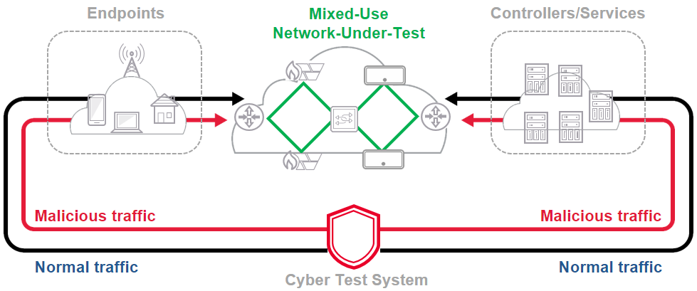
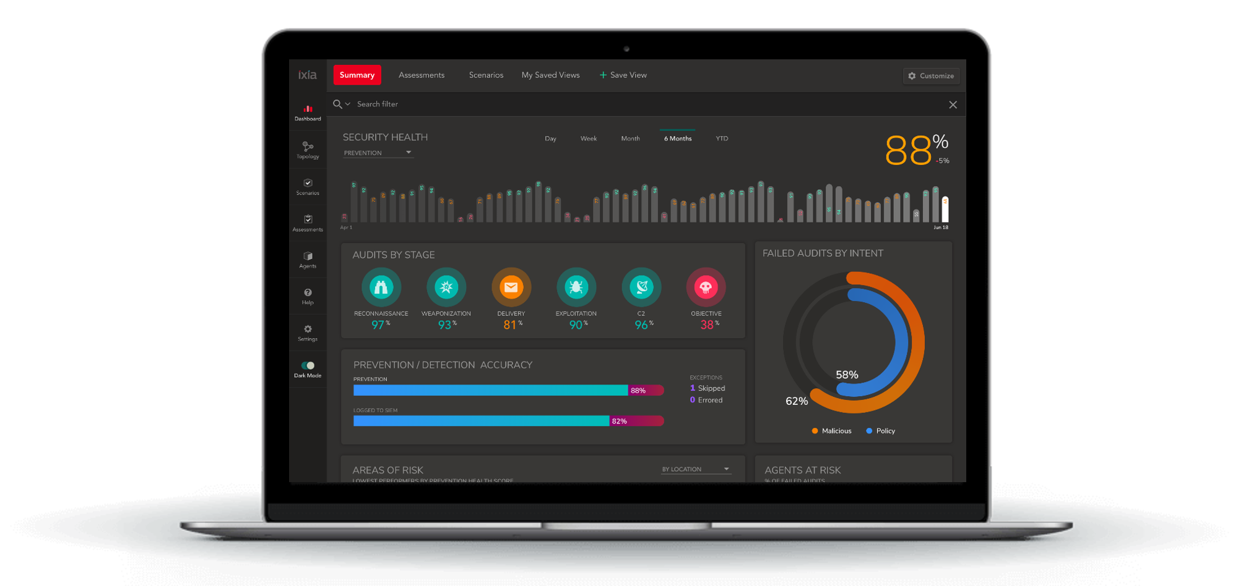
Testing IP
…under cyber attack
Ensure transit nodes/endpoints have hardened OS
  Common vulnerability scans
  Robust authentication procedure if asset is captured
  In-depth IoT survivability analysis
Ensure network monitoring DCO (defensive cyber operations)
effectiveness
  No visibility blind spots for packet collection
  Identify and mitigate network intrusions with high confidence
  Incorporate SOAR (security, orchestration, automation and response) workflow
  Recognize and mitigate rogue or compromised nodes
Test with live but controlled cyber attacks
  DDoS, botnets, malware, advanced persistent threat (APT) with lateral movement
  Full kill-chain emulation following the Mitre ATT&CK framework
Cyber attack simulation (Automated red team)
Notes:
In addition to physical attacks, battlefield networks will be subjected to continuous cyber attacks of all kinds. Adversaries will attempt to use RF links to disrupt communications or inject false information onto the network, or a network node may be captured. If an adversary finds its way onto the network, many known (and unknown) cyber attack vectors will be utilized immediately. The network, and all devices on it, must be protected against such attacks. Testing that protection is extraordinarily complicated – how do you test for unknown zero-day cyber attacks? This requires hardened, reliable operating systems with robust authentication mechanisms but beyond that the network must be continuously monitored so that intrusions can be detected and eliminated immediately.
The network should be tested against all known cyber attacks in a controlled environment (where even successful attacks are benign), requiring software and hardware that can emulate such attacks, backed by a support team that continually updates the attack database when new attacks are discovered. Imagine the power of having an automated red team member continuously performing attacks against the network so that you can understand changes in the attack surface and defensive posture. Attacks and kill-chains are easy to comprehend because they are mapped to the Mitre ATT&CK framework.

Slide 14
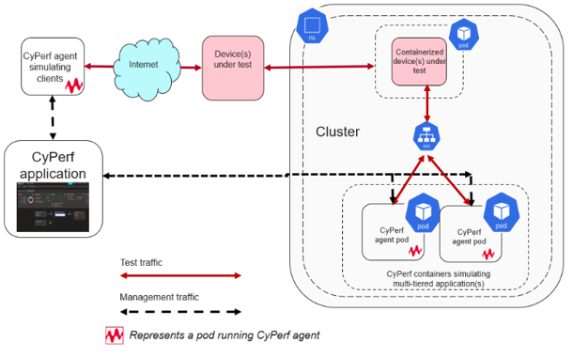
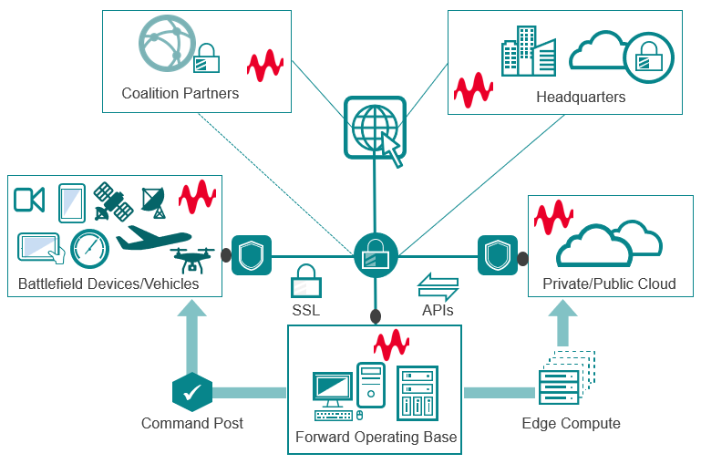
Considerations for Another Time
…EXTENDED capabilities
Container-based Capabilities
  Prove isolation, security and resiliency across “apps”
  Test performance and orchestration
Public Cloud
  Test connection KPIs and security posture
  Test processing and storage elasticity
  Monitor for cyber intrusion
  Test efficacy of DevSecOps integration
AI/ML
  Algorithms to avoid interference complicates the testing
  Network behavior is unpredictable
  Nodes may react to interference, but was the reaction effective?
  Test for success rather than looking for a specific reaction from a network device
Container testing
Distributed testing
Notes:
When considering network testing, there are other considerations that will become more important in the future but are beyond the scope of this briefing. Current software development trends are moving toward containerization, which must itself be tested against attacks. Any network that makes use of the public cloud must be extensively tested for security. New mission apps will be developed using the agile methodology alongside devsecops pipelines in software factories. AI-based autonomous devices that we mentioned earlier in this talk and AI-based networks change the testing paradigm entirely. These are topics for future discussions.

Slide 15
Testing the Network
…under many combinations of the above
Testing network functionality is not enough
  User interface testing – Need to be sure that users can handle whatever gets thrown at them
  Test many scenarios to ensure that the network survives under a combination of different degradations and attacks at the same time
  It’s too much!
Test Automation is required
  US military recently began to require this
Notes:
At the end of the day, testing the network and the devices on it is not enough. All these things must be tested together, and they must result in a system that is robust under all combinations of conditions, with multiple threat conditions degrading the overall system at the same time. This creates millions of possible test scenarios – far too many for a comprehensive test suite to cover in any reasonable amount of time. The industry has responded by creating test automation capabilities that simplify this problem. The US DoD has taken notice of the issue and recently began to require test automation.

Slide 16

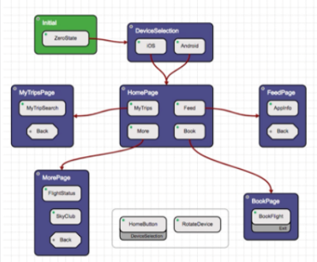

AI Assisted Automation
Intelligent exploratory testing identifies unique combinations not easily conceived of in the testing lab. This approach mimics real user behavior such as stressful situations in the field (multiple clicks, unusual ordering of actions, “fat finger” data entry, etc.)
“Digital twin” model
User journey
Interactive model building
Ensemble of algorithms drive intelligent automated creation of user journeys
Full IDE for test automation snippets & scripts
Regression packs
Model generation from existing assets e.g. Gherkin
AI bug hunting
Import existing process diagrams
Coverage analysis
Defines all possible journeys
Can include regression packs of pre-defined test cases
Real user journeys
Intelligent application “scraping”
Mission objective
Change & defect monitoring
Notes:
Test automation is greatly enabled using digital twin models enhanced with artificial intelligence, and machine learning algorithms. A digital twin represents all the possible user journeys across all systems. Thousands or millions of possible combinations can be easily encoded within a simple model that can be manually or auto-generated.
Test cases can be specified in detailed regression tests or by using an ensemble of different AI-based algorithms that all work together to determine the next best action. This allows for the most important test scenarios to be identified and automatically included in the test suite, resulting in complete test coverage without the need to exhaustively test every possible combination of scenarios. The result is a system that enables bugs to be found and identified quickly and user interface actions to be optimized so that the most common operations are the easiest for the user to access.
However, test automation does not come for free and it is important to develop and maintain the digital twin model from the beginning of the development process.

Slide 17
Summary
…and some suggestions
Designing mixed-use networks is hard. Testing them is harder.
Consider accelerating the delivery of capabilities via 3rd party expert testing
  In-house test tools are often not comprehensive enough against a fully integrated system
  Designing, developing and maintaining in-house test tools is a distraction to the actual capability under test
  No one person knows how to do everything
  Few companies can offer one-stop shopping
Need to plan for testing in advance
  Test interfaces may need to be built into the hardware/software
  Special test equipment may be needed
  “Digital twin” models should be developed at the same time as the system
  Include testing in the plan for budget and schedule
Notes:
In summary, testing mixed-use networks is more complex, time-consuming, and costly than it might at first appear. It is paramount to design and implement the test system and the overall network simultaneously. Some test assets must be built into the network itself, and hardware/software interfaces need to be included in the system design. Without this advanced preparation, a program’s budget and schedule are greatly at risk. Building such a complicated system and leaving testing as an afterthought is careless.
Finally, consider using a third party (or an in-house testing group that’s independent of the development team) for testing. From a cost-effective standpoint, modern test environments must be flexible enough to accommodate any test requirement within a recreation of the chaos of expected (and unexpected) signals on the battlefield. The traditional stovepipe test per device is important in early development stages but insufficient for determining battlefield readiness. Very few companies can implement such an elaborate environment while also perform thorough testing. Development teams are usually not experts in testing devices, networks, hardware, software, and user interfaces all at the same time. But that’s okay because their focus should be on innovation. Test with the help of trusted test vendors that bring expertise from across all aspects of the battlefield network ecosystem. There aren’t many who fit that description so plan carefully.

