Slide 1
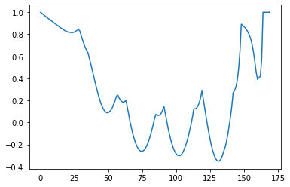
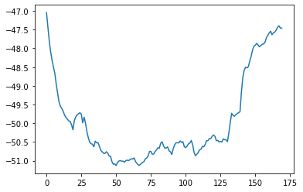
Seminal Analysis Methodology Based on Uncorrelated Data Collection in Either Benign or Contested Environments
1Lt Nathan A. Ruprecht, Mrs. Elisa N. Carrillo, & Capt Loren E. Myers
746 TS/TGGA, Holloman AFB, NM, USA
elisa.carrillo@us.af.mil
Introduction & Data
Methodology & Results
A continual question in test is to answer how many data points are required to produce statistically significant results for decision makers and what constitutes an event. Especially in constant benign or contested environments, if each sample or a second counts as a data point. At least with flight test, profiles are determined beforehand to know limitations and parameters. With a planned profile and therefore target time, space, and position information (TSPI), this methodology can be ran prior to test to predict the number of data points to be collected. Optimized test planning will reduce test time while maintaining test rigor and data integrity. This methodology is intended for inertial guidance, GPS, or blended navigation units as universal use, it’s computationally heavy which is made doable with the processing power of today’s computers. This is an ongoing project to both develop and characterize this methodology. Specifics of the platform, unit under test (UUT), times, and power levels are intentionally removed for public release.
UUT1 3D Pos Autocorrelation to find first instance of 0 correlation
UUT1 3D Pos
idx=67, number of autocorr points=3
Autocorr RMS = 49.952m
All data RMS = 49.346m
Three UUTs were flown on the same platform as the Ultra High-Accuracy Reference System (UHARS) for 4, 9, and 5 sorties respectively in both clear air and GPS degraded environments. Minimum intervals of uncorrelated data from TSPI column(s) of interest are calculated and aligned to the reference system to then calculate the root mean squared error. For completeness, results are shown for using all samples collected as well as the uncorrelated error methodology data. Confidence intervals at 80%, 90%, and 95% are captured to show tightness of distribution. This is repeated for both benign and contested Positioning, Navigation, Timing (PNT) environments.
UUT 1 was experimental and understandably had larger error; incrementally UUT 2 is more developed showing better performance; and, UUT 3, as a near final system, demonstrated the best performance. As expected, there is more error in all UUTs when flown in a GPS degraded environment compared to clear air. Looking at uncorrelated error methodology to error using all samples, there are slight differences with some TSPI parameters showing better or worse but no clear pattern to signify bias.
The top left figure shows an example of plotted correlation coefficients in order to grab the first instance of zero correlation. This index is used to grab every idx-th point for error calculation The top right then shows the error between the UUT and reference system (UHARS) in that the autocorrelate error would grab the idx-th point of the UUT for RMS calculation. These values are comparable and proof of concept to use this method when designing a test for sortie parameters.
Correlation Coefficient
3D Position Error (m)
idx
Collected Data Point
Autocorrelation lag index
UUT1
CI (%) | 3D Pos RMS (m) |  |  |  | 3D Vel RMS (m/s)
 | Benign |  | Contested |  | Benign |  | Contested
 | Uncorr | All Data | Uncorr | All Data | Uncorr | All Data | Uncorr | All Data
80 | 4636 | 3559 | 55.93 | 105.2 | 18.22 | 24.95 | 8.29 | 18.10
90 | 4683 | 3569 | 55.25 | 105.6 | 18.31 | 25.02 | 8.34 | 18.17
95 | 4722 | 3577 | 55.50 | 106.0 | 18.39 | 25.08 | 8.38 | 18.22
Flight Hours
 | Benign | Contested
UUT1 | 10 | 14
UUT2 | 22.5 | 31.5
UUT3 | 12.5 | 17.5
Ref | 45 | 63
UUT2
CI (%) | 3D Pos RMS (m) |  |  |  | 3D Vel RMS (m/s)
 | Benign |  | Contested |  | Benign |  | Contested
 | Uncorr | All Data | Uncorr | All Data | Uncorr | All Data | Uncorr | All Data
80 | 1.737 | 2.390 | 3.514 | 11.25 | 0.442 | 0.255 | 0.315 | 1.666
90 | 1.741 | 2.396 | 3.532 | 11.42 | 0.443 | 0.262 | 0.316 | 1.692
95 | 1.743 | 2.402 | 3.547 | 11.57 | 0.444 | 0.267 | 0.317 | 1.713
Conclusions
The uncorrelated error methodology is comparable to the error of all data collected. Since the exact specifications of the UUTs were in development and unknown, it cannot be determined which method is more accurate. However, the uncorrelated error approach allows for better design of test knowing the amount of data to expect while maintaining statistical power.
UUT3
CI (%) | 3D Pos RMS (m) |  |  |  | 3D Vel RMS (m/s)
 | Benign |  | Contested |  | Benign |  | Contested
 | Uncorr | All Data | Uncorr | All Data | Uncorr | All Data | Uncorr | All Data
80 | 2.820 | 4.471 | 1.913 | 11.912 | 0.477 | 0.401 | 0.178 | 0.720
90 | 2.833 | 4.480 | 1.920 | 12.191 | 0.479 | 0.412 | 0.178 | 1.767
95 | 2.843 | 4.487 | 1.925 | 12.421 | 0.480 | 0.420 | 0.179 | 1.806
Disclosure
All data and code is controlled by the 746 Test Squadron, Holloman AFB, NM. All authors contributed equally to method and code development, data analysis, and/or accuracy of presented work.

