Slide 1
Topic Modeling and Visualization for ATC Test Incident Report Data
Sage Leone
Distribution D
Student
Army Research Laboratory

Slide 2
About Me
Rising junior at University of Maryland
Studying computer science and mathematics
ARL intern in Summer 2020

Slide 3
Project Synopsis
Problem: Manual data processing is inefficient
Solution: Automate classification with topic modeling
HPC processing power
Spark ML and SQL
Goals:
Develop topic model for testing data
Produce visualizations for easy analysis

Slide 4
U.S. Army Testing Workflow
Program produces large amounts of data
Requires analysis to improve on problems
Analysis of data
Lots of data means this is computationally heavy
Visualizations created to display in meaningful way
Updates to test’s program based on discovered trends and problems
Notes:
Big Picture
ExLF produces lots of data, which needs analyzed to make improvements
Topic modeling allows for analysis and categorization of any text data
Apache Spark allows for necessary analysis functions to be run using distributed power of HPC

Slide 5
U.S. Army Testing Workflow
Program produces large amounts of data
Requires analysis to improve on problems
Analysis of data
Lots of data means this is computationally heavy
Visualizations created to display in meaningful way
Updates to test’s program based on discovered trends and problems
Notes:
Big Picture
ExLF produces lots of data, which needs analyzed to make improvements
Topic modeling allows for analysis and categorization of any text data
Apache Spark allows for necessary analysis functions to be run using distributed power of HPC

Slide 6
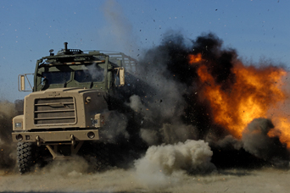
Background
Topic Modeling
Unsupervised method for classification of text documents
Automatically defines topics and describes documents in terms of them
High Performance Computing
Aggregated computing power for quick and complex processing
Apache Spark
Provides data management and processing functions for big data
Supports distributed computing
Expedient Leader Follower (ExLF) Program
Army program for autonomous vehicle control
Current work on developing visual analytics platform

Slide 7
Overview of Dataset
ExLF data from June to October 2019
Documents information and incidents during testing
Narratives section textually describes problems and fixes

Slide 8
HPC Resources
Centennial
SGI
Production system
Production: 2017
Processing cores: 74,880
GPGPUs: 40 NVIDIA Tesla K40
Memory: 253 Terabytes
Peak Capability: 2.6 PFLOPS

Slide 9
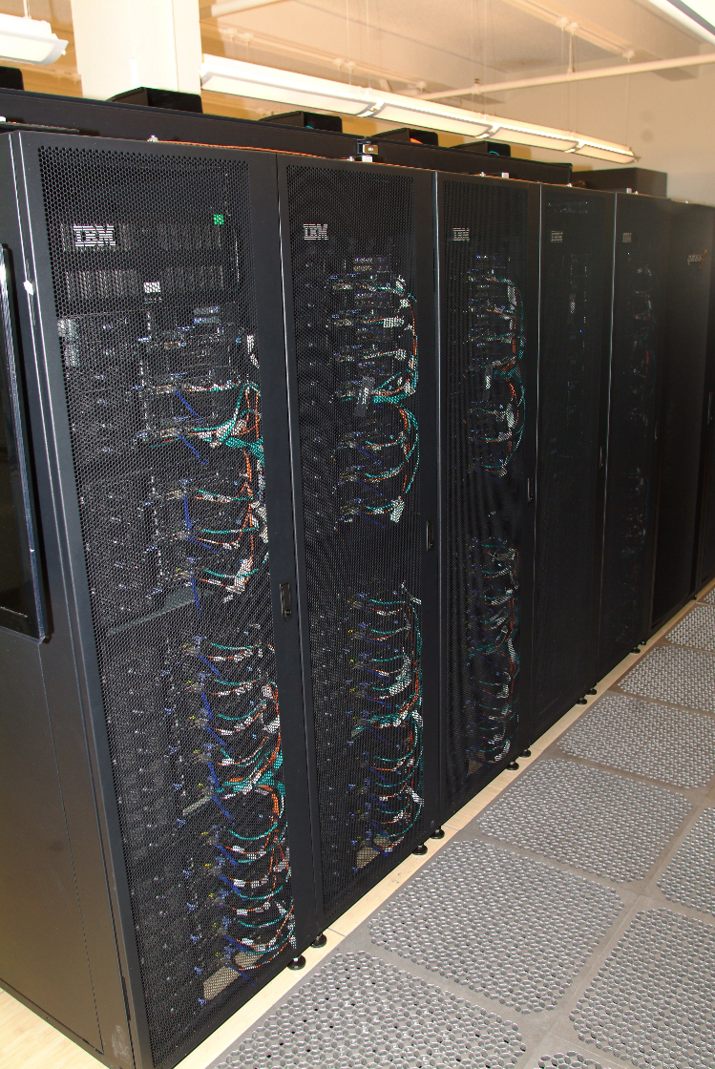
HPC RESOURCES
FOB
IBM IDataPlex
Research Testbed System
Production: 2012
Processing cores: 1,024
GPGPUs: 16 NVIDIA Tesla K20
Memory: 4 Terabytes
200 TB RAID Storage
Peak Capability: 21 Teraflops
Lawrence Livermore National Laboratory’s Magpie for a big data stack

Slide 10
Methods - Overview
Load data
Prepare text
Train topic model
Visualize results

Slide 11
Methods - Overview
Load data
Prepare text
Train topic model
Visualize results

Slide 12
Methods – Load Data
ExLF dataset stored in csv files on FOB
Read into Spark dataframe
Distributed storage and processing
Application of ML and SQL functions

Slide 13
Methods - Overview
Load data
Prepare text
Train topic model
Visualize results

Slide 14
Methods – Prepare Text
Native python functions to remove special characters, abbreviations
Spark ML and SQL functions to tokenize, form ngrams, create term frequency vectors, and prepare term frequency inverse document frequency (TF-IDF) matrix

Slide 15
Example Text Cleaning
“Three dogs ate all the bones; the one cat ate fast.”
“three dog ate bone one cat ate fast”
[“three”, “dog”, “ate”, “bone”, “one”, “cat”, “ate”, “fast”]
[“three dog”, “dog ate”, “ate bone”, “bone one”, “one cat”, “cat ate”, “ate fast”]
(7, [0, 1, 2, 3, 4, 5, 6], [1.0, 1.0, 2.0, 1.0, 1.0, 1.0, 1.0])
input to topic modeling algorithm!

Slide 16
Methods - Overview
Load data
Prepare text
Train topic model
Visualize results

Slide 17
Latent Dirichlet Allocation (LDA)
Topic modeling algorithm
Assumes documents made from probability distribution of topics, and topics have probability distribution of terms
Works backwards to determine model to best represent this
Defines probability that a term is in a topic and probability that a topic is in a document
Outputs topics as lists of terms with probabilities, and documents as lists of topics with probabilities
word word word word word word word word word word word word word word word word word word word word word word word word word word word word word word word word word word word word word word word word
Topic 1:
P*term, P*term, P*Term, P*term…
Topic 2:
P*term, P*term, P*Term, P*term…
Topic 3:
P*term, P*term, P*Term, P*term…
Topic 1: 60%
Topic 2: 25%
Topic 3: 15%

Slide 18
Latent Dirichlet Allocation (LDA)
Factors document-term frequency matrix into document-topic and topic-term matrices
Iterates through words in documents to improve topic-term probabilities
Proportion calculations include constants defined as parameters to LDA method
$$p(word w with topic t) = p(topic t | document d) ∗ p(word w | topic t)$$
new probability for topic-term matrix
how many words in document d belong to topic t
how many documents are in topic t because of word w

Slide 19
Methods – Train Topic Model
Implement LDA algorithm to produce topic model
Iteration to find optimal parameters with 70/30 train-test split
Vary number of topics, accepted confidence levels, alpha/beta constants
Apply to documents to categorize

Slide 20
Methods - Overview
Load data
Prepare text
Train topic model
Visualize results

Slide 21
Methods – Visualize Results
Produced topic definitions and document classifications
Queried this data to develop sample analyst charts using Plotly

Slide 22
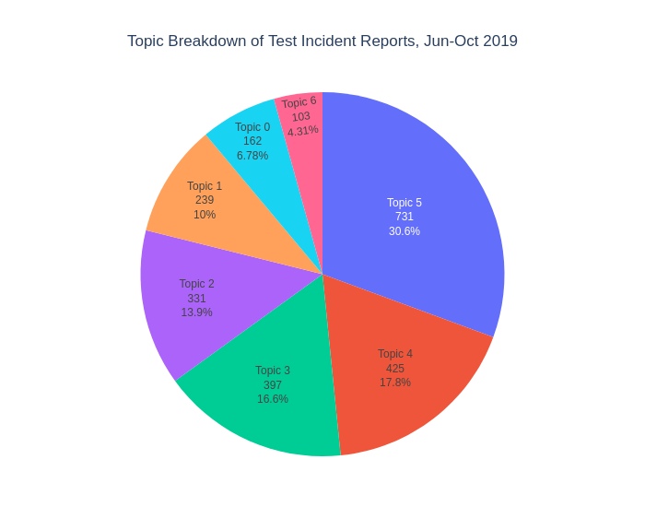
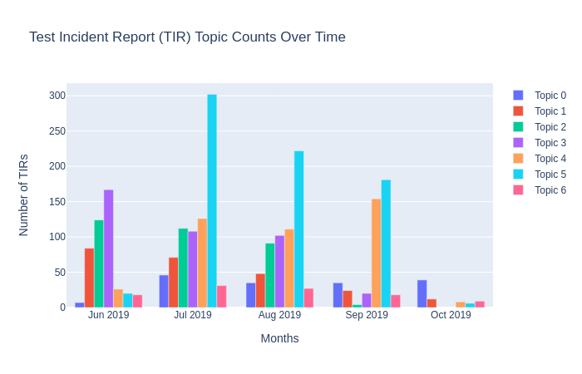
Results
Sample analysis charts displaying topic distribution of corpus

Slide 23
Results
Previous ARL research duplicated this visualization using HPC resources
Problem: Missing classification of TIRs

Slide 24
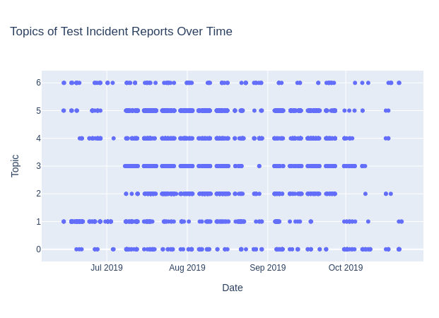
Results
Previous ARL research duplicated this visualization using HPC resources
Problem: Missing classification of TIRs
Graphs reports by date and topic

Slide 25
Conclusions
Script developed to implement topic modeling for test data
Faster, lower cost data analysis
Quick turnaround to address problems fast
Feasibility of Apache Spark with HPC resources for distributed processing

Slide 26
Future Work
Integrate Apache Hive data tables as sources to speed initial processing times
Data streaming using Spark Streaming for real-time analysis
Generalization of text processing for other datasets
Added UI to allow analysts to personalize processing and charts
Integration into the developing ExLF visual analytics platform

Slide 27
Acknowledgements
High Performance Computing Modernization Program and Internship Program
Army Research Laboratories
Jamie Infantolino
Adam Childs
Cleon Anderson
Virginia To

Slide 28
References
https://www.atec.army.mil/atc/history.html
https://www.arl.hpc.mil/hardware/index.html
D. Zou, “Automated Data Visualization Approaches for the Aberdeen Test Center”
https://spark.apache.org/
https://www.analyticsvidhya.com/blog/2016/08/beginners-guide-to-topic-modeling-in-python/
https://monkeylearn.com/blog/introduction-to-topic-modeling/
hive/hdfs
https://spark.apache.org/docs/latest/streaming-programming-guide.html

