Slide 1
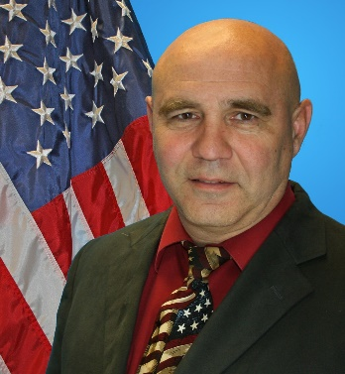
DOD T&E Certification
Dr. Paul Shaw
Professor, Cybersecurity
Defense Acquisition University (DAU)

Slide 2
DoD T&E Certification
Certification is a combination of acquisition training, education requirements, & experience
DoD has established competencies with the career field that can be developed through training, education, & experience

Slide 3
DoD T&E Community
T&E serves all of our Services:
Army
Navy
Marine Corps
Air Force
Space Force
Joint Forces

Slide 4
DoD T&E Community
T&E Professionals have knowledge of new & legacy systems. They assist with requirements development & capability assessments.
Department of Defense (DoD) T&E professionals provide timely and accurate information to senior leadership & program managers (PMs) on requirements development
They make determinations on system operational effectiveness, operational suitability, & survivability (to include cybersecurity)/lethality
They model operational threats & make certain appropriate test resources/infrastructure are available to conduct the tests

Slide 5
DoD T&E Community
Testing early & often is a critical aspect of ensuring warfighters have combat credible systems at the speed of relevance.
Example objectives of the DoD T&E community:
Securing software & cybersecurity evaluations
Increasing the use of prototyping & experimentation
Integrated test & evaluation
Improving test infrastructure
Improving the use of modeling & simulation

Slide 6
DoD T&E Community
There tends to be high T&E involvement if:
Program exceeds (or has the potential to exceed) certain dollar value threshold such as our major programs – (Major Defense Acquisition Programs - MDAPs) - as well as highly classified programs
Program has a high level of Congressional or OSD interest
Weapons, equipment, or munitions that provide or enable a critical mission warfighting capability or a militarily significant change to a weapon system

Slide 7
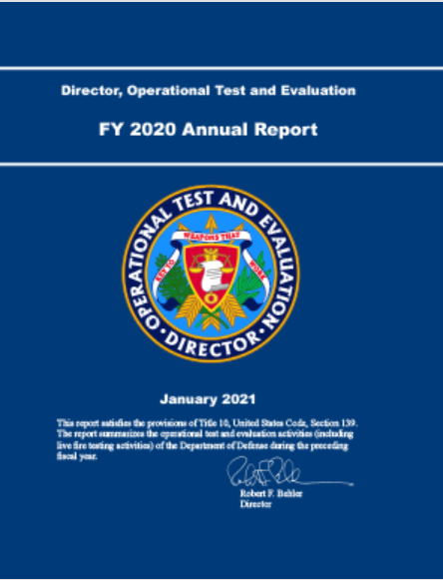
DoD T&E Sample Report
Every year the DoD Director of Operational Test and Evaluation (DOT&E) creates an annual report to Congress. These reports are often available to the public, like the FY20 DOT&E Annual Report (published January 2021), which reads:
“Bringing T&E into the 21st century will require substantial investment, a different approach to acquiring expertise, and intragovernmental support of the live-fire and OT&E mission. That commitment of resources, time, and energy will pay enormous dividends for our women and men in uniform.” (p. 1)
https://www.dote.osd.mil/annualreport/

Slide 8
T&E Positions
T&E certification - a requirement for career progression & verification of achievement of core T&E competencies.
Representative DoD T&E positions are:
Test Range Operator
Operational Test Lead
Test Planner
T&E Lab Manager
Chief Development Tester

Slide 9
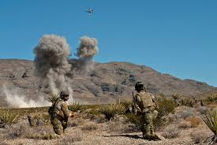
T&E Assignments
Headquarters & Staff (OSD, JS, COCOMs, JITC, SYSCOMS, etc.)
Program Management & Matrix Support
Range/Lab/Field Supporting Activities

Slide 10
DoD Acquisition Workforce
Defense Acquisition Workforce Improvement Act (DAWIA)
The Defense Acquisition Workforce Improvement Act (1990) requires the Department of Defense to establish education and training standards, requirements, and courses for the civilian and military workforce. Statutory language covering the Defense Acquisition Workforce is contained in United States Code (USC), Title 10, Chapter 87.

Slide 11
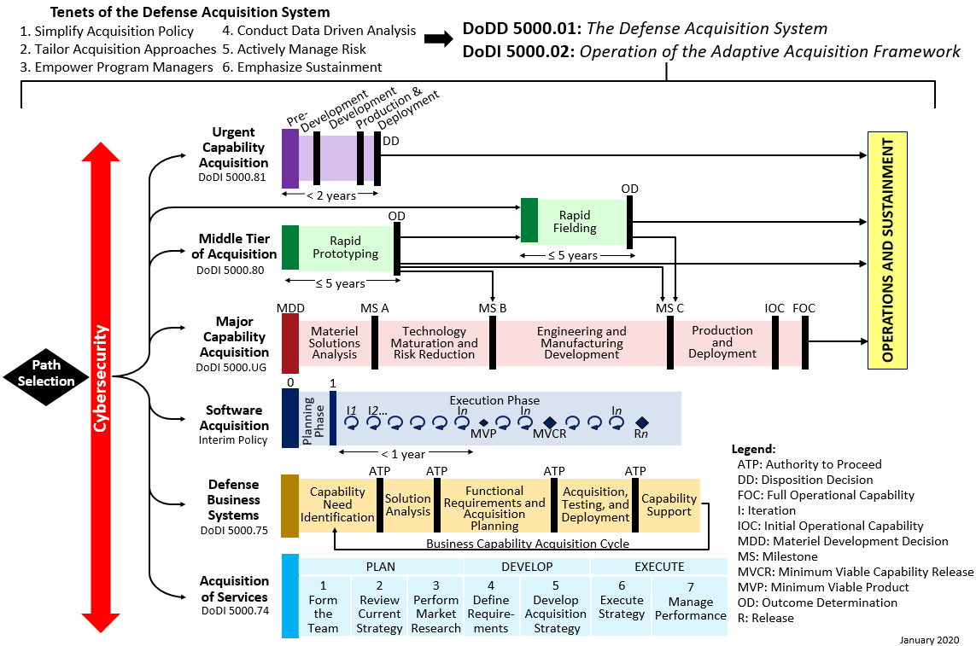
Adaptive Acquisition Framework

Slide 12
Job Accomplishment
Development of the Knowledge, Skills, & Abilities (KSAs) to perform proper evaluation of systems for operational effectiveness, operational suitability, & survivability/lethality
Progression in your T&E KSAs will be a combination of training, education, & experience

Slide 13
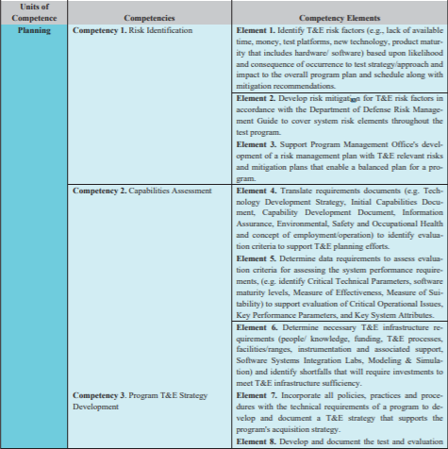
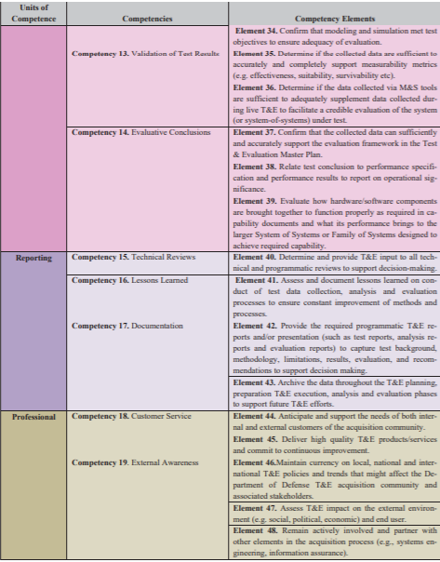
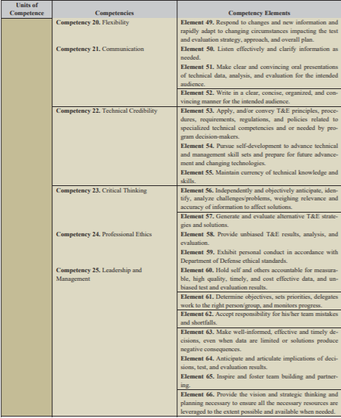
DoD T&E Competencies
Sample competencies illustrated below:
https://www.dau.edu/cop/test/_layouts/15/WopiFrame.aspx?sourcedoc=/cop/test/DAU%20Sponsored%20Documents/TE%20Workforce%20Competency%20Model_1June2017%20PRMark.pdf&action=default

Slide 14
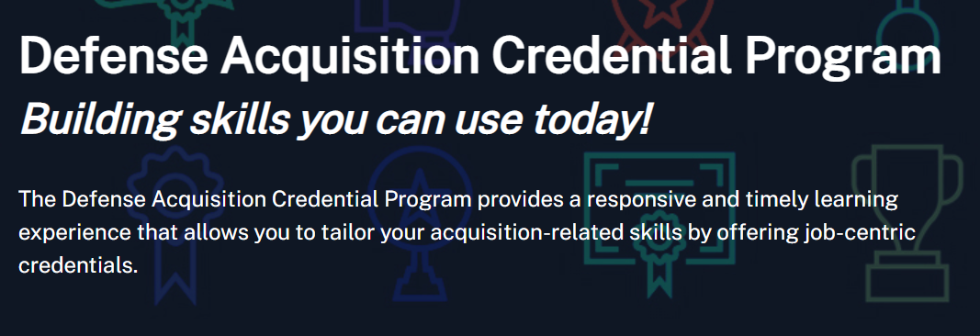
DAU Credential Program
https://www.dau.edu/training/pages/credentials.aspx

Slide 15
ITEA’s CTEP Certification
ITEA has a two level certification for the CTEP
Foundational
Practitioner

Slide 16
Why Testing is Important

Slide 17
Questions

