Slide 1
Trideum Miniature Data Acquisition System
DISTRIBUTION STATEMENT A: Approved for public release. Distribution is unlimited.
UNCLASSIFIED // For Public Release

Slide 2
Who Is Trideum?
Vision why we are here
"to embrace our world's toughest challenges with a servant heart"
Mission what we do
Take care of our customers, our employee family, and our communities
Values more than ethics & integrity
Stewardship
Servant Leadership
Sacrifice
Trideum Corporation is a small business headquartered in Huntsville, Alabama with approximately 400 employees.
Highly qualified professionals, using proven processes and methods.
25%
Have Advanced Degrees
60% +
Served in the Military or Government
92%
Hold Active Security Clearances
75%
Are Actively Involved in their Communities
UNCLASSIFIED // For Public Release

Slide 3
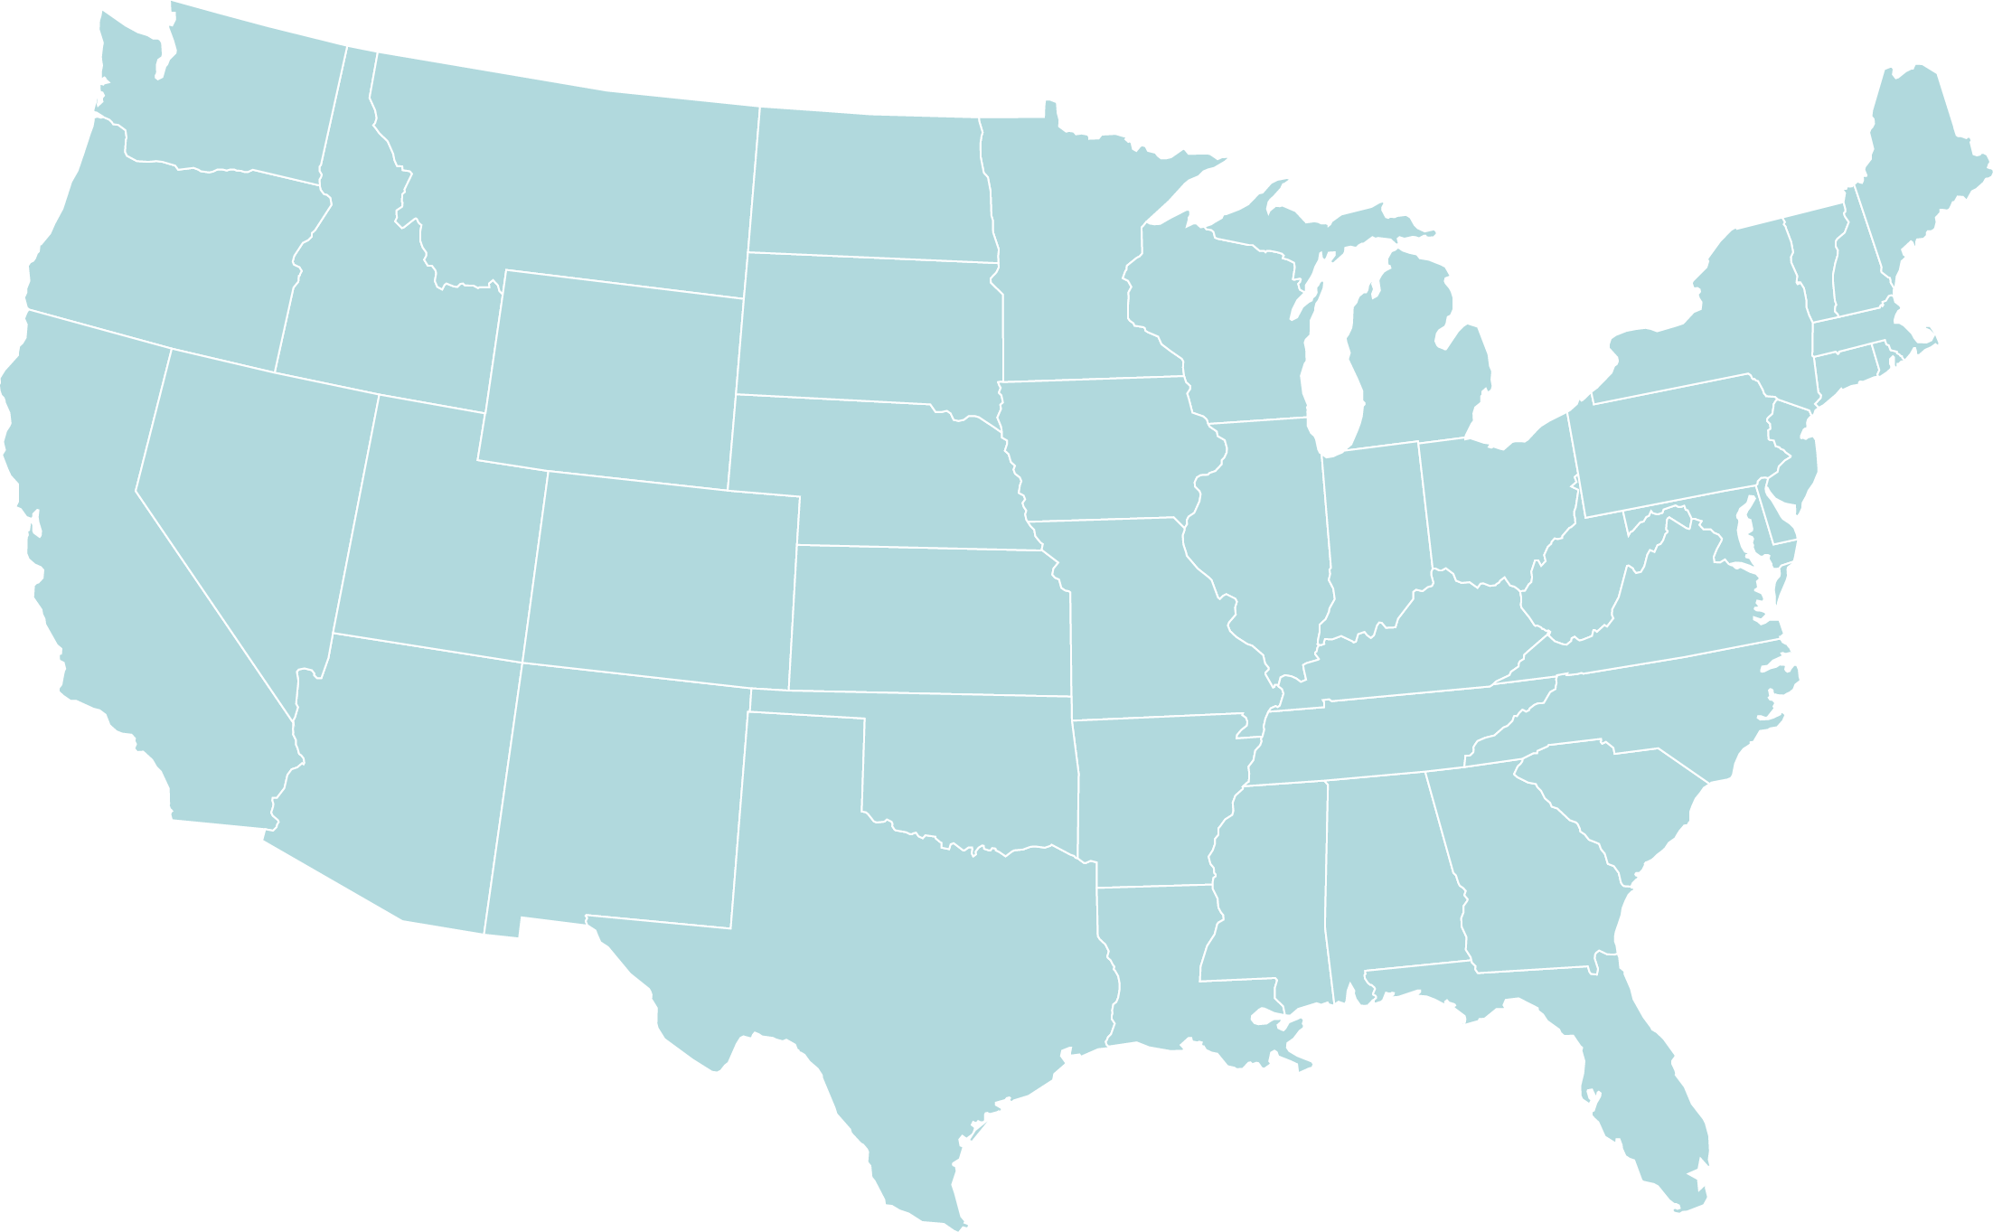
Trideum Locations
Operating 40+ contracts in 24 States, Washington D.C., and Kuwait
GVSC, OSCE
Arlington Heights USAR MTC
Camp Parks USAR MTC
Fort Dix USAR MTC
Aberdeen Test Center
Fort Belvoir: C5ISR Center, AMSO Ft Lee Sustainment CoE
APEN
Ft. Leavenworth
CAC – CGSC - NSC
Headquarters in Huntsville, AL
Fort Knox USAR MTC
Huntsville HQ
Fort Huachuca
WSMR
Ft. Sill
Ft. Bliss
Fort Leonard Wood
MSCoE
ARCENT Training & Ranges Udari & Buehring Kuwait
Satellite offices in El Paso, Killeen, and Leavenworth
El Paso
Fort Hood
JBSA MTC
Fort Rucker Aviation CoE
Houston USAR MTC
Orlando
ACC & PEO STRI
UNCLASSIFIED // For Public Release

Slide 4
Operational Sectors
Systems & Technologies
Advanced Capabilities & Integration
Training Services & Solutions
Core Competencies
Leveraging Supporting Capabilities and Technologies
Distributed LVC-G
Cyber Capabilities / Technologies
Modeling and Simulation (M&S)
User Experience (UX)
Test and Evaluation
Training and Training Development
Research, Development, and Rapid Prototyping
Targets and Threat Systems
Software Development
Autonomous & Semi-Autonomous Systems
Data Science and Analytics
Systems
Engineering
Cross / Extended Reality (XR) – AR / VR / MR
Artificial Intelligence (AI) / Machine Learning (ML)
UNCLASSIFIED // For Public Release

Slide 5
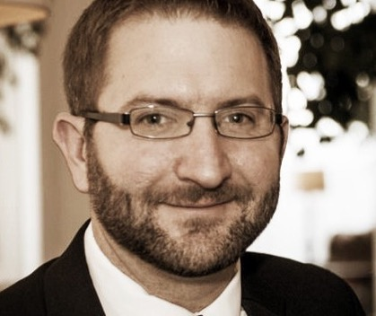
Who am I?
Trideum Senior Solutions Architect, Applied Systems and Technology
Current foci: Instrumentation development, data collection and analytics, streaming data science
Past:
2 years in manufacturing
10 years as a civil servant at Redstone Arsenal
Test – RTTC (now RTC)
Lab – AMRDEC (now CCDC AvMC)
PEO/PM – PEOMS/PM CMDS (now PM SHIELD)
4 Years in biotech / software startups
3 Years in blockchain (DoD and commercial)
Jason Martin
About me, my interests:
Cool tech, tinkering
Skiing, mountain biking
Youth mentorship
Camping, hiking, adventure
Pushing the envelope
UNCLASSIFIED // For Public Release

Slide 6
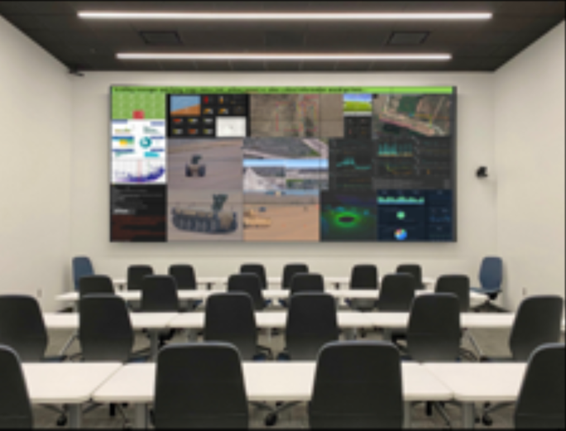
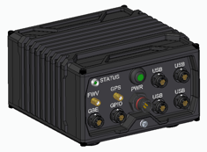
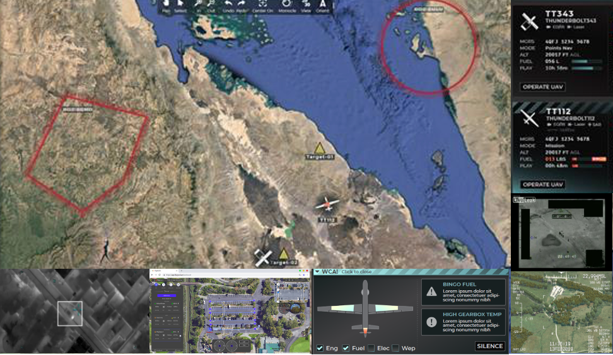
Trideum Solutions
Trideum Data Acquisition System
Small (5x5x3”), lightweight (~2lbs)
Built-in positioning and dynamics
Streaming video and data
Platform bus data collection
Modular sensor connectivity
Trideum Leopard
Data ingest and management
Streaming analytics
Insightful Visualizations
Video Distribution
UNCLASSIFIED // For Public Release

Slide 7
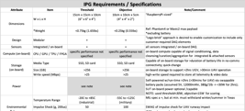
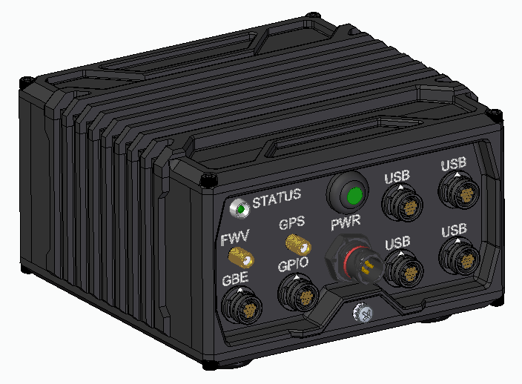
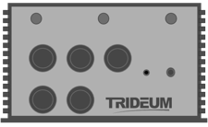
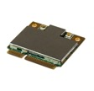
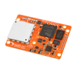
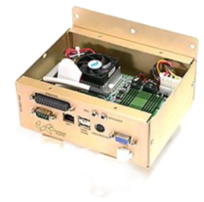
Trideum Miniature Modular DAS
(Data Acquisition System)
Small form factor (~ 0.75kg, < 4” x 6” x 6”) data acquisition system
IP67-compliant waterproofing
Operational temperature range of -20C to 85C
On-board compute & GPU
Built-in up to 2TB of fast data storage
Selectable connectivity: Ethernet, 5G, (4G, Wi-Fi & more)
Built-in sensing capability
Real-Time Kinetic (RTK) positioning (cm-level accuracy)
Six-degree-of-freedom Inertial Measurement Unit (IMU) and magnetometer
General Purpose Input/Output (GPIO)-Digital
Modular data collection from external sensors
4k Universal Serial Bus (USB) camera feeds at up to 60 Frames Per Second (fps)
Environmental (Atm. pressure, RH, and temperature) monitoring
GPIO-Analog
Other sensors
Live-streaming of collected data (incl. 4K/60fps video) via selected connectivity protocol
Low power draw (15-20W, typical), enabling long runtimes with practically sized batteries
“Plug-and-play” configurability and use, using open standards for data and control
Upgradeable design that permits the future integration of additional capabilities
Intelligent monitoring of vehicle bus platforms, e.g., MIL-STD-1553
USB and Inter-Integrated Circuit (I2C) peripherals for monitoring variety of sensors
Advanced data processing, using artificial intelligence (AI) and machine learning (ML)
*design objectives
1Q - FY22 (4Q - CY21)
2Q - FY22 (1Q - CY22)
3Q - FY22 (2Q - CY22)
4Q - FY22 (3Q - CY22)
1Q - FY23 (4Q - CY22)
2Q - FY23 (1Q - CY23)
3Q - FY23+ (2Q - CY23+)
Requirements
Design
Components
Prototype
Product
Upgrades
UNCLASSIFIED // For Public Release

Slide 8
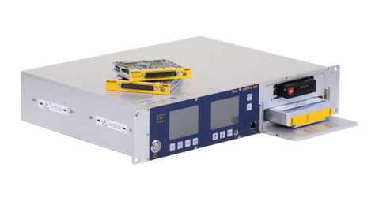
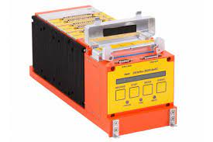
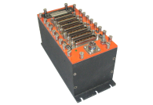
Why the DAS?
Traditional data acquisition systems
Large & heavy (even the small ones)
Only proprietary expandability
Difficult to use and configure
Expensive
Don’t interface well with COTS/open source systems
Not “smart”
UNCLASSIFIED // For Public Release

Slide 9
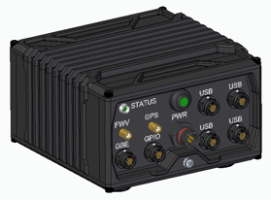
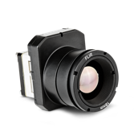
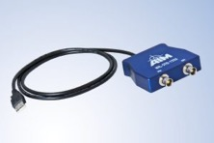
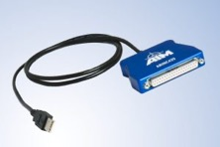
Why the DAS?
The Trideum DAS is designed for vehicle data acquisition at the system level.
cm-level accuracy positioning and 6-axis IMU
High resolution and framerate video
System bus data collection (1553, 429, CANbus, etc)
The Trideum DAS is truly small and modular.
~5”x5”x3” and weighing only ~2lbs
Peripherals are connected as needed, and require no space or weight if not used. High speed USB 3.0 interfaces provide ability to connect with endless third party peripherals
Shore power, battery, or vehicle power operated
The Trideum DAS is easy to use and “smart.”
Capable of edge analytics (including ML) and custom logic
Plug-and-play through simple REST API and usage/configuration utility
Accessories shown:
FLIR BOSON 640 LWIR camera
Allied Alvium 1800 visible camera
AIM 1ch 1553 BC/RT
AIM 12ch 429 interface
All simultaneously connectable
UNCLASSIFIED // For Public Release

Slide 10
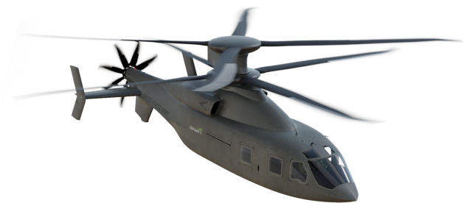
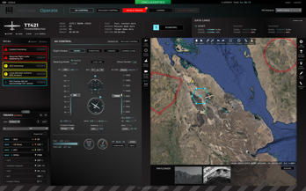
Example DAS employment
Power
Battery: sized for runtime.
Ex: 12V 3Ah – 1-2 hours
Vehicle power – indefinite
Connectivity
Ethernet to radio or built-in wifi/4g/5g
Cockpit camera
Visible spectrum
Nose camera
LWIR spectrum
Live Streaming Data
h.264 variable bandwidth IP video
RTK positioning
6DOF acceleration data
Filtered 1553, 429, and ethernet data
USB Peripherals
1553 Bus Data collection
429 bus Data collection
Trideum DAS System
(built-in ethernet data collection)
Trideum Leopard
Live visualization and analytics
DAS system configuration and control
Post-test download
All collected data
UNCLASSIFIED // For Public Release

Slide 11
Target DAS Applications
Phase 1 (CY 2022)
Smart data collection for small or large form-factor manned or unmanned vehicles and for remote and environmentally exposed locations lacking shore power
Phase 2 & Beyond (2023 -> ?)
Active control of test events and systems
Remote/distributed simulation participation
Multi-DAS cooperation & teaming
And more!
UNCLASSIFIED // For Public Release

Slide 12
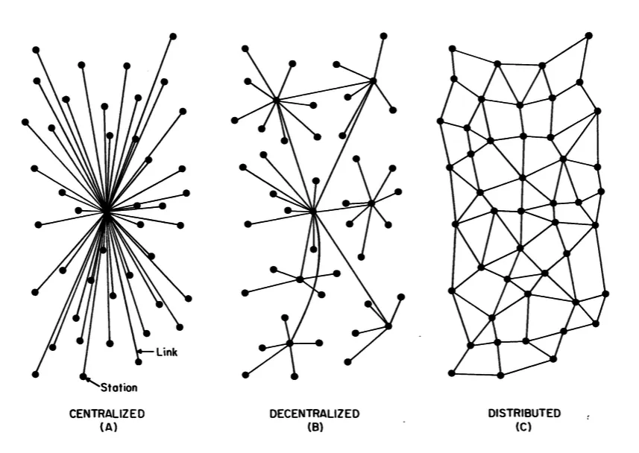
The “Starfish and the Spider”
UNCLASSIFIED // For Public Release

Slide 13
The “Starfish and the Spider”: DAS
”Spider”
”Starfish”
Event Management
Event Management
DAS
Simulation Control
Event Control
Data Collection
Edge Analytics
DAS
Data Collection
Event Control
Simulation Node
Participant
DAS
Participant
Simulation
Simulation Node
Participant
DAS
Simulation Node
Participant
DAS
Participant
Simulation Node
Participant
DAS
DAS
DAS
Participant
Participant
Distributed data collection, simulation
UNCLASSIFIED // For Public Release

Slide 14
Wrap-up
Trideum DAS is more than a data acquisition system
Event control, edge analytics, and simulation are just a few examples of advanced capabilities the system may offer
Trideum DAS is not a replacement for all capabilities available in other data acquisition systems
Trideum DAS offers a unique and specific set of capabilities that will enable new paradigms in data collection for certain use cases
May often be used in conjunction with other systems
Trideum DAS will be in production Q1FY23
Reach out using the contact info at the end of this brief to learn more
Stick around for my next talk: Trideum Leopard
The data ecosystem that pairs perfectly with the Trideum DAS and other data-rich live environments
UNCLASSIFIED // For Public Release

Slide 15
Questions
Jason Martin
Senior Solutions Architect
jmartin2@trideum.com
15
UNCLASSIFIED // For Public Release

Slide 16
Contact Us
General Information
info@trideum.com
Business Development
BD@trideum.com
Jason Martin (Applied Technology)
jmartin2@trideum.com
UNCLASSIFIED // For Public Release

