Slide 1
CLEARED
For Open Publication
Jun 22, 2022
Department of Defense
OFFICE OF PREPUBLICATION AND SECURITY REVIEW
Applying Scientific Test and Analysis Techniques (STAT) to Testing and Evaluating Performance Across the Cyber Domain
Mike Gilmore, Kelly Avery, Matt Girardi, John Hong, Rebecca Medlin
July 2022
Institute for Defense Analyses
730 East Glebe Road  Alexandria, Virginia 22305

Slide 2
Evaluating Performance Across the Cyber Domain
The core of the emerging National Defense Strategy will include “integrated deterrence,… a framework for working across warfighting domains, theaters and the spectrum of conflict.”*
Thus, successfully executing Multi-Domain Operations (MDO) will remain key to the strategy.
Enabling successful execution will include robust performance across the Cyber Domain, an important and increasingly contested part of MDO.
Comprehensive and efficient cybersecurity testing will be needed to rigorously evaluate mission assurance across the Cyber Domain.
*See https://www.defense.gov/News/News-Stories/Article/Article/2954945/integrated-deterrence-at-center-of-upcoming- national-defense-strategy/, accessed March 7, 2022
1

Slide 3
How Can STAT Benefit Cyber Testing and Evaluation?
The DoD Cybersecurity T&E Guidebook “promotes data-driven mission- impact-based analysis and assessment methods for cybersecurity test and evaluation...”
In that regard, Scientific Test and Analysis Techniques offers:
Efficient coverage of operational space and potential vulnerabilities consistent with limited resources and time
Objective and quantitative determination of how much testing is enough and risks of insufficient testing
Identification and statistical quantification of significant factors/vulnerabilities
Quantitative evaluation of what is lost if rules of engagement (ROE) are too constraining and/or time is too short
Addition of structure to previously ad hoc test events, thereby aiding comprehensive evaluation, while not eliminating free play
2

Slide 4
Framework for Applying STAT
(or for Planning any Test and Evaluation)
Determine scope of test
Test & Evaluation
requires collaboration
Questions you can ask about the system
Identify appropriate metrics
How you should measure system performance
Subject Matter Expertise
Analytical Expertise
Identify factors that affect performance
Types of data to collect, operational envelope
STAT tools can be applied
at each step
Develop Test Design
Quantity of data necessary, best resource allocation, objective plans
Conduct the test
Adjust test execution if necessary
Analyze the data
Structured mathematical data analysis plan appropriate for the design
Draw conclusions
Defensible risk assessments based on test results
3

Slide 5
Determine scope of test
Where/what are the potential vulnerabilities?
Example 1 – Using STAT to Help Structure a Systematic Cyber Assessment of a Hypothetical Processing System (PS)
4

Slide 6
Hypothetical PS—Comprises 15 Subsystems; 2 Operations Consoles
How can STAT help?
Subsystem 1
Subsystem 2
STAT can be used to---
Subsystem 3
Subsystem 4
Subsystem 5
Subsystem 6
Subsystem 7
Subsystem 8
Subsystem 9
Subsystem 10
Subsystem 11
Subsystem 12
Subsystem 13
Subsystem 14
Subsystem 15
Operations Console 1
Operations Console 2
Initially guide systematic
assessments in narrowing the number of subsystems to be tested*
Aid structuring the “final” tests
Aid analysis of test results
*Potential venues include Cyber Table Tops (CTTs) and other Mission-Based Cyber Risk Assessments (MBCRAs)
5

Slide 7
Structuring a Systematic Cyber Assessment of a Hypothetical Processing System (PS)
--Attacks on Single Subsystems—
Narrow the Number of Potential Vulnerabilities
--Attacks Spanning Multiple Subsystems—
6

Slide 8
Options for Design of PS Cyber Assessment--- Single Subsystem Attacks
1 Subsystem 1
Consider entry using Operations Consoles---2-level factor (Entry)
Remaining subsystems are targets---15-level factor (Target)
Subsystem 2
Subsystem 3
Subsystem 4
Subsystem 5
Subsystem 6
Subsystem 7
Subsystem 8
Subsystem 9
Subsystem 10
Subsystem 11
Subsystem 12
Subsystem 13
Subsystem 14
Subsystem 15
Operations Console 1
Operations Console 2
PS Option 1: Operations Console 1, Operations Console 2 for Entry (2)
Remaining Subsystems are Targets (15) Nearsider and Insider Attack Postures (2) Native, Foreign Tools (2)
120 Total Combinations
Consider 68 percent (minimal) and 80 percent power to correctly assess/identify vulnerabilities to subsystems (true positive)
Consider 80 percent confidence of correctly excluding vulnerabilities (true negative)
7

Slide 9
PS Design Options for Assessment--- Single Subsystem Attacks
Attack Posture
15 Subsystems 15 Subsystems
Target Subsystems
Assessing 45 potential vulnerabilities covers 120 combinations with 68% power
and 80% confidence; 65 assessments required for 80% power
Distribution Statement A: Approved for public release. Distribution is unlimited.
8

Slide 10
Structuring a Systematic Cyber Assessment of a Hypothetical Processing System (PS)
--Attacks on Single Subsystems—
Narrow the Number of Potential Vulnerabilities
--Attacks Spanning Multiple Subsystems—
9

Slide 11
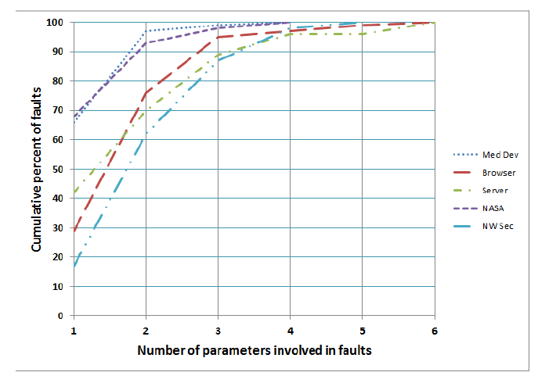
Software Faults versus Number of Interacting Parameters
~87% to 99% of faults involve 3 parameters
~60% to 96% of faults involve 2 parameters
Source: Kuhn, D., et al, Practical Combinatorial Testing, October 2010,
available at https://nvlpubs.nist.gov/nistpubs/Legacy/SP/nistspecialpublication800-142.pdf, accessed January 14, 2022.
PARAMETER = Input Data OR Configuration
Treat Subsystems spanned as a Configuration
10

Slide 12
Options for Design of PS Cyber Assessment--- Attacks Spanning Two Subsystems
Suppose: Assessment of single subsystems described previously narrows focus to 8 subsystems for initial insider (only) penetration/attack through Operations Console 1 or 2; but---
Concern exists regarding attacks spanning more than one subsystem
Consider attacks spanning those 8 subsystems and any one of the other 15-1 with the tool(s) used unspecified, but assumed to be those most applicable
in each case as determined by prior assessment (e.g., specific native or foreign)
PS Option 2: Operations Console 1, Operations Console 2 for Entry 8 Subsystems are first Targets (Target Subsystem 1)
14 Subsystems are second targets (Target Subsystem 2) Insider Attack Posture
Most Applicable Tool
224 Total Combinations (2x8x14)
11

Slide 13
PS Design Options for Assessment--- Attacks Spanning Two Subsystems
15 Subsystems
8 Subsystems
Target Subsystem 1
Assessing 50 potential vulnerabilities covers 224 combinations with 68% power
and 80% confidence; 65 assessments for 80% power
Distribution Statement A: Approved for public release. Distribution is unlimited.
12

Slide 14
PS Design Options for Assessment--- Attacks Spanning Three Subsystems
Suppose Further: Assessment of two-subsystem combinations narrows focus to 6 subsystems as second targets; but---
Concern exists regarding attacks spanning up to three subsystems
Consider attacks spanning the identified 8 first targets, 6 second targets, and any one of the remaining 15-2 subsystems
PS Option 3: Operations Console 1, Operations Console 2 for Entry 8 Subsystems as first Targets (Target Subsystem 1)
6 Subsystems as second targets (Target Subsystem 2) 13 Subsystems as third targets (Target Subsystem 3) Insider Attack Posture
Most Applicable Tool
1248 Total Combinations (2x8x6x13)
13

Slide 15
PS Design Options for Assessment--- Attacks Spanning Three Subsystems
6 Subsystems
8 Subsystems
Target Subsystem 1
Target Subsystem 3
15 Subsystems each vertical band
Assessing 55 potential vulnerabilities covers 1248 combinations with 68% power and 80% confidence; 70 assessments for 80% power
14

Slide 16
Framework for Applying STAT
(or for Planning any Test and Evaluation)
Determine scope of test
Questions you can ask about the system
Identify appropriate metrics
How you should measure system performance
Demonstrated
Test & Evaluation requires collaboration
Subject Matter Expertise
Analytical Expertise
Identify factors that affect performance
Types of data to collect, operational envelope
STATtools can be applied
at each step
Develop Test Design
Quantity of data necessary, best resource allocation, objective plans
How might this work?
Conduct the test
Adjust test execution if necessary
Analyze the data
Structured mathematical data analysis plan appropriate for the design
Draw conclusions
Defensible risk assessments based on test results

Slide 17
Applying the Framework to Cyber T&E (Steps 2 - 3)
Objectives---
Cooperative test – attempt to comprehensively identify vulnerabilities and validate exposures in system
Adversarial test – using the results of the cooperative test in as realistic setting as appropriate, assess system/users to protect, mitigate, and restore when faced with
various types of cyber threats
Potential response variables---
Attack thread length/number of steps
Level of threat capability required to achieve action (Nascent, Limited, Moderate, Advanced)
Severity of mission effects (None, Low, Med, High) (AA only)
Time to detect / mitigate / restore Time to penetrate / achieve effect
Potential factors---
Protocol or objective (Web application, servers, interfaces with other systems, etc.)
Type of cyber effect (Confidentiality, Integrity, Availability)
Starting posture (Outsider, Near-sider, Insider)
Tool Type (Native, Foreign)
System load/Number of users (Low, High)
Level of defender participation (Users only, Users + local defenders, Users + local + CSSP)
Examples of many possibilities

Slide 18
Applying the Framework to Cyber T&E (Steps 2 – 3)
Consider a sequential approach –
First stage -- screen for potential vulnerabilities
Second stage – refine test, characterize significance of factors and interactions in greater detail
Cyber/system SMEs should determine which interaction effects are likely/interesting, which specific response variables are most meaningful
Create design first, then update based on specifics, such as rules of engagement (ROE) and disallowed combinations, while considering tradeoffs
Enables effects/constraints of ROE to be understood
Could include ability to control for learning effects over time
Would need to randomize to the extent possible and collect enough data to be able to include coefficients for time and person in the model

Slide 19
Applying the Framework to Cyber T&E (Steps 2 – 3)
A model is fit to data to form an empirical relationship between the response variable and factor settings for the purposes of:
--Determining which factors have a large effect on the response
--Making predictions across the factor space (including combinations that were not explicitly tested)
--Quantifying uncertainty in test results
Responses: Time to get in/achieve effect, Thread length, Level of
One such model could be:
threat required, Time to detect/mitigate/restore, Severity of mission effects
y
_{S} D f E
Normally-distributed error
Estimated model coefficients
While the model is linear in its parameters, the factors/responses are not necessarily linear or normal:
Time-based responses are likely right-skewed, so lognormal regression or a survival model may be appropriate
The mission effects response is categorical so a multinomial logistic regression is one appropriate modeling choice
The test could be designed to allow the ability to include additional recorded factors (e.g. tool/method, time) in the model and estimate their effects

Slide 20
Example 2 – Hypothetical Command and Control (C²) System
Develop Test Design

Slide 21
Hypothetical C2 System
P 1
P 2
P 3
P = Protocol
User 1
User 2
Application Server
Data Base
External Systems
Web Server
E-System 1
E-System 2
E-System 3
E-System 4
E-System 5
E-System 6
E-System 7
E-System 8
E-System 9
E-System 10
E-System 11
E-System 12
E-System 13
E-System 14
P 4
P 5
P 6
P 7
Directly Connected
Maintenance Protocols
External Systems
D-System 1
D-System 2
D-System 3
D-System 4
D-System 5
D-System 6
= Protocol/Entry Point
= Objective

Slide 22
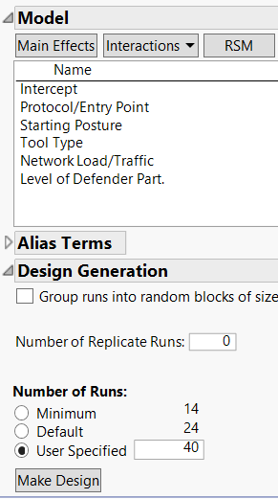
Design for Cooperative Test (1 of 2)
Create a design using the 5 varied factors presented earlier
For the cooperative test, cover the space of all entry point/protocol combinations (an 8-level factor)
Focus on main effects
Can choose more than the minimum number of runs enabling additional covariates to be included in the statistical model during analysis
Forty runs (attempted penetrations) chosen as an example, but more usually better

Slide 23
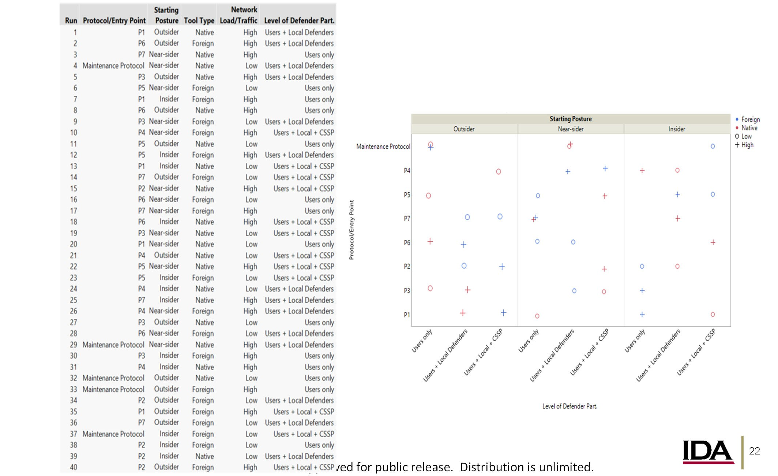
Design for Cooperative Test (2 of 2)
The resulting 40 run design provides coverage (albeit sparse) of the 8 X 3 X 3 X 4 = 288 factor space

Slide 24
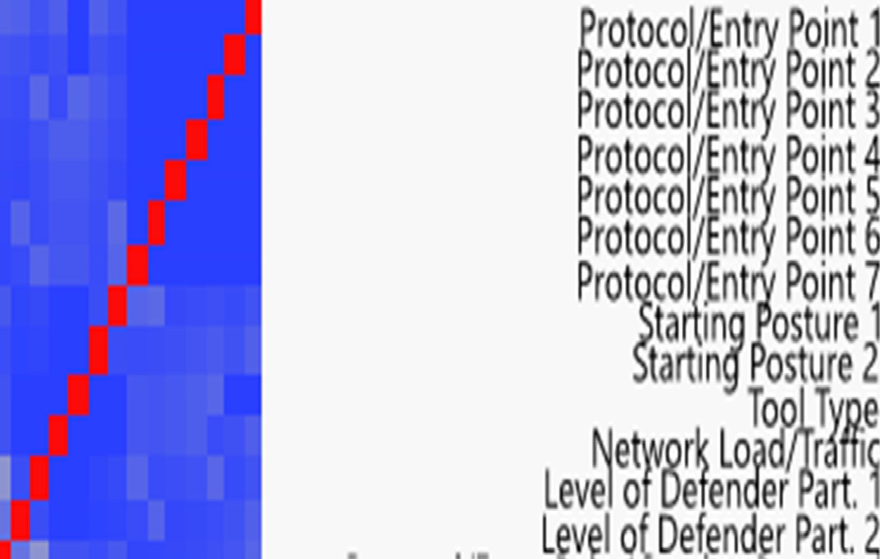
Cooperative Test Measures of Merit
The design is sufficient to provide high power to detect large differences (SNR=2) in main effects with 80% confidence
There is necessarily some aliasing in the design, but it is mostly among higher order terms. Correlations between main effects are very low and not a concern
Term | Power
Protocol/Entry Point | 0.77
Starting Posture | 0.99
Level of Defender Participation | 0.99
Tool Type | 1.00
Network Load/Traffic | 1.00
No major confounding between factors
Distribution Statement A: Approved for public release. Distri
b
ution is unlimited.

Slide 25
Analysis—How it Might Work
Analyze the data

Slide 26
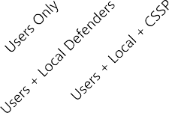
Example Analysis of a Continuous Response Variable
Starting Posture
Native Foreign Low High
Outsider
Nearsider
Insider
Maintainence Protocol
P7
Protocol / Entry Point
P6
Execute the Test
P5
P4
P3
P2
Capture the Data
P1
Test Point to Execute
Level of Defender Participation
Notional distribution of the continuous response variable collected from the 40 test points
Level of Defender Part.

Slide 27
Example Analysis of a Continuous Response Variable
After executing the test, we can perform an exploratory analysis. Observations considering three of the factors include Native Tools appear to have higher responses than Foreign Tools, as do Insider Attacks. There also appear to be some differences in responses across the Protocols.
Response Legend
High
Notional Continuous Response Variable
Low
Tool Type
8 Protocols
Observed Response
Protocol / Entry Point
Distribution Statement A: Approved for public release. Distribution is unlimited.
26

Slide 28
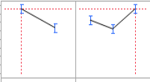
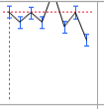
Example Analysis of a Continuous Response Variable
Our test design enables us fitting the statistical model as a function of the design factors
y
_{S} D f E
Observed Response
From the model fit, we see that some factors have an effect on the Notional Continuous Response Variable
Statistical difference between
Statistical differences also exist between some of the Protocols
Native and Foreign tools ---and--- Starting Postures
We can summarize the results using the point estimate and confidence intervals
Notional Results Estimated Mean
Notional Results Estimated Mean
Native Foreign
Tool Type
Outsider Nearsider Insider
8 Protocols
Protocol / Entry Point
Starting Posture

Slide 29
Back-up

Slide 30
PS Design Options for Assessment--- Single Subsystem Attacks
Attack Posture
15 Subsystems
15 Subsystems
Target Subsystems
Assessing 65 potential vulnerabilities covers 120 combinations with 80% power and 80% confidence
Distribution Statement A: Approved for public release. Distribution is unlimited.

Slide 31
PS Design Options for Assessment--- Attacks Spanning Two Subsystems
15 Subsystems
8 Subsystems
Target Subsystem 1
Assessing 65 potential vulnerabilities covers 120 combinations with 80% power and 80% confidence
Distribution Statement A: Approved for public release. Distribution is unlimited.

Slide 32
PS Design Options for Assessment--- Attacks Spanning Three Subsystems
6 Subsystems
8 Subsystems
Target Subsystem 1
Target Subsystem 3
15 Subsystems each vertical band
Assessing 70 potential vulnerabilities covers 1248 combinations with
80% power and 80% confidence
31

