Slide 1
Test Flag Enterprise
Multi-Domain Integration in Open Medium
Maj ‘Siphon’ Burfeind
Multi-Domain Test Force

Slide 2


UNCLASSIFIED
Test Flags The Big Picture
Overview
Imperative
Test Flags are all-domain, large force test series focused on kill-web integration, advanced survivability, and data-driven experimentation.
2018 National Defense Strategy
“Deliver performance at the speed of relevance. Success no longer goes to the country that develops a new technology first, but rather to the one that better integrates it and adapts its way of fighting.“
AFI99-103 6 APRIL 2017
“Air Force systems are expected to fully integrate with systems, activities, and products from all Services and National agencies. Capabilities-based testing requires a full understanding of joint operational concepts in order to develop test scenarios that will provide meaningful results.“
Orange
Flag
Emerald
Flag
Black
Flag
Other
Events
Mission
Key Principles
The mission of the Test Flag Enterprise is to enable next generation data-driven decisions at the engineering, tactical, and operational levels and bring night one combat capability to warfighters at the speed of relevance.
Operational Enviro
All Domain
Test Over Training
Data Driven
Shared Resources
Free Objectives
VS
≠
VS
VS
UNCLASSIFIED

Slide 3
UNCLASSIFIED
Test Flags Where They Fit
Field
Combat
Capability
CCMD Event
Neptune
Northern Edge
Valiant Shield
Providence Champion
Etc
Orange
Flag
Black
Flag
Emerald
Flag
Risk reduce, experiment, and expose tech to complex, data-driven environment | Building block TTP development, tactical evaluations | Graduation events, full tactical integration, in-theater leave behind | Deliver proven and tested JADC2 and all-domain combat capability faster
UNCLASSIFIED

Slide 4
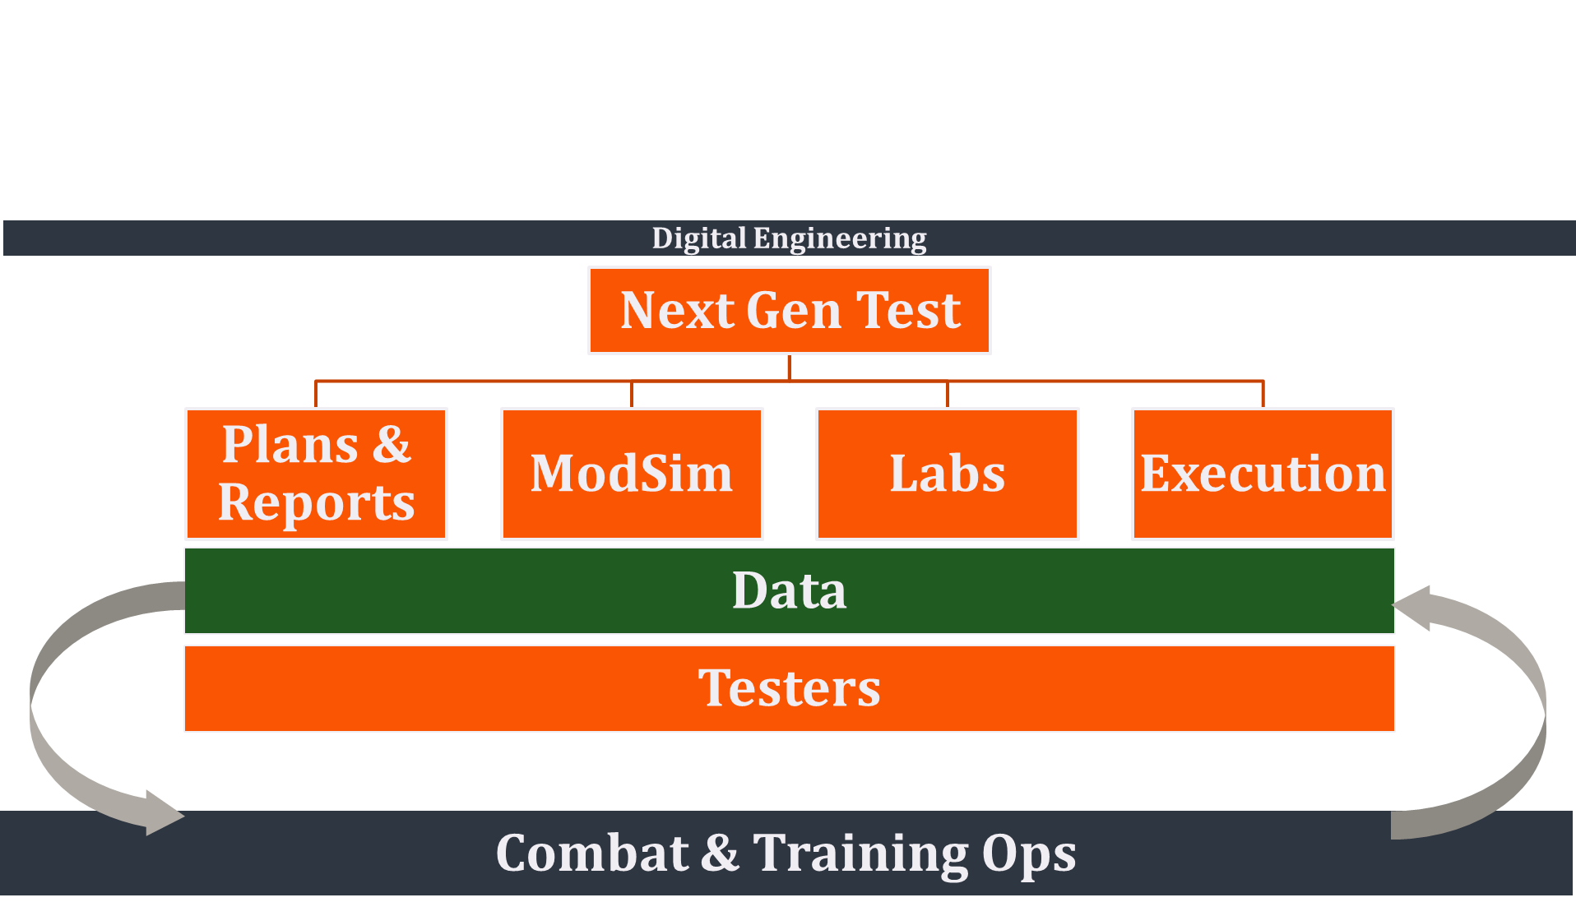
UNCLASSIFIED
FoO Lines of Effort
UNCLASSIFIED

Slide 5
UNCLASSIFIED
One Event By the Numbers
Participants
15 Test Flight
194 Fighter Sq
370 Flight Test Sq
411 Flight Test Sq
417 Test and Evaluation Sq
422 Test and Evaluation Sq
44 Reconnaissance Sq
461 Flight Test Sq
605 Test and Evaluation Sq Det 1
605 Test and Evaluation Sq Det 3
72 Test and Evaluation Sq
88 Test and Evaluation Sq Det 1
AFRL - Other
AFRL - SDPE
Boeing FTB
Clutch Shot
CMCC
DARPA
Delta 4
IFAST
MCTSSA
Multi Domain Task Force
Missile Defense Agency
NIFE
NIWC – Pacific
NSA
SHOC-N
VX-31
VX-9
28 Objectives
2 Vuls
7 Hours of Test
10 Test Scenarios
34 Participants
48 Airborne Aircraft
5+ On-Orbit Space Systems
5 Land Units
2 Cyber Capabilities
1 Aegis HITL Facility
13 Datalinks & Networks
16,000 Sq NM Range
500,000 Lbs Fuel
$14B Impacted Programs
UNCLASSIFIED

Slide 6









UNCLASSIFIED
Kill Web Integration
AFATDS
Advanced Field Artillery
Tactical Data System
CEC
Cooperative Engagement Capability
CMCC
Common Mission Control Center
EOC
Engagement Operations Center
IBS
Integrated Broadcast System
IFCN
Integrated Fire Control Network
IFDL
Intra Flight Data Link
IP
Internet Protocol
JREAP
Joint Range Extension Applications Protocol
JTMC
Joint Track Management Capability
MACCS
Marine Air Command and Control System
MADL
Multifunction Advanced Datalink
MIC
Message Injection Cell
OPIR
Overhead Persistent Infrared
SHOC-N
Shadow Operations Center-Nellis
UDL
Unified Data Library
OPIR
UDL
STARLINK
IBS
IFDL
CMCC
Link-16
MIC
AFATDS
SHOC-N
MADL
Network /
Bridge
ADOC
MACCS
JADC2
NODE
IP
( JTMC )
JREAP
CEC
ARMY
NAVY
MARINE CORPS
AIR FORCE
SPACE FORCE
EOC
IFCN
COMPASS
CALL
UNCLASSIFIED

Slide 7
UNCLASSIFIED
Kill Web Integration
AFATDS
Advanced Field Artillery
Tactical Data System
CEC
Cooperative Engagement Capability
CMCC
Common Mission Control Center
EOC
Engagement Operations Center
IBS
Integrated Broadcast System
IFCN
Integrated Fire Control Network
IFDL
Intra Flight Data Link
IP
Internet Protocol
JREAP
Joint Range Extension Applications Protocol
JTMC
Joint Track Management Capability
MACCS
Marine Air Command and Control System
MADL
Multifunction Advanced Datalink
MIC
Message Injection Cell
OPIR
Overhead Persistent Infrared
SHOC-N
Shadow Operations Center-Nellis
UDL
Unified Data Library
OPIR
UDL
STARLINK
IBS
IFDL
CMCC
Link-16
MIC
AFATDS
SHOC-N
MADL
Network /
Bridge
ADOC
MACCS
JADC2
NODE
IP
( JTMC )
JREAP
CEC
ARMY
NAVY
MARINE CORPS
AIR FORCE
SPACE FORCE
EOC
IFCN
COMPASS
CALL
UNCLASSIFIED

Slide 8
UNCLASSIFIED
Large Scale Challenges
Geo Distributed Integrated T&E
  Non-Trivial
  Needs to be Easy
Resource Priorities
  Misaligned Range Priorities
  MD Tests Cancelled
Representative Connectivity
  System Under Test
  Range Infrastructure
Representative Geography
  Climate
  Threats
Common Instrumentation
  Multi-Domain Chapter 10
UNCLASSIFIED

Slide 9
UNCLASSIFIED
Discussion / Questions
UNCLASSIFIED

